Slide 1
Learning
“Learning denotes changes in a system that enables a system to do the same task more efficiently the next time.” – Herbert Simon
“Learning is constructing or modifying representations of what is being experienced.” – Ryszard Michalski
Why Learn?
Understand and improve efficiency of human learning.
Discover new things, patterns or structures that were previously unknown to humans.
To reproduce intelligent behavior from machines.

Slide 2
Machine Learning : Definition
Machine learning is a type of artificial intelligence (AI) that provides computers with the ability to learn without being explicitly programmed.
Machine learning focuses on the development of computer programs that can change when exposed to new data.
Formal Definition
A computer program is said to learn from experience E with respect to some class of tasks T and performance measure P if its performance at tasks in T, as measured by P, improves with experience E.

Slide 3
Programs vs learning algorithms
Algorithmic solution
Machine learning solution
Data
Program
Data
Output
Computer
Computer
Output
Program

Slide 4
Terminology of ML
Train Data
Test Data
Features - The number of features or distinct traits that can be used to describe each item in a quantitative manner
Feature Extraction - It is the preparation of feature vector and it transforms the data in the high-dimensional space to a space of fewer dimensions.
Training/Evolution Set - The set of data to discover potentially predictive relationships.

Slide 5
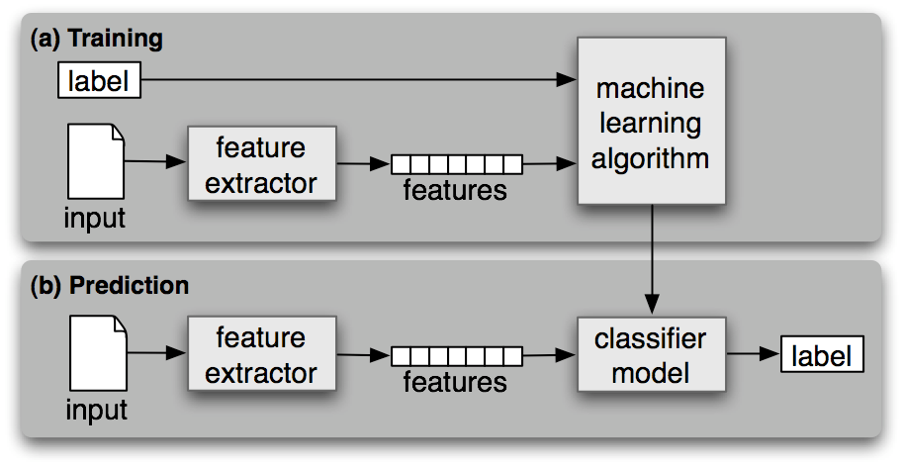
Workflow of ML

Slide 6
Types of Learning
Supervised Learning
Unsupervised Learning
Semi-Supervised Learning
Reinforcement Learning

Slide 7
Components of a learning problem
Task: The behaviour or task being improved.
For example: classification, acting in an environment
Data: The experiences that are being used to improve performance in the task.
Measure of improvement :
For example: increasing accuracy in prediction, acquiring new, improved speed and efficiency

Slide 8
Learner
Experiences
Data
Problem/
Task
Learner
Models
Reasoner
Background knowledge/
Bias
Answer/
Performance

Slide 9
Types of machine learning
Supervised Learning
X,y (pre-classified training examples)
Given an observation x, what is the best label for y?
Unsupervised learning
X
Given a set of x’s, cluster or summarize them
Semi-supervised Learning
Reinforcement Learning
Determine what to do based on rewards and punishments.

Slide 10
Supervised Learning
X y
New Input x
Input1 Output1
Learning Algorithm
Input2 Output2
Model
Input3 Output3
Input-n Output-n
Output y

Slide 11
Unsupervised Learning
X
Clusters
Input1
Learning Algorithm
Input2
Input3
Input-n

Slide 12
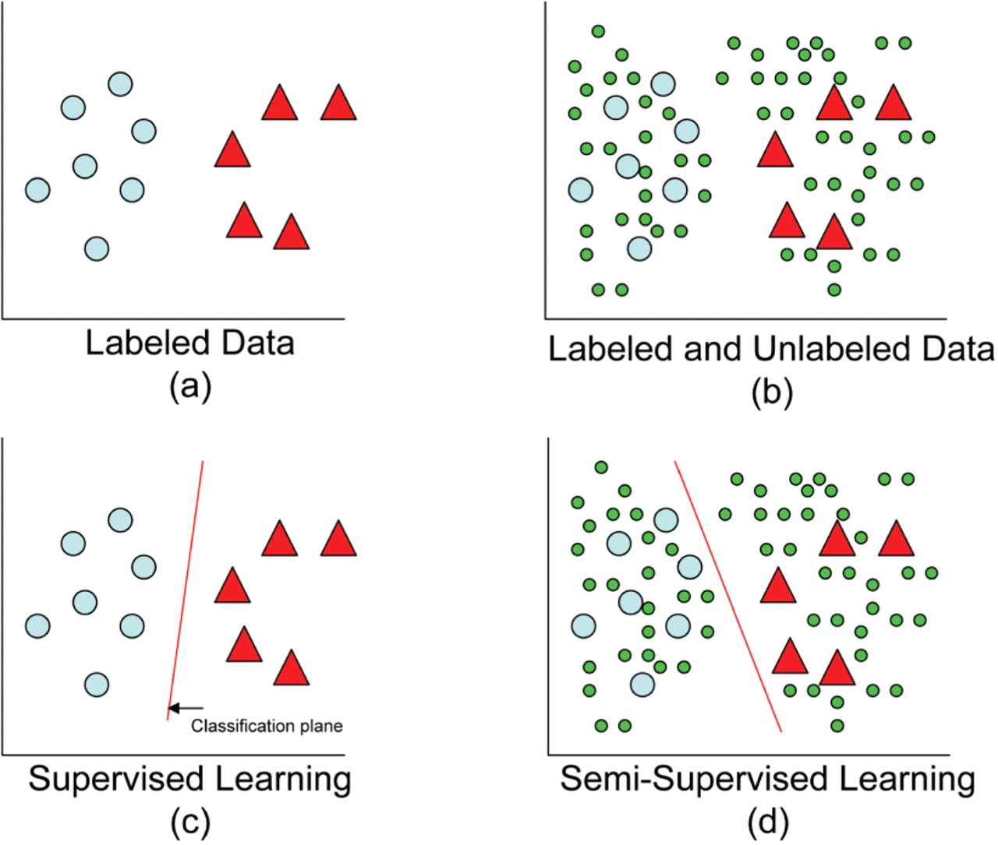
Semi-supervised learning

Slide 13
Reinforcement Learning
Action a_{t}
State s_{t}
S_{t+1}
Agent
Environment
Reward r_{t}
r_{t+1}

Slide 14
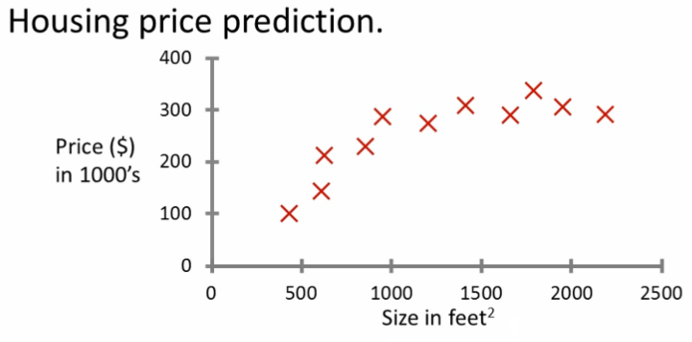
Linear Regression
Probably the most common problem type in machine learning
Starting with an example
How do we predict housing prices
Collect data regarding housing prices and how they relate to size in feet

Slide 15
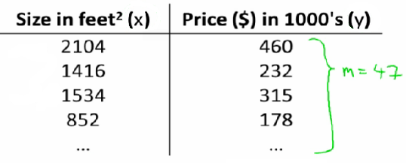
Data for Housing Price Prediction
Notation
m= number of training examples
x's = input features
y's = output variable

Slide 16

Hypothesis for Linear Regression
How do we represent hypothesis h ?Going to present h as;
h_{θ}(x) = θ₀ + θ₁x
h(x) (shorthand)

Slide 17
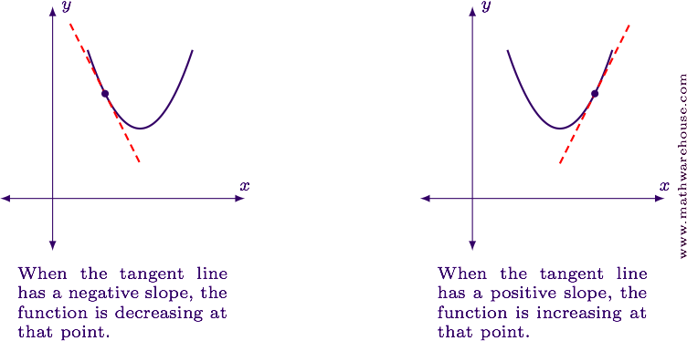
Gradient Decent
Gradient: Essentially means slope.
Mathematically slope is defined as the the rate at which the y−axis changes above the rate at
which the x−axis changes.
Descent: To go down.
WIKIPEADIA SAYS:
Gradient descent is a first-order optimization algorithm. To find a local minimum of a function using gradient descent, one takes steps proportional to the negative of the gradient (or of the approximate gradient) of the function at the current point. If instead one takes steps proportional to the positive of the gradient, one approaches a local maximum of that function; the procedure is then known as gradient ascent.

Slide 18
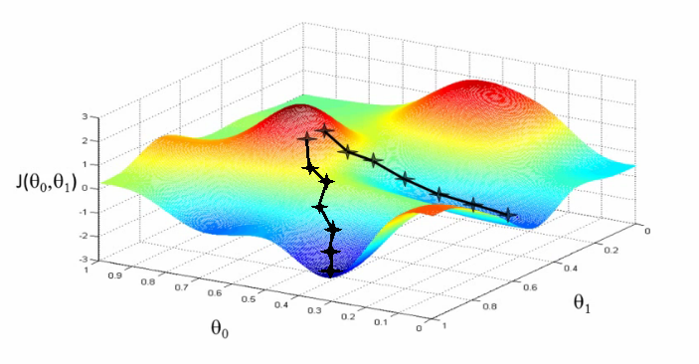

Working of Gradient Decent
Minimize cost function J
Gradient descent
Used all over machine learning for minimization
Problem
We have J(θ₀, θ₁)
We want to get min J(θ₀, θ₁)
Mathematically :

Slide 19
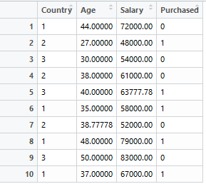
Feature Scaling
Consider the following data set
Age in the range of 0-100
Salary of the order of 100000
Purchased in the range 0-10
Applying ML algorithms on this type of data directly can affect precision and accuracy.
Running gradient descent on this data can take a long time to find the global minimum

Slide 20
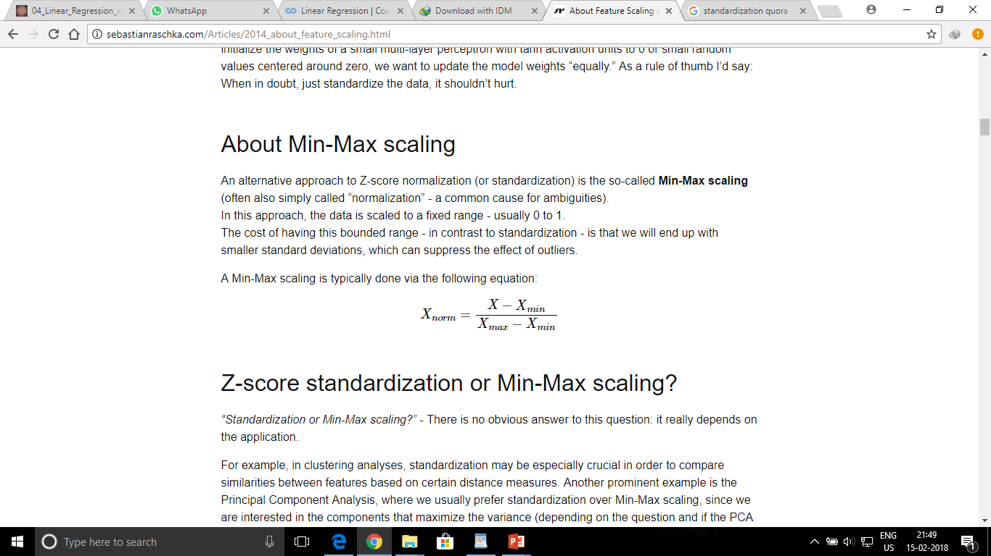
Types of Scaling
Standardization:
Normalisation
In this approach, the data is scaled to a fixed range - usually 0 to 1.
The result of standardization (or Z-score normalization) is that the features will be
rescaled so that they’ll have the properties of a standard normal distribution with
μ=0 and σ=1.
μ is mean and σ is standard deviation.
Standard scores (also called z scores) of the samples are calculated as follows:
z=(x−μ)/σ

Slide 21
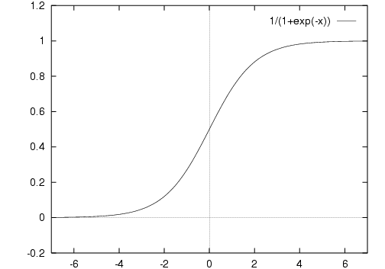

Sigmoid Function
Most often, we would want to predict our outcomes as YES/NO (1/0).
For example:
Is your favorite football team going to win the match today? — yes/no (0/1)
The Sigmoid function is given by:
It is an activation function.
Sigmoid Functions are used excessively in neural networks.

Slide 22
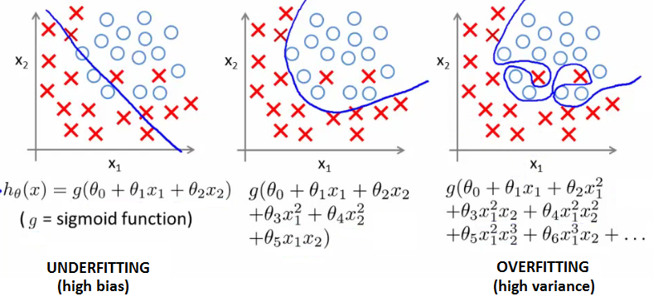
Problem of Misfit
See the following graphs:
In the first graph, first degree curve (aka straight line) is used, but this doesn’t fit the data enough. This is underfitting. We need to fit a higher degree curve.
In the second graph, the second degree polynomial curve fits the data much better and also removes the noise in the data.
In the last graph, a much higher degree polynomial curve is used for fitting, which tries to fit the noise in the input data as well. This is overfitting.
Under fitting
Right fit
Overfitting

Slide 23
Addressing Overfitting
Reduce number of features
Manually select which features to keep
Model selection algorithms are discussed later (good for reducing number of features)
But, in reducing the number of features we lose some information
Regularization
Keep all features, but reduce magnitude of parameters θ
Works well when we have a lot of features, each of which contributes a bit to predicting y

Slide 24

Regularization
Regularization is tuning the complexity of preferred model so your models are better at predicting or generalizing.
To regularize, A tuning parameter (lambda) lets you change the complexity of the model, or a selection of models of different complexities.
J(θ) =
λ is regularization parameter

Slide 25
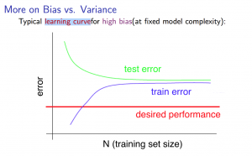
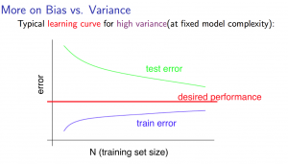
Bias:
Bias refers to the error due to overly-simplistic assumptions or faulty assumptions in the learning algorithm. Bias results in under-fitting the data. A high bias means our learning algorithm is missing important trends amongst the features.
Variance:
Variance refers to the error due to an overly-complex that tries to fit the training data as closely as possible. In high variance cases the model’s predicted values are extremely close to the actual values from the training set. The learning algorithm copies the training data’s trends and this results in loss of generalisation capabilities. High Variance gives rise to over-fitting

Slide 26
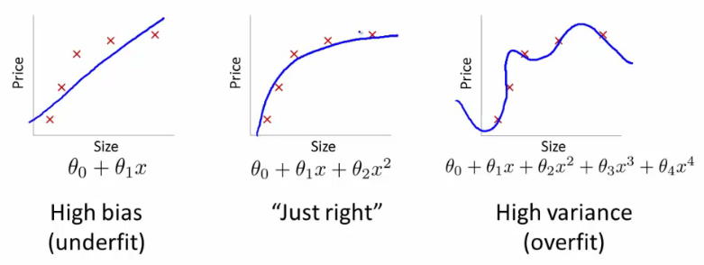
Bias VS Variance
If you get bad results usually because of one of
High bias - under fitting problem
High variance - over fitting problem
Important to work out which is the problem
Knowing which will help let you improve the algorithm
Bias/variance shown graphically below

Slide 27
Bias Variance Trade off
Parametric or linear machine learning algorithms often have a high bias but a low variance.
Non-parametric or non-linear machine learning algorithms often have a low bias but a high variance.
There is no escaping the relationship between bias and variance in machine learning.
Increasing the bias will decrease the variance.
Increasing the variance will decrease the bias.

Slide 28
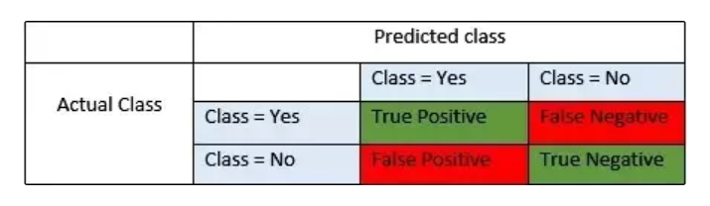
Precision Recall
Confusion Metrics : Used to describe the performance of a classification model on a set of test data.
TP : The value of actual class is yes and the value of predicted class is also yes.
FP: When actual class is no and predicted class is yes
TN: The value of actual class is no and value of predicted class is also no
FN: When actual class is yes but predicted class in no
Precision :
(correctly predicted Positive) / (total predicted Positive) = TP / TP + FP
Recall :
(correctly predicted Positive) / (total correct Positive observation) = TP / TP + FN
F1 Score :
Harmonic mean of recall and precision
= 2*(recall * precision) / (recall + precision)
Source: Quora

Slide 29
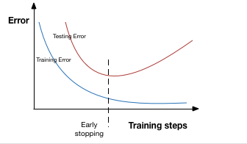
Training and Test Data
What is a Training Data Set in ML?
The training data set in Machine Learning is the actual dataset used to train the model for performing various actions. This is the actual data the ongoing development process models learn with various API and algorithm to train the machine to work automatically.
What is Test Dataset in ML?
This is the data typically used to provide an unbiased evaluation of the final that are completed and fit on the training dataset. Actually, such data is used for testing the model whether it is responding or working appropriately or not.

Slide 30
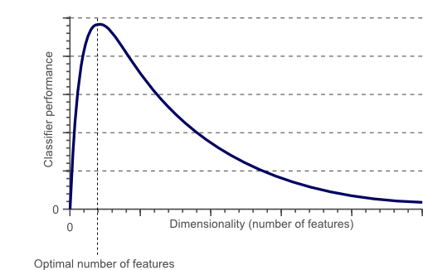
Curse of Dimensionality
The curse of dimensionality refers to how certain learning algorithms may perform poorly in high-dimensional data.
When the number of features or dimensions are too large, we face a lot of problems in machine learning.
we may need to increase the number of training data exponentially, to overcome the curse of dimensionality and that may not be feasible.

Slide 31
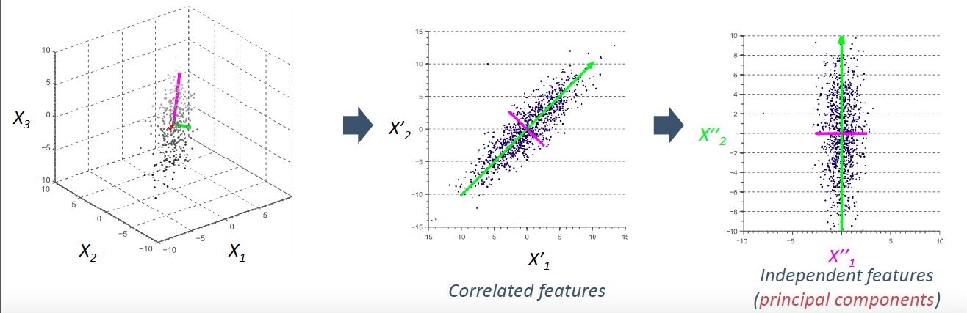
Dimensionality Reduction using PCA
PCA: Principal Component Analysis
PCA converts n dimensional data to m dimensional data (where n>m) by finding relationship between data.
Figure illustrate the conversion of 3-D data into 1-D data.

Slide 32
Type of Problems

Slide 33
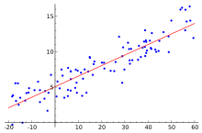
Regression Models
If label is real number/continuous, then it is regression problem.
It is a measure of the relation between the mean value of one variable (e.g. output) and corresponding values of other variables (e.g. time and cost).
Regression analysis is a statistical process for estimating the relationships among variables.
For univariate distribution, we use Linear Regression Model.
For multivariate distribution, we use Multivariate Regression Model.
For regression analysis, when the dependent variable is binary, we use Logistic Regression Model.

Slide 34
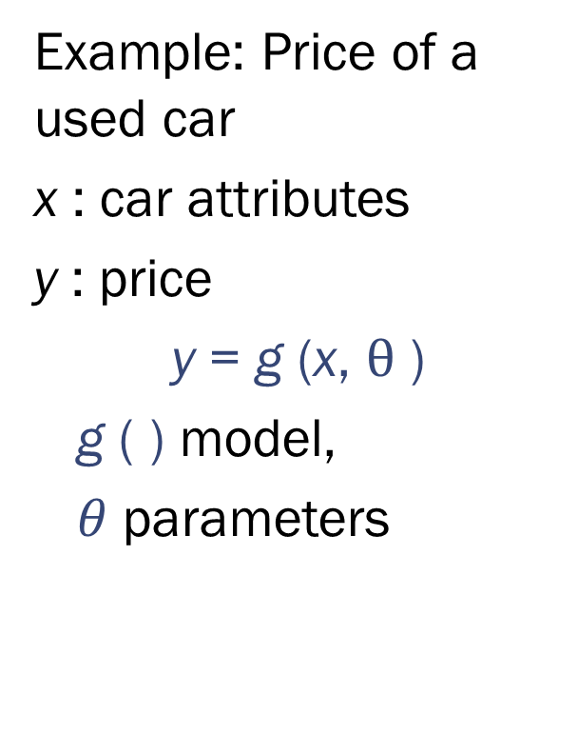
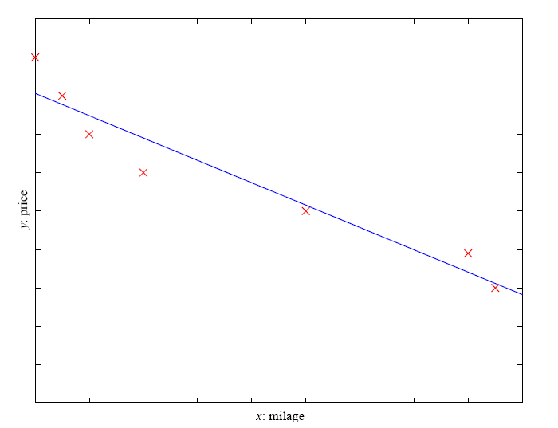
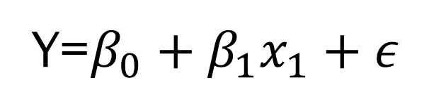
Linear Regression
y = wx+w₀
y: price
Y=$β_{0}+β_{1}x_{1}+ε$
x: mileage

Slide 35
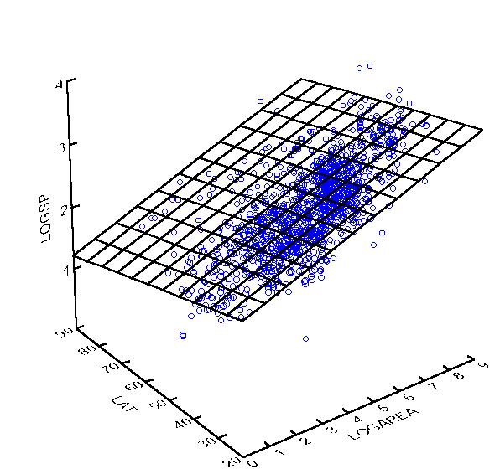
Multivariate Regression

Slide 36
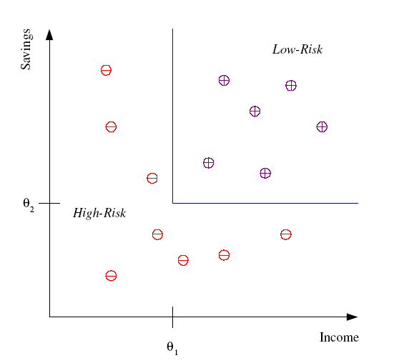
Classification
Example: Credit scoring
Differentiating between low-risk and high-risk customers from their income and savings

Slide 37
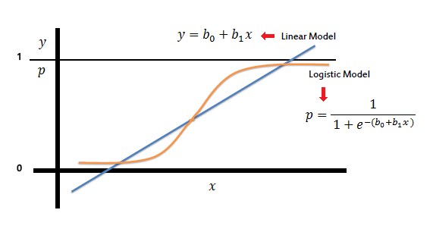
Logistics Regression

Slide 38
Classification & Regression Model
Decision Tree
Random Forest

Slide 39
Decision Tree
A decision tree is a classifier in the form of a tree structure with two types of nodes:
Decision node: Specifies a choice or test of some attribute, with one branch for each outcome
Leaf node: Indicates classification of an example

Slide 40
Decision Tree Example 1 Whether to approve a loan
Employed?
No
Yes
Credit Score?
Income?
High
Low
High
Low
Approve
Reject
Approve
Reject

Slide 41
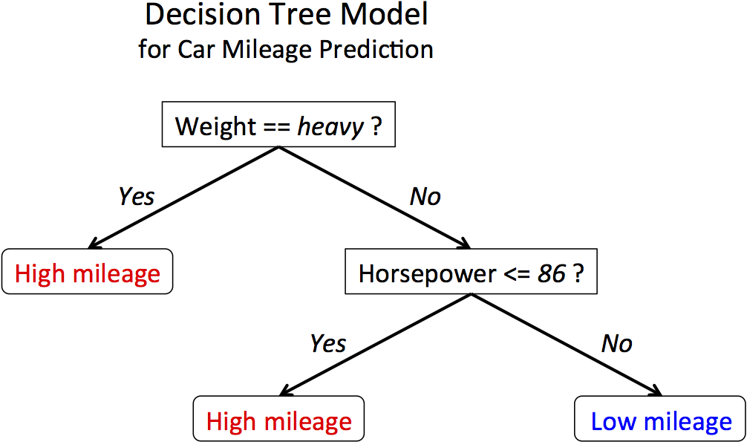
Decision Tree Example 3

Slide 42
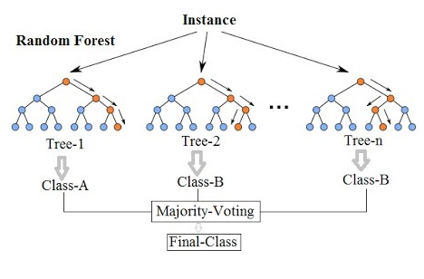
Random Forest

