Slide 1
Wikipedia Search Engine
By - Raj Maurya

Slide 2
Why Spark?
Efficient to handle & process Big Data
Provides efficient and scalable Machine Learning Library
Widely used by Data Scientists to process Big Data

Slide 3

What is Spark?
“A fast and general engine for large-scale data processing.”

Slide 4
Features
Uses “in memory analytics”
Scalable: Lightening fast cluster computing
Fast: 10x faster on disk to 100x faster in memory than Hadoop Map Reduce
DAG Engine (Directed Acyclic Graph) optimizes workflows

Slide 5
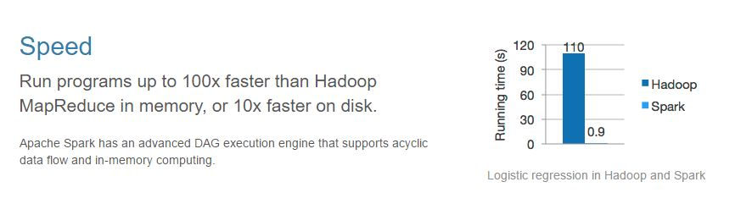
Speed

Slide 6
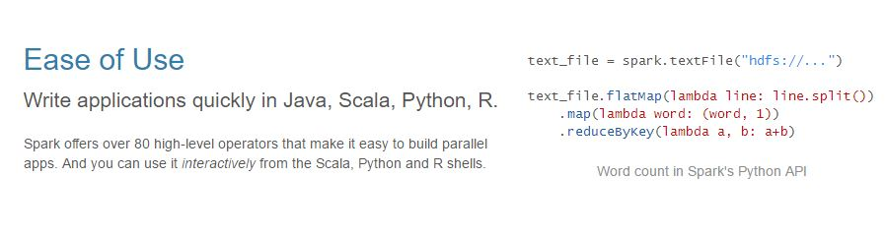
Ease of Use

Slide 7
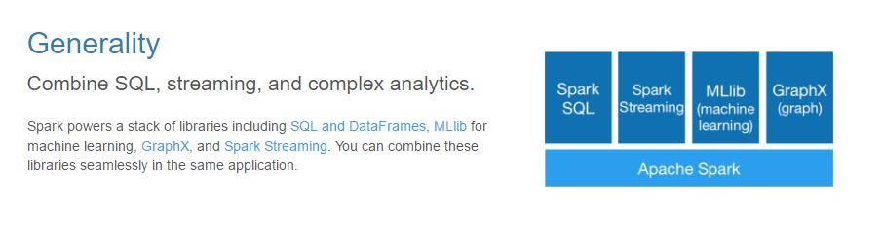
Generality

Slide 8
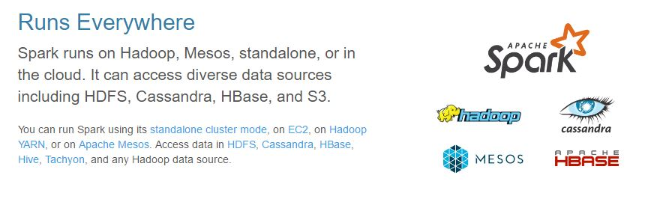
Platform

Slide 9
It’s Hot!!
Amazon
EBay: Log analysis
NASA: Deep Space Network
Yahoo
Trip Advisor
More: http://spark.apache.org/powered-by.html

Slide 10
It’s easy
Best to code in Python, Scala
Also available for Java & R, but less implementations yet.
Built Around: RDD

Slide 11
Python vs Scala
Why Python?
Interpreted Language, no need to compile or manage dependencies
Less coding overhead
Python is applicable everywhere
No need to learn a new language
But…
Scala more popular choice with Spark
Spark is built in Scala so it has more feature and libraries

Slide 12
Installing Spark
Linux
Windows

Slide 13
Interacting with Spark
pyspark: to enter the pyspark shell.
quit(): to exit shell
spark-submit file_name.py: to submit a job

Slide 14
RDD
Resilient (fault tolerant)
Distributed
Dataset
(similar to Data Frames in R except that it is not necessary to have tabular data)

Slide 15
SparkContext
Created by your driver program
Responsible for making RDD’s resilient and distributed
Creates RDD’s
Spark Shell creates a “sc” object for you

Slide 16
Creating RDD’s
nums = parallelize([1,2,3,4])
sc.textFile(“file:///c:/data/abc.txt”)
Can also be created from:
Hive
JDBC
Cassandra
HBase
ElasticSearch
JSON, CSV, Sequence Files etc.

Slide 17
Classes of things on RDD
Transformations
Actions

Slide 18
Transformations
map: map a function to RDD (row of data) and produces 1 for every row/RDD (returns RDD or python data objects)
flatmap: similar to map, but can return more than one value
filter: to create boolean function that returns yes or no (ex: a row should be preserved or not)
Many more: distinct, sample, union, intersection, subtract etc.

Slide 19
Map & Lambda Function
rdd = sc.parallelize([1,2,3,4])
rdd = rdd.map(lambda x: x*x) OR def squareit(x):
return x*x
rdd = rdd.map(squareit)
This will yield 1, 4, 9, 16

Slide 20
Actions
collect: collect on RDD returns planar python object and that can be used to print and iterate over
count: counts the number of entries in the RDD
countByValue: counts unique values that occur in the RDD
Many more: take, top, reduce etc.

Slide 21
Lazy Evaluation
Nothing actually happens in your driver program until an action is called
(i.e. DAG is not formed until action is called)

Slide 22
Introduction to MLLib
Built-in component for Machine Learning on top of Spark Core
Performs ML jobs on Massive Datasets in distributed environment i.e. clusters

Slide 23
MLLib Capabilities
Feature Extraction
Term Frequency / Inverse Document Frequency – useful for search
Basic Statistics
min, max, mean, variance etc.
Linear Regression
Logistic Regression
Decision Trees etc.
(supports almost every popular ML algorithms, you can write your own algorithms too)

Slide 24
Can we use native Python code?
Yes, but to utilize powerful distributed computing capacity we need to use MLLib Libraries.
MLLib Libraries are built keeping in mind the RDDs and distributed processing so they are much more efficient.

Slide 25
Special MLLib Data Types
Vector (similar to R i.e. homogeneous list)
LabeledPoint (human readable label assigned to data)
Rating (1-N rating for automatic product recommendation)

Slide 26
A step towards Search Engine!
Building block of our search algorithm: TF-IDF
TF: Term Frequency
IDF: Inverse Document Frequency
TF-IDF figures out what terms are most relevant for a document

Slide 27
TF-DF
Term Frequency is just measures how often a word occurs in a document
“A word that occurs frequently is probably important to that document’s meaning”
Document frequency is how often a word occurs in an entire set of documents i.e. all of wikipedia pages
This tell us about common words that just appear everywhere no matter what the topic is, like ‘is’, ‘the’, ‘and’ etc.

Slide 28
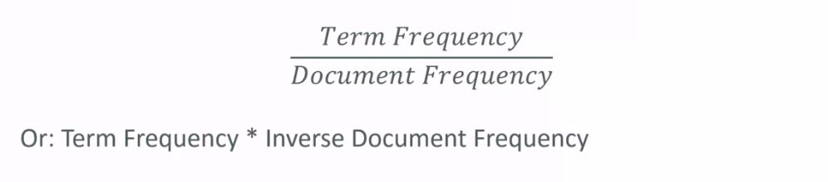
IDF
So a measure of relevancy of a word to a document might be:
That is, take how often the word appears in a document, over how often it just appears everywhere.
That gives you a measure of how important and unique this word is for this document.

Slide 29
TF-IDF in Practice
Limitations of TF-IDF:
TF-IDF assumes that there is no relation between words i.e. it considers it as just “a bag of words”
Parsing documents into bag of words can be the most of work. What about synonyms? Various tenses? Abbreviations? Capitalizations? Misspellings?
Doing this at a scale is the hardest part!
Overcoming the Limitations:
Spark to handle scaling
Words can be represented to HASH Value (number) for efficiency
We actually use the logarithm of the IDF, since word frequencies are distributed exponentially. This gives us a better weighting of a words overall popularity

Slide 30
Using TF-IDF in our Search Engine
Creating simple search algorithm:
Compute TF-IDF for every word in a the corpus (collection of data)
For a given search word, sort the documents by their TF-IDF score for that word
Display the results
This algorithm works only for searching a “single keyword”.
If we want to make it generalized for “string based searching” then
Tokenize the search string by space to get the list of words
Now for each word compute TF-IDF
Make an algorithm for best combination of TF-IDFs of respective words to predict exact document
Display the results

Slide 31
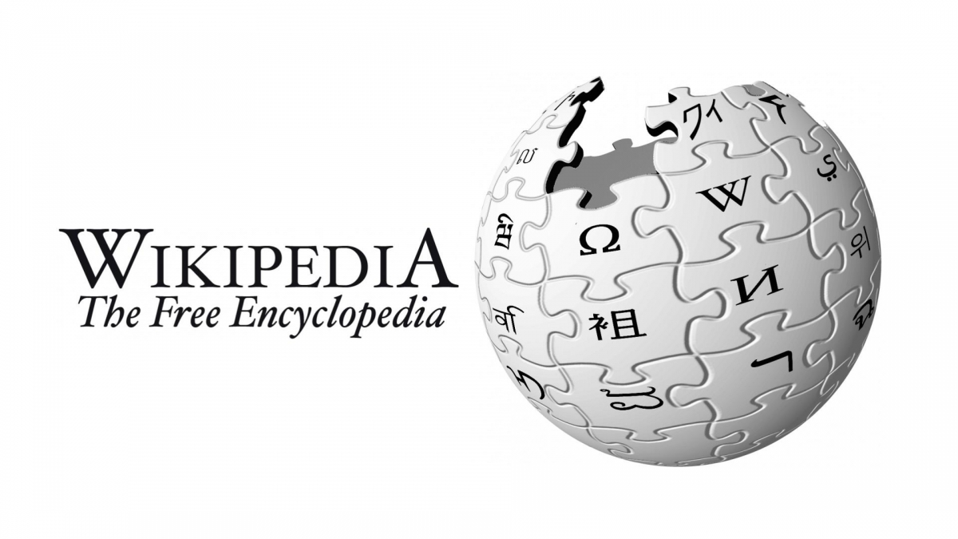
Let’s Make our own Wikipedia Search Engine!!
We will consider only word frequency to measure the relevance of the article!!
Let’s use TF-IDF on Wikipedia!

Slide 32
Let’s do it!!
.....

Slide 33
How to design UI for your Search Engine?
You may use any web development platform or technology.
Example:
Django for Python
ASP.NET for R
Shiney R
(Since it’s beyond the scope of this workshop, so we won’t cover it)

Slide 34
Want more?
We used only a small subset of wikipedia data that was already formatted.
In order to take real feel:
Use Web Scraping to get Wikimedia Data Dumps to your cluster.
Now use Machine Learning on that data to make Search Engine.
(practically this would need a lot of computing capacity since data would be in GBs, so you would need a large cluster, laptops won’t suffice)

Slide 35
Interesting Facts!
Who has the world’s largest cluster in the world?
Yahoo! (cluster of 40000 nodes)
Approximately how many times does Google improves it’s Page Rank Algorithm in a year?
Around 50 times a year

Slide 36
Thank You!

