Slide 1
HabotConnect Hiring Project
Junior Cloud & DevOps Engineer — GCP / Django / React
Secure Staging Provisioning, Fail-Closed CI/CD, and Deterministic Data Validation
Candidate: Raj Soni
Submission deliverables: Terraform, GitHub Actions, Django/DRF, DCYN, schema mapping, and documentation

Slide 2
1. Project Objective
Translate a vague production incident into secure, reproducible engineering controls.
Provision D0 Raw Landing and D1 Staged/Enforced data layers using Terraform.
Prevent insecure or non-compliant commits from progressing through CI/CD.
Validate student onboarding data deterministically before downstream analytics.

Slide 3
2. Production Scenario
A junior developer introduced hardcoded API credentials into application code.
A schema mismatch broke downstream analytics.
Required response: restore security, enforce automated quality gates, and make data validation deterministic.
Core principle: remove reliance on human memory through Poka-Yoke automation.

Slide 4
3. Architecture Overview
Developer
GitHub
CI/CD Gates
GCP Data Layers
Application data: Student JSON → Django REST Framework → validation/DCYN → staged analytics.
Infrastructure: Terraform → GCS D0 Raw Landing + BigQuery D1 Staged/Enforced.
Security: IAM Conditions + public access prevention + encryption + Row-Level Security.

Slide 5
4. Terraform Secure Provisioning
GCS D0 Raw Landing bucket with Uniform Bucket-Level Access.
Public Access Prevention is enforced.
Customer-managed KMS encryption and object versioning are configured.
BigQuery D1 dataset and student onboarding table are provisioned as code.
IAM access is constrained using a time-based IAM Condition.

Slide 6
5. GCP Security Controls
Identity
IAM Conditions
Encryption
RLS
Least-privilege access is applied to the data layers.
GCS access is conditional and public access is prevented.
Data is protected with encryption keys.
BigQuery Row-Level Security restricts analytics rows by region.

Slide 7
6. Poka-Yoke CI/CD Build Gate
Format
Lint
Terraform
Secrets
Trivy
GitHub Actions automatically checks every push and pull request.
Formatting, linting, Terraform validation, secret detection, and vulnerability scanning are automated.
No deployment stage is allowed to proceed after a mandatory gate fails.

Slide 8
7. Fail-Closed Demonstration
Example violation: a hardcoded API secret is committed.
Gitleaks detects the secret and returns a non-zero failure status.
GitHub Actions marks the job as failed.
The pipeline stops; downstream deployment cannot proceed.
The same principle applies to formatting, lint, Terraform validation, and high/critical findings.

Slide 9
8. Django REST Framework + DCYN
Student JSON
DRF Serializer
Strict Validation
DCYN YES/NO
Boolean business decisions are represented explicitly as YES or NO.
Parent consent is a mandatory onboarding gate.
Invalid values are rejected before entering the application data flow.
The decision logic is deterministic and does not depend on human interpretation.

Slide 10
9. Schema Mapping & Analytics
Incoming JSON
Validated Fields
D1 BigQuery
Analytics
The schema mapping spreadsheet documents source type, required status, validation rule, DCYN logic, and BigQuery type.
Region is retained for Row-Level Security.
The spreadsheet uses Wrap Text for full visibility.
Derived DCYN decision is calculated rather than treated as an uncontrolled input.

Slide 11
10. Repository & Operational Controls
terraform/: Infrastructure-as-Code resources and variables.
.github/workflows/: automated CI/CD quality and security gate.
django/: model, serializer, and DCYN validation library.
schema/: student onboarding mapping workbook.
README.md: architecture, assumptions, validation commands, and security model.
.gitignore: prevents Terraform state, variable files, environment files, and key material from being committed.

Slide 12
11. Key Outcomes & Interview Demo
Secure, reproducible staging infrastructure defined through Terraform.
Automated Fail-Closed controls prevent insecure code from progressing.
Deterministic validation protects application and analytics data quality.
Least-privilege IAM, encryption, and Row-Level Security protect cloud data.
Interview demonstration: run validation → show pipeline failure on an insecure commit → show corrected pipeline passing.

Slide 13
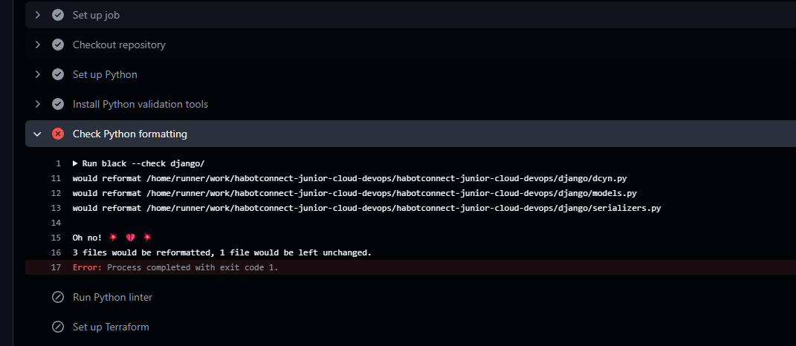
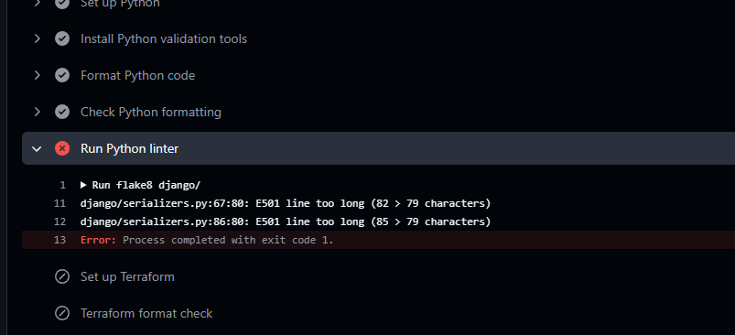
12. Main Error and issue When running pipeline (Some Screenshots)

Slide 14
