Slide 1

AstroSage Analysis
PRINCE KUMAR

Slide 2
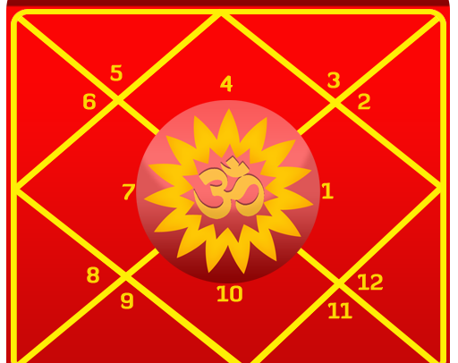
WHAT IS ASTROSAGE ?
AstroSage is one of the most authentic astrology destinations for not only those who are seeking astrological assistance, but also for high-level astrological research and development on wide scale. It is a prolific astrological source for people to help them out from mundane questions to specialized queries. Our aim is to ameliorate those who are facing problems and betterment of humanity using divine science of astrology.

Slide 3
Problem Statement
AstroSage is looking to improve its call center operations. To handle the increasing volume of calls and diverse types
of customer interactions—like phone calls, chats, and consultations—management needs a better understanding of
several key areas:
- How call volume and agent workload change over time.
- What factors most influence customer satisfaction.
- A breakdown of operational costs and revenue.
- Patterns in repeat callers and how they use the platform.
- Where to best invest resources, whether in hiring new staff, training existing ones, or upgrading technology.

Slide 4
Data Overview
Total Consultation | 28027
Net Amount | 213987.31
Top 10 Guru on Call , Chat Duration (minute) , Earning and Rating
Guru Name | Sum of Call time Duration (Minute ) | Sum of Chat Duration ( Minute ) | Sum of Astrologers Earnings | Average of rating
Astro Divya | 2358.846 | 4551 | 3696.9853 | 3.479166667
Astro Ruchi | 2252.6342 | 2737 | 10274.658 | 4.442728443
Astro Seema | 1531.569 | 2552 | 2690.8173 | 3.398347107
Astro Shalini | 2948.3075 | 1685 | 6807.6067 | 3.417108251
Astro Sonam S | 1978.9112 | 3180 | 2907.4947 | 3.719414894
Dr Balkrisna | 1323.6726 | 1898 | 15910.208 | 2.593886463
Tarot Ari | 1085.7309 | 1203 | 2222.5587 | 3.854166667
Tarot Bee Riya | 359.5957 | 2801 | 2178.7125 | 2.36204576
Tarot Rupika | 936.616 | 2031 | 2198.75 | 2.846560847
Usha Siingh | 186.8486 | 520 | 2870.2667 | 2.15
Total Calls | 8508
Net Amount (Call) | 168442.03
Total Chat | 19514
Net Amount (Chat) | 45494.68

Slide 5
Data cleaning and analysis or methodology
Data Cleaning Process
Data Analysis Techniques
Data Inspection: Review data for completeness and accuracy.
Handling Missing Values:
Imputation (Not available (N/A), and ‘0’)
Removing Duplicates: Identify and eliminate duplicate entries.
Standardization: Ensure consistent formatting (e.g., date formats, categorical variables).
Descriptive Analysis: Summarize historical data to understand trends and patterns.
Predictive Analysis: Use statistical models to forecast future call volumes and customer behaviour
Sentiment Analysis: Analyse customer feedback to gauge satisfaction levels.

Slide 6
Identifying Performance Gaps
AstroSage has been facing challenges in maintaining optimal call centre performance.
As per given Data :
Declining customer satisfaction scores | Inconsistent call volumes. | Variability in agent performance.
Average Customer satisfaction is very low. Average Rating is 2.93 , which is very low . | Daily Call volume is inconsistent. Total change in Call volume is in negative , and average change is in negative. | Overall Agent performance is poor. Average performance of guru is not fair .
AstroSage's performance compare to its competitor, AstroGuru
To compare AstroSage's performance to its competitor, AstroGuru, we can analyse several key performance metrics typically used in call centre operations.

Slide 7
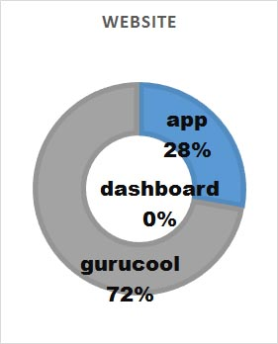
Traffic website
According to given data
Most traffic comes from Gurucool (72%),
While the app contributes 28% and the dashboard shows 0%, indicating Gurucool is
Primary platform for user engagement
User Traffic ( Platform )
Gurucool App Dashboard

Slide 8
Revenue vs Volume Comparison
Although the chat volume contributes to 79% of volume share but it contributes only 21% to revenue share
Call volumes is 30% only but contributes 70% to revenue share

Slide 9
Total sales and revenue generated by each category
This Chart analyzes the revenue and astrologer payouts across various consultation types.
It highlights that call consultations generate the highest Profit on the platform.

Slide 10
Hourly Distribution of calls
The chart depicts the hourly distribution of the calls between 01-December and 03 -January.
The highest call volumes occur between 7 AM and 1 PM, peaking at 8 Am (660 calls). Activity declines steadily in the evening ,with the lowest traffic during late- night hours(12 AM – 3 AM).

Slide 11
Change in daily call volume day by day
Average Daily Call Volume : 250
The chart and the pivot data displays the change in daily call volume.

Slide 12
Daily count of Consultant Type
According to Given Data
Daily consultant (including call, chat..)

Slide 13
User call status
According to given data Only 41% call are completed Need to improve call completing percentage by providing automate IVR call for initial engage and hire more agent to increase call completing

Slide 14
User chat status
According to given data Only 29% chat are completed which is very low Need to improve chat completing percentage by providing automate AI Chat support for initial engage and improve AI Chat Bot
increase chat completing

Slide 15
Top 10 guru
Represents the top 10 guru on earning based on various criteria like "sum of astrologers earnings", "sum of chat duration" and "sum of call time duration".

Slide 16
Rating vs count of rating
Based on the data, customer satisfaction is low, as evidenced by a large number of poor ratings. To address this, implementing a free AI Chatbot is recommended to provide instant support and improve customer experience. This will not only resolve common issues quickly but also provide valuable feedback for further improvements.

Slide 17
Rating wise gurus distribution
Most Common Ratings: The ratings are relatively spread out, but the most frequently given ratings are 2 and 3, with 115 and 117 unique gurus receiving these ratings, respectively. This suggests that many gurus are perceived as average or slightly above average by users.
Declining Trend: There’s a noticeable decline in the number of unique gurus receiving higher ratings (6 through 8), with 89 for a rating of 6 and 86 for 8. This trend suggests that as the ratings increase, fewer gurus are meeting the higher standards expected by users.
Targeted Improvement Programs: Focus on those receiving low ratings (0 and 1) to identify specific areas for improvement, such as training or resource allocation.

Slide 18
Rating wise user distribution
High Low-Rating Count : Rating 0 is the highest(2,739 users), showing major dissatisfaction.
Boost Engagement: Actively engage average rates (2&3) to improve satisfaction.
Track Trends: Monitor ratings over time to measure improvements and adjust strategies.

Slide 19
Top- 10 Gurus based on Rating
The highest-rated experts are Mystical Puja Rai
(Tarot) and Astro Daljit Kaur, both rated close
to 7.5-8 .
Other top performers include Tarot, Reema,
Astro Ankita Saraswat, with consistently strong
ratings.
There are 1 slicers in our dashboard:
- Based on Rating
- Month based

Slide 20
Average Rating by Consultation Type
Call consultations were very effective, earning an average rating that
was almost as high as "Complementary."
This shows that users found them to be reliable and helpful.
.The lowest average rating was for chat sessions, which suggests
a need for service improvement.
This could be due to factors like slow responses,
unclear information, or a lack of available agents.

Slide 21
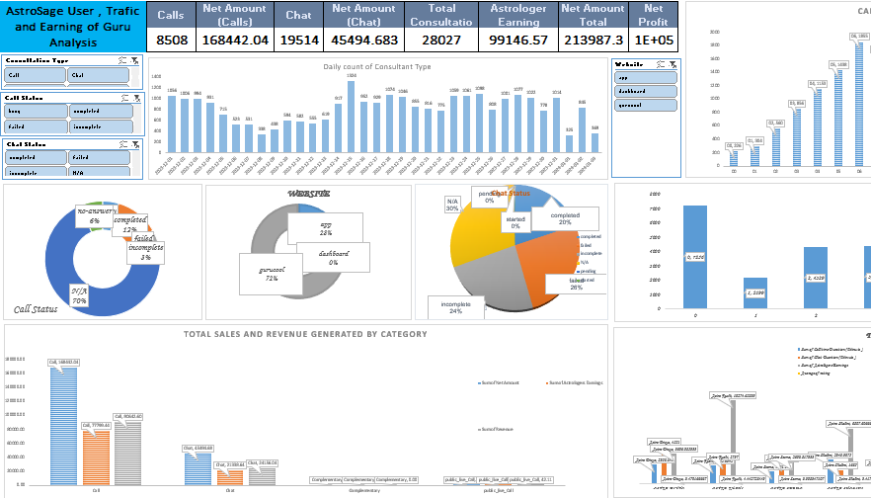
Astrosage dashboard

Slide 22
Recommendations:
Hiring & Training : Invest in hiring additional agents and providing training to improve agent performance and reduce workload.
Technology Upgrades : Implement AI chatbots to handle routine inquiries and predictive analytics to optimize agent allocation during peak times.
Customer Feedback & Monitoring Systems: Develop tools to capture real-time feedback and monitor agent performance, allowing for immediate interventions.
Operational Efficiency : Invest in optimizing call routing systems to ensure efficient use of agent time and reduce queue times.

Slide 23
CONCLUSION
Suggestions for improvement Based on Findings
Agent Training:
Focus training on areas that correlate with high satisfaction, such
As consultation effectiveness or reduced resolution time.
Optimization of Call Duration:
Identify the optimal duration range where satisfaction is highest and aim
for efficiency within that range.
Feedback Integration:
Use customer feedback to identify pin points and success areas
for iterative improvement.
Strategic Resource Allocation:
Deploy high-performing agents during critical time slots or for
complex cases to maintain satisfaction levels.

Slide 24
Thank You

