Slide 1
DEEP LEARNING • MEDICAL IMAGE ANALYSIS
Brain Tumor MRI Classification, Segmentation & XAI
TEAM MEMBERS
Purnima Roy
Samian Hussain
1
2
Samian hussan
3
Rasidul houque
4
Musrat Jahan Afrin
ID:0182320012101318
ID:0182320012101358
ID:0182320012101333
ID:0182320012101324
3
Sristy Rani Deb
ID:0182320012101380
01

Slide 2
DEEP LEARNING • MEDICAL IMAGE ANALYSIS
Brain Tumor MRI Classification, Segmentation & XAI
An end-to-end, segmentation-guided and explainable MRI analysis framework
1
MRI
2
MASK
3
4-CLASS
4
XAI
INPUT
LOCALIZE
PREDICT
EXPLAIN
Dataset Audit → Preprocess → Segment → Classify → Explain → Validate

Slide 3
01 • PROJECT FLOW
From raw MRI to a trustworthy prediction
The notebook implements a complete research pipeline.
1
DATASET
2
AUDIT
3
SEGMENT
4
CLASSIFY
5
XAI
Download + structure
Integrity + leakage
Tumor mask + ROI
4-class diagnosis
Grad-CAM++ + trust
Core tasks
Proposed idea
Trust layer
Segmentation + classification
TrustSeg-XAI multi-task learning
XAI + causal + calibration

Slide 4
02 • INTRODUCTION
Why analyze brain tumors from MRI?
The project combines localization, diagnosis and explanation in one workflow.
Clinical motivation
Research problem
Project vision
MRI provides detailed brain-tissue information, but interpretation depends on expert analysis.
A model should identify the tumor region and classify the tumor type.
Move beyond accuracy toward tumor-focused and interpretable AI.
INPUT
1
Brain MRI
2
Tumor ROI
3
4 Classes
4
Grad-CAM++
Raw image
Where?
What type?
Why?

Slide 5
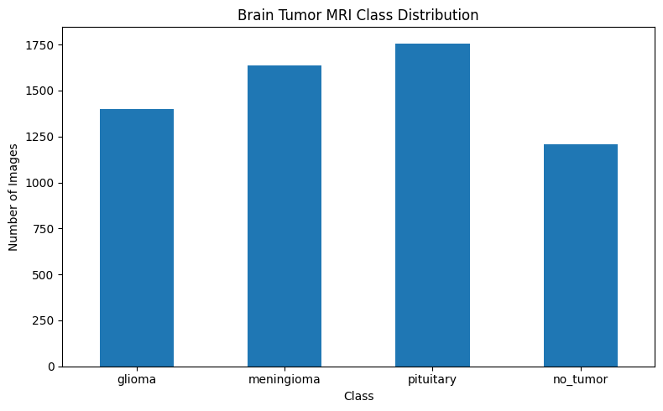
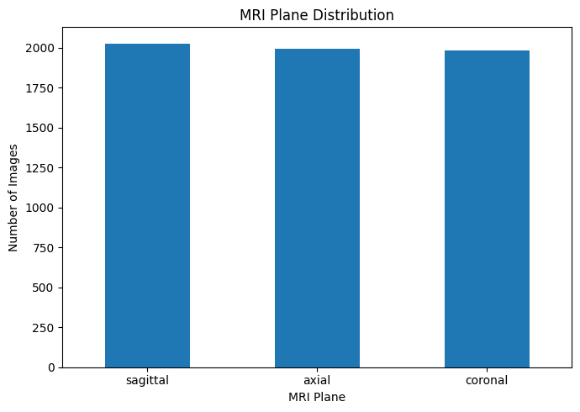
03 • DATASET
Brain Tumor MRI Dataset
Separate classification and segmentation task folders are used.
CLASSIFICATION
SEGMENTATION
CLASSES
INPUT
6,000
4,793
4
256×256
5,000 train • 1,000 test
3,933 train • 860 test
Glioma • Meningioma • Pituitary • No Tumor
3-channel MRI

Slide 6
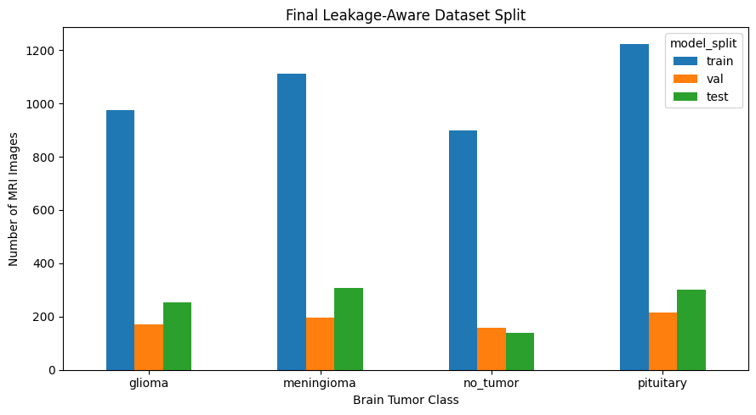
04 • DATA QUALITY
Audit first — train second
Integrity and cross-task consistency are checked before experiments.
File integrity
Duplicates
Leakage
Corrupted / unreadable images
Exact + near-duplicate detection
Train/test independence
Image–mask pairing
Mask quality
Cross-task analysis
Correct correspondence
Valid binary masks
Classification ↔ segmentation
Audit output
Clean + validated + leakage-aware dataset ready for reproducible experiments.

Slide 7
05 • DATA PIPELINE
Standardizing MRI inputs
All models use a consistent 256×256 representation.
1
Resize
2
Normalize
3
Mask
4
Augment
5
Split
256 × 256
Intensity
Binary tumor mask
Training-only
Leakage-aware
MRI TENSOR
MASK TENSOR
SEED
3 × 256 × 256
1 × 256 × 256
42
Model input
Binary target
Reproducibility
MRI → Resize → Normalize → Augment → Ready

Slide 8
06 • SEGMENTATION
U-Net baseline
Pixel-level tumor localization establishes the segmentation reference.
1
MRI
2
Encoder
3
Bottleneck
4
Decoder
5
Mask
Input
Features
Context
Reconstruction
Tumor
Loss
Optimizer
Selection
BCEWithLogitsLoss + DiceLoss
AdamW • LR 1e-4
Best validation Dice

Slide 9
07 • ADVANCED BASELINE
U-Net++ + ResNet34
Nested skip connections provide richer multi-scale feature fusion.
ENC
X
X
X
MASK
ENC
X
X
X
MASK
ENC
X
X
X
MASK
ENCODER
NESTED SKIPS
DECODER → MASK
DICE
IOU
ENCODER
86.66%
79.91%
ResNet34
Best independent segmentation
Best independent segmentation
ImageNet pretrained

Slide 10
08 • CLASSIFICATION
Four-class brain tumor prediction
Two transfer-learning backbones are compared.
GLIOMA
MENINGIOMA
PITUITARY
NO TUMOR
Class 01
Class 02
Class 03
Class 04
EfficientNet-B0
ACCURACY
MACRO-F1
99.00%
99.04%
ImageNet pretrained • fine-tuning • early stopping
Best
Reported test result
Evaluation: Accuracy • Macro-F1 • MCC • ROC-AUC • Confusion Matrix

Slide 11
09 • SECOND BASELINE
ConvNeXt-Tiny
A modern convolutional backbone provides a strong comparison model.
1
MRI
2
ConvNeXt-Tiny
3
Global Pool
4
4-Class Head
Input
Deep features
Representation
Prediction
TEST ACCURACY
MACRO-F1
Takeaway
98.90%
99.04%
EfficientNet-B0 has the highest reported accuracy.
Strong baseline
Same macro-F1 as EfficientNet
10

Slide 12
10 • MODEL COMPARISON
Classification results
Official test performance reported by the implementation.
MODEL
ACCURACY
MACRO-F1
ROLE
EfficientNet-B0
99.00%
99.04%
Best accuracy
ConvNeXt-Tiny
98.90%
99.04%
Strong baseline
TrustSeg-XAI
97.80%
97.95%
Proposed multi-task
BEST ACCURACY
BEST MACRO-F1
PROPOSED
99.00%
99.04%
97.80%
EfficientNet-B0
EfficientNet / ConvNeXt
TrustSeg-XAI

Slide 13
TrustSeg-XAI
Segmentation-guided multi-task learning connects tumor localization with classification.
1
FULL MRI
2
SHARED ENCODER
3
TUMOR ROI
4
FEATURE FUSION
5
4-CLASS HEAD
Global context
ConvNeXt-Tiny
Segmentation decoder
Global + tumor
Final diagnosis
Segmentation branch
Classification branch
Joint learning
Predict tumor mask / ROI
Use global + ROI-guided features
Optimize both tasks together
WHERE IS THE TUMOR? → WHAT TYPE IS IT? → WHY DID THE MODEL DECIDE?

Slide 14
Consistent and reproducible training
Training configuration is explicitly defined in the notebook.
AdamW
1e-4
1e-4
Optimizer
Learning rate
Weight decay
ReduceLROnPlateau
Early stopping
AMP
Scheduler
Patience = 3
Mixed precision
Segmentation selection → validation Dice • Final evaluation → untouched official test set

Slide 15
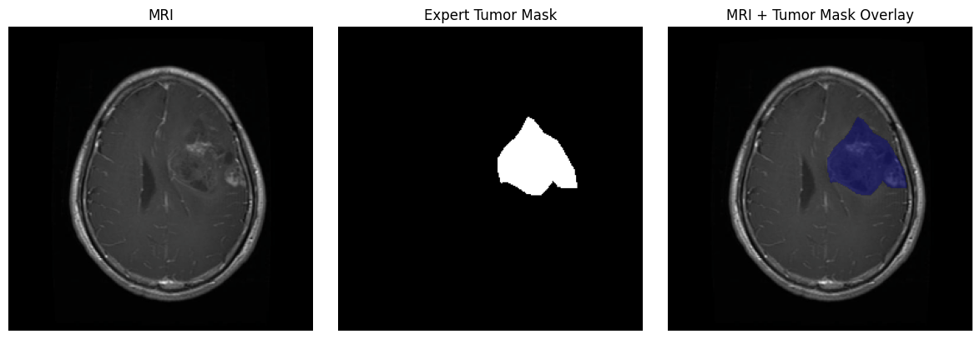
13 • VISUAL RESULT
Expert tumor mask on MRI
The notebook visualizes the MRI, expert mask and overlay.
MRI
Original brain MRI
Expert Mask
Pixel-level tumor annotation
Overlay
Tumor region highlighted on MRI

Slide 16
14 • XAI
Grad-CAM++ — making the decision visible
The predicted class is converted into a spatial relevance heatmap.
1
MRI
2
TRUSTSEG-XAI
3
GRAD-CAM++
4
EXPLANATION
Input image
Prediction
Relevance map
Important region
What it shows
XAI metrics
Causal test
Which spatial regions influence the selected class?
Dice • IoU • Pointing Game
Tumor occlusion vs matched background
15

Slide 17
15 • QUANTITATIVE XAI
Explanation quality was measured
A stratified 150-image subset was selected before observing Grad-CAM++ results.
XAI DICE
XAI IOU
SUBSET
FAITHFULNESS
0.0650
0.0417
150
0.3176
Overlap with tumor mask
Spatial overlap
50 × 3 MRI planes
Tumor vs background margin
Pointing Game
Tumor Occlusion
Background Occlusion
Checks whether maximum activation lands inside the tumor region.
Removes tumor information and measures probability change.
Matched background removal provides a causal comparison.
16

Slide 18
16 • TRUST ANALYSIS
Trust beyond accuracy
The study checks calibration, negative controls and cross-plane robustness.
EFFICIENTNET ECE
CONVNEXT ECE
TRUSTSEG ECE
NO-TUMOR EMPTY
0.006844
0.009868
0.018729
98.57%
Calibration
Calibration
Calibration
140 official test images
Cross-plane
Negative control
Interpretation
Axial 97.99% Coronal 98.36% Sagittal 96.97%
False tumor detection = 1.43%
Reliability is evaluated separately from raw accuracy.

Slide 19
17 • SEGMENTATION RESULTS
Which model localizes the tumor best?
Official test Dice and IoU.
MODEL
DICE
IOU
U-Net + ResNet34
85.54%
78.02%
U-Net++ + ResNet34
86.66%
79.91%
TrustSeg-XAI
83.83%
75.62%
BEST DICE
BEST IOU
TRUSTSEG-XAI
86.66%
79.91%
83.83%
U-Net++ + ResNet34
U-Net++ + ResNet34
Joint multi-task Dice

Slide 20
18 • TAKEAWAYS
What did the implementation achieve?
Main findings from the reported experiments.
01
Best classification
02
Best segmentation
EfficientNet-B0 → 99.00% accuracy
U-Net++ + ResNet34 → 86.66% Dice
03
Proposed framework
04
XAI validation
TrustSeg-XAI combines segmentation + classification
Grad-CAM++ + overlap + causal tests
05
Reliability
06
Complete pipeline
Calibration + controls + cross-plane analysis
Audit → preprocess → train → compare → explain
Key message: predictive performance, explanation quality and reliability are different dimensions.

Slide 21
19 • CONCLUSION
A complete, explainable Brain Tumor MRI framework
The project moves from data validation to prediction and trust analysis.
1
DATA
2
PREPROCESS
3
SEGMENT
4
CLASSIFY
5
XAI
6
VALIDATE
Audit
Standardize
Tumor ROI
4 classes
Grad-CAM++
Trust checks
Contribution
Evidence
Next step
Segmentation-guided multi-task learning
Classification + segmentation + XAI + reliability
External validation and larger multi-source datasets
THANK YOU

