Slide 1
Online recharge system
Raj Vardhan Upreti - 0204471
Rachit Mishra - 0204470
Priya Dixit - 0204468

Slide 2
Content
Introduction
Database layout
Entity Relationship Diagram
Data Flow Diagram
Snapshots
Summary

Slide 3
INTRODUCTION
In this project, Online Recharge System we tried to achieve recharge of mobile phones, dth and credit card payments with ease at your fingertips.
Our web application gives user a simple interface for making phone/dth recharge of various operators.
It follows a very simple concept, for a user to make recharge or payment he/she must have to register or login first and after that he/she can make recharges or payments with their wallet balance.

Slide 4
Database Layout
There are several table used in the database for this web application. Details about these tables are given next.

Slide 5
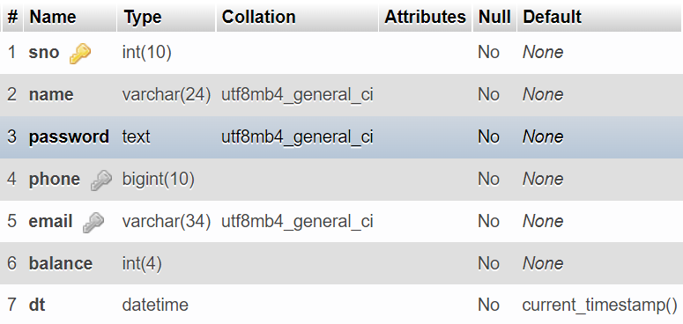
Members table
For serial number
Used as primary key
For user’s name
For storing password
For phone number
For email id
For wallet balance
For the date and time of account registering

Slide 6
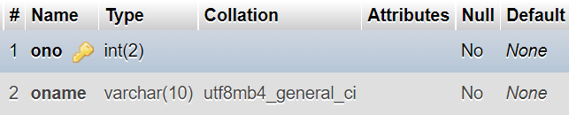
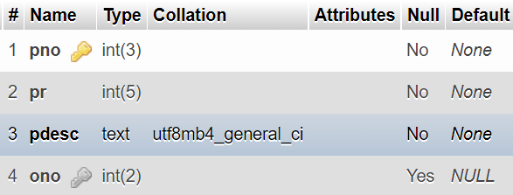
plan table
Operator Number
Used as primary key
Operator Name
Operator table
Plan Number
Plan Rate
Plan Description
Operator Number
Used as reference key from operator table

Slide 7
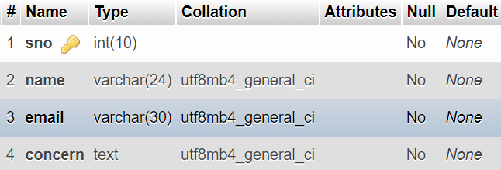
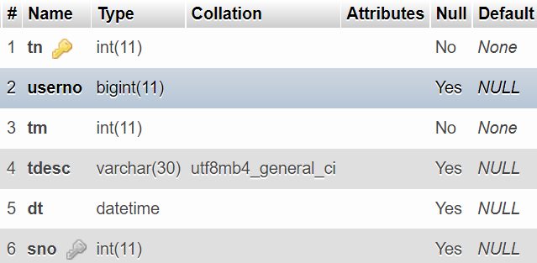
Transaction table
For serial number
For name
For email
For the Query user had
contact table
Transaction number
No or id on which recharged/bill paid
Transaction amount
Transaction description
Date and time of transaction
User serial number used as referred key from member table

Slide 8
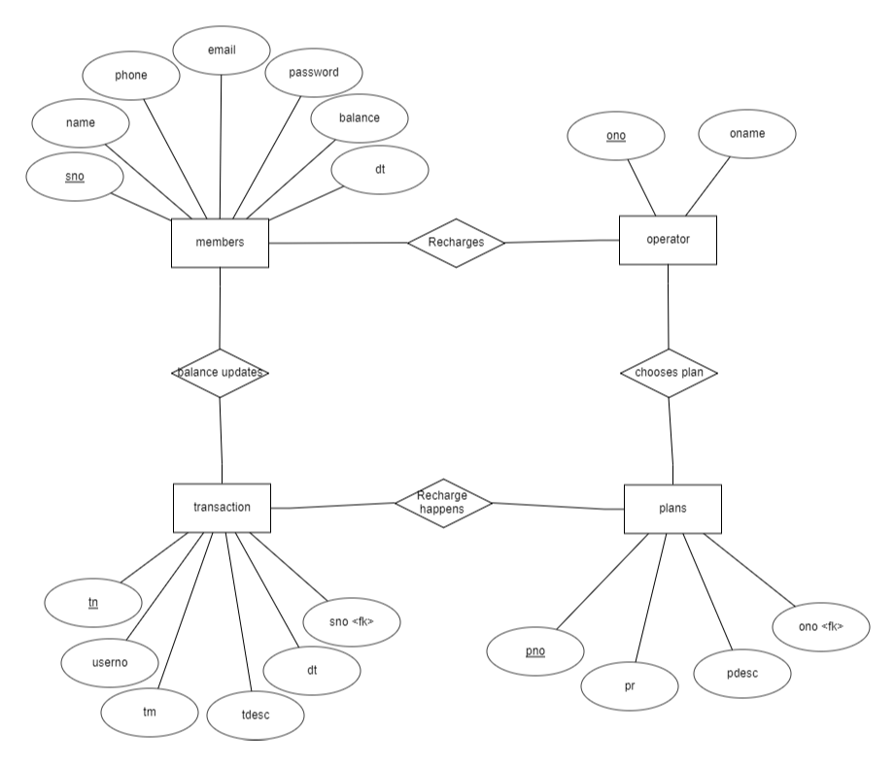
Entity relation diagram

Slide 9
Data Flow Diagram
Level 0 dfd
Recharges
Online Recharge Portal
User
Operator
Updates balance
Gives Confirmation

Slide 10
Level 1 dfd
Transactions
updates
Recharges
Online Recharge Portal
User
Log in
Had query
Query

Slide 11
Snapshot of web application.​
There are few snapshot of web application with description included next.

Slide 12
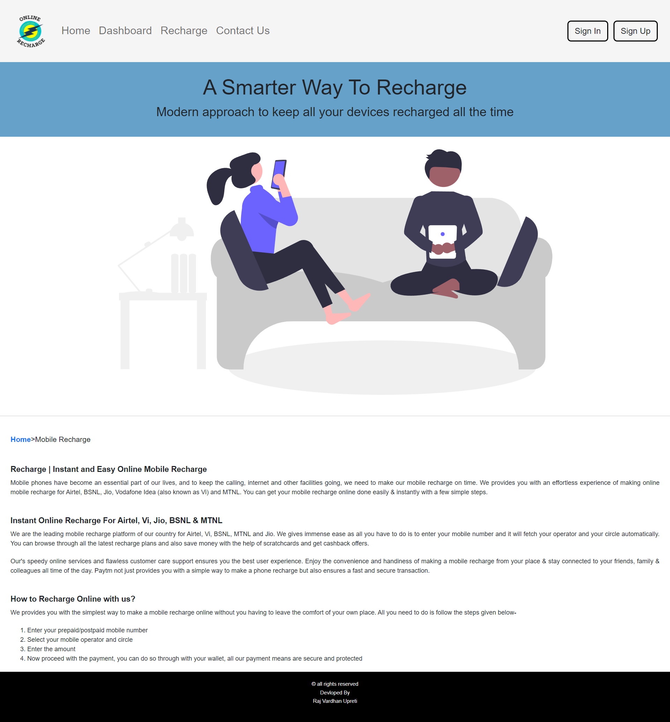
Home page
For Recharging
Contacting us for help
For Login into account
For Signup with our site
Dashboard that will be showed after login

Slide 13
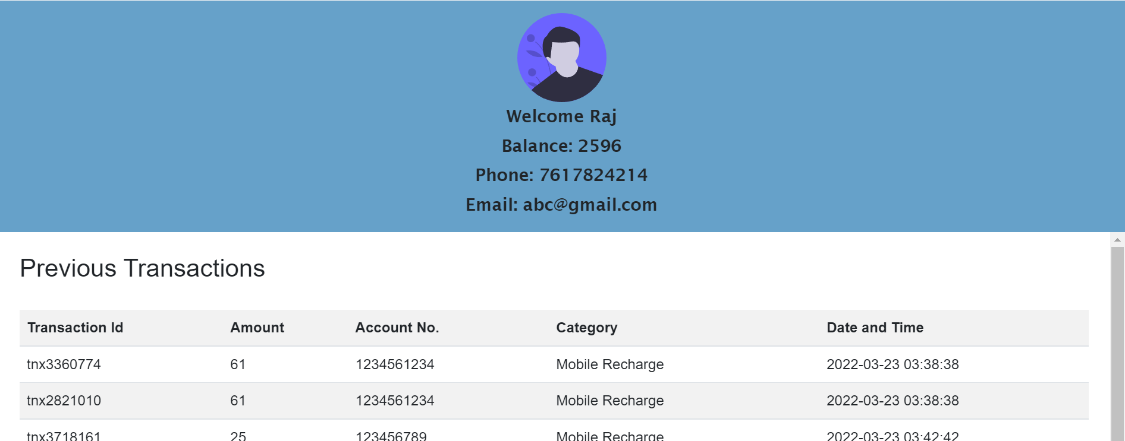
User dashboard
Username
Wallet Balance
Previous Transaction
Phone Number
Email Id

Slide 14
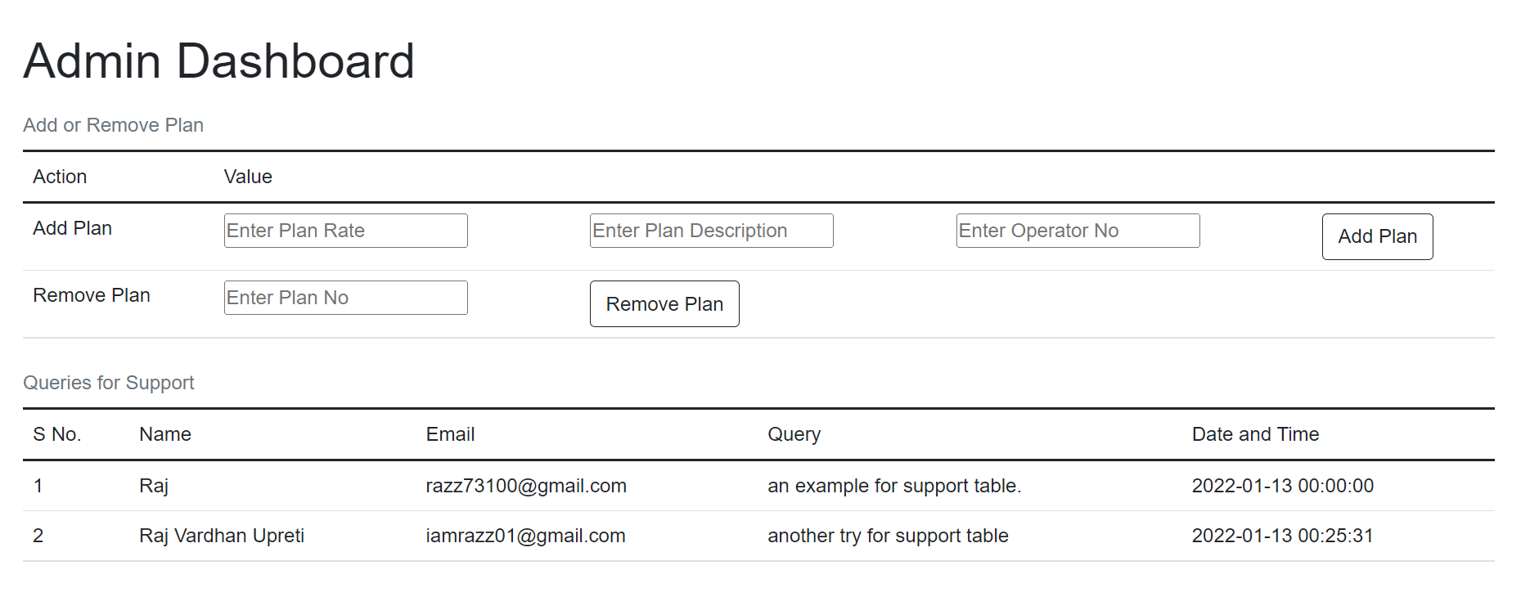
Admin dashboard
To remove old plan
To add new plan
Queries from support table

Slide 15
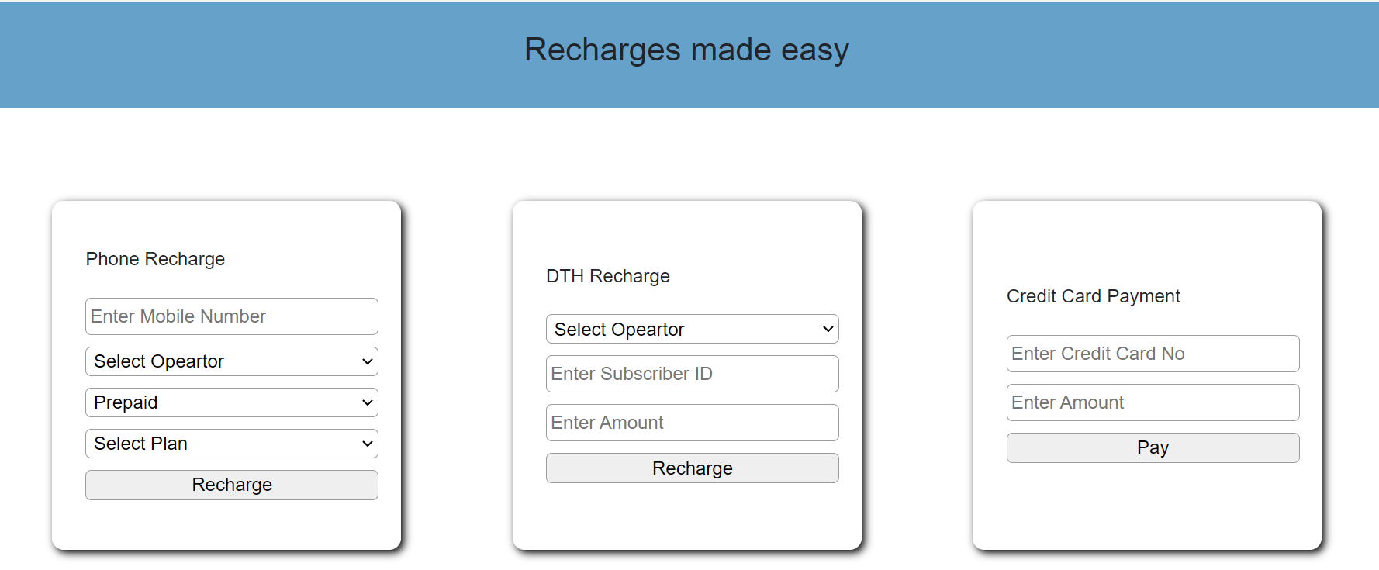
Recharge
For Mobile recharge
For Dth recharge
For Credit Card payment

Slide 16
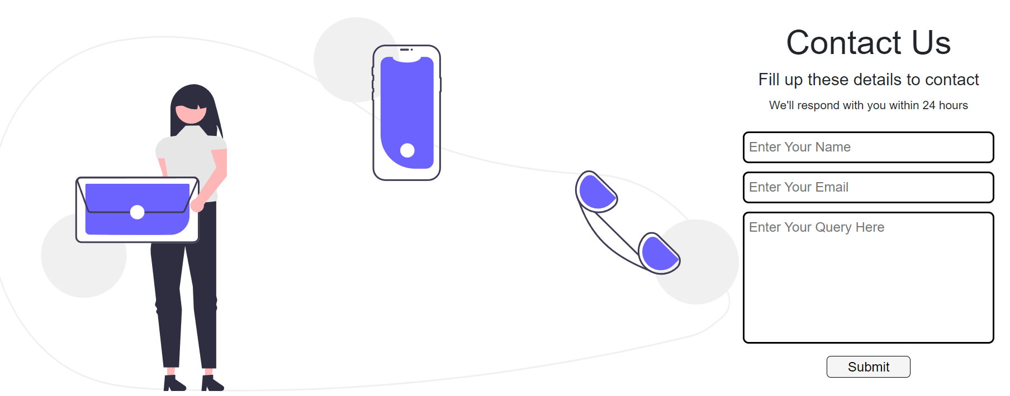
Contact us
User Email on which we reach out
User query to whom we respond

Slide 17
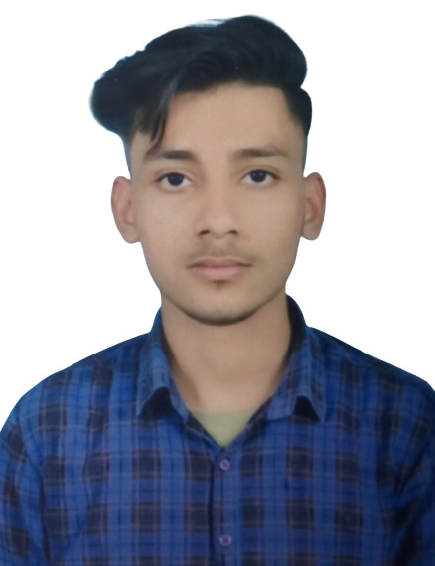


MEET OUR TEAM
RAJ VARDHAN UPRETI
RACHIT MISHRA
PRIYA DIXIT
BCA 5th Sem
BCA 5th Sem
BCA 5th Sem

Slide 18
SUMMARY
At last I just want to say that as in the previous slides we saw how our web application works and other details about our site, the main objective of our website is to provide an easy and effective way for recharging mobile phones or dth and to pay the credit card bills with ease.

Slide 19
THANK YOU

