Slide 1

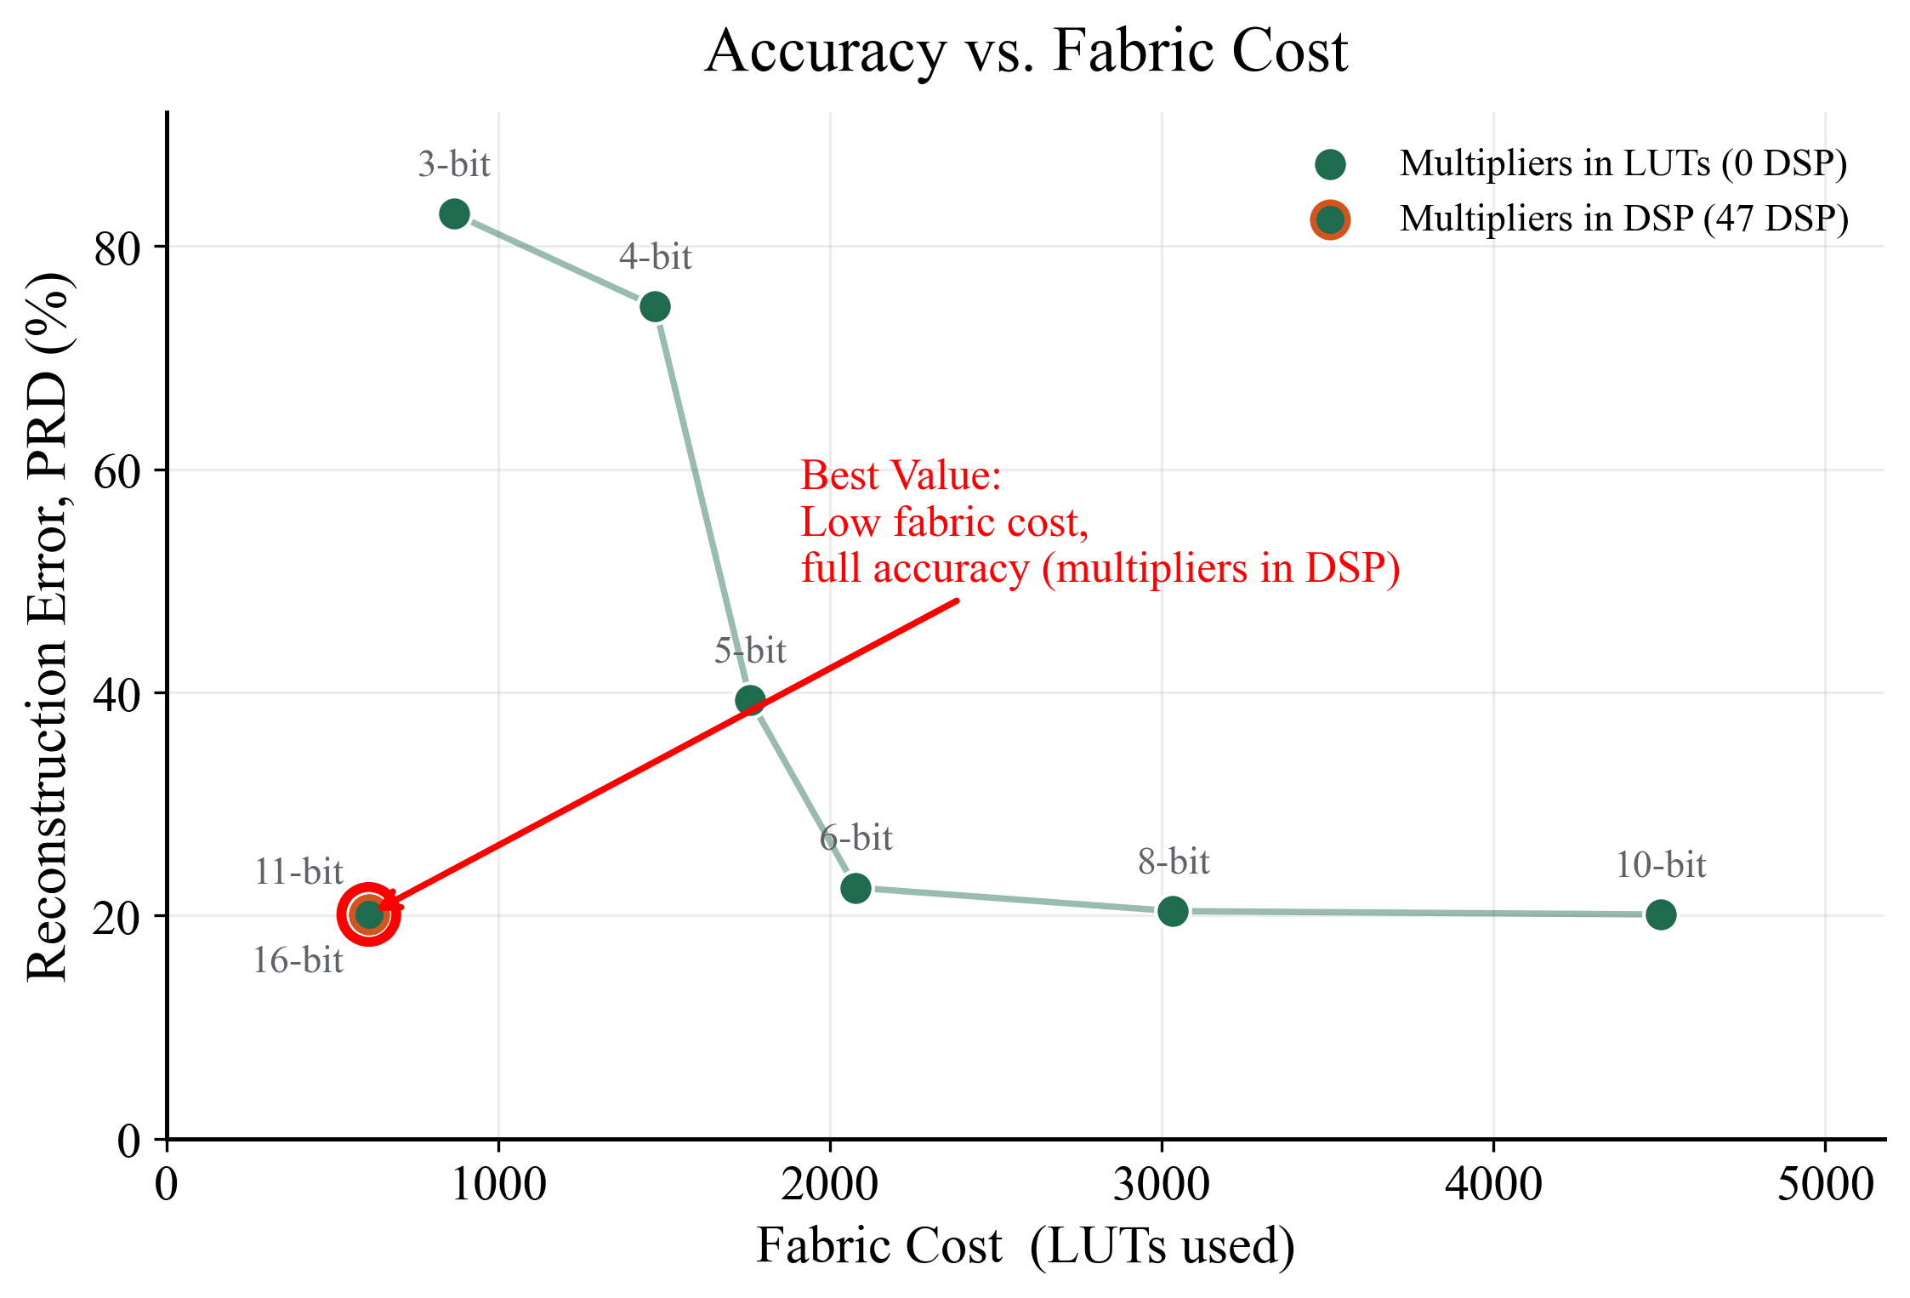
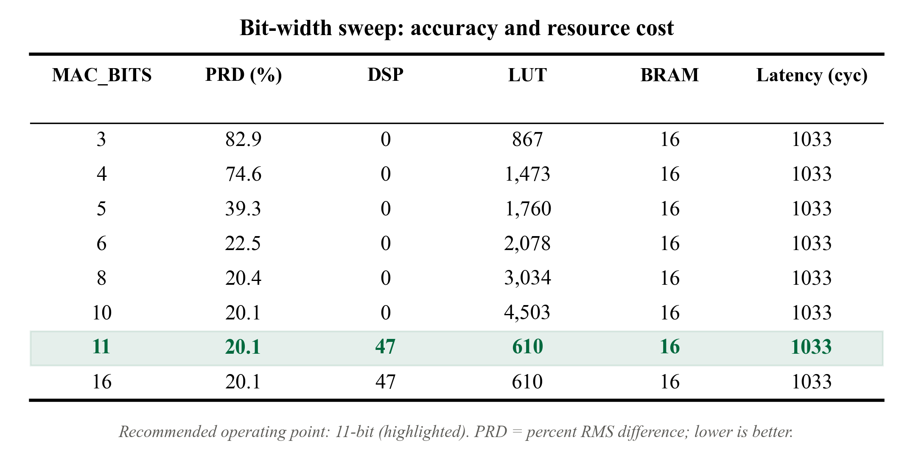
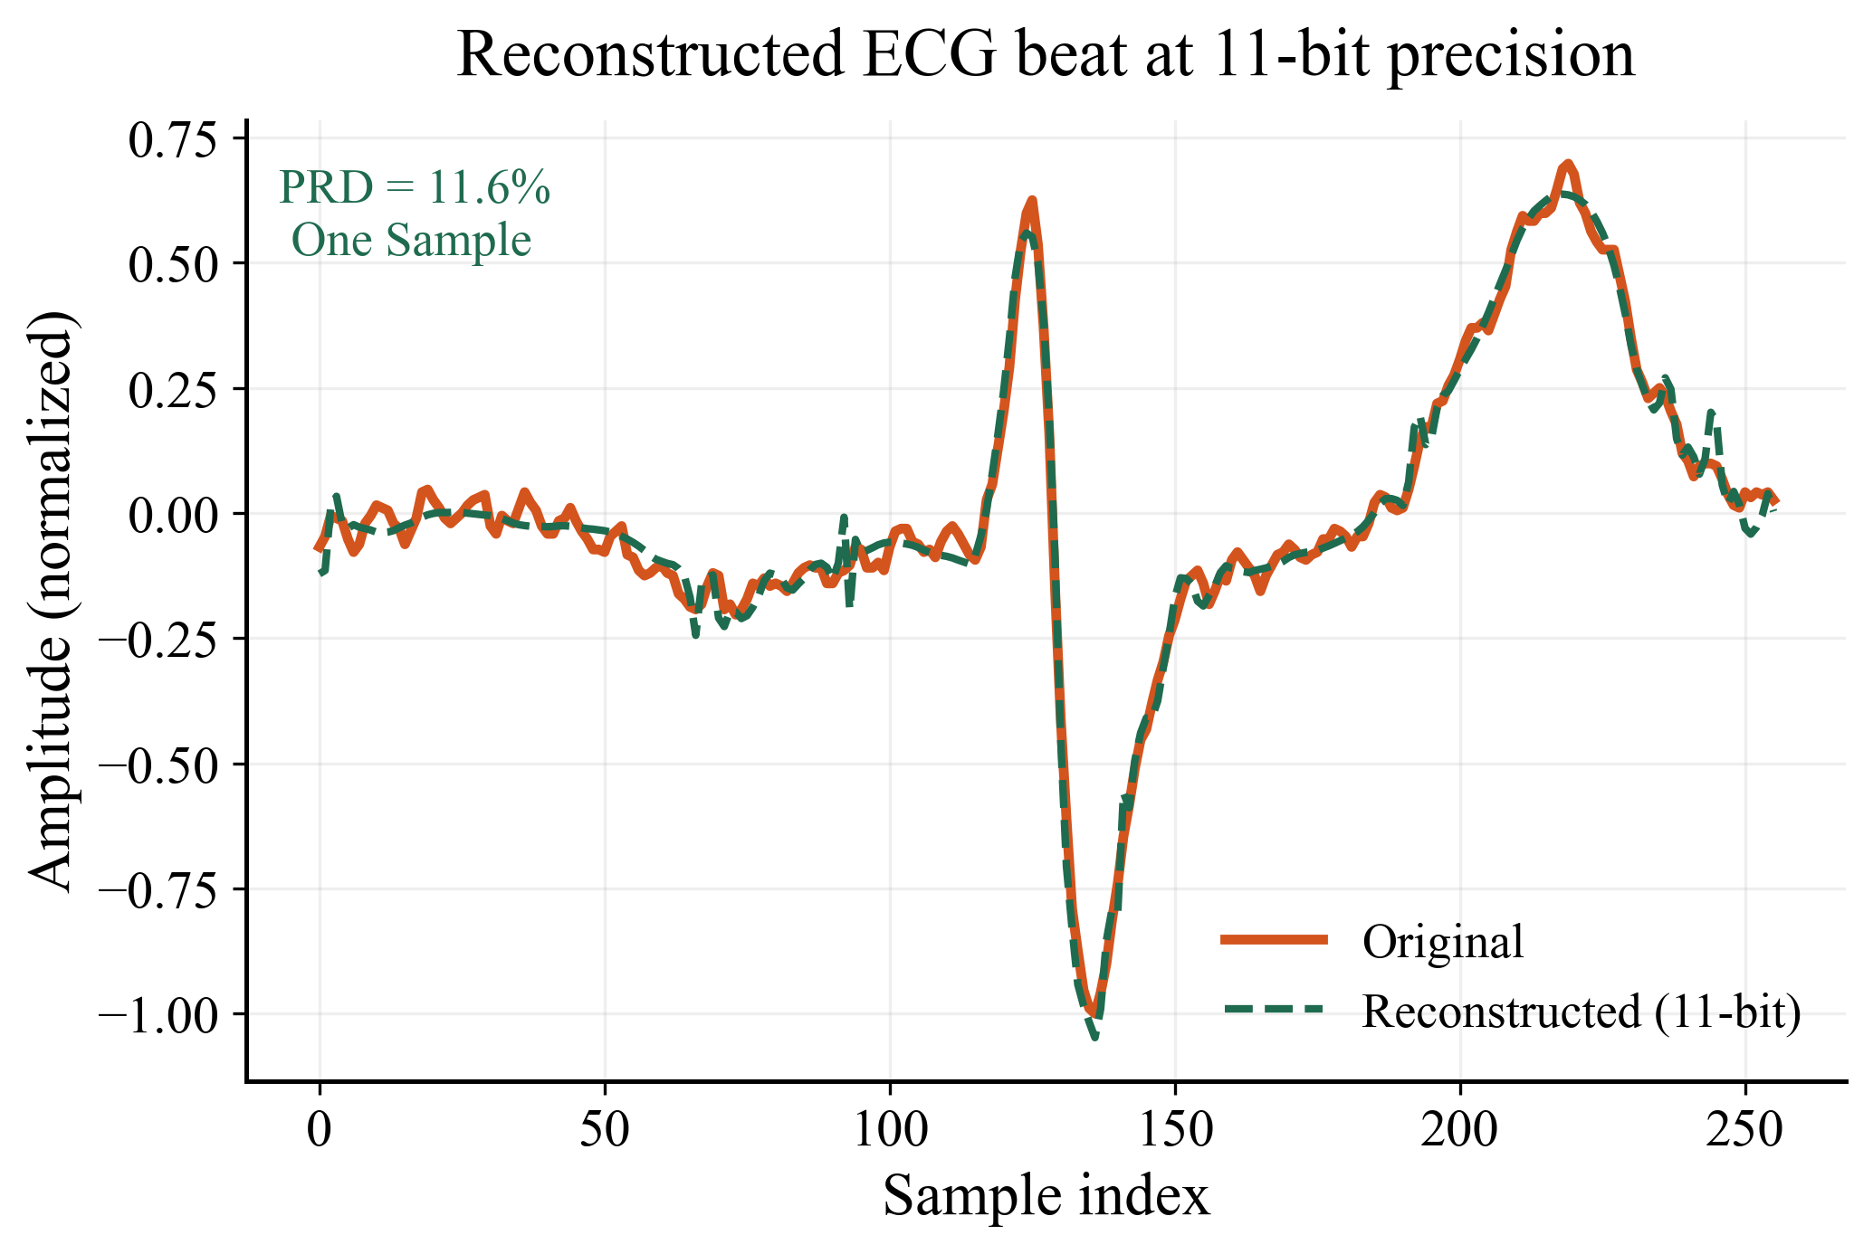
Fixed-Point OMP for ECG Compressed Sensing: a precision-resource study on the Zynq-7020
Brandon Carido, Michael Dang, Connor Machado
Thayer School of Engineering, Dartmouth College, Hanover, NH, USA
Abstract
Results
Conclusion
Compressed sensing reduces the data a wearable ECG sensor must acquire and transmit, but shifts the cost to signal recovery, which must run cheaply on embedded hardware. We implement a fixed-point Orthogonal Matching Pursuit (OMP) recovery engine for the Zynq-7020, partitioning the algorithm so the parallel correlation step maps to programmable logic while the sequential least-squares solve runs in software on the Cortex-A9. Using a Bernoulli ±1 measurement matrix at a 0.5 compression ratio (M = 128, N = 256) and a Daubechies-4 wavelet sparsifying basis, we characterize the design across MAC operand bit-widths on real MIT-BIH ECG data. Our central result is a precision–resource Pareto front: reconstruction error (PRD) is essentially flat from 16 bits down to 8 bits, then degrades sharply below 6 bits, identifying 11-bit arithmetic as the efficient operating point. Below 11 bits the multipliers consume LUT fabric; at 11 bits they map to the otherwise‑idle DSP array, freeing fabric for the AXI interface, control, and other system logic at no accuracy cost. Against a tuned Cortex-A9 software baseline (187 µs per correlation pass), the fixed-point engine achieves an estimated ~18× speedup on the correlation step.
We characterized a fixed-point OMP recovery engine for ECG compressed sensing across MAC precision on the Zynq-7020. The precision–resource Pareto front shows that 11-bit arithmetic sits at the efficient knee: it matches the reconstruction quality of full 16-bit precision while using a fraction of the resources, and only below 6 bits does quality collapse. At this operating point the correlation engine runs an estimated ~18× faster than a tuned Cortex-A9 software baseline. The db4 wavelet basis was essential — it more than halved reconstruction error versus the DCT by better representing the QRS transient. Together these results give a concrete recommendation for resource-constrained deployment: an 11-bit fixed-point correlation engine with software least-squares is the efficient design point for this class of recovery problem.
Architecture
Hardware/software partition. Correlation is parallel and dominates runtime — mapped to 32 parallel MACs in fabric. Least-squares is sequential and runs in software, where it's inexpensive.
Sparsifying basis. DCT poorly represents the QRS transient (~57% PRD). A db4 orthonormal wavelet captures it far better (~20% PRD) and avoids the dual-basis pitfalls of biorthogonal wavelets.
Parameterized precision. A single MAC_BITS generic lets the same engine synthesize at every operating point, enabling the bit-width sweep that drives the headline result.
Speed Up Results
~18× faster than tuned Cortex-A9 software
187 µs → 10.33 µs per correlation pass 11-bit, compute-only, single pass
Scope & Limitations
Reconstruction quality is bounded by the compression ratio. At M/N = 0.5, mean PRD is ~20%, above the <9% "very good“ literature threshold. This is a fundamental consequence of aggressive undersampling on morphologically complex ECG, not a precision artifact. Our contribution is the precision/resource characterization at a usable operating point, not meeting an absolute quality target.
The integrated system was not run end-to-end on hardware. The correlation engine and the software baseline were each validated independently; full PS↔PL integration over AXI was out of scope for the project timeframe. Reported latencies for the FPGA path are analytical (cycle counts × clock period) and synthesis-based, not measured on a live board.
Methodology
Compressed sensing model. Each 256-sample ECG window is sampled as y = Φs with a fixed Bernoulli ±1 matrix (M = 128, a 0.5 compression ratio). Recovery uses the effective dictionary D = Φψ (db4 wavelet basis, unit-norm atoms).
Sparsifying basis. A DCT basis recovered poorly (~57% PRD) — the QRS transient is not DCT-sparse, and undersampling amplifies the error. A db4 orthonormal wavelet captures it far better (~20% PRD) without the dual-basis complications of biorthogonal wavelets.
Hardware/software partition. OMP alternates a parallel correlation/argmax step (256 atoms × 128-tap products) with a sequential least-squares solve. We map the correlation engine to fabric (32 parallel MACs) and keep the least-squares solve in software on the Cortex-A9.
Bit-width sweep. A single MAC_BITS parameter lets one design synthesize at every precision. We sweep MAC_BITS ∈ {3–16}, measuring PRD in a bit-accurate fixed-point simulation on MIT-BIH data and DSP/LUT/BRAM from Vivado synthesis.
Baseline. A tuned C correlation pass (–O3, NEON, fast-math) runs on the Cortex-A9 at 667 MHz, timed on-chip over 1000 iterations.
Future Work
Close the integration loop. Connect the validated correlation engine to the software driver over AXI and measure true end-to-end recovery latency and energy on the Zynq, replacing the current analytical estimates.
Improve reconstruction quality. Raise the measurement ratio (M/N > 0.5) or adopt a learned/overcomplete ECG dictionary to push PRD toward the <9% clinical-quality range, and quantify the resulting resource cost on the same Pareto axes.
References
[1] J. A. Tropp and A. C. Gilbert, "Signal recovery from random measurements via orthogonal matching pursuit," IEEE Trans. Inf. Theory, vol. 53, no. 12, pp. 4655–4666, Dec. 2007.
[2] H. Rabah, A. Amira, B. K. Mohanty, S. Almaadeed, and P. K. Meher, "FPGA implementation of orthogonal matching pursuit for compressive sensing reconstruction," IEEE Trans. Very Large Scale Integr. (VLSI) Syst., vol. 23, no. 10, pp. 2209–2220, Oct. 2015.
[3] A. L. Goldberger et al., "PhysioBank, PhysioToolkit, and PhysioNet: Components of a new research resource for complex physiologic signals," Circulation, vol. 101, no. 23, pp. e215–e220, Jun. 2000.

