Slide 1
A new approach to link transport emissions and air quality: An intelligent transport system based on the control of traffic air pollution

Slide 2
Introduction
Road transport is major source of urban emissions and air pollution
Complex relationship between emissions and concentrations
Proposes integrated modeling framework to analyze management strategies
Links transportation, emission, and air quality models
Enables assessment of traffic impacts on air quality

Slide 3
Requirement Analysis
Identify environmental objectives for air quality
Establish emission reduction targets and concentration relationships
Monitor air quality
Collect input data on potential emission reduction measures
Conduct preliminary assessments to guide future air quality strategies

Slide 4
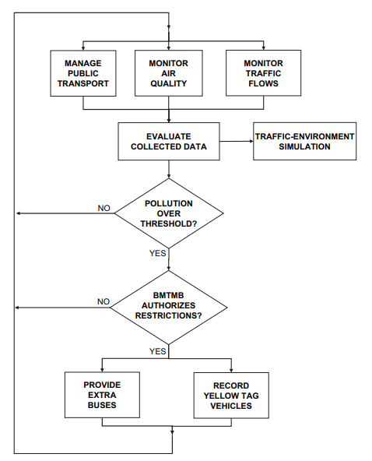
Decisional diagram of the Beijing ITS-TAP project

Slide 5
Main System Components
Data Centre for integrated system management with traffic-environmental modeling tool (TEM)
Network of air quality monitoring stations (AQMS)
Network of private traffic monitoring stations (TMS)
Public Transport Management Subsystem (PTMS)
TEM runs air quality calculations to identify strategies to manage private and public transport using two simulation tools

Slide 6
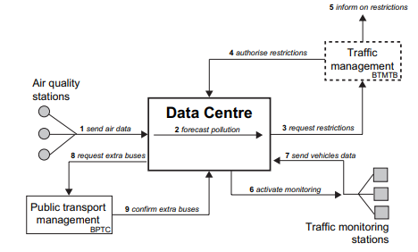
Action scheme of the Beijing ITS-TAP project.

Slide 7
System Implementation
Air quality and traffic flow measurements input transportation and dispersion models in TEM
Transportation model calculates traffic emissions, dispersion model calculates concentrations
If pollution exceeds targets, areas can be restricted for polluting vehicles (low emission zones)
Traffic monitoring stations control restricted areas, public transit provides alternatives
System tracks data on restrictions to study relationship between air pollution and traffic

Slide 8
Integrated System
Set up transportation and dispersion models to simulate scenarios and calculate emissions and air quality
Measure pollutant concentrations in ambient air
Measure traffic-generated emissions
Monitor traffic sources
Manage public transportation
Integrated system links traffic and air quality measurements through modeling modules to automate assessment

Slide 9
Thank You

