Slide 1
An integrated simulation system for traffic induced air pollution

Slide 2
Purpose/Motivation
Paper aims to develop integrated simulation system for traffic, emissions, and air pollution
Motivated by growing traffic and emissions decreasing urban air quality
Traffic is major source of emissions in cities
Current methods can't simulate management strategies
Proposes coupling models for traffic, emissions, and air quality

Slide 3
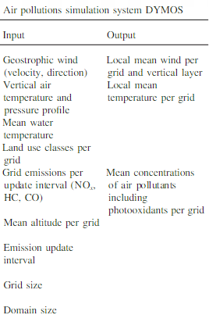
Air Pollution Transport Model DYMOS
Integrates mesoscale atmospheric model REWIMET
Adds atmospheric chemistry model CBM-IV
REWIMET models transport and dispersion over urban scales (movement)
CBM-IV models ozone and photochemical reactions (chemistry)
Parallel implementation enables operational use

Slide 4
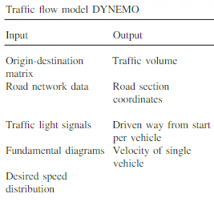
Traffic Flow Model DYNEMO
Incorporates mesoscopic traffic model DYNEMO
Combines microscopic vehicle interactions and macroscopic traffic flow
Models individual vehicle speeds and congestion propagation
Implemented in parallel for computational performance
Provides input to emission model

Slide 5
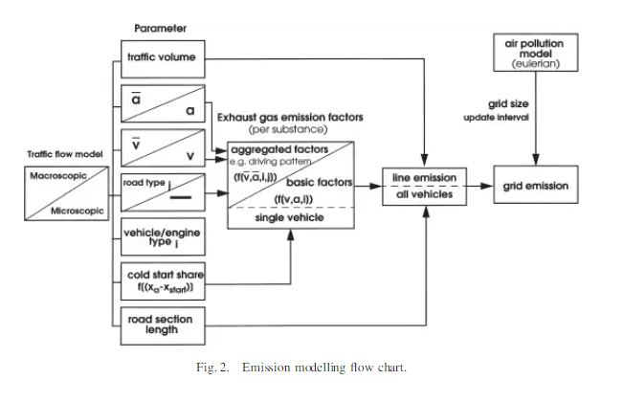
Traffic Emission Modelling
Emission model based on vehicle type and activities
Uses measurements to estimate emissions for driving conditions
Applies standard driving cycles or empirical driving patterns
Adds cold start emissions using test data
Integrated directly into dynamic traffic model

Slide 6
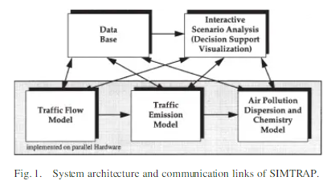
Sub-models to Final Model
Integrates the models into a coupled system
Traffic model DYNEMO feeds emission model
Emission model feeds air quality model DYMOS
Enables dynamic simulation of traffic emissions
Implemented on distributed high performance computing

Slide 7
Simulation run details
Demonstrates system for Berlin/Brandenburg region
Models 5 million people over 150 x 150 km domain
Traffic model includes major highways and city roads
Shows dynamic CO emissions across road network
Air quality model predicts ozone concentrations

Slide 8
Result Accuracy
Validation against monitoring networks
Results match well with field measurements
Demonstrates feasibility of integrated modeling
Enables testing traffic management strategies
Advances state-of-the-art in dynamic traffic emissions modeling

Slide 9
Achievements
Novel integrated modeling system coupling models for traffic, emissions, and air pollution
Incorporates state-of-the-art mesoscopic traffic model and atmospheric chemistry model
Implemented on parallel computing for operational use
Demonstrated for Berlin region with good validation
Provides platform for testing traffic and emissions management strategies

Slide 10
Sub-models to Model
Integrates the models into a coupled system
Traffic model DYNEMO feeds emission model
Emission model feeds air quality model DYMOS
Enables dynamic simulation of traffic emissions
Implemented on distributed high performance computing

