Slide 1
Lab2 Image classification

Slide 2
Pytorch tutorial
https://youtu.be/MrnQ5LgcNBI
https://youtu.be/QAY6sfca6wI
Pytorch version is 0.4 in this tutorial
Official tutorial
https://pytorch.org/tutorials/
莫凡
https://www.youtube.com/watch?v=lAaCeiqE6CE&list=PLXO45tsB95cJxT0mL0P3-G0rBcLSvVkKH
You can only use pytorch in this Lab!!

Slide 3
Lab2 Commands
Decompress the files with command
tar xvf ~dl2023f_ta1/Lab02.tar
Environment (every time before opening jupyter)
source /home/NFS/opt/scripts/load_ml2023f.sh

Slide 4

Dataset – Food Classification
Classify 4 types of food
Baked potato
Crispy chicken
Donut
Fries

Slide 5
Tasks in this lab
1. In “Lab2_ResNet18.ipynb”
Build Resnet18 by yourself
(You can’t call the model directly with this command)
Achieve at least 75% validation accuracy
(put the screenshot in your report)

Slide 6
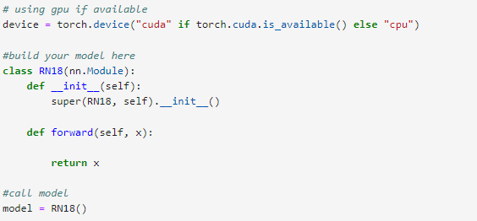
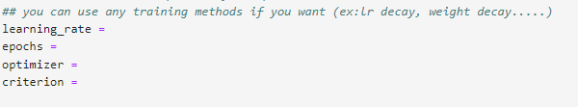
Code

Slide 7
Tasks in this lab
2. In “Lab2_advance.ipynb”
Do your best to improve accuracy
Calling different models with pretrained weight is allowed
Basically any methods you learn are allowed
(Exception: Label test data yourself or find more training data online)
Upload your result to Kaggle
Make graphs with Tensorboard

Slide 8

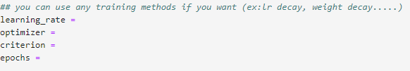


Code

Slide 9
Tasks in this lab
3. Write a report
Required
Compare resnet18 with and without pretrained
Screenshot of task1 (>75% accuracy)
In task2, make graphs for learning rate schedule, weights and gradients (With Tensorboard)

Slide 10

Tensorboard
https://pytorch.org/docs/stable/tensorboard.html
You can specify your output directory in SummaryWriter(“dir”)
(Default: runs/)

Slide 11
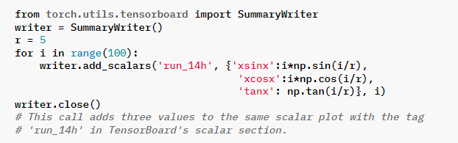
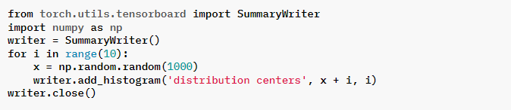
Tensorboard
Some examples on pytorch.org:

Slide 12
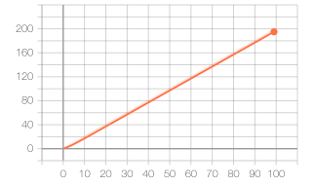
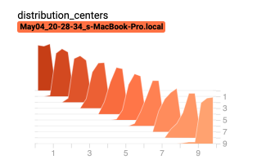
Tensorboard
After training, show the result by:
$ srun --gres=gpu:1 tensorboard --logdir runs/ --bind_all
(Run it at terminal)

Slide 13
Score
Validation accuracy in Task 1 >75% (40%)
Report (30%)
Performance Rank in Kaggle (30%)

Slide 14
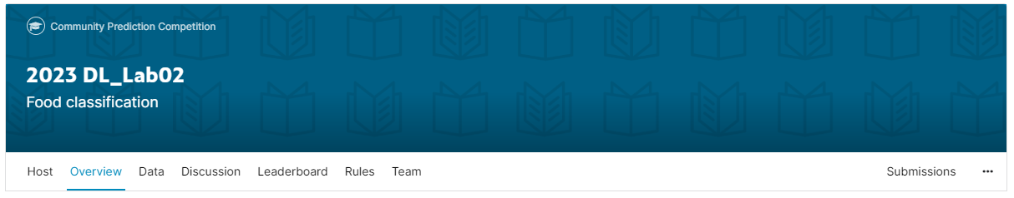
Kaggle
Create Kaggle account first
Team name should be your student ID
Competition URL:
https://www.kaggle.com/t/caab4a83da794c0e9cdef73a3a6cf503

Slide 15
Upload to Kaggle
Prediction
Write the prediction to csv file (ID_result.csv)
Two column: ID,label
Evaluation
Categorization accuracy
Upload to Kaggle

Slide 16
Reminder
Submit Deadline : 2 week (2023/10/31 11:59 PM)
Upload 3 files to new e3
Lab2_advance.ipynb
Lab2_ResNet18.ipynb
StudentID_report.pdf (example: 311555555_report.pdf)
Submit your result to Kaggle

Slide 17
Notice!!!
Change your team name to your student ID
If TA can not find your ID, you will lose 20% of score in this lab
You only have 20 times maximum daily submissions

Slide 18
Supplement: ResNet18
paper
Deep Residual Learning for Image Recognition
https://openaccess.thecvf.com/content_cvpr_2016/papers/He_Deep_Residual_Learning_CVPR_2016_paper.pdf

Slide 19
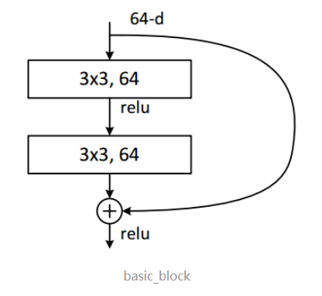
Supplement: ResNet18
Basic Residual Block

Slide 20
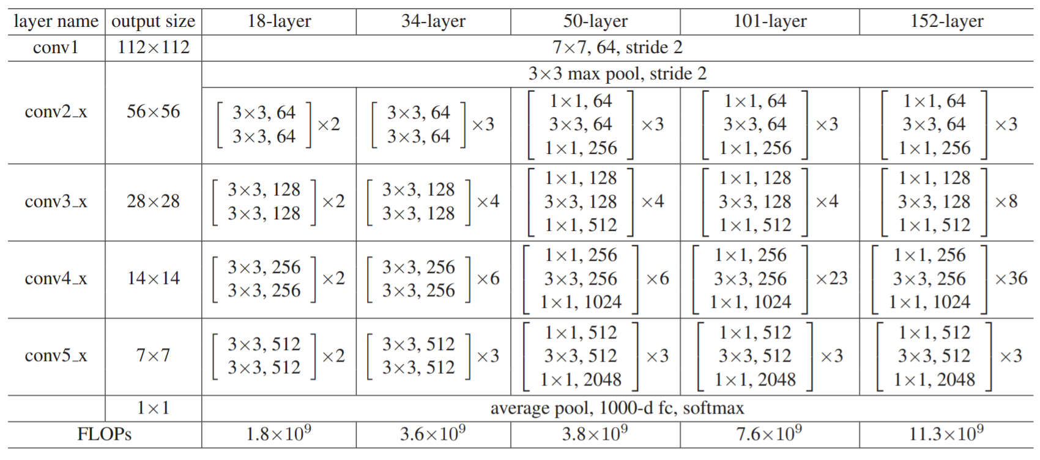
Supplement: ResNet18
Architecture

