Slide 1
DIP 2023 final project check point
Group 39
Group member: 109511207蔡宗儒、109511234 蔡鎧宇

Slide 2
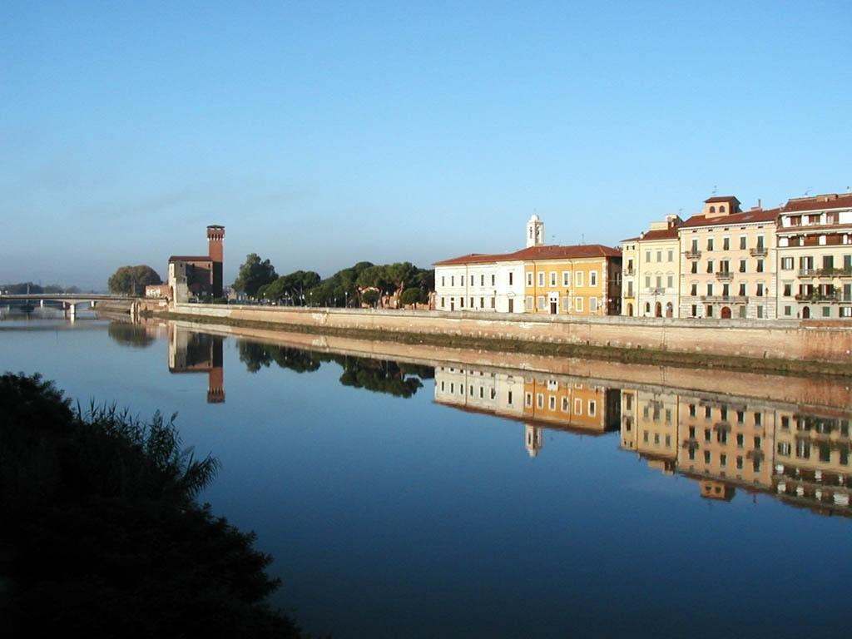
Probable Problem
Reflection
The sky color and the water color are similar
Mist might cause blurred boundaries

Slide 3
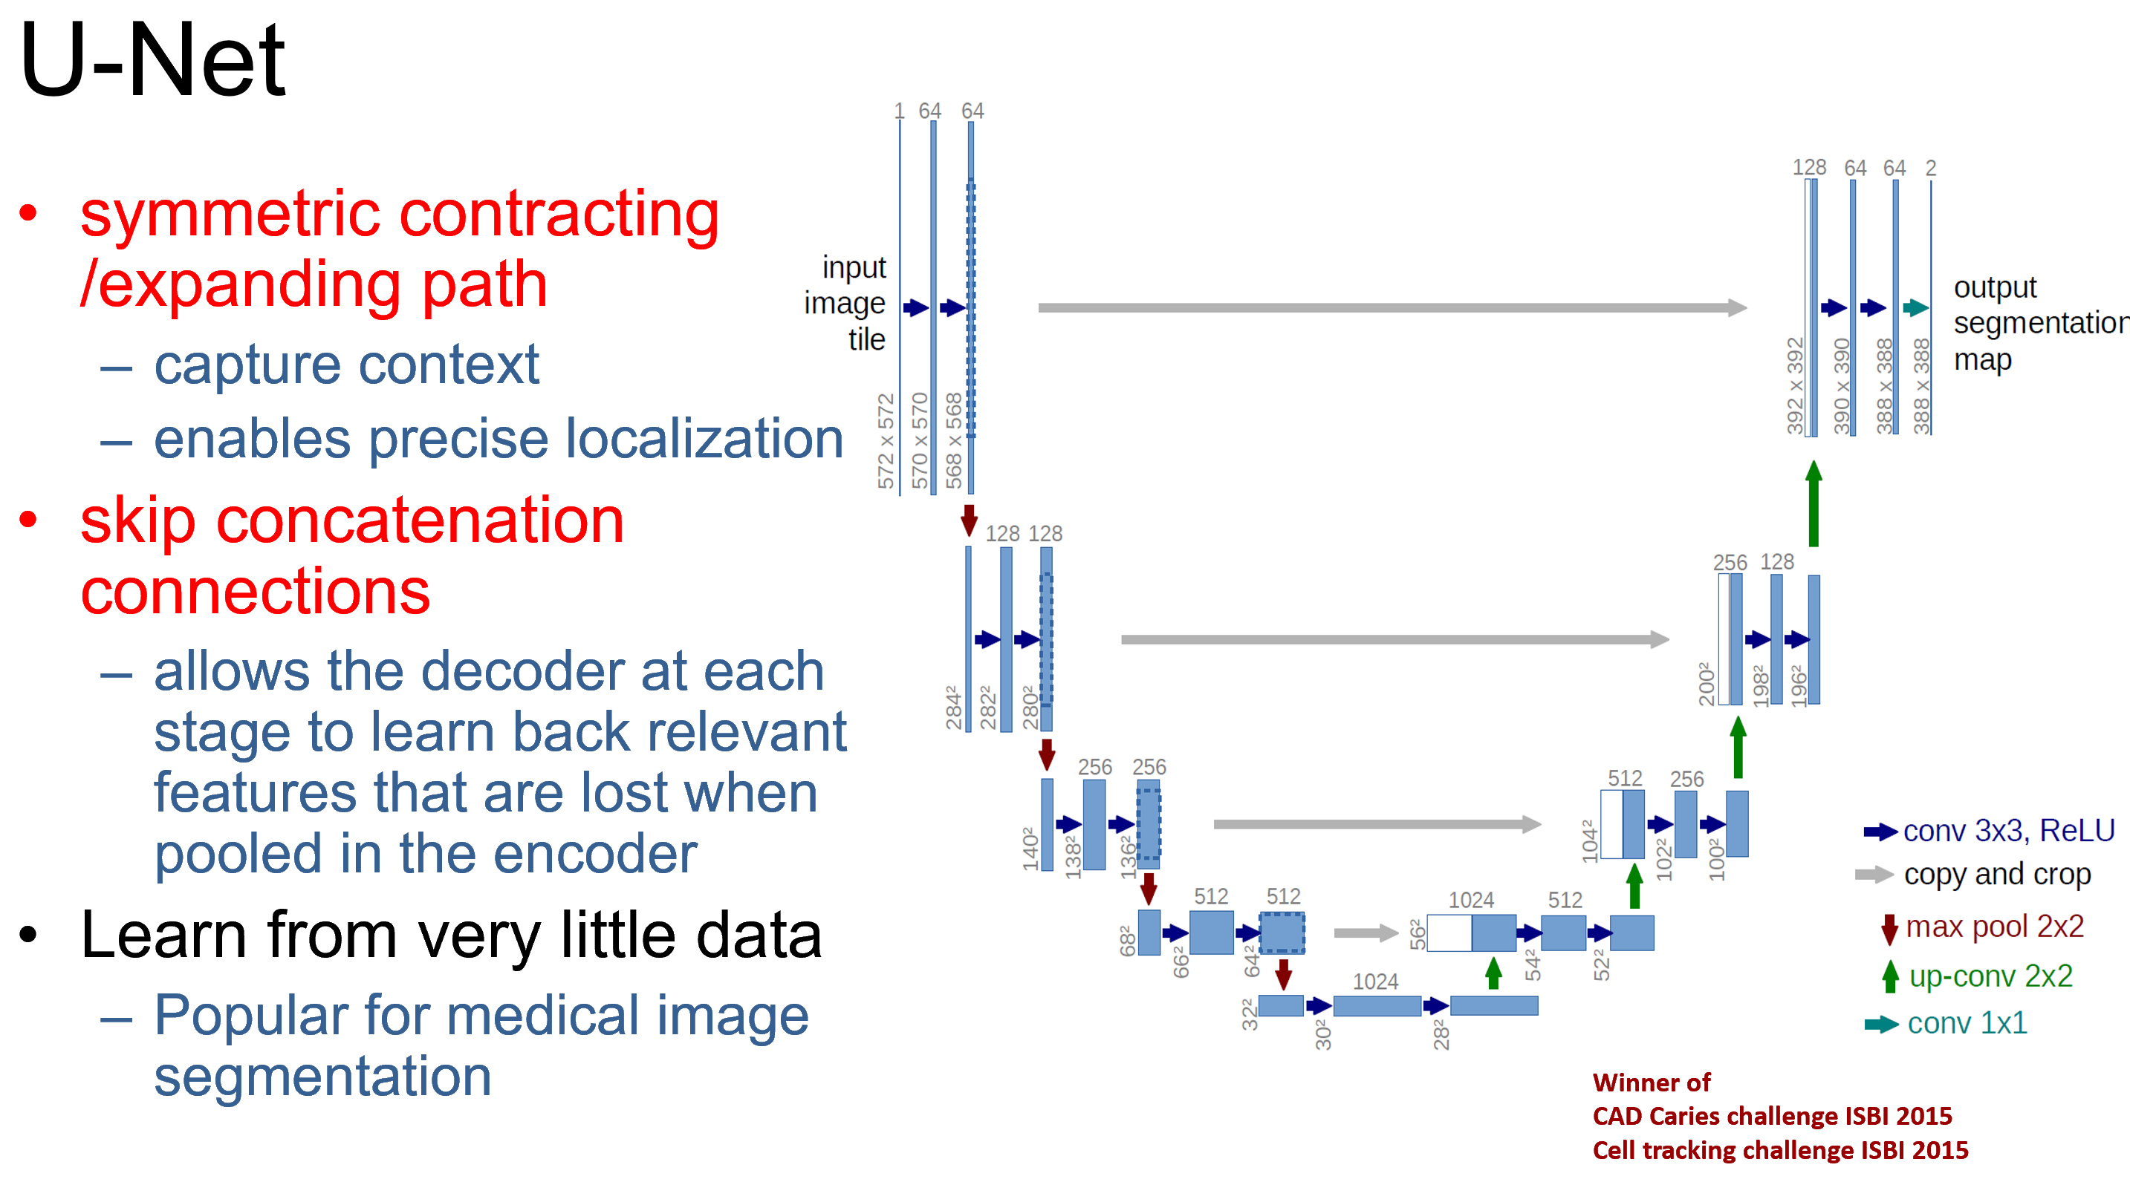
Deep Learning Based Method
U-Net
HRNet
FCN

