Slide 1
DIP Final Project Presentation
Group 39
Group member: 109511207蔡宗儒、109511234 蔡鎧宇

Slide 2
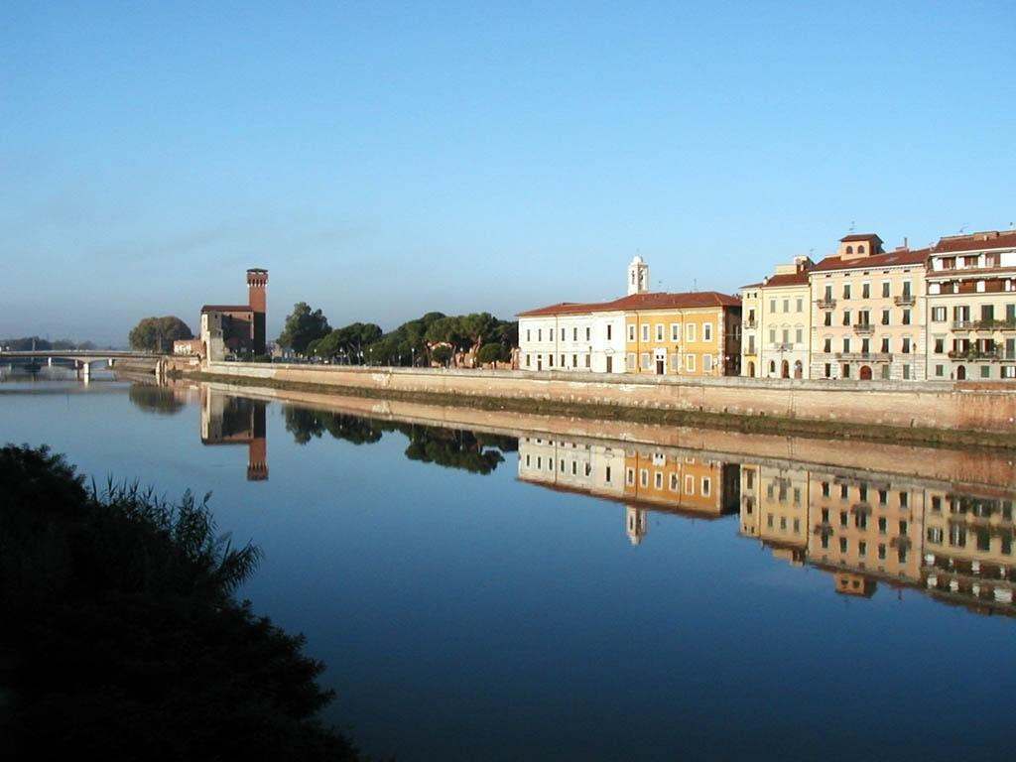
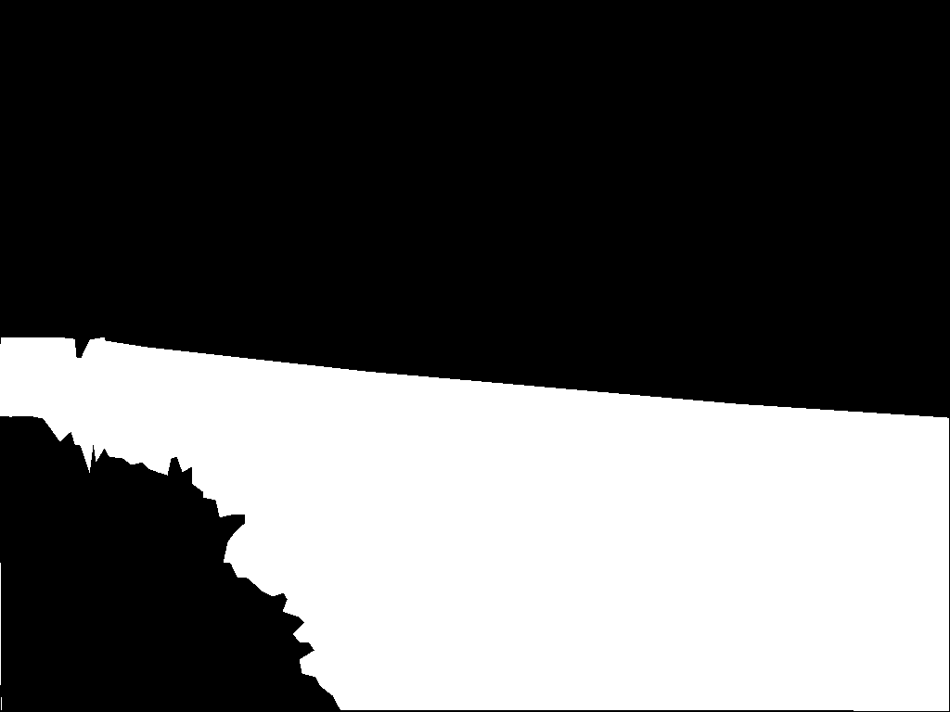
Probable Problem
Reflection

Slide 3
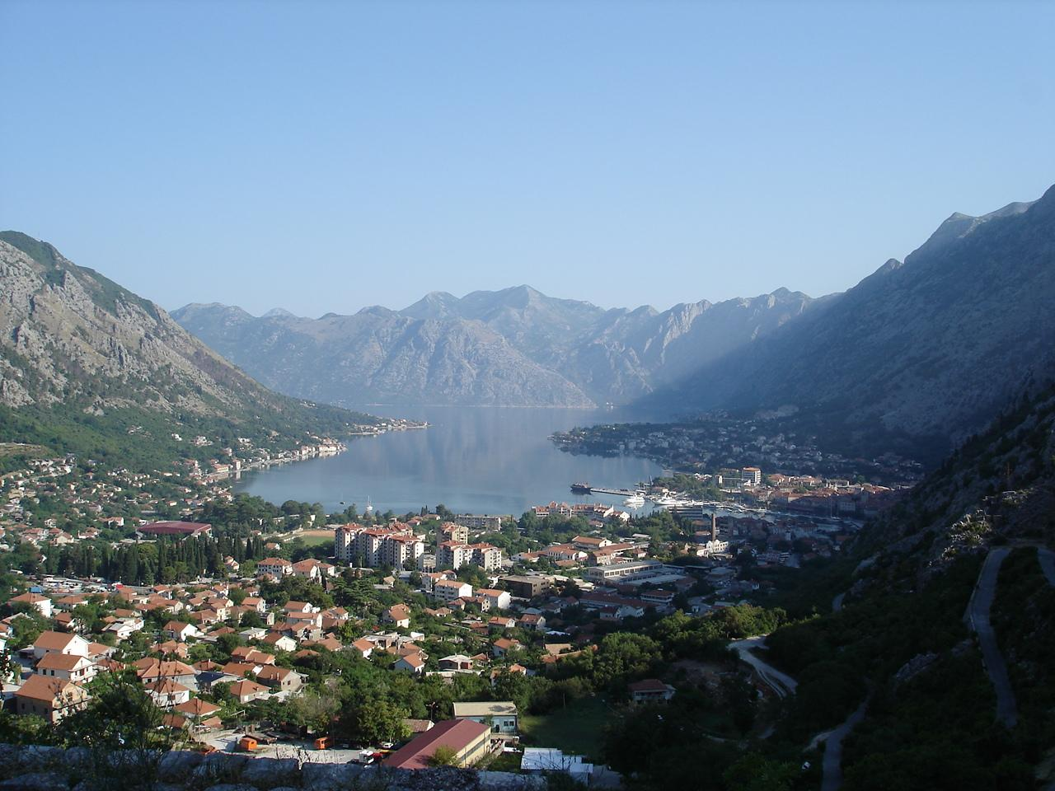

Probable Problem
Similar sky color and the water color

Slide 4
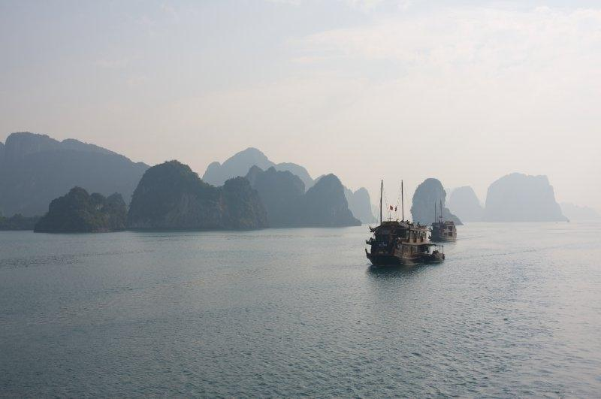

Probable Problem
Mist might cause blurred boundaries

Slide 5
Deep Learning Based Method
U-Net
U-Net++
Linknet
FPN

Slide 6
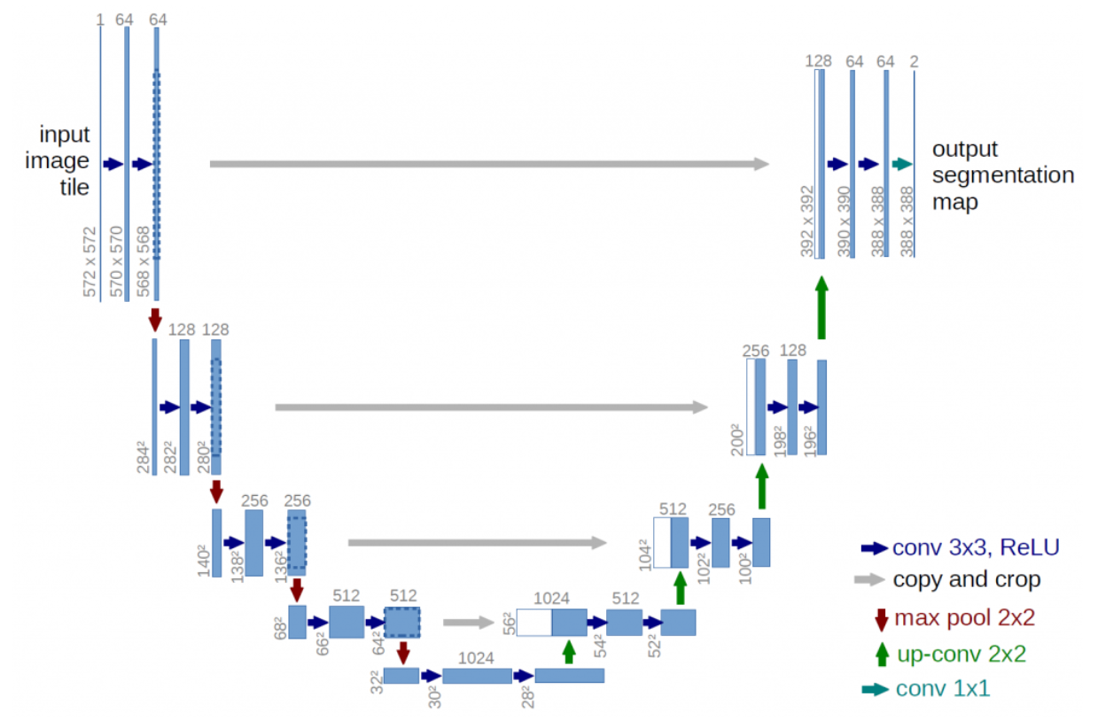
Deep Learning Based Method
U-Net

Slide 7
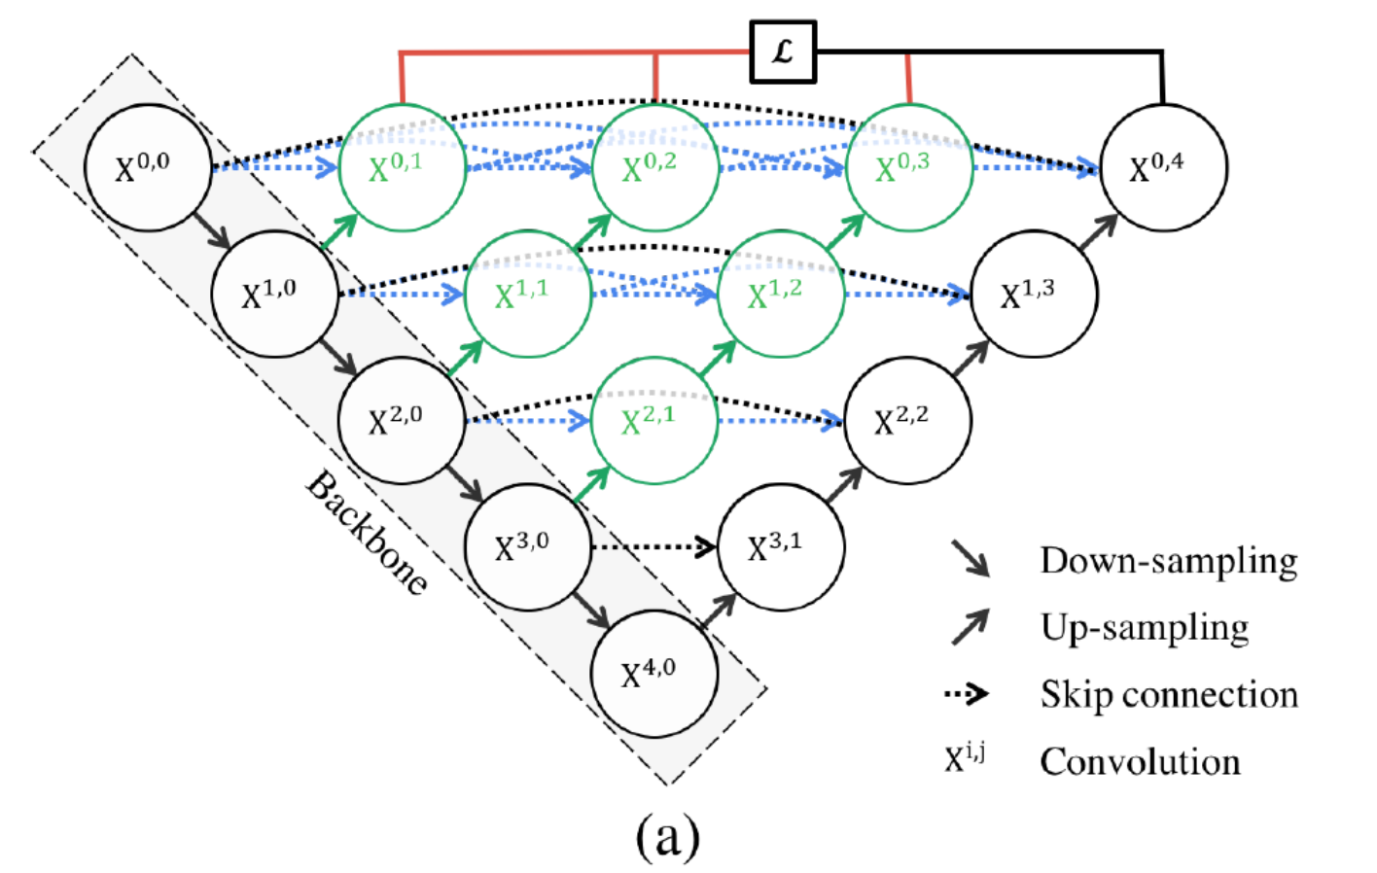
Deep Learning Based Method
U-Net++

Slide 8
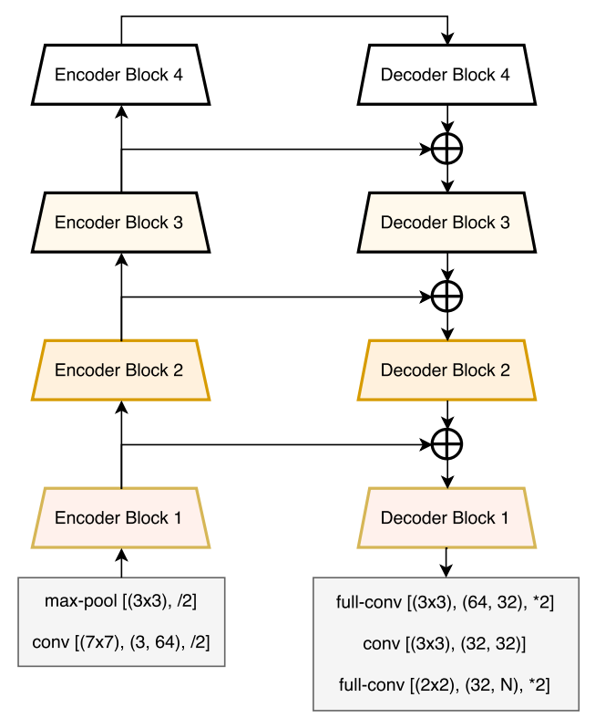
Deep Learning Based Method
Linknet

Slide 9
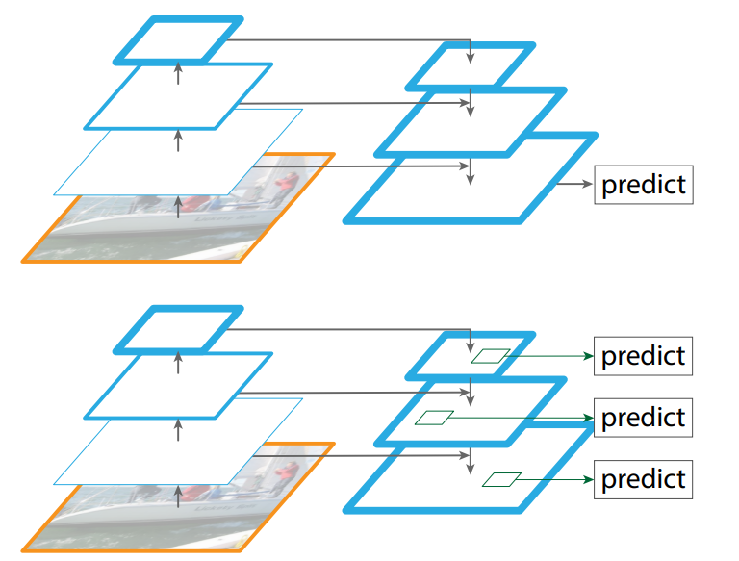
Deep Learning Based Method
FPN

Slide 10
Comparison Of Different Model
Decoder | Improvement
Unet | 提出在upsample和downsample的feature map中加入residual以傳遞位置資訊。
Unet++ | 增加upsample和residual中的conv node數量，以增加模型的複雜度。
Linknet | 使用較輕量化的backbone，並簡化Unet中的pooling層以更好的傳遞梯度優化訓練。
FPN | 在不同大小的feature map都預測一個mask，讓模型能取得在不同大小上不同強度的資訊。

Slide 11
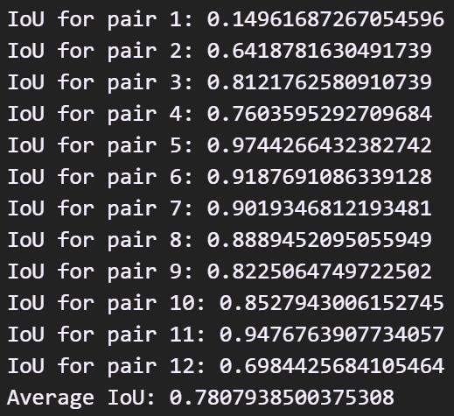
Result
Model: FPN
Backbone: moblienet_v2
avgIoU: 0.78079

Slide 12
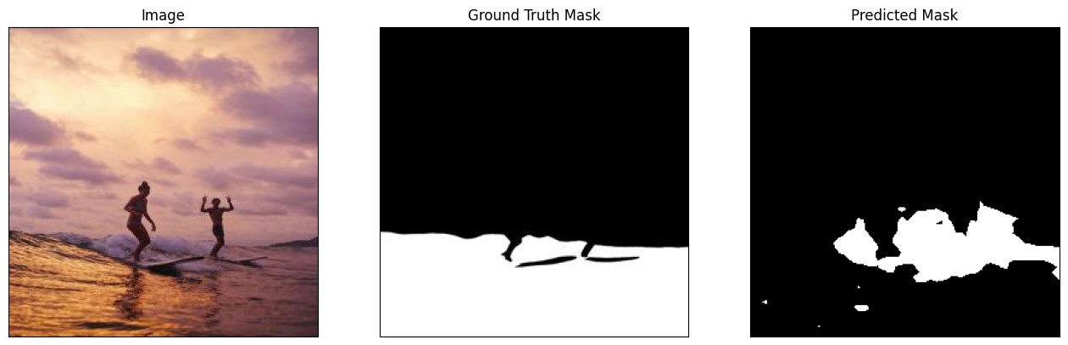
Discussion

Slide 13
Performance On Different Model

Slide 14
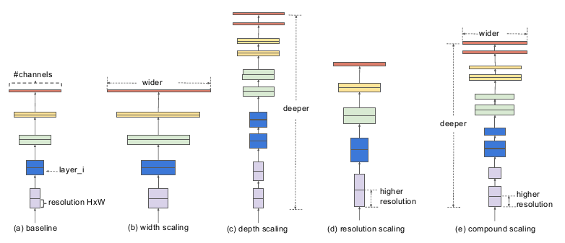
Comparison of Different Encoder
Best encoder: efficientnet-b3
Encoder | Params(M)
efficientnet-b3 | 10
mobilenet_v2 | 2
vgg11 | 9

Slide 15
Conclusion
Model | Encoder | IOU
FPN | efficientnet-b3 | 0.83287
 | mobilenet_v2 | 0.78079
 | vgg11 | 0.81569
Linknet | efficientnet-b3 | 0.82386
 | mobilenet_v2 | 0.79218
 | vgg11 | 0.77852
Unet | efficientnet-b3 | 0.82859
 | mobilenet_v2 | 0.75932
 | vgg11 | 0.78720
Unet++ | efficientnet-b3 | 0.81038
 | mobilenet_v2 | 0.76806
 | vgg11 | 0.81770

Slide 16
Division of Task
蔡宗儒(109511207)- finish finetune code、make presentation ppt、 train half of model
蔡鎧宇(109511234)- finish pretrained code、make report、train half of model

Slide 17
Reference
[1] Ronneberger, O., Fischer, P., & Brox, T. (2015). U-net: Convolutional networks for biomedical image segmentation. In Medical Image Computing and Computer-Assisted Intervention–MICCAI 2015: 18th International Conference, Munich, Germany, October 5-9, 2015, Proceedings, Part III 18 (pp. 234-241). Springer International Publishing.
[2] Zhou, Z., Rahman Siddiquee, M. M., Tajbakhsh, N., & Liang, J. (2018). Unet++: A nested u-net architecture for medical image segmentation. In Deep Learning in Medical Image Analysis and Multimodal Learning for Clinical Decision Support: 4th International Workshop, DLMIA 2018, and 8th International Workshop, ML-CDS 2018, Held in Conjunction with MICCAI 2018, Granada, Spain, September 20, 2018, Proceedings 4 (pp. 3-11). Springer International Publishing.
[3] Chaurasia, A., & Culurciello, E. (2017, December). Linknet: Exploiting encoder representations for efficient semantic segmentation. In 2017 IEEE visual communications and image processing (VCIP) (pp. 1-4). IEEE.
[4] Lin, T. Y., Dollár, P., Girshick, R., He, K., Hariharan, B., & Belongie, S. (2017). Feature pyramid networks for object detection. In Proceedings of the IEEE conference on computer vision and pattern recognition (pp. 2117-2125).
[5] Sandler, M., Howard, A., Zhu, M., Zhmoginov, A., & Chen, L. C. (2018). Mobilenetv2: Inverted residuals and linear bottlenecks. In Proceedings of the IEEE conference on computer vision and pattern recognition (pp. 4510-4520).
[6] Tan, M., & Le, Q. (2019, May). Efficientnet: Rethinking model scaling for convolutional neural networks. In International conference on machine learning (pp. 6105-6114). PMLR.
[7] Simonyan, K., & Zisserman, A. (2014). Very deep convolutional networks for large-scale image recognition. arXiv preprint arXiv:1409.1556.
[8] https://github.com/erdemunal35/WaterSegNets
[9] https://github.com/qubvel/segmentation_models.pytorch

