Slide 1
R
Programming

Slide 2
R Matrix
In R, a two-dimensional rectangular data set is known as a matrix.
A matrix is created with the help of the vector input to the matrix function.
On R matrices, we can perform addition, subtraction, multiplication, and division operation.

Slide 3
Access Matrix Items
We can access the items by using [ ] brackets.
The first number "m" in the bracket specifies the row-position, while the second number "n" specifies the column-position
Ex: thismatrix[1, 2]

Slide 4
contd..
The whole row can be accessed if you specify a comma after the number in the bracket
Thismatrix[2,]
Thismatrix[,2]

Slide 5
Access More Than One Row/Column
More than one row can be accessed if you use the c() function.
thismatrix[c(1,2),]
thismatrix[,c(1,2)]

Slide 6
Add Rows and Columns
Use the cbind() function to add additional columns in a Matrix
Use the rbind() function to add additional rows in a Matrix

Slide 7
Remove Rows and Columns
Use the c() function to remove rows and columns in a Matrix

Slide 8
Check if an Item Exists
To find out if a specified item is present in a matrix, use the %in% operator

Slide 9
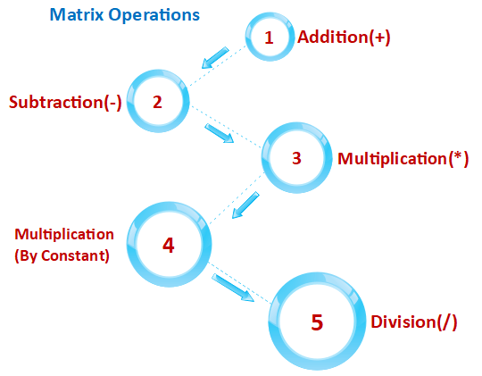
Matrix operations

Slide 10
Applications of matrix
In geology, Matrices takes surveys and plot graphs, statistics, and used to study in different fields.
Matrix is the representation method which helps in plotting common survey things.
In robotics and automation, Matrices have the topmost elements for the robot movements.
Matrices are mainly used in calculating the gross domestic products in Economics, and it also helps in calculating the capability of goods and products.
In computer-based application, matrices play a crucial role in the creation of realistic seeming motion.

Slide 11
R factor
Factors are R’s way of storing categorical information, like ethnicity or eye color. To make a factor, pass an atomic vector into the factor function.
R will recode the data in the vector as integers and store the results in an integer vector.
R will also add a levels attribute to the integer, which contains a set of labels for displaying the factor values,

Slide 12
Create a factor
In the first step, we create a vector.
Next step is to convert the vector into a factor,
factor_data<- factor(vector)

Slide 13
Accessing components of factor
Like vectors, we can access the components of factors.
The process of accessing components of factor is much more similar to the vectors.
We can access the element with the help of the indexing method or using logical vectors.

Slide 14
Modification of factor
Like data frames, R allows us to modify the factor.
We can modify the value of a factor by simply re-assigning it.
In R, we cannot choose values outside of its predefined levels means we cannot insert value if it's level is not present on it.

Slide 15
R Data Frames
Data frames are the two-dimensional version of a list.
They are the most useful storage structure for data analysis, and they provide an ideal way to store an entire
Dataset.
data frame is R’s equivalent to the Excel spreadsheet because it stores data in a similar format.
Data frames group vectors together into a two-dimensional table. Each vector becomes a column in the table.
A matrix can contain one type of data, but a data frame can contain different data types such as numeric, character, factor, etc.

Slide 16
Data Frames
The columns name should be non-empty.
The rows name should be unique.
The data which is stored in a data frame can be a factor, numeric, or character type.
Each column contains the same number of data items.

Slide 17
How to create Data Frame
In R, the data frames are created with the help of frame() function of data.
This function contains the vectors of any type such as numeric, character, or integer.

Slide 18
Functions in Data Frame
R provides an in-build function called str() which returns the data with its complete structure.
R provides the summary() function to extract the statistical summary and nature of the data.
dim() function to find the amount of rows and columns in a Data Frame
ncol() function to find the number of columns and nrow() to find the number of rows
length() function to find the number of columns in a Data Frame

Slide 19
Access Items
We can use single brackets [ ], double brackets [[ ]] or $ to access columns from a data frame.

Slide 20
Modification in Data Frame
Add a column by adding a column vector with the help of a new column name using cbind() function.
Add rows by adding new rows in the same structure as the existing dataframe and using rbind() function
Delete the columns by assigning a NULL value to them.
Delete the rows by reassignment to them.

Slide 21
Statistics in R
Statistics is the science of analyzing, reviewing and conclude data.
The R language was developed by two statisticians.
It has many built-in functionalities, in addition to libraries for the exact purpose of statistical analysis.

Slide 22
R Data Set
A data set is a collection of data, often presented in a table.
There is a popular built-in data set in R called "mtcars" (Motor Trend Car Road Tests), which is retrieved from the 1974 Motor Trend US Magazine.

Slide 23
Outliers
Max and min can also be used to detect outliers. An outlier is a data point that differs from rest of the observations.

Slide 24
Mean, Median, and Mode
Mean - The average value : To calculate the average value (mean) of a variable from the mtcars data set, find the sum of all values, and divide the sum by the number of values.
Median - The middle value : The median value is the value in the middle, after you have sorted all the values.
Mode - The most common value : The median value is the value in the middle, after you have sorted all the values.

Slide 25
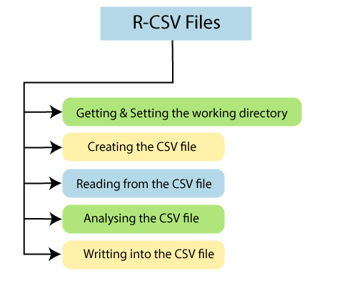
R CSV Files

Slide 26
A Comma-Separated Values (CSV) file is a plain text file which contains a list of data.
These files can sometimes be called character-separated values or comma-delimited files.

Slide 27
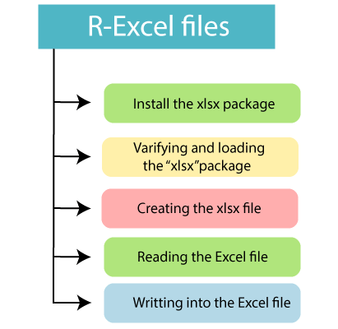
R Excel file
The xlsx is a file extension of a spreadsheet file format which was created by Microsoft to work with Microsoft Excel.
R allows us to read data directly from these files by providing some excel specific packages.

Slide 28
Install xlsx Package
Our primary task is to install "xlsx" package with the help of install.package command.
install.packages("package name")
install.packages("xlsx")

Slide 29
Installing exel package
#Installing xlsx package
install.packages("xlsx")
# Verifying the package is installed.
any(grepl("xlsx",installed.packages()))
# Loading the library into R workspace.
library("xlsx")

Slide 30
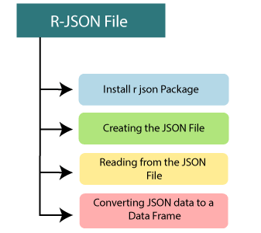
R JSON File

Slide 31
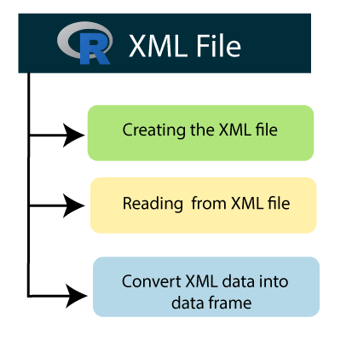
R XML File

