Slide 1
Decision Making

Slide 2

Reference
Artificial Intelligence for Games, 2nd Ed 2009
By Ian Millington
Chapter 5

Slide 3
Outline
Decision Trees
State Machines
Behavior Trees

Slide 4
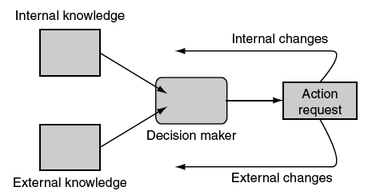
What is Decision Making?
The ability of a character to decide what to do
  Most of gamers think game AI is all about decision making
Notes:
External knowledge is the information that a character knows about the game environment around it: the position of other characters, the layout of the level, whether a
switch has been thrown, the direction that a noise is coming from, and so on.
Internal knowledge is information about the character’s internal state or thought processes: its health, its ultimate goals, what it was doing a couple of seconds ago, and so on.
Actions:
1- External that will change the external state of the character (such as throwing a switch, firing a weapon, moving into a room)
2- Internal that only affect the internal state. Changes to the internal state are less obvious in game applications but are significant in some decision making algorithms. They might correspond to changing the character’s opinion of the player, changing its emotional state, or changing its ultimate goal.

Slide 5
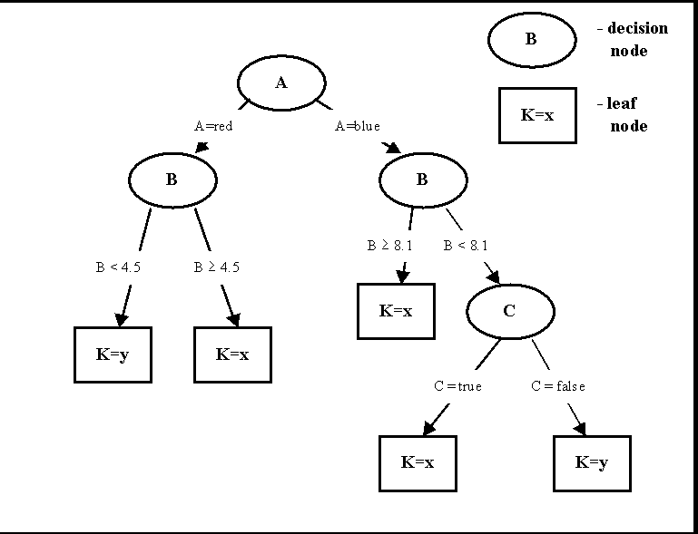
Decision Trees
One of the famous decision making mechanisms
Advantages:
  Fast, easily implemented, modular, and simple to understand.
Applications:
  To control characters such as animation control.

Slide 6
Decision Trees:
Problem Statement
Given a set of knowledge, we need to generate a corresponding action from a set of possible actions.
  We need a method that can easily group lots of inputs together under one action, while allowing the input values that are significant to control the output.

Slide 7
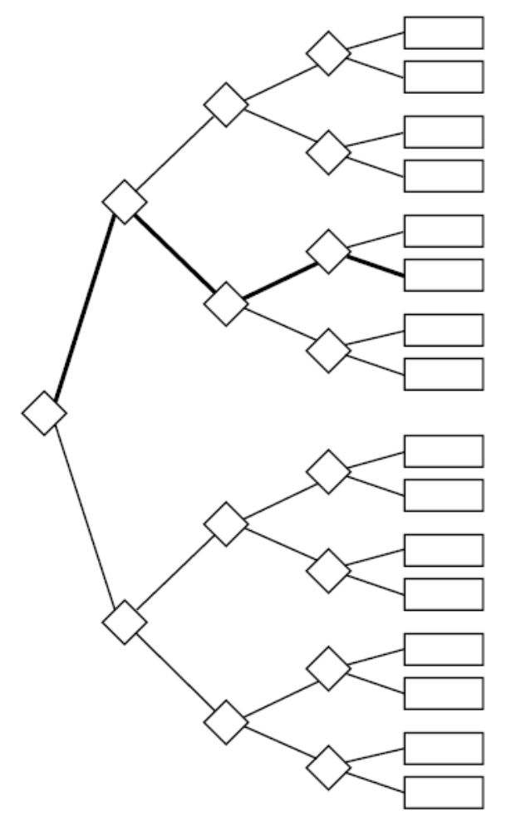
Decision Trees:
Algorithm
A decision tree is made up of connected decision points.
The tree has a starting decision, its root.
For each decision, starting from the root, one of a set of ongoing options is chosen.

Slide 8
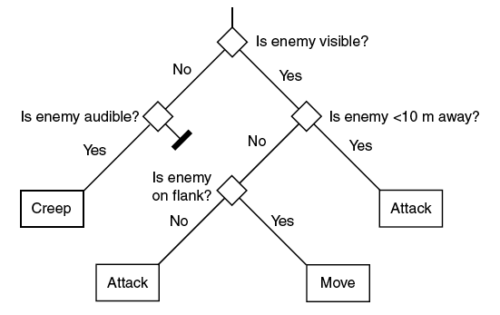
Decision Trees:
Example

Slide 9
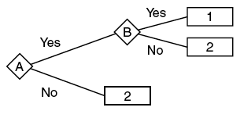
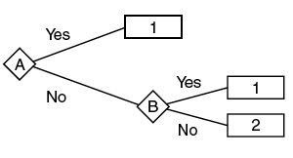
Decision Trees:
Combinations of Decisions
If A AND B then Action 1, else Action 2
If A OR B then Action 1, else Action 2

Slide 10
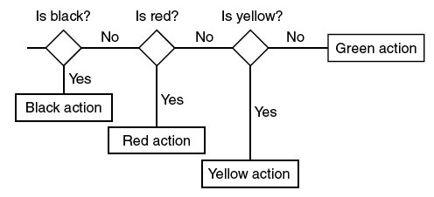
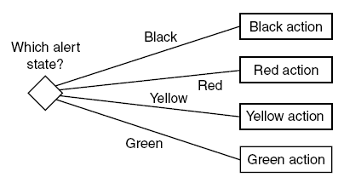
Decision Trees:
Implementations Examples

Slide 11
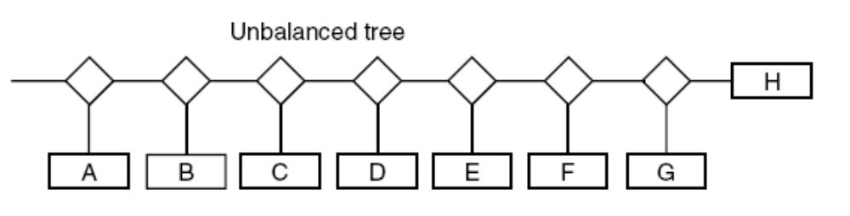
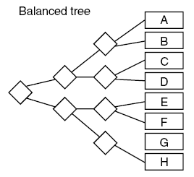
Decision Trees:
Implementations Examples (cont.)
Balanced tree
Issue to consider:
  Execution time
Question: Which method is better?

Slide 12
Decision Trees:
Debugging Issue
It is possible that some of the branches will never be tested during the development cycle

Slide 13
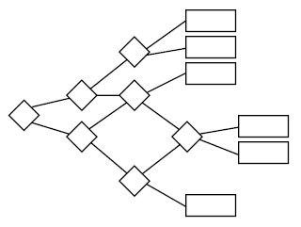
Decision Trees:
Merging Branches

Slide 14
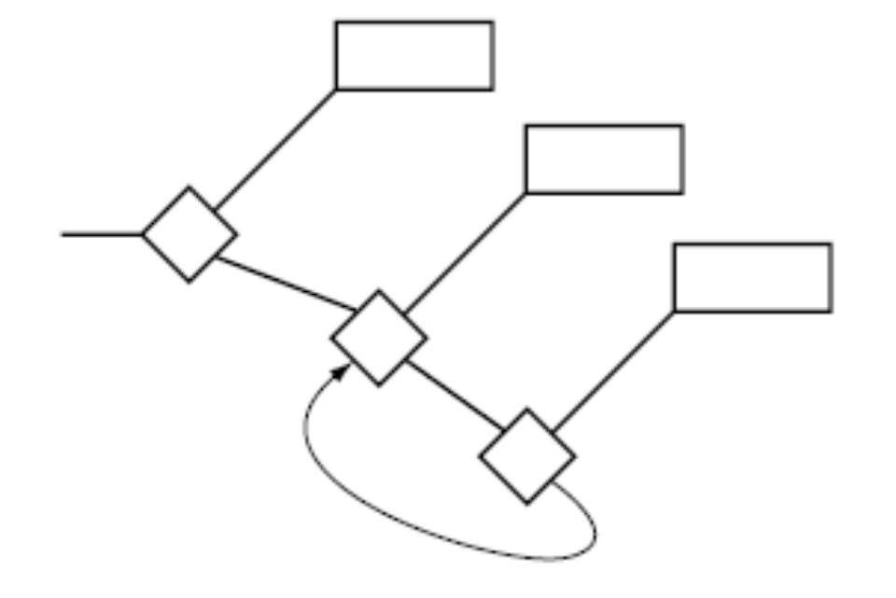
Decision Trees:
Merging Branches (cont.)
In merging branches we must take care not to introduce any loop

Slide 15
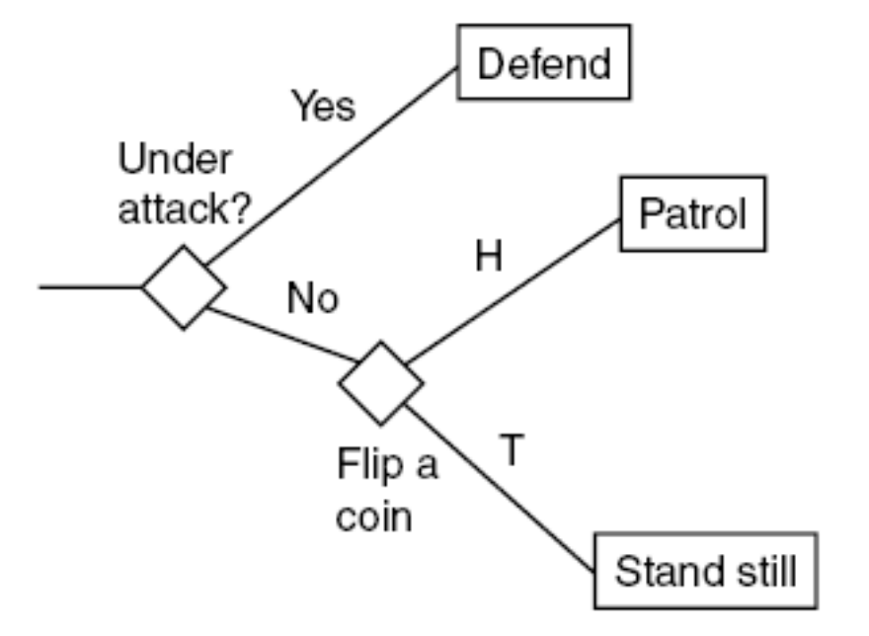
Random Decision Trees
Sometimes some element of random behavior choice adds unpredictability, interest, and variation.

Slide 16
Random Decision Trees (cont.)
Since the decision tree is processed every frame, having a random action at every frame will be abnormal
One solution is to track what was the decision in the previous frame. Then follow the same decision in the next frames until a change in conditions happens

Slide 17
Random Decision Trees:
Pseudo Code
struct RandomDecision (Decision):
lastFrame = -1
lastDecision = false
def test():
# check if our stored decision is too old
if frame() > lastFrame + 1:
# Make a new decision and store it
lastDecision = randomBoolean()
# randomBoolean() returns a random Boolean value, either true or false.
# Either way we need to update the frame value
lastFrame = frame()
# frame() returns the number of the current frame.
# We return the stored value
return lastDecision

Slide 18
Random Decision Trees:
Timing Out
We can add time-out feature to random decision so it looks more natural and intelligent

Slide 19
Timing Out Pseudo Code
struct RandomDecision (Decision):
lastFrame = -1
firstFrame = -1
lastDecision = false
timeOut = 1000 # Time out after this number of frames
def test():
# check if our stored decision is too old or if we’ve timed out
if frame() > lastFrame + 1 , or
frame() > firstFrame + timeOut:
# Make a new decision and store it
lastDecision = randomBoolean()
# Set when we made the decision
firstFrame = frame()
# Either way we need to update the frame value
lastFrame = frame()
# We return the stored value
return lastDecision

Slide 20
Outline
Decision Trees
State Machines
Behavior Trees

Slide 21
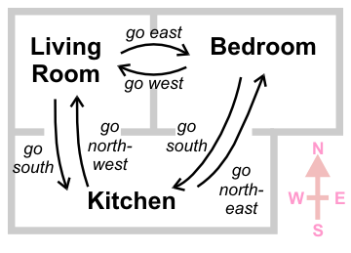
State Machines
A better way to simulate behavior of characters whose actions depend on some events is to use state machines (instead of checking the character’s behavior every frame as in decision trees)
  The vast majority of decision making systems used in current games is based on state machines along with scripting.

Slide 22
State Machines (cont.)
A set of states that the agent can be in
Connected by transitions that are triggered by a change in the world
Normally represented as a directed graph, with the edges labeled with the transition event
State A
State B
State C

Slide 23
Example:
State Machine vs. Decision Trees
State A
State B
State C
Bedroom
Kitchen
Bedroom
Living Room
Living Room
Kitchen

Slide 24
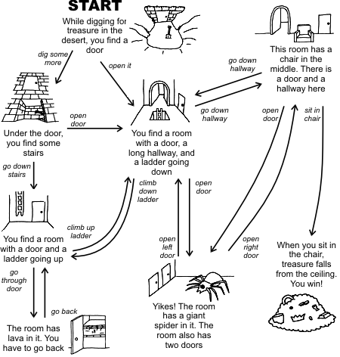
State Machines (cont.)
A good platform for interactive storytelling

Slide 25
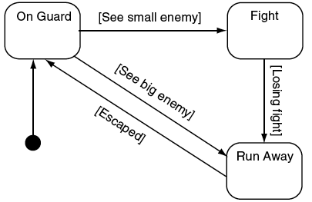
State Machines (cont.)
When a transition’s conditions are met, the state is triggered.
When the transition is followed to a new state, the new state is fired.
  This separation allows the transitions to also have their own actions.

Slide 26
Pseudo Code
class StateMachine:
# Holds a list of states for the machine
states
# Holds the initial state
initialState
# Holds the current state
currentState = initialState

Slide 27
# Checks and applies transitions, returning a list of actions.
def update():
# Assume no transition is triggered
triggeredTransition = None
# Check through each transition and store the first one that triggers.
for transition in currentState.getTransitions():
if transition.isTriggered():
triggeredTransition = transition
break
Notes:
1- The order of checking is important
2- Only one transition is selected each time

Slide 28
# Check if we have a transition to fire
if triggeredTransition:
# Find the target state
targetState =triggeredTransition.getTargetState()
# Add the exit action of the old state, the transition action and the entry for the new state.
actions = currentState.getExitAction()
actions += triggeredTransition.getAction()
actions += targetState.getEntryAction()
# Complete the transition and return the action list
currentState = targetState
return actions
#Otherwise just return the current state’s actions
else: return currentState.getAction()

Slide 29
Pseudo Code:
Data Structures
class State:
def getAction()
def getEntryAction()
def getExitAction()
def getTransitions()
class Transition:
def isTriggered()
def getTargetState()
def getAction()

Slide 30
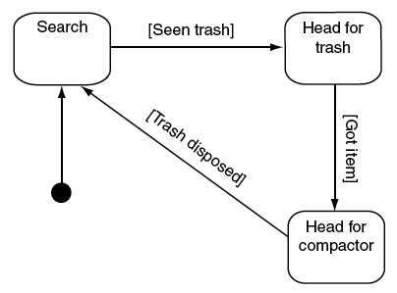
Question
How to add alarm behaviors?
Example: Recharging state (when the robot has low power and needs to be recharged)

Slide 31
Why we can’t have SM like this?
Get power
No power
Recharged
No power
Recharged
No power
Recharged

Slide 32
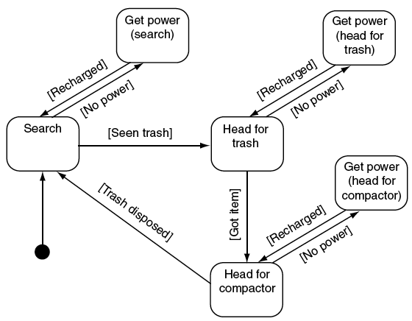
Standard SM implementation:
It doubles the number of states

Slide 33
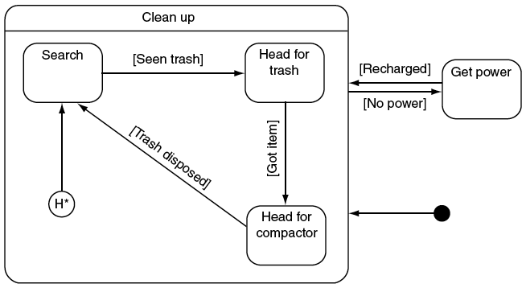
Hierarchical State Machine
We check the transition for the higher level first
  If no high level transition triggers, then we check the lower level transitions
We keep track of the state of the cleaning state machine, even if we are in the process of recharging.
  When the recharging is over, the cleaning state machine will pick up where it left off.

Slide 34
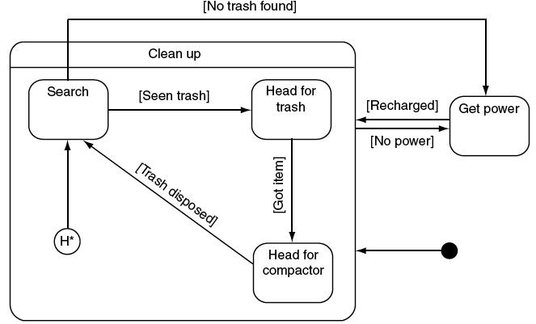
Hierarchical State Machine (cont.)
In some cases we can also transit to the higher state directly
  After charging, it will come back to H* if it transits directly from search state

Slide 35
Example 1
Start: H* to State A
  State: [L,A]
  Action: A_{entry}
State L
2
State A
State C
State M
4
1
5
7
3
H*
State B
State N
6

Slide 36
Example 2
Transition 1 is triggered:
  State: [L,B]
  Action: L_{active} + A_{exit} + 1_{action} + B_{entry}
State L
2
State A
State C
State M
4
1
5
7
3
H*
State B
State N
6
Notes:
We always check first if the top-level state machine detects any valid transitions. If not, we will call state machine L to see if it has any

Slide 37
Example 3
Transition 4 is triggered:
  State: M
  L keeps a record of being in State B
  Action: L_{exit} + 4_{action} + M_{entry}
State L
2
State A
State C
State M
4
1
5
7
3
H*
State B
State N
6

Slide 38
Example 4
Transition 5 is triggered:
  State: N
  Action: M_{exit} + 5_{action} + N_{entry}
State L
2
State A
State C
State M
4
1
5
7
3
H*
State B
State N
6

Slide 39
Example 5
Transition 6 is triggered:
  State: [L,B] (we will back to state B)
  Action: N_{exit} + 6_{action} + L_{entry}
    Note: We don’t return the B_{entry} action, because we didn’t return the B_{exit} action when we left state L previously.
      This is a personal preference for implementation. If you want to exit and reenter State B, then you can modify your algorithm to return these extra actions at the appropriate time.
State L
2
State A
State C
State M
4
1
5
7
3
H*
State B
State N
6

Slide 40
Example 6
Transition 3 is triggered:
  State: N
    Note: L no longer keeps track of State B (like in Example 3), because we transitioned out of that state. If we fire transition 6 to return to State L, then State L’s initial state (A) would be selected, just like in Example 1.
  Action: B_{exit}+ L_{exit} + 3_{action} + N_{entry}
State L
2
State A
State C
State M
4
1
5
7
3
H*
State B
State N
6

Slide 41
Example 7
Transition 7 is triggered:
  State: M
  Action: N_{exit} + 7_{action} + M_{entry}
State L
2
State A
State C
State M
4
1
5
7
3
H*
State B
State N
6

Slide 42
Example 8
Transition 2 is triggered:
  State: [L,C]
  Action: M_{exit} + 2_{action} + L_{entry} + C_{entry}
State L
2
State A
State C
State M
4
1
5
7
3
H*
State B
State N
6

Slide 43
Assignment #6.1
What will be the State and Action sequence if Transition 2 is triggered after Example 3?
  State: ?
  Action: ?
State L
2
State A
State C
State M
4
1
5
7
3
H*
State B
State N
6

Slide 44
Assignment #6.2
Implement this state machine with decision trees
State L
2
State A
State C
State M
4
1
5
7
3
H*
State B
State N
6

Slide 45
Combining Decision Trees and State Machines
Decision trees are an efficient way of matching a series of conditions (AND, OR) while this is not so easy in SM
We can combine the two approaches by:
  Replacing transitions from states with decision trees.
    The leaves of the tree, will be states (rather than being actions as before).

Slide 46
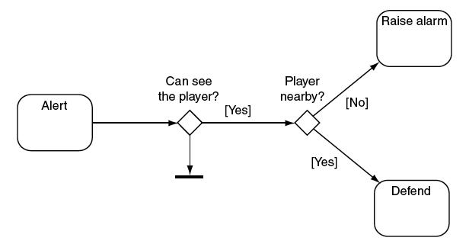
Example

Slide 47
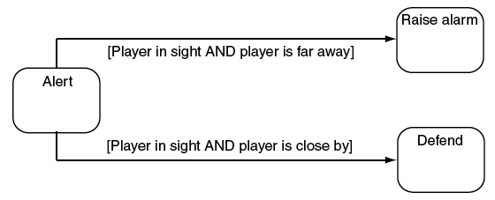
Using state machine only:
So what is the disadvantage of this?

Slide 48
Outline
Decision Trees
State Machines
Behavior Trees

Slide 49

Behavior Trees
Another popular tool for creating AI characters.
Very similar to Hierarchical State Machines
  Task instead of State
Halo 2 [Bungie Software, 2004] was one of the first high-profile games for which the use of behavior trees was described in detail and since then many more games have followed suit.

Slide 50
Tasks
Actions to be taken by CPU
  Tasks can be very simple actions (e.g. reading a value)
  For more complex actions, tasks can be composed into sub-trees.
  These complex actions can again be composed into higher level behaviors.

Slide 51
Behavior Trees
Main Advantage
Ability to compose tasks easily
  All tasks have the same basic structure with common interface.
  They return with a status code indicating either success or failure
  They are largely self-contained
  GUI to edit trees
Hence, they can be easily built up into hierarchies (i.e., behavior trees) without having to worry about the details of how each sub-task in the hierarchy is implemented
Notes:
.

Slide 52
Types of Task
Leaf Nodes
  Conditions: test some property of the game
    Returns the success status code if the Condition is met and returns failure otherwise.
  Actions: change the state of game
    Returns success status code if the action completes
Branches
  Composites: combinations of conditions, actions, and compositions
Notes:
Conditions example: tests for proximity (is the character within X units of an enemy?), tests for line of sight, tests on the state of the character (am I healthy?, do I have ammo?), and so on.
Actions examples: actions for animation, for character movement, to change the internal state of the character (resting raises health, for example), to play audio samples, to engage the player in dialog, etc.

Slide 53
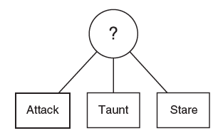
Types of Composite Task
Selector
  Returns a success status code when one of its children runs successfully.
  Will keep on trying as long as its children are failing.
    If it runs out of children completely, it will return a failure status code.

Slide 54
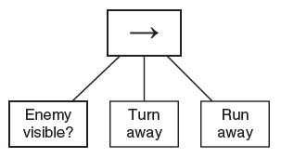
Types of Composite Task
Sequence
  Returns a failure status code when one of its children fails.
  Will keep on trying as long as its children are successful.
    If it runs out of children completely, it will return a success status code.

Slide 55

Example
Task: moving into a room
What if the door is closed?

Slide 56
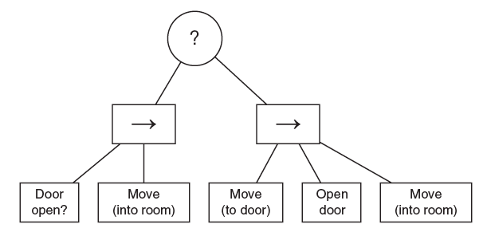
Pseudo Code:
If is_open(door):
move_to(room)
else:
move_to(door)
open(door)
move_to(room)
Selector
Sequence

Slide 57
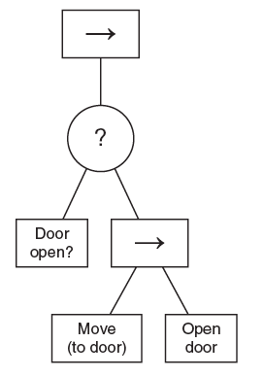

If not is_open(door):
move_to(door)
open(door)
move_to(room)

Slide 58
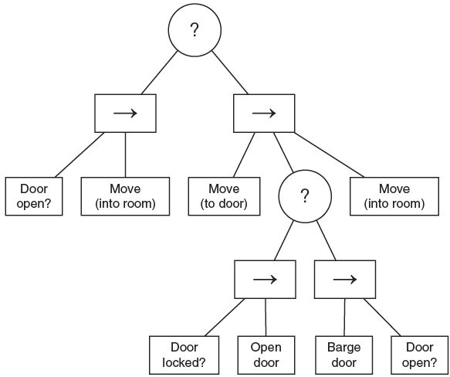
Dealing with locked door

Slide 59
Assignment #6.3
Implement this behavior tree with State Machine

Slide 60
Pseudo Code
class Task:
# Holds a list of the children (if any) of this task
children
# Always terminates with either success (True) or failure (False)
def run()
Example:
class EnemyNear (Task):
def run():
if distanceToEnemy < 10:
return True
# Task failure, there is no enemy nearby
return False

Slide 61
class Selector (Task):
def run():
for c in children:
if c.run():
return True
return False

Slide 62
class Sequence (Task):
def run():
for c in children:
if not c.run():
return False
return True

Slide 63
Non-Deterministic Composite Tasks
If we always try the same things in the same order, we might end up with a predictable AI
  It is better to make some sort of randomness in selection/sequence if possible

Slide 64
Non-Deterministic Composite Tasks- Pseudo Code
class RandomSelector (Task):
children
def run():
while True:
child = random.choice(children)
result = child.run()
if result:
return True
Question: What are the problems of this code?

Slide 65
class NonDeterministicSelector (Task):
children
def run():
shuffled = random.shuffle(children)
for child in shuffled:
if child.run(): break
return result

Slide 66
class NonDeterministicSequence (Task):
children
def run():
shuffled = random.shuffle(children)
for child in shuffled:
if not child.run(): break
return result

Slide 67
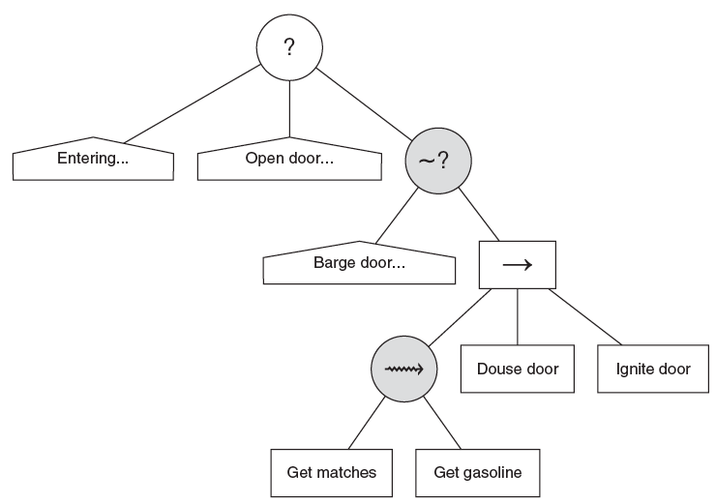
Non-Deterministic Composite Tasks- Example

Slide 68
Decorator Tasks
A type of composite task with one single child task that modifies its behavior in some way.
  There are many different types of useful Decorators.
Decorator
Child Task

Slide 69
Decorator Task Example:
Inverter
class Inverter (Decorator):
def run()
return not child.run()
Inverter
Child Task

Slide 70
Decorator Task Example:
Filter
Allows its child behavior to run or not.
  If they allow the child behavior to run, then whatever status code it returns is used as the result of the filter.
  If they don’t allow the child behavior to run, then they normally return in failure.

Slide 71
Decorator Task Example:
Limit
Limits number of the times that the child runs
class Limit (Decorator)
runLimit
runSoFar = 0
def run():
if runSoFar >= runLimit:
return False
runSoFar++
return child.run()

Slide 72
Decorator Task Example:
Until Fail
class UntilFail (Decorator):
def run():
while True:
result = child.run()
if not result: break
return True

Slide 73
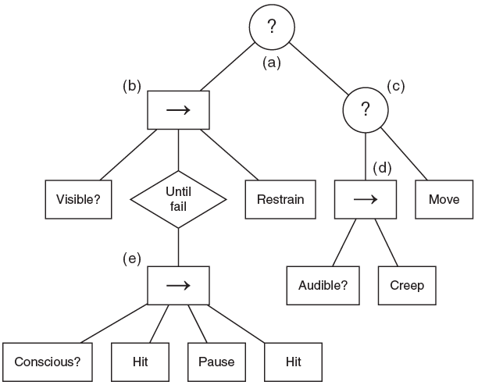
Decorator Example
Notes:
Enemy fight example

Slide 74
Question: Why are there two hitting tasks in this tree?

Slide 75
Pseudo Code
ex = Selector(
Sequence(Visible,
UntilFail(Sequence(Conscious, Hit, Pause, Hit)),
Restrain),
Selector(
Sequence(Audible, Creep),
Move)
)

Slide 76
Checking Resource Availability
By hard-coding the test in the behavior:
class PlayAnimation (Task):
animation_id
speeddef
def run():
if animationEngine.ready():
animationEngine.play(animation, speed)
return True
# Task failure, the animation could not be played.
return False

Slide 77
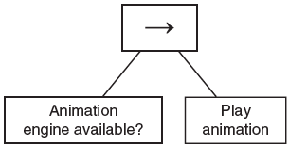
Checking Resource Availability (cont.)
By creating a Condition task to perform the test and using a Sequence

Slide 78
Checking Resource Availability (cont.)
By using a Decorator to guard the resource
Guard
class SemaphoreGuard (Decorator):
# Holds the semaphore that we’re using to guard a resource.
semaphore
def SemaphoreGuard(semaphore):
this.semaphore = semaphore
def run():
if semaphore.acquire()
result = child.run()
semaphore.release()
return result
else:
return False
Child Task
class Semaphore:
# Creates a semaphore for a resource with # the given maximum number of users.
def Semaphore(maximum_users)
# Returns true if the acquisition is
# successful, and false otherwise.
def acquire()
def release()

Slide 79
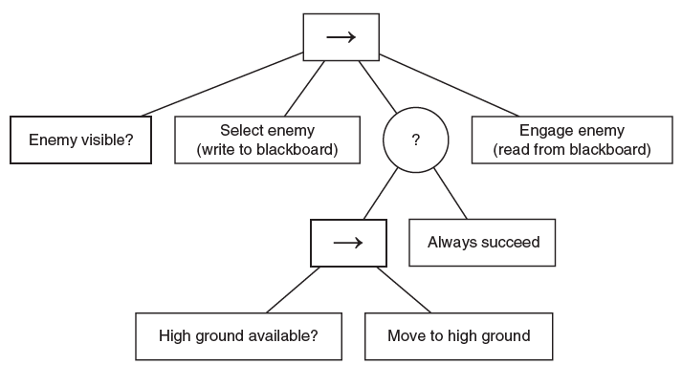
Behavior Trees
Adding Data
The current task structure only returns True/ False
We can use Blackboard technique to pass data between different tasks

Slide 80
Behavior Trees
Adding Data (cont.)
We can have a private blackboard for each sub-tree using a decorator:
class BlackboardManager (Decorator):
blackboard = null
def run():
blackboard = new Blackboard()
result = child.run()
delete blackboard
return result
Blackboard Manager
Child Task

Slide 81
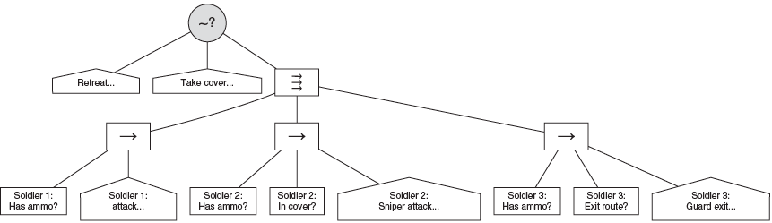
Parallel Tasks
Can be used for sets of Actions that can occur at the same time, e.g. to control the behavior of a group of characters

Slide 82
Pseudo Code for Parallel Sequence Task
def runChild(child):
runningChildren.add(child)
returned = child.run()
runningChildren.remove(child)
if returned == False:
terminate()
result = False
else if runningChildren.length == 0:
result = True
def terminate():
for child in runningChildren:
child.terminate()
class Parallel (Task):
children
# Holds all the children currently running.
runningChildren
# Holds the final result for our run method.
result
def run()
result = undefined
# Start all our children running
for child in children:
thread = new Thread()
thread.start(runChild, child)
# Wait until we have a result to return
while result == undefined:
sleep()
return result
Defines new thread for each child
Terminates all threads if any of children fails

Slide 83
Using Parallel Task for Condition Checking
Question: What is the problem of this implementation?
Player in position?
Provide Service

Slide 84
Using Parallel Task for Condition Checking
We can use parallel task to solve this problem:
Question: What is the problem of this implementation?
Until fail
Provide Service
Player in position?

Slide 85
Using Parallel Task for Condition Checking
Interrupter
Provide Service
Perform Interruption
Until fail
Interrupter is a decorator that lets its child node run normally.
  If the child returns a result, it passes that result on up the tree.
  If the child is still working, it can be asked to terminate itself, whereupon it returns a predetermined result.
Player in position?

Slide 86
Behavior Trees
Limitations
Behavior trees works best if the character transitions between types of behavior based on the success or failure of actions.
Main limitation is when we deal with state-based behaviors
  In such situations SM is more useful (in particular when the character needs to respond to external events)
  In fact, game designers who use Behavior Trees, tend to avoid state behaviors such as noticeable changes of character disposition or alarm behavior.

Slide 87
Assignment #6.4
Implement this SM using Behavior Trees
Submission deadline:
5 October 2011
Recharge
No power
Recharged
Seen trash
Search
Tidy Trash
Trash disposed

Slide 88
Behavior Trees
Limitations (cont.)
We can build a hybrid system where characters have multiple behavior trees and use a state machine to determine which behavior tree they are currently running.
Unfortunately, this solution adds considerable extra burden to the AI toolchain developers, since they now need to support two kinds of authoring: state machines and behavior trees.

Slide 89
Thank you !

