Slide 1

Caching
@thecodealchemist

Slide 2
What is Caching?

Slide 3
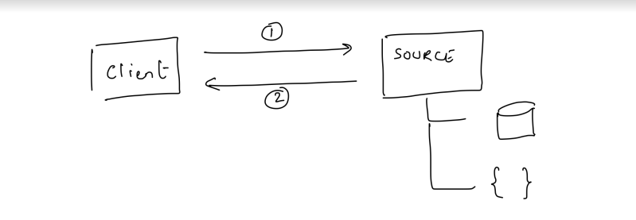
Without Cache

Slide 4
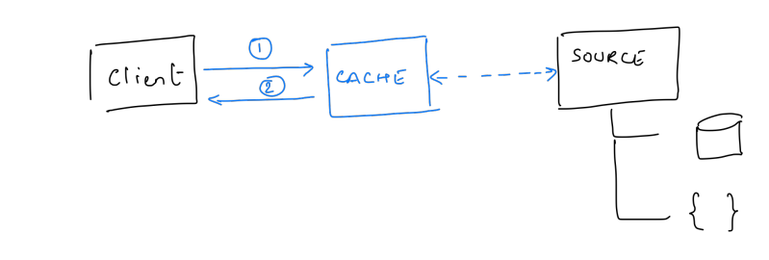
With Cache

Slide 5
Why is Caching important?

Slide 6
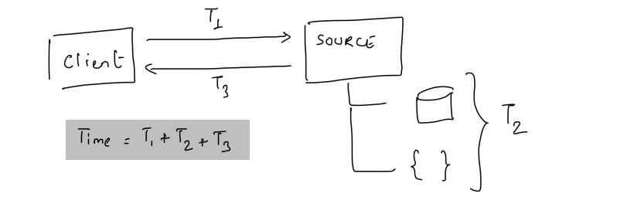
Time without Cache

Slide 7
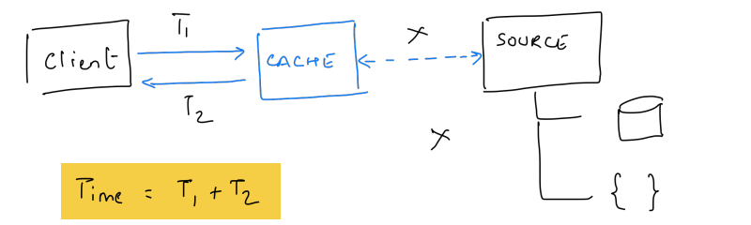
Time with Cache

Slide 8
Caching examples
L1, L2 caches
Disk cache
DNS cache
CDNs

Slide 9
Fundamentals
Cache hit
Cache miss

Slide 10
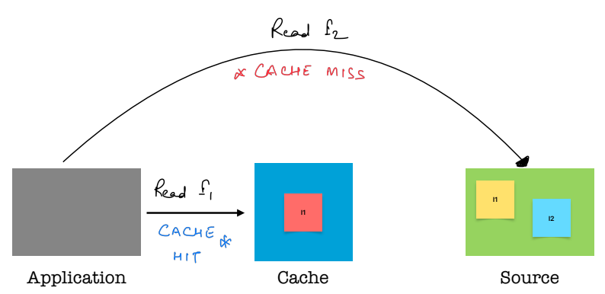
Cache hit & miss

Slide 11
Fundamentals
Cache expiration
Cache eviction
Cache invalidation

Slide 12
 | Cache expiration | Cache eviction | Cache invalidation
Definition | about considering a cached item stale | About removing or replacing cached items | Explicitly invalidating entries
Purpose | Ensuring freshness | Ensuring size and freshness | Ensuring freshness and latest data
Implementation | Generally using TTLs | Strategies like LRU, LFU | Explicit events, commands

Slide 13
Cache Expiration
Time based
Idle time based
Version based

Slide 14
Time based Cache expiration
Data is considered valid for a specific time duration.
Examples:
short lived data, user sessions
Scenarios:
Predictable updates
Well-defined validity periods
Considerations:
choosing TTL values
handling timezone
refreshing expired entries

Slide 15
Idle time based Cache expiration
Data is considered valid as long as it is being accessed.
Examples:
Active user sessions
Scenarios:
Keeping active data
User Interaction-Dependent Data
Considerations:
choosing idle time threshold
handling continuous access

Slide 16
Version based Cache expiration
Data versions are assigned, and the cache is refreshed when a new version is available.
Examples:
Documents, configurations
Scenarios:
Distributed caching
Clear version semantics
Considerations:
Having a proper versioning
Concurrency management

Slide 17
Cache Eviction
Least Recently Used (LRU)
Most Recently Used (MRU)
Least Frequently Used (LFU)
Random Replacement
Priority-Based Eviction
Cost-Based Eviction
Size-Based Eviction
First-In-First-Out (FIFO)
Hybrid Eviction Policies
Smart/Dynamic Eviction Policies

Slide 18
Least Recently Used (LRU)
Evicts the least recently accessed items first
Good for caching web pages, images

Slide 19
Most Recently Used (MRU)
Evicts the recently accessed items first
Example - Media streaming

Slide 20
Least Frequently Used (LFU)
Evicts items with the least frequent access
Good for use-cases where frequency is directly proportional to the usefulness.

Slide 21
Random Replacement
Randomly selects items for eviction
Useful where there’s no clear pattern

Slide 22
Priority/Cost/Size-Based Eviction
Evicts items based on their priority, associated cost, or size
Suitable for scenarios where priorities/cost can be defined

Slide 23
First-in-First-out (FIFO)
Evicts the oldest cached items first
Suitable for scenarios where such ordering doesn’t impact the Cache performance

Slide 24
Hybrid Eviction
Combines multiple eviction strategies to achieve a balance between different factors
Suitable for scenarios where a single policy is not effective

Slide 25
Dynamic Eviction
Adjust eviction strategy dynamically
Suitable for scenarios where access patterns are dynamic

Slide 26
Cache Invalidation
Time based
Event based
Write-through and Write-behind based
Manual

Slide 27
Time based
Entry invalidated after a duration of time
Examples – API responses, stock prices, etc.
Suitable for scenarios where data changes infrequently

Slide 28
Event based
Entry is invalidated based on internal/external events
Example – shopping cart
Suitable where changes are driven by events that we may/may not own

Slide 29
Write-through and Write-behind
When cache and the source is updated simultaneously
When source is updated asynchronously
Suitable for scenarios when consistency is important

Slide 30
Manual
Cache is invalidated manually
Scenarios where human intervention or ad-hoc updates are required

Slide 31
Consistency and Coherence
Consistency
Consistency is about cached data as compared to the original source
Inconsistent caching may cause stale data
Coherence
It’s about uniformity of data across different caches
Synchronization and conflicts

Slide 32
Best practices
Use Cache Invalidation Wisely
1
Implement Proper Expiration Policies
2
Consider Event-Driven Invalidation
3
Use Versioning for Coherence
4
Optimize Communication Between Caches
5
Choose caching libraries wisely
6
Consider using read-through and write-through models
7

Slide 33
Cache Warm-up
Proactively loading data into the cache
Different ways to warm-up the cache
Lazy
Eager
Scheduled jobs
Can load full or partial cache

Slide 34
Cache Warm-up
Benefits
Reduced latency
Improved user experience
Resource utilization
Watch-out
Freshness
Resource utilization

Slide 35
Caching Strategies
Cache-Aside
Application owns the cache updates
Read-Through
Cache itself own the cache updates
Write-Through
Data is written to Cache and data source simultaneously
Write-Behind
Cache first → Source later(async)

