Slide 1
Kafka
@thecodealchemist

Slide 2
What is Kafka?
Apache Kafka is an open-source distributed event streaming platform.
Highly available
Fault tolerant
Scalable
High throughput

Slide 3
What is an Event Streaming Platform?
Capturing data in real-time from different sources as a stream of events
Storing events durably
Processing events as they occur or retrospectively
Routing the events to different destinations

Slide 4
Main Concepts
Event or Record or Message
Producer
Consumer
Topic
Partitions
Brokers

Slide 5
How it works?
Broker
Producer1
Topic 1
Consumer 1
Producer2
Topic 2
Consumer 2

Slide 6
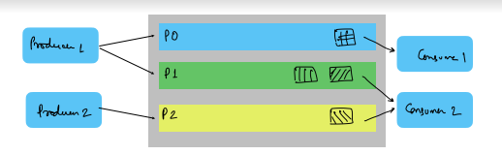
Topics and Partitions

Slide 7
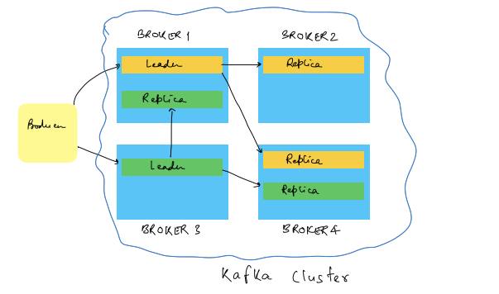
Kafka Cluster

Slide 8
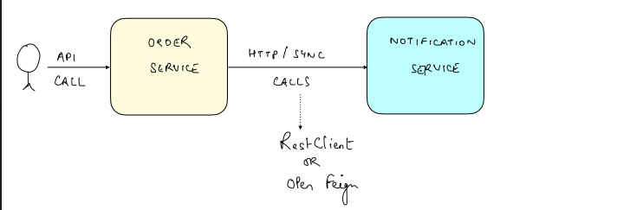
Without Kafka

Slide 9
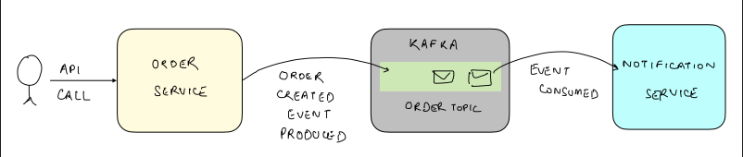
With Kafka

Slide 10
Agenda
Run kafka on Local
Create Order Topic
Develop Order Service
Develop Notification Service

