Slide 1
UNIT-I
KCS-601
SOFTWARE ENGINEERING
PART-I
Software Engineering

Slide 2
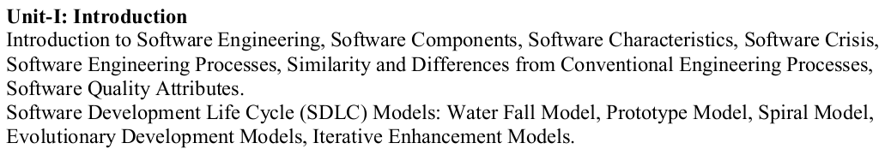
Syllabus

Slide 3
Software Engineering
Software engineering (SE) is the application of a systematic, disciplined, quantifiable approach to the design, development, operation, and maintenance of Software, and the study of these approaches; that is, the application of engineering to Software.

Slide 4
Classification Of Software
Custom Software
For a specific customer
Generic Software
Sold on open market
Often called
COTS (Commercial Off The Shelf)
Shrink-wrapped
Embedded Software
Built into hardware
Hard to change

Slide 5
Types Of Software
System Software-This Software includes the operating system and all utilities that enable the computer to function.
Application Software-These consist of programs that do real work for users. For example, word processors, spreadsheets, and database management systems fall under the category of applications Software.

Slide 6
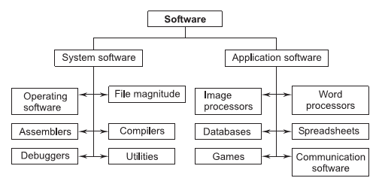
Types Of Software

Slide 7
Software Myth
It is Defined in these categories-
Management Perspectives
Customer Perspectives
Practitioners (Developer) Perspectives

Slide 8
Software Myths
Software is Easy to Change.
Computer Software provides the greater reliability than the device they replaced.
Testing Software Can remove all errors.
Reusing Software increase safety.
Software with more features is better Software.
Once we write the program and get it to work, our job is
done.
The only deliverable work product for a successful project is the working program.

Slide 9
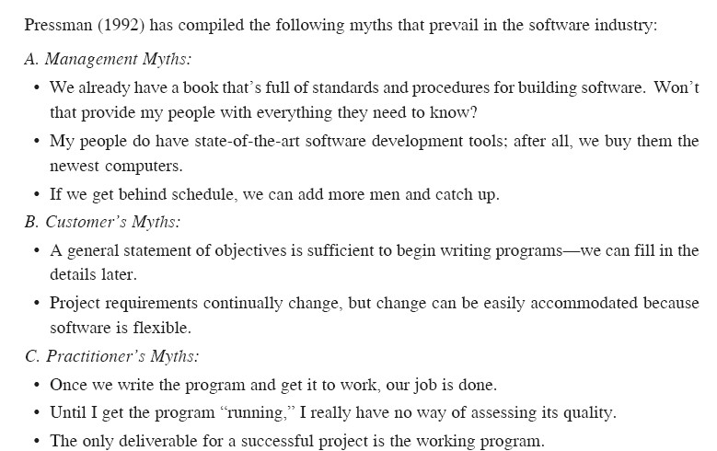
Software Myth

Slide 10
Software Myths
“If my project is behind the schedule, I always can add more programmers to it and catch up …”(a.k.a. “The Mongolian Horde concept”)
“ We
already have a book of standards and
procedures for building software. It does provide my people with everything they need to know …”
“If I decide to outsource the software project to a third party, I can just relax: Let them build it, and I will just pocket my profits …”

Slide 11
Software Components
Off-the Self Components.
Full Experience Components.
Partial Experience Components.
New Components.

Slide 12
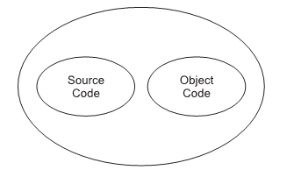
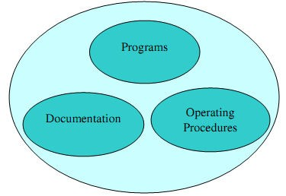
Software Components
Program=Source code + object code
Software=Program + Documentation + Operating Procedures

Slide 13
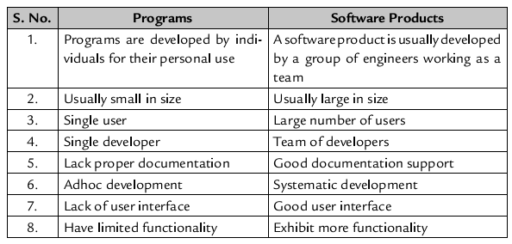
Software Components

Slide 14
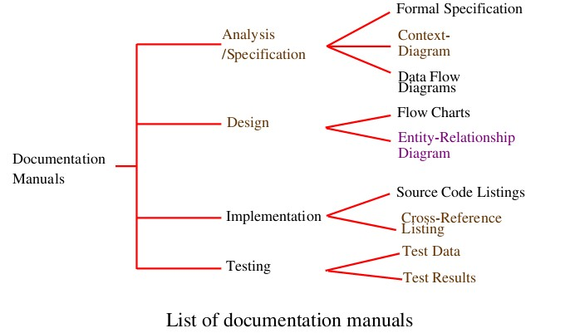
Documentation consists of different types of manuals are:

Slide 15
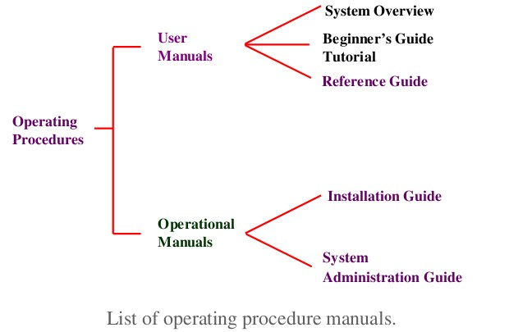
Documentation consists of different types of manuals are:

Slide 16
Importance of Software
Computer Software has become a driving force-
It is the engine that drives business decision making.
It serves as the basis for modern scientific
investigation and engineering problem-solving.
It is embedded in all kinds of systems, such as transportation, medical, telecommunications, military, industrial processes, entertainment, office products, etc.

Slide 17
Software Characteristic(important)
Important Characteristics are-
Software does not wear out.
Software is Flexible and Reliable.
Software is Engineered, Not Manufactured.
Reusability Of Components.

Slide 18
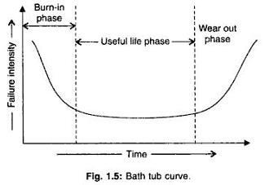
Software does not wear out-

Slide 19
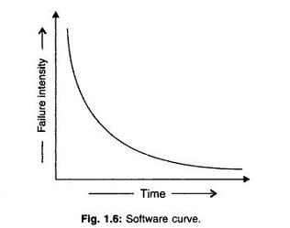
Software does not wear out-

Slide 20
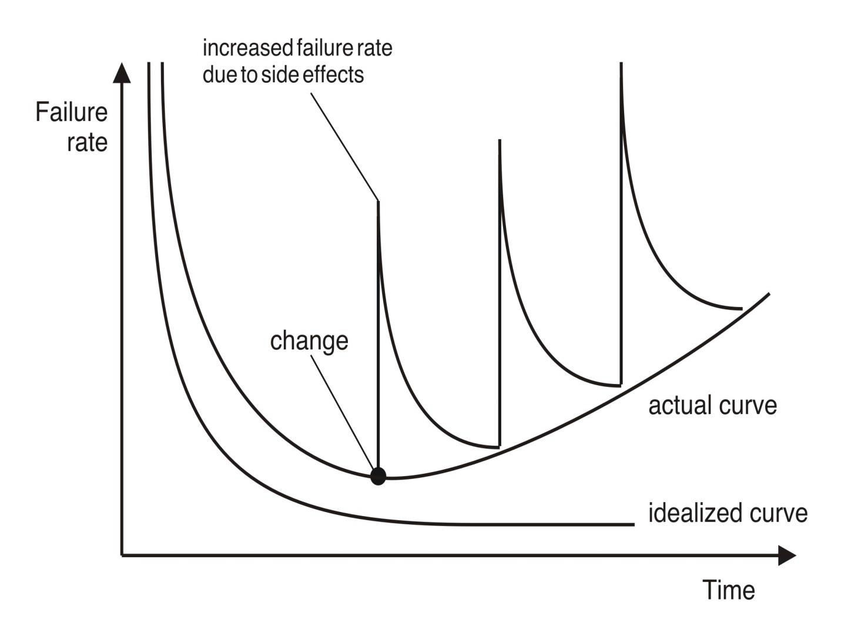
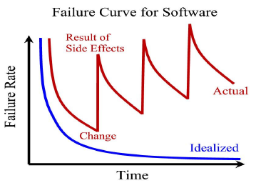
Wear vs. Deterioration
Software deteriorates (Become worse) over time

Slide 21
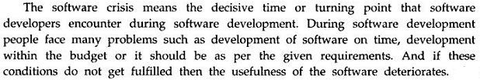
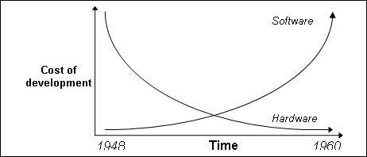
Software Crisis
Software crisis is a term used in the early days of computing science for the difficulty of writing useful and efficient computer programs in the required time.

Slide 22
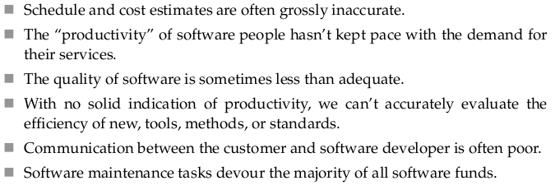
Problems faced by Customers due to S/W Crisis

Slide 23
Software Crisis
S/W crisis from programmer point of view:-
i)Problem of compatibility.
ii)Problem of Portability.
iii)Proclaiming documentation.
iv)Problem of pirated s/w.
v)Problem in co-ordination of work of different people. vi)Problem of proper maintenance.
S/W crisis from user point of view:-
i) s/w cost is very high.
ii)Price of h/w grows down.
iii)Lack of development specification.
iv)Problem of different s/w versions.
v)Problem of bugs or errors.

Slide 24
Causes and Solution of S/W Crisis
The causes of the software crisis were linked to the overall complexity of hardware and the software development process. The crisis manifested itself in several ways:
1. Projects running over-budget
2. Projects running over-time
3. Software was very inefficient
4. Software was of low quality
5. Software often did not meet requirements
6. Projects were unmanageable and code difficult to maintain
7. Software was never delivered
The main cause is that improvements in computing power had outpaced the ability of programmers to effectively utilize those capabilities.
Possible Solution:
Various processes and methodologies have been developed over the last few decades to improve software quality management such as procedural programming and object-oriented programming. However software projects that are large, complicated, poorly specified, and involve unfamiliar aspects, are still vulnerable to large, unanticipated problems.

Slide 25

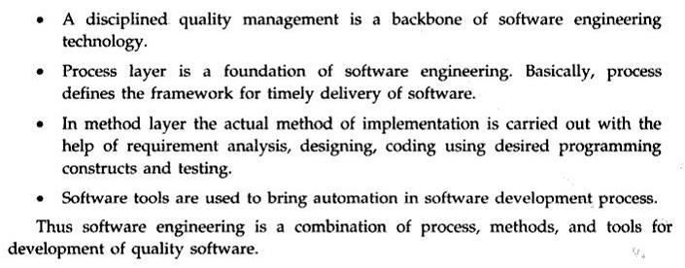

Software Engg: Layered Approach

Slide 26
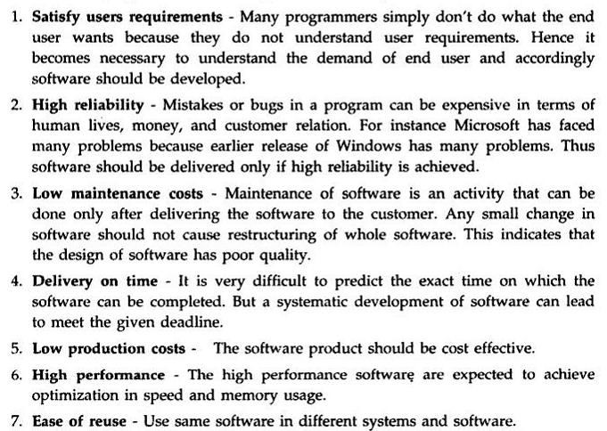
Goals Of Software Engg

Slide 27
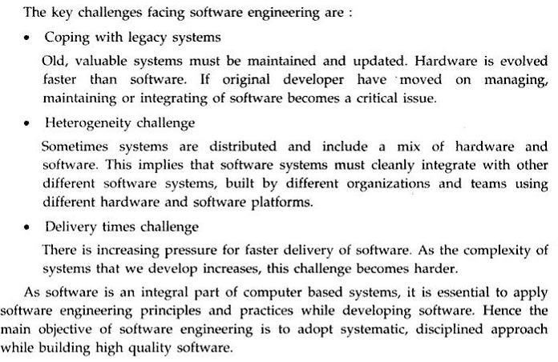
Challenges In Software Engg

Slide 28
Software Engg. Process
Sequence of steps required to develop or maintain software.
A Software process is the related set of activities and processes that are involved in developing and evolving a Software system.
A set of activities whose goal is the development or evolution of Software.
A Software process is a set of activities and associated
results, which produce a Software product.
A process defines who is doing what, when and how to reach a certain goal.

Slide 29
Fundamental Software Process Activities
Common to All Software process-
Software Specifications-
The functionality of the Software and constraints on its operation must be defined.
Software Development-
Software that meets the specifications must be produced.
Software Validation-
The Software must be validated to ensure that it does what the
customer wants.
Software Evaluation-
The Software must be develop to meet changing customer needs.

Slide 30
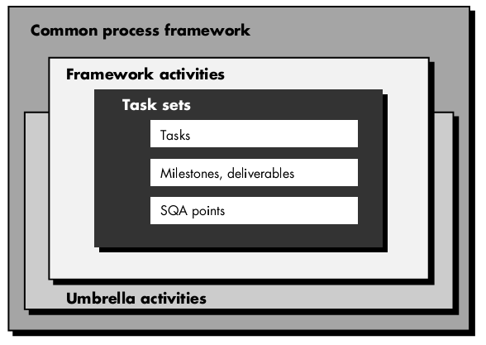
Software Process Framework
CSE@HCST 4/27/2016

Slide 31
Software Engg.Process
Five Generic Common Process Framework activities are-
Communication
Planning
Modeling
Analysis of requirements
Design
Construction/Development
Code generation
Testing
Deployment

Slide 32
Umbrella Activities (after deployment)
Software project tracking and control.
Formal technical reviews.
Software quality assurance.
Software configuration management.
Work product preparation and production (activities to create models, documents, logs, forms, lists, etc.).
Reusability management (defines criteria for work product
reuse and establish mechanisms to achieve component reuse).
Measurement.
Risk management.

Slide 33
Identifying a Task Set
A task set defines the actual work to be done to accomplish the objectives of a software engineering action.
A list of the task to be accomplished
A list of the work products to be produced
A list of the quality assurance filters to be applied

Slide 34
Process Assessment
SPICE (ISO/IE15504) standard defines a set of
requirements for process assessment
ISO 9001:2000 for Software defines requirements for a quality management system that will produce higher quality products and improve customer satisfaction

Slide 35
Software Process Characteristic
Software Process Characteristics are-
Understandability
Visibility
Robustness
Reliability
Acceptability
Maintainability
Rapidity
Supportability

Slide 36
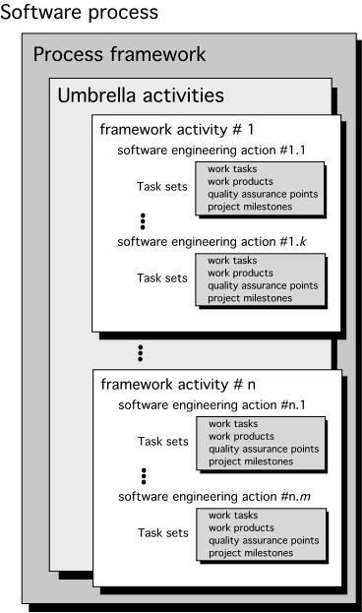
A Generic Process Model

Slide 37
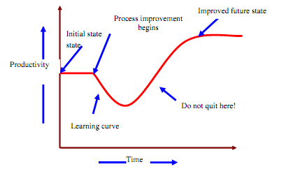
Software Process
The software process is the way in which we produce software.
Why is it difficult to improve software process ?
• Not enough time
• Lack of knowledge
• Wrong motivations
• Insufficient commitment

Slide 38
Software Process Models
Based on s/w process, s/w products and the role of people involve in s/w engg.
Work Flow model
Data Flow model
Role/Action Model
Most s/w process model are based on one of three general approaches of s/w development:
1.Waterfall approach
2. Iterative development approach
3. Computer Based S/W Engg. (CBSE) approach

Slide 39
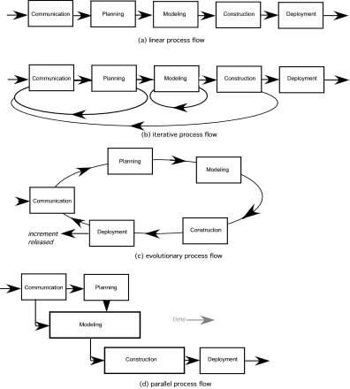
Process Flow

Slide 40
Difference between Conventional and Software Engg
Issue | S/W Engg. | Conventional Engg.
Foundation | Based on CS, IS & Discrete maths. | Based on science,maths & emperical knowledge.
Cost | Project cost is higher than h/w. | Some projects material cost is high rather than manufacturing cost
Replication | Copy/paste, downloading, CD/DVD possible | Not possible, every time create new unit
Innovation | New and untested elements may be applied | Apply known and tested principles
Duration | Project lies for some years or decade | Projects endures for centuries e.g. bridges
Blame | Engineers blame themselves for problems | Engineers can blame to others
Age | SE is about 50 years old | CE is thousands of years old
Domain | Uses limited no. of concepts | Uses unlimited no. of concepts
Research | Research the unknown | Apply research result in known

Slide 41
Difference between Conventional and Software Engg.
Software Engineering: Abstract Design ⎯⎯→ Abstract Code
Conventional Engineering: Abstract Design ⎯⎯→ Concrete Products

Slide 42
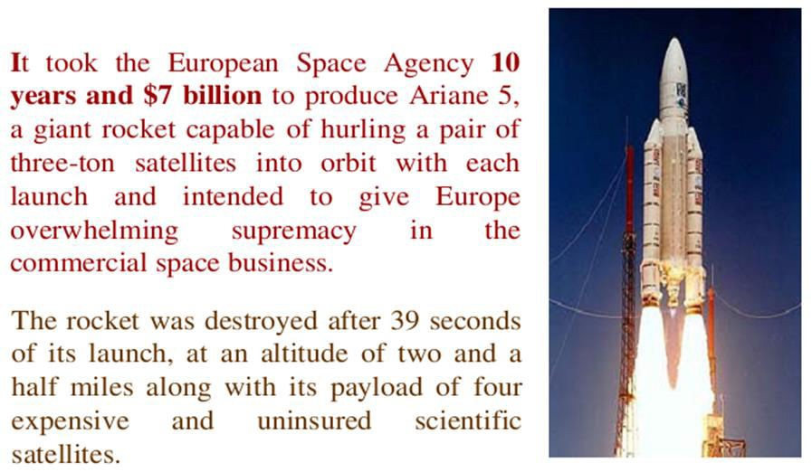
Some Software failures
Ariane 5

Slide 43
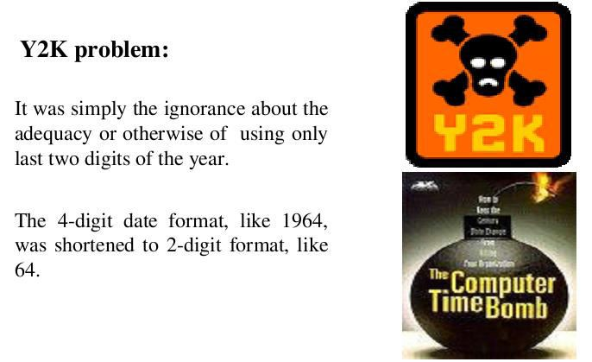
Some Software failures

Slide 44
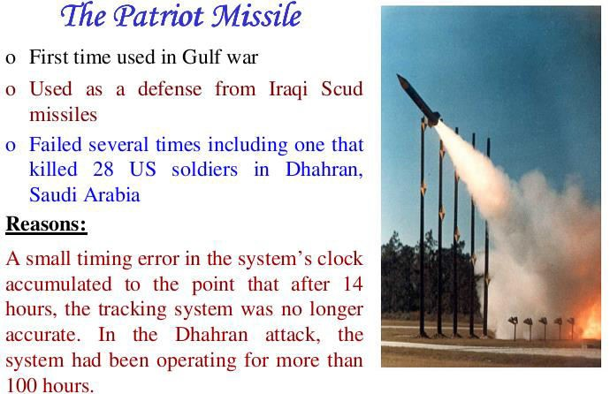
Some Software failures
CSE@HCST 4/27/2016

Slide 45
Some Terminologies
Deliverables and Milestones.
Product and Process.
Measures, Metrics, and Indicators.
Feasibility.
Requirements.
Requirement elicitation.
Software quality assurance.
Cost analysis.
Scheduling.

Slide 46
Deliverables and Milestones-
Deliverables can be agreements or evaluations, normally deliverables are objects, such as source code or user manuals.
Milestones are events that can be used for telling the status of the project. For example, the event of completing the user manual could be a milestone.

Slide 47
Product and Process-
What is delivered to the customer is called the product. It may include source-code specification documents, manuals, documentation, etc. Basically, it is nothing but a set of deliverables only.
Process is the way in which we produce Software. It is the collection of activities that leads to (a part of) a product. An efficient process is required to produce good quality products.
if the process is weak, the end product will undoubtedly suffer.

Slide 48
Measures, Metrics, and Indicators-
In Software
quantitative
engineering
indication of
measures
amount,
provide a
dimension,
capacity, or size of a given attribute of a product.
Metrics are a quantitative measure of the degree to which a system, component, or process possesses a given attribute of a product.
An indicator is a combination of metrics.

Slide 49
Difference between data and information
 | Data | Information
Data is collection of raw facts and figures. |  | Information is processed data.
Data is unarranged and unorganized.. |  | Information is arranged and organized
Data is un-meaningful |  | Information is meaningful.
Data is input. |  | Information is output.
Data is used less frequently. |  | Information is used frequently.
Data represents facts before processing |  | Information represents results ( after processing).
Data is not helpful in decision-making. |  | Information is helpful in decision-making.
Data is raw material for information. |  | Information is the final product of data.
Data are unprocessed records |  | Information contains processed records
Data is in large amounts |  | Information is in small amounts
If data is lost, it is very difficult (or even impossible in some situations) to re collect. |  | If information is lost, it is easily derived from stored data, again.
Data depends upon the sources |  | Information depends upon data

Slide 50
Feasibility, Requirements, Requirement elicitation, Software quality assurance, Cost analysis, Scheduling
Feasibility—Determining if the proposed development
is worth while.
Requirements- Determining what functionality the
Software should contain.
Requirement elicitation- Obtaining the requirements from the user.
Software quality assurance- Determining activities
that will help ensure quality of the product.
Cost analysis—Determining cost estimates.
Scheduling—Building a schedule for the development.

Slide 51
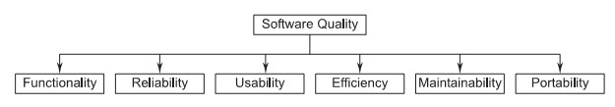
Software Quality Attributes [FRUEMP]
Software quality is comprised of six main attributes
(called characteristics)-
for Software products, these attributes can be
defined as follows.

Slide 52
Software Quality Attributes-
Functionality: The capability to provide functions which meet
stated and implied needs when the Software is used.
Reliability: The capability to maintain a specified level of performance.
Usability: The capability to be understood, learned, and used.
Efficiency: The capability to provide appropriate performance relative to the amount of resources used.
Maintainability: The capability to be modified for purposes of making corrections, improvements, or adaptation.
Corrective, Adaptive, Perfective.
Portability: The capability to be adapted for different specified environments without applying actions or means other than those provided for this purpose in the product.
.

Slide 53
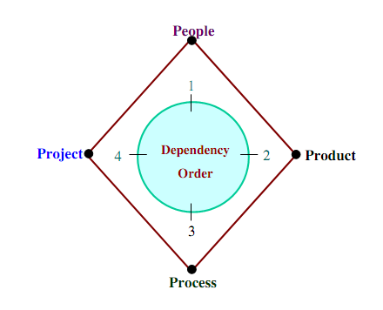
Role of Management in Software Development(4P’s)

Slide 54
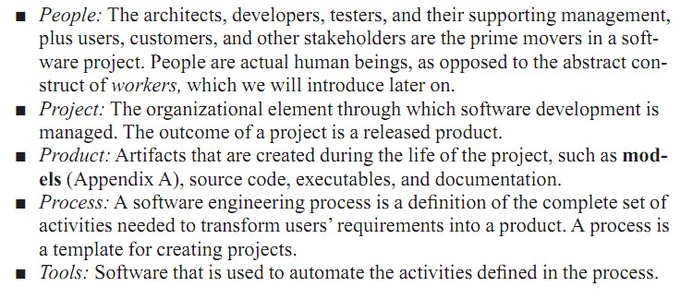
Role of Management in Software Development

Slide 55
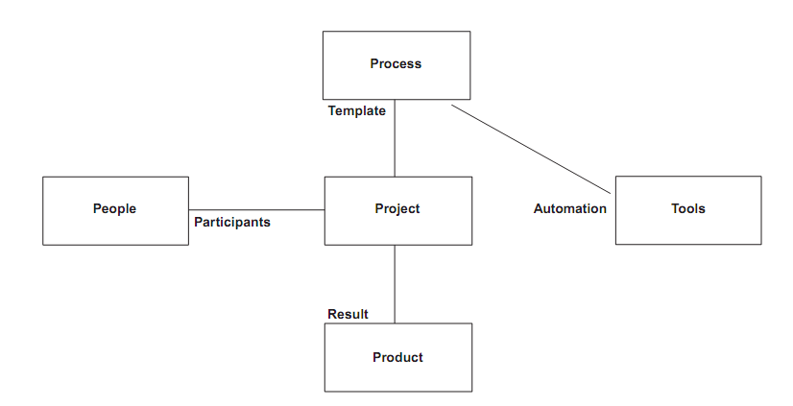
Role of Management in Software Development

