Slide 1
SDLC Models

Slide 2
SDLC
SDLC stands for “ Software Development Life Cycle”.
It is the series of identifiable stages that a software product undergoes during its lifetime.
SDLC model is a descriptive and diagrammatic representation of the software life cycle.
A life cycle model represents all the activities required to make a software product transit through its life cycle phases.

Slide 3
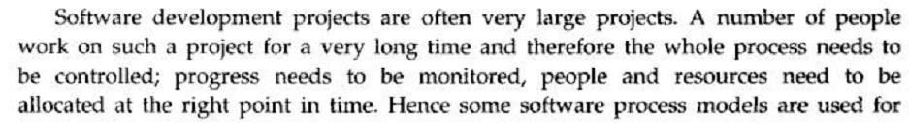
Software Development Life Cycle
A framework that describes the activities performed at each stage of a software development project.

Slide 4
Software Development Life Cycle
An information system goes through a series of
phases from conception to implementation.
This process is called the Software-Development Life-Cycle. Various reasons for using a life-cycle model include:-
Helps to understand the entire process
Enforces a structured approach to development
Enables planning of resources in advance
Enables subsequent controls of them
Aids management to track progress of the system

Slide 5
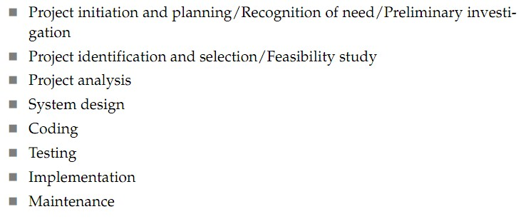
Software Development Life Cycle
Software development life-cycle can be divided
into 5-9 phases:

Slide 6
Outputs of SDLC Phases
SDLC Phase | Input | Output
Requirement gathering /elicitation/Initial phase | Customer or user requirement | URS (user requirement specification)
Analysis phase | URS document | SRS (Software Requirement Specification)
Designing Phase | SRS document | TDD(Technical design document) [UML diagrams etc.]
Coding phase | TDD | Developed software , Abstract code
Testing Phase | Developed software(Build),Test Case,Test Environment. | Quality Product,Test Deliverables,Test Reports, modification/change request.
Implementation | Quality product,Tested and build module / application / solution. | Real time Issues, Application live for User Acceptance Testing and ensure its running with out bug and errors, Operational System
Maintenance | Operational system | working business solution

Slide 7
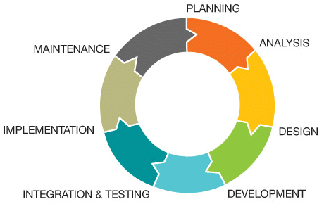
1
2
7
6
3
5
4
Software Development Life Cycle (SDLC)

Slide 8
Software Development Life Cycle
Background on software process models
1950 ：Code-and-fix model
1956 ： Stage-wise model (Bengington )
1970 ： Waterfall model (Royce)
1971 ： Incremental model(Mills)
1977 ： Prototyping model(Bally)
1988 ： Spiral model(Boehm)

Slide 9
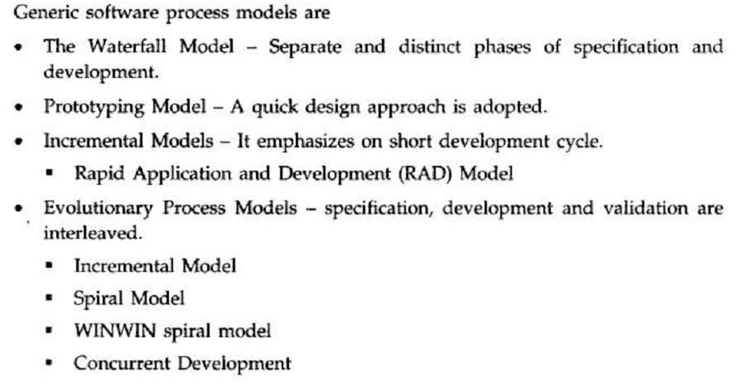
Generic S/W Process Models-

Slide 10
SDLC Models
Waterfall Model
Prototype Model
Spiral Model
Evolutionary Development Model
Iterative Enhancement Model
RAD Model
Agile Model

Slide 11
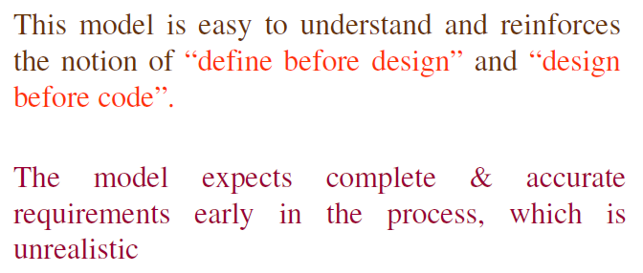
1. Classical Waterfall Model

Slide 12
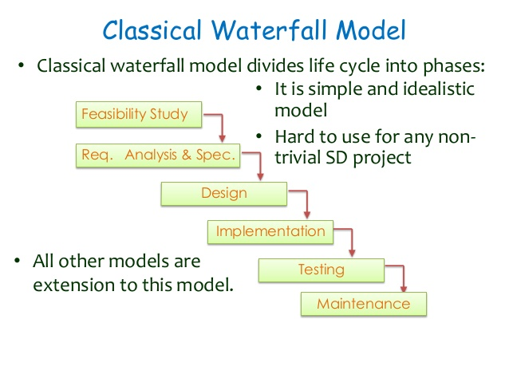
Classical Waterfall Model(Cont..)

Slide 13
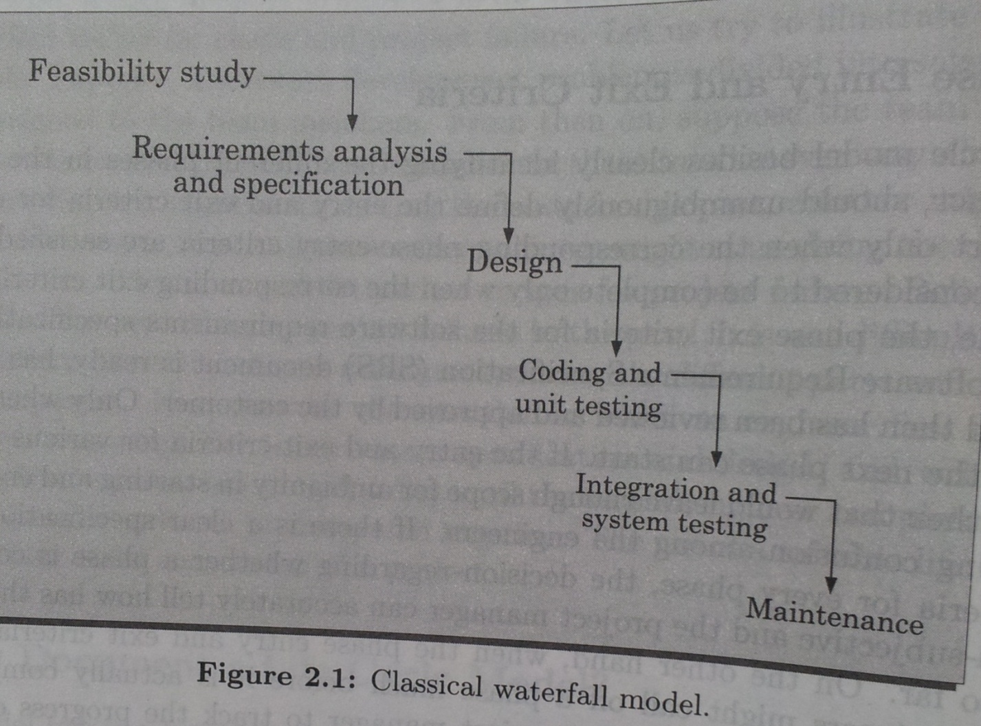

Slide 14
Phases of Waterfall Model(Cont..)
Feasibility study: checking of financially and technical possibility to develop the product.
Requirement Analysis and Specification: The aim of this phase is to understand the exact requirement of the customer and to document them properly.
Requirement Gathering and Analysis: This phase is done to get a clear understanding of the requirements and to remove the inconsistencies and incompleteness in the requirements.
Requirement Specification: The requirement which are gathered are now converted into a specification document known as SOFTWARE REQUIREMENT SPECIFICATION(SRS).

Slide 15
Phases of Waterfall Model(Cont..)
Design: Transform the SRS Document into a structure that can be implemented into some programming language.
Two different approaches
Procedural Design Approach- based on Data Flow oriented design -SA and SD
Object –oriented design- Objects are identified in the problem and solution domain and also identified the relationship among the objects.

Slide 16
Phases of Waterfall Model(Cont..)
Coding and Unit Testing: Translate software design into a source code
This phase is also known as implementation phase.
Integration and System Testing: Integration of different modules are undertaken and system testing perform.
System testing consist of:
Alpha testing
Beta testing
Acceptance testing

Slide 17
Phases of Waterfall Model(Cont..)
Maintenance: last phase of SDLC
It starts when the software is delivered to the user or launched in the market.
Types
Corrective maintenance
Perfective Maintenance
Adaptive Maintenance

Slide 18
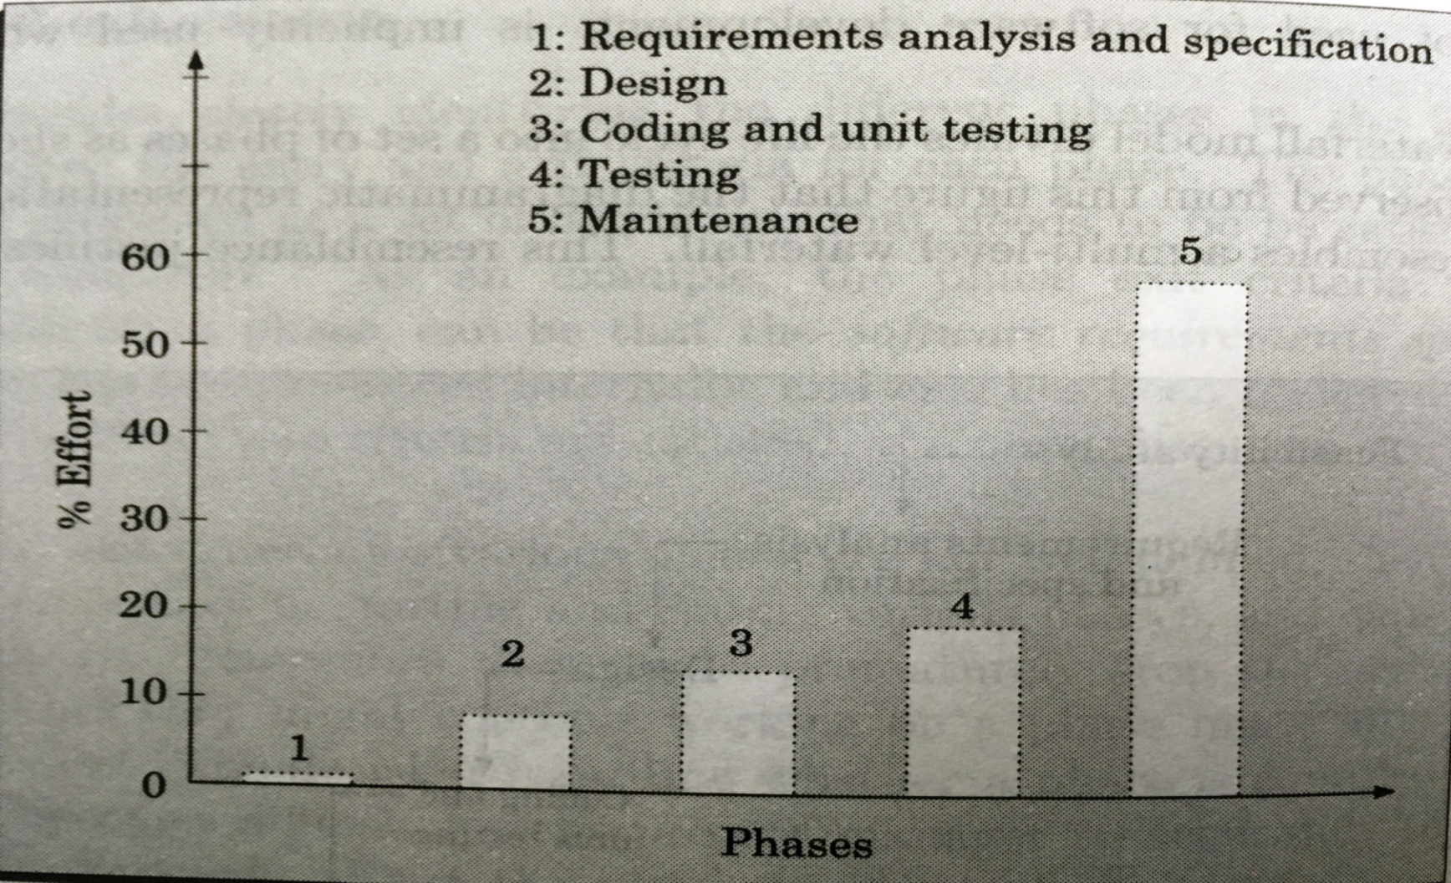
The Effort estimation of Waterfall Model

Slide 19
Advantages
Simple and easy to understand
Easy to manage due to rigidity of requirements
Phases are complete one at a time
Estimation activity is less complex
Suitable for small projects

Slide 20
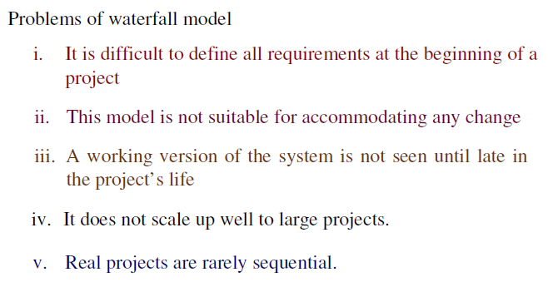
Waterfall Model (cont...)

Slide 21
When to use the Waterfall Model
Requirements are very well known.
When it is possible to produce a stable
design.
a new version of an existing product.
porting an existing product to a new platform.

Slide 22
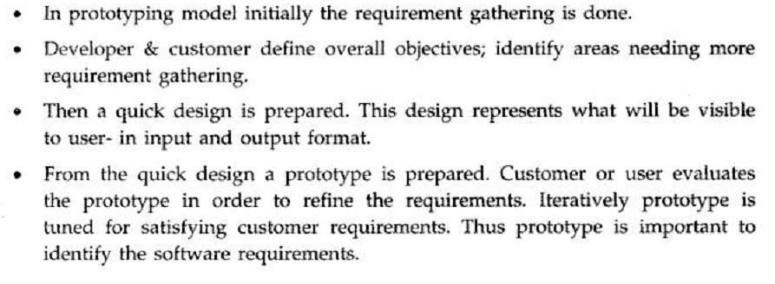
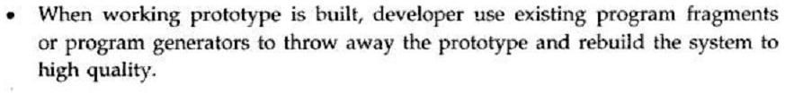
2. Prototype Model

Slide 23
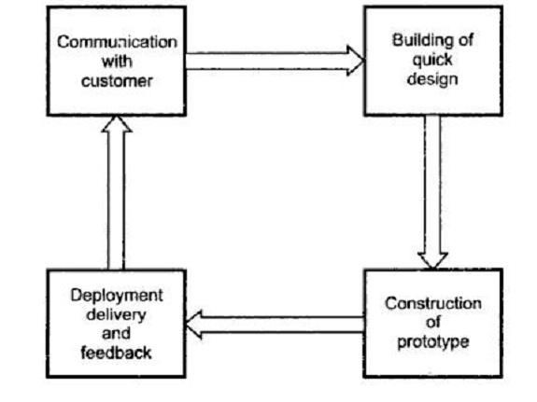
Prototype Model

Slide 24
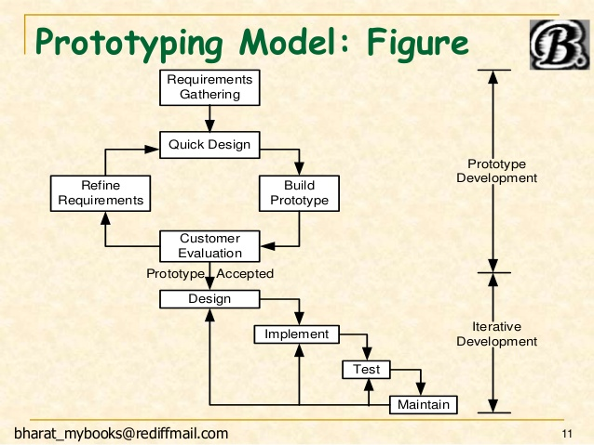

Slide 25
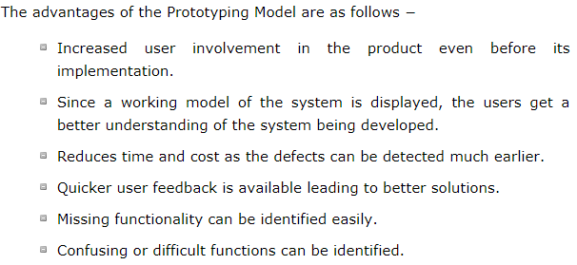
Advantages

Slide 26
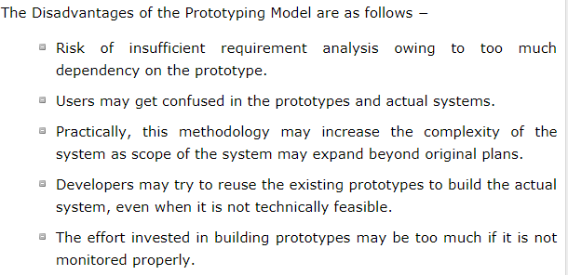
Disadvantages

Slide 27
When to Use…..
Requirements are unstable
Short lived demonstration required
when the desired system needs to have a lot of interaction with the end users.
Typically, online systems, web interfaces have a very high amount of interaction with end users, are best suited for Prototype model. It might take a while for a system to be built that allows ease of use and needs minimal training for the end user.
Prototyping ensures that the end users constantly work with the system and provide a feedback which is incorporated in the prototype to result in a useable system. They are excellent for designing good human computer interface systems.

Slide 28
3. Iterative Enhancement Model
This model has the same phases as the waterfall
model, but with fewer restrictions.
Generally the phases occur in the same order as in the waterfall model, but they may be conducted in several cycles.
Useable product is released at the end of the each cycle, with each release providing additional functionality.

Slide 29
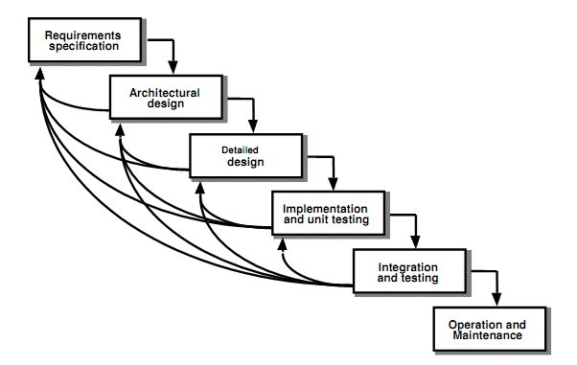
Iterative Enhancement Model

Slide 30
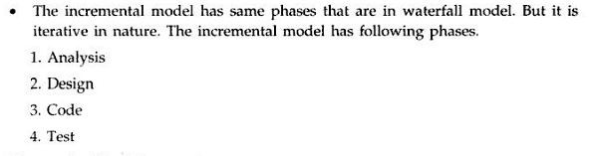
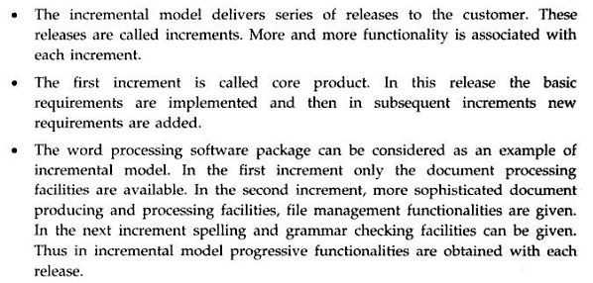
Iterative Enhancement Model(Incremental Model)

Slide 31
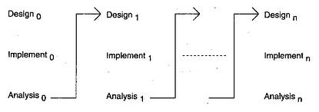

Slide 32
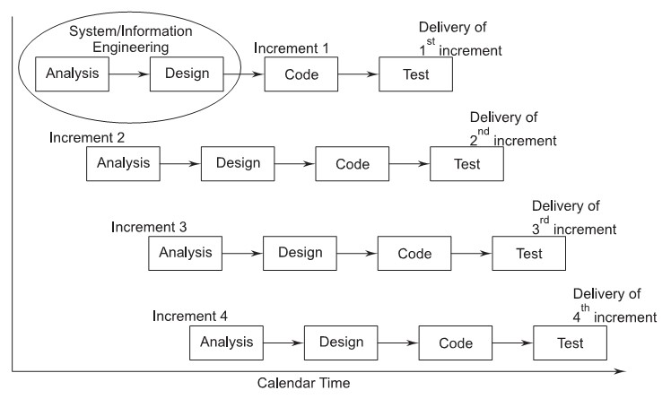
Iterative Enhancement Model(Incremental Model)

Slide 33
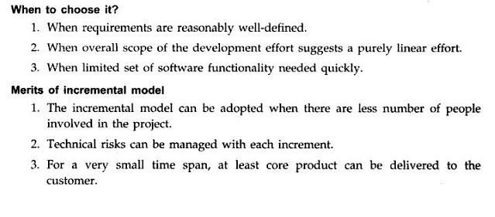
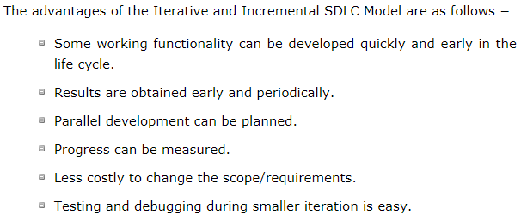
Iterative Enhancement Model(Incremental Model)

Slide 34
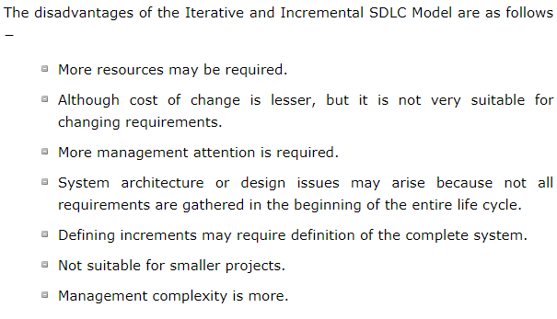
Demerits of Iterative model:
Each phase of an iteration is rigid with no overlaps
Costly system architecture or design issues may arise because not all requirements are gathered up front for the entire lifecycle

Slide 35
4. Spiral Model
The spiral model is intended for large, expensive
and complicated projects.
The spiral model focuses on identifying and eliminating high-risk problems by careful process design.
Boehm defines risk management as a discipline
whose objectives are to-
identify, address, and eliminate software risk items before they become either threats to successful software operation or a major source of expensive software rework.

Slide 36
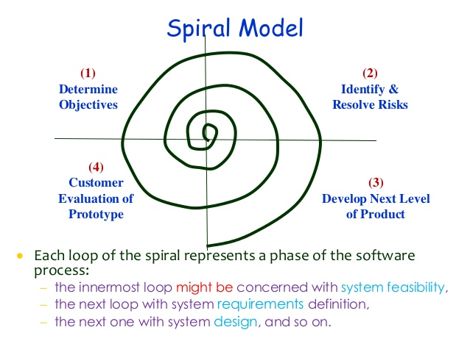
Spiral Model
& Plan for Next phase

Slide 37
Each phase in this model is split into four sectors (or quadrants)
The first quadrant identifies the objectives of the phase and the alternative solutions possible for the phase under consideration.
In the second quadrant we evaluate different alternatives based on the objectives and constraints. The evaluation is based on the risk perceptions for the project.

Slide 38
Each phase in this model is split into four sectors (or quadrants)
The third quadrant is the next step that emphasizes development of strategies that resolve the uncertainties and risks. This may involve activities, such as benchmarking, simulation, and prototyping.
In the last or fourth quadrant we determine the objective that should be fulfilled in the next cycle of our software development in order to build the complete system.

Slide 39
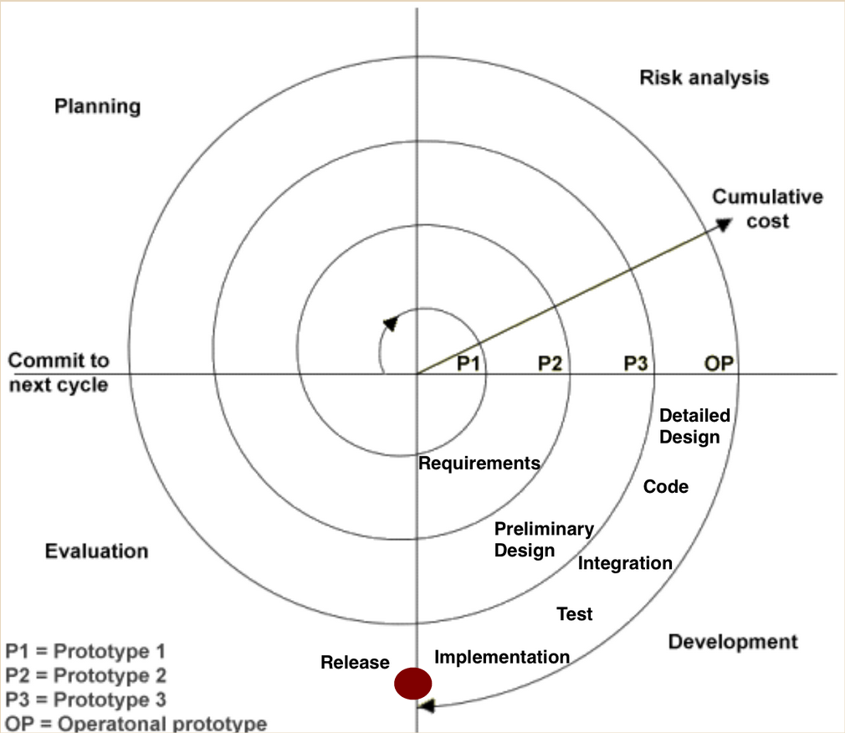
Planning Phase: Requirements are gathered during the planning phase. Requirements like ‘BRS’ that is ‘Bussiness Requirement Specifications’ and ‘SRS’ that is ‘System Requirement specifications’.
Risk Analysis: In the risk analysis phase, a process is undertaken to identify risk and alternate solutions. A prototype is produced at the end of the risk analysis phase. If any risk is found during the risk analysis then alternate solutions are suggested and implemented.
Development Phase: In this phase software is developed, along with testing at the end of the phase. Hence in this phase the development and testing is done.
Evaluation phase: This phase allows the customer to evaluate the output of the project to date before the project continues to the next spiral.

Slide 40
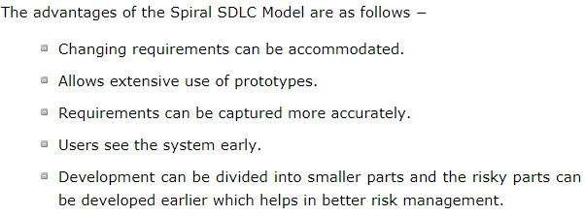
Advantages

Slide 41
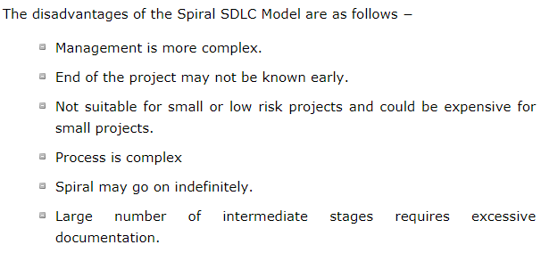
Disadvantages

Slide 42
When to Use Spiral Model….
When costs and risk evaluation is important
For medium to high-risk projects
Long-term project commitment unwise because of potential changes to economic priorities
Users are unsure of their needs
Requirements are complex
New product line
Significant changes are expected (research and exploration)

Slide 43
5. Evolutionary/Incremental Development Model
Evolutionary model (aka successive versions or
incremental model):
> The system is broken down into several modules which can be incrementally implemented and delivered.
First develop the core modules of the system.
The initial product skeleton is refined into increasing levels of capability:
> by adding new functionalities in successive versions.

Slide 44
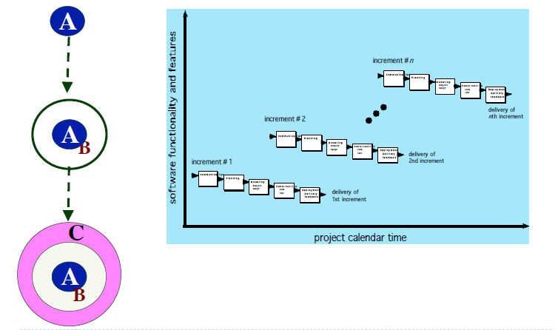
Incremental Model

Slide 45
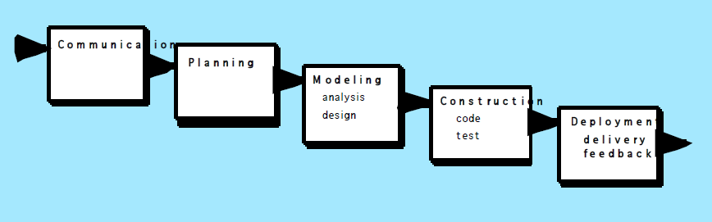

Slide 46
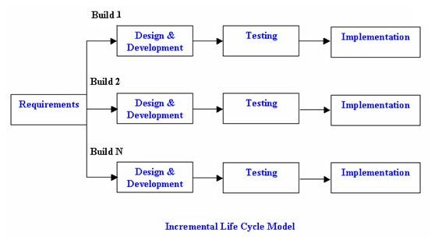
.
.

Slide 47
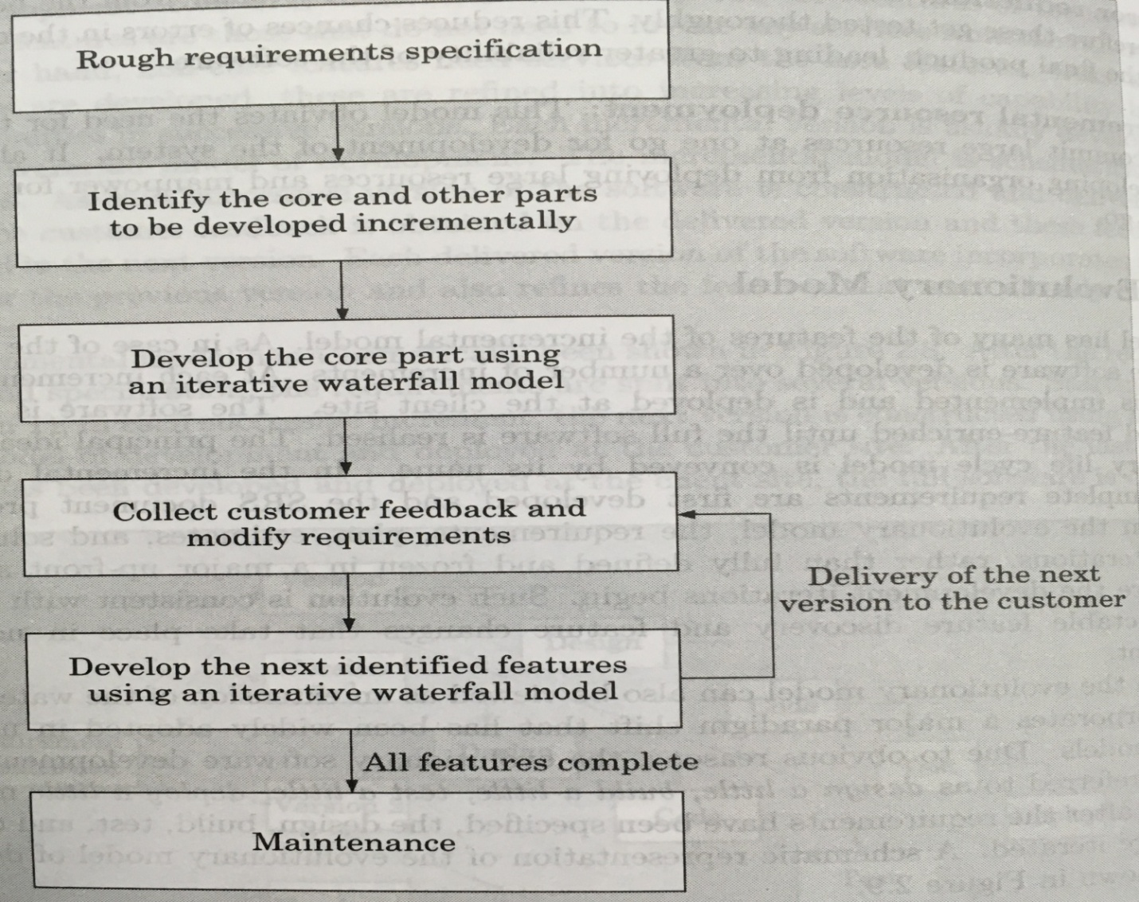
Evolutionary Development Model
Contains many features
of incremental model
2. Sometimes referred to
as design a little,
build a little,
test a little,
deploy a little model.

Slide 48
Advantages
Generates working software quickly and early during the software life cycle.
This model is more flexible – less costly to change scope and requirements.
It is easier to test and debug during a smaller iteration.
In this model customer can respond to each built.
Lowers initial delivery cost.
Easier to manage risk because risky pieces are identified and handled during it’s iteration.
Error reduction
Incremental resource deployment

Slide 49
Disadvantages
Needs good planning and design.
Needs a clear and complete definition of the whole system before it can be broken down and built incrementally.
Total cost is higher than waterfall.
Ad hoc design
Feature division into incremental parts can be non-trivial

Slide 50
When to use
This model can be used when the requirements of the complete system are clearly defined and understood.
Major requirements must be defined; however, some details can evolve with time.
There is a need to get a product to the market early.
A new technology is being used
Resources with needed skill set are not available
There are some high risk features and goals.
The evolutionary model is well-suited to use in Object-oriented software development projects.

Slide 51
6.Rapid Application Development(RAD)Model
Rapid Application Development is a linear sequential software development process model that emphasizes an extremely short development cycle.
Rapid application achieved by using a Component Based Construction approach.
If requirements are well understood and project scope is constrained the RAD process enables a development team to create a ―”fully functional system” within very short time periods (e.g., 60 to 90 days).

Slide 52
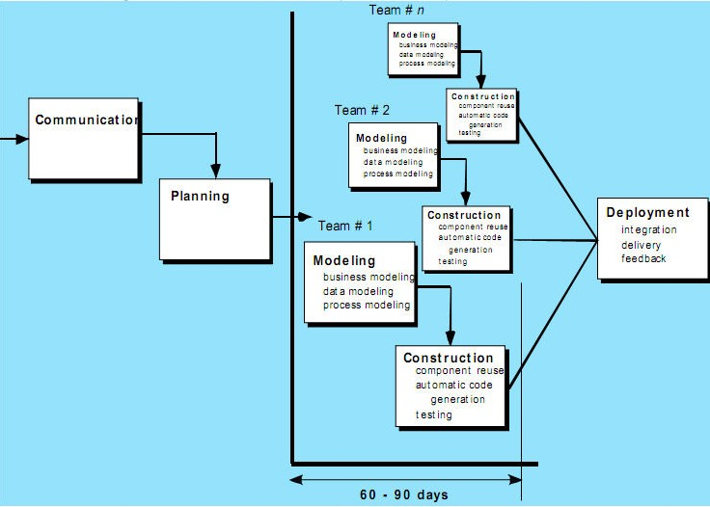

Slide 53
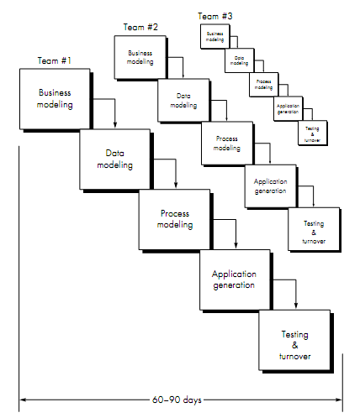

Slide 54
RAD Phases :
Business modeling.
Data modeling.
Process modeling.
Application generation.
Testing and turnover.

Slide 55
RAD Phases involve:
Business Modeling:
The information ﬂow among business functions is
modeled in a way that answers the following questions-
Where does information come from and go ?
Who processes it ?
What information drives the business process?
What information is generated ?
Data Modeling:
The information flow defined as part of the business modeling phase is refined into a set of data objects that are needed to support the business.
The characteristics (called attributes) of each object are identified and the relationships between these objects are defined.

Slide 56
RAD Phases involve:
Process modeling:
The data modeling phase are transformed to achieve the information flow necessary to implement a business function.
To add, modify, delete, or retain a data object, there is a
need for description which is done in this phase.
Application generation:
RAD assumes the use of 4 generation techniques.
Rather than creating software using conventional 3 generation programming languages, the RAD process works to reuse existing program components (when possible) or created reusable components (when necessary).

Slide 57
RAD Phases involve:
Testing and Turnover:
Since the RAD process emphasizes reuse, many of the program components have already been tested.
So we use some these already existing programs which are already tested.
This reduces over all testing time.
However, new components must be tested and all interfaces
must be fully exercised.

Slide 58
Advantages & Disadvantages of RAD:
Advantages-
1.Reduced development time.
2.Uses component-based construction and emphasizesreuse and code generation.(Increases reusability of components)
3.Quick initial reviews occur
4.Encourages customer feedback
5.Integration from very beginning solves a lot of integration issues.

Slide 59
Disadvantages-
For large, but scalable projects, RAD requires sufficient human resources to create the right number of RAD teams.
Requires strong commitment between developers and customers for “rapid-fire” activities
High performance requirements maybe can’t meet (requires tuning the components).
Depends on strong team and individual performances for identifying business requirements.
Only system that can be modularized can be built using RAD
Requires highly skilled developers/designers.
High dependency on modeling skills
Inapplicable to cheaper projects as cost of modeling and automated code generation is very high.

Slide 60
When to use RAD model:
RAD should be used when there is a need to create a system that can be modularized in 2-3 months of time.
It should be used if there’s high availability of designers for modeling and the budget is high enough to afford their cost along with the cost of automated code generating tools.
RAD SDLC model should be chosen only if resources with high business knowledge are available and there is a need to produce the system in a short span of time (2-3 months).
For customized software
For Non-critical software
For highly constraint project schedule
For large software

Slide 61
Selection of a Life Cycle Model
Selection of a model is based on:
Requirements.
Development team.
Users.
Project type and associated risk.

Slide 62
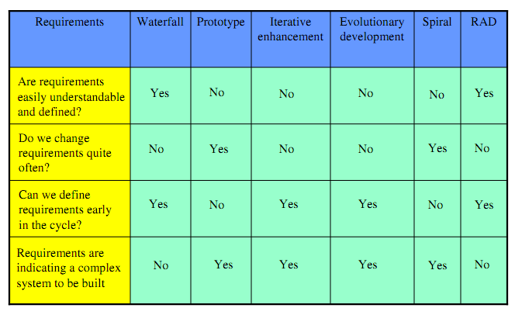
Based On Characteristics Of Requirements

Slide 63
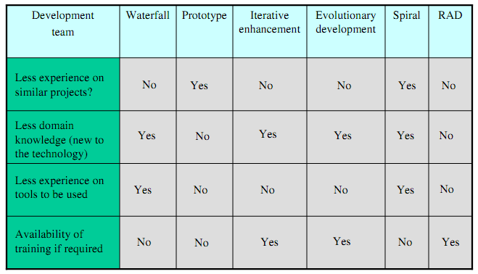
Based On Status Of Development Team

Slide 64
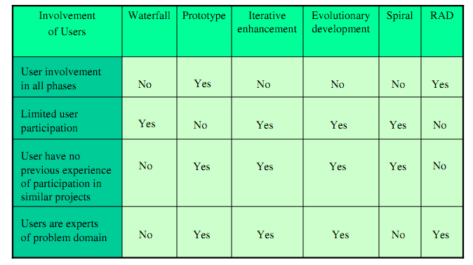
Based On User’s Participation

Slide 65
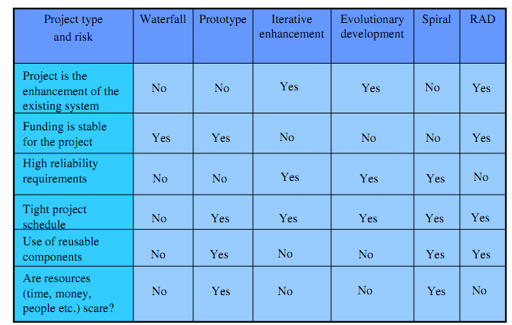
Based On Type Of Project With Associated Risk

Slide 66
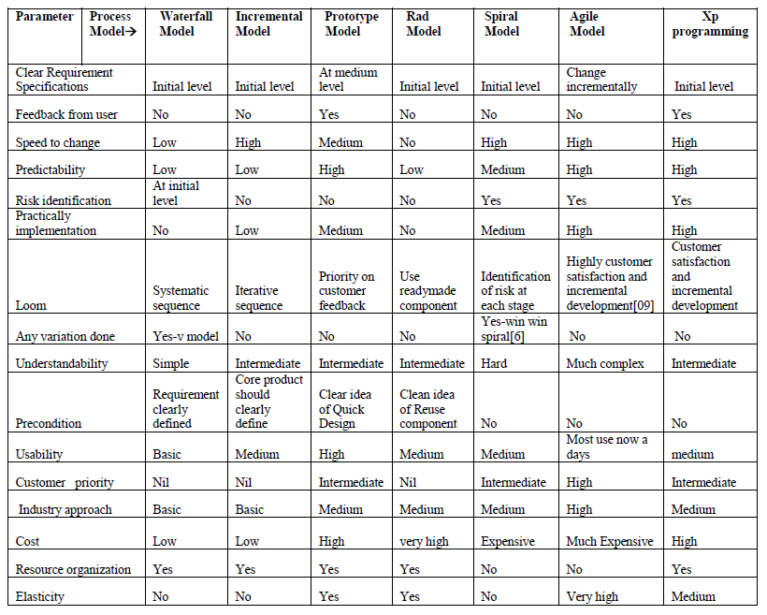
Comparison/Selection of various Software Models

Slide 67
END OF Unit-II

