Slide 1
JSON APIs
By James Brown
05/24/2020

Slide 2
TOPICS
What are JSON APIs?
JSON API vs SOAP API
JSON Request Headers
JSON Request Body
JSON Response Body

Slide 3
What are JSON APIs
Application Program interfaces that sends data in JavaScript Object Notation.
Use RESTful architecture
A collection of key/value pairs
These key/value pairs can be strings, objects, arrays, booleans, and more.
These are replacing SOAP APIs

Slide 4
JSON APIs vs SOAP APIs
SOAP is a protocol, whereas JSON is an object
JSON uses javascript object notation whereas SOAP uses XML
JSON is lighter on bandwidth in comparison to SOAP
Since JSON is the lighter solution, processing speeds are quicker than SOAP APIs
JSON apis use a RESTFUL architecture, whereas SOAP is it’s own architecture

Slide 5
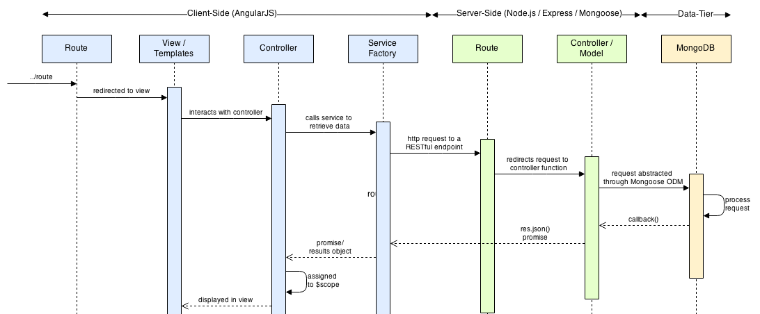
End to End Data Flow

Slide 6
JSON Request Header
Where you specify:
API end-point
content type
Authorization
Custom key value pairs (an example of this would be to pass a value to specify a particular mode of an application)

Slide 7
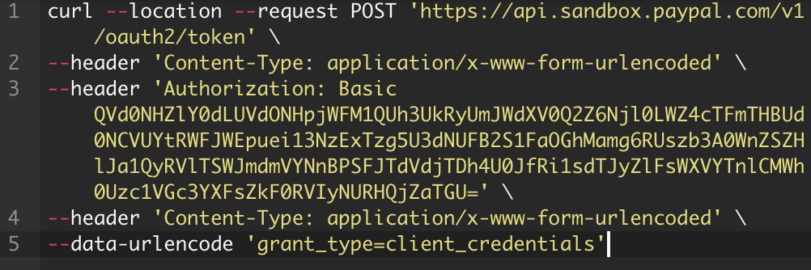
JSON Request Header Example

Slide 8
JSON Request Body
This is where you declare your key/key value pairs.
Can contain:
Objects
Arrays
Booleans
And more

Slide 9
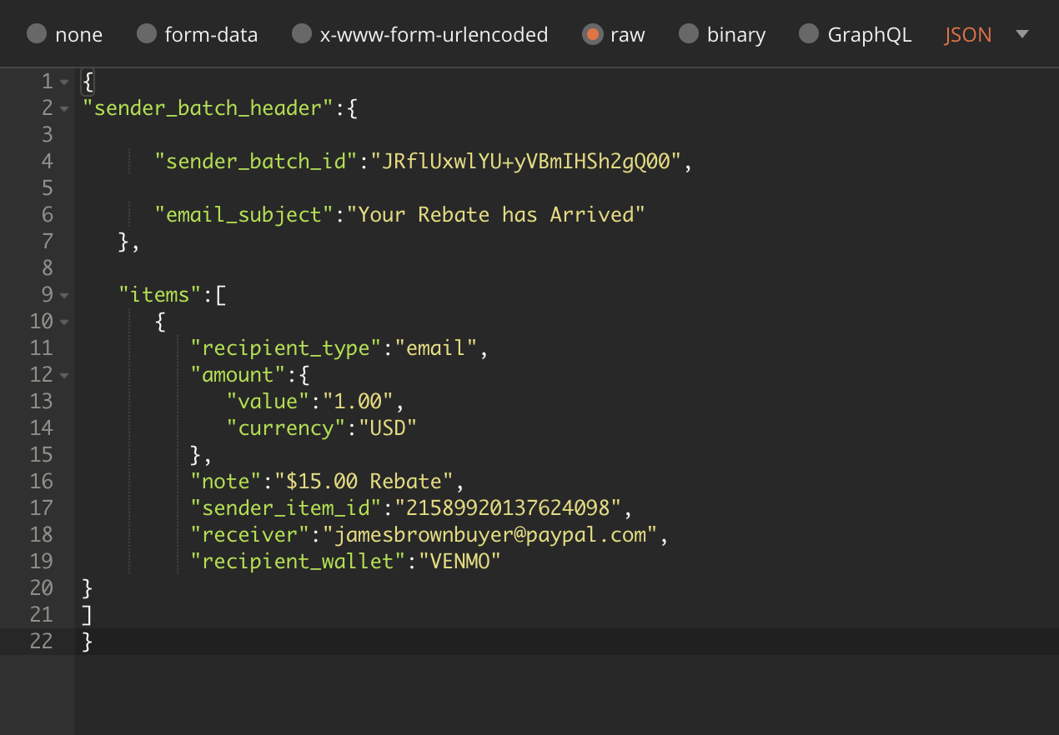
JSON Request Body Example

Slide 10
JSON Response Body
The response body is the result you get from the API when it is invoked
This contains key value pairs
These details allow you to make decisions with your application based on the result

Slide 11
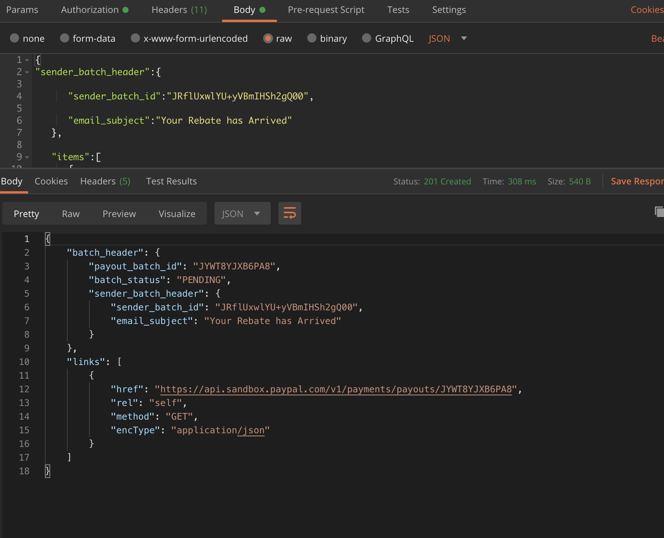
JSON Response Body Example

Slide 12
Sources
“Calling Third-Party HTTP-Based RESTful APIs from the MEAN Stack.” Programmatic Ponderings, 13 Jan. 2015, programmaticponderings.com/2015/01/06/calling-third-party-web-apis-from-the-mean-stack/.
“REST.” – REST API Tutorial, restfulapi.net/json-syntax/.

