Slide 1
Hypermedia Design Business Use Case
By James Brown
06/7/2020

Slide 2
TOPICS
Observations
Solution
Semantic Descriptors
State Diagram
Media Type
JSON Response Body
Source

Slide 3
Observations Of The Business
We are seeing a lot of API abandonment as your service requires the user register an API key before it can be used.
This is leading to developers abandoning your services as they don’t know why it is necessary for them to register an account and create an API key.
Developers don’t know how to register for an API key.
Your email support has fielded over 2000 emails on this issue in the last 2 months.

Slide 4
Solution
A way to resolve this would be to offer a set number of API calls that do not require an account. Each call will return the number of free calls that remain, along with a link that points to instructions for creating an account.
This will drive more engagement as users get a taste of what the software has to offer, while at the same time staying informed.

Slide 5
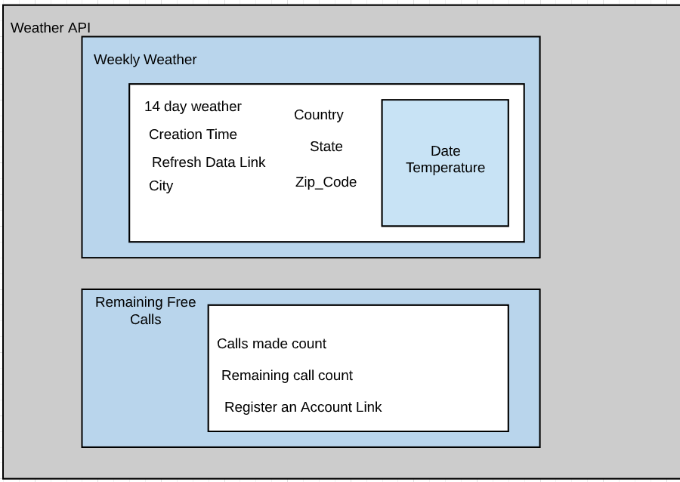
Semantic Descriptors

Slide 6
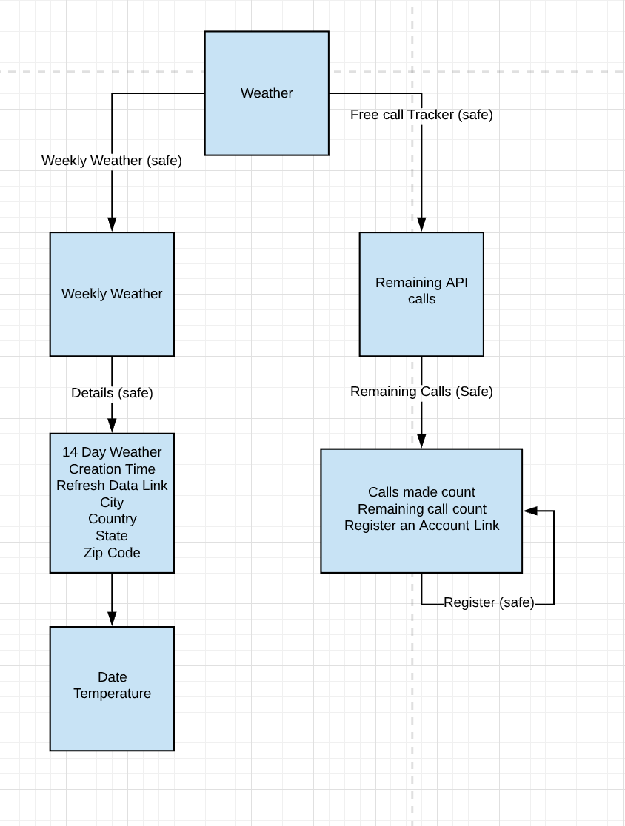
State Diagram

Slide 7
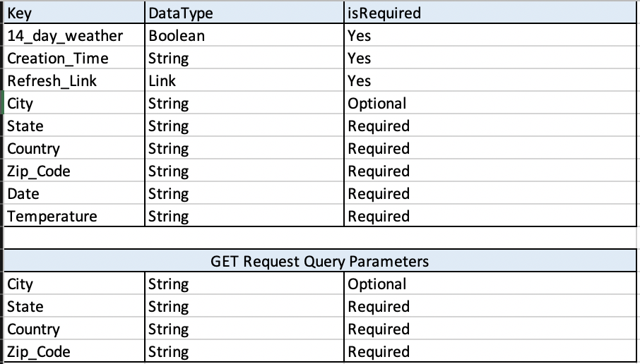
Media Type (JSON)

Slide 8
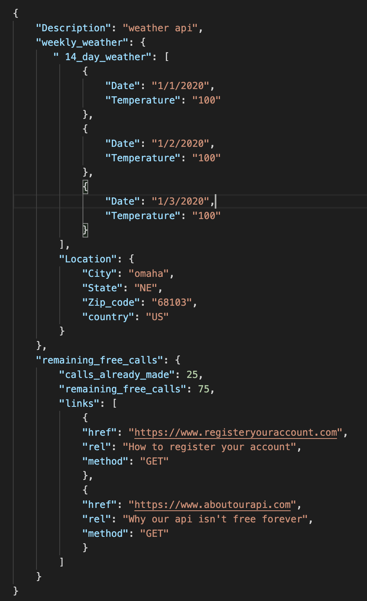
JSON Response Body of GET Request

Slide 9
ROI
Less API abandonment
Increased usage
Less consumer confusion
Allows the client a streamlined way of onboarding
Less calls to support center for unauthorized access errors because api is transparent

Slide 10
Source
Richardson, L., & Amundsen, M. (2013). RESTful Web APIs.

Slide 11
Thank you for your time. Questions?

