Slide 1
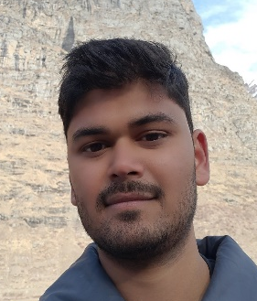


Rahul Sahu
Career Summary: Experienced Frontend developer with Angular, React, JS, etc and with hands-on experience on Java Spring in backend.
A
Photo
Career Highlights
Currently working as Software Applications Engineer II (Frontend) in HP Inc. since last 2 years and 6 months.
Worked 9 months in Highradius Co. as a Full stack developer.
Education
B.Tech. in Computer Science and Engineering
From Kalinga Institute of Industrial Technology, Bhubaneshwar, IN
Career aspirations (Top 3)
Medium Term:-
Become Expert in Frontend Development.
Acquire intermediate level experience in Backend development.
Get hands-on DevOps.
Long Term:-
Become expert in Backend development.
Become expert in DevOps.
Current Position: Software Applications Engineer II
Job Level: Intermediate
Organization size:
Reporting Manager: Tushar Govalkar
Key Strengths: Frontend (Angular, React, JS, etc.)
Development Actions: Backend ( Java Spring )
IND
Time in Current Role: 3 months
HP Tenure: 3 years 6 months
Total Work Experience: 3 years 3 months
Work Location: Bangalore, IN
Home Location: Indore, IN

Slide 2
Rahul Sahu
DTO DXT
My career map

