Slide 1

GitHub Copilot Hackathon
Theme 1: Weather Forecasting Tool (Python)
Solution Name: WeatherSense
Team Name - Python Pappus
Team Leader Name - Rishiraj Biswas
Team Leader Email Address - biswas.rishiraj@gmail.com

Slide 2

Brief Summary of Project:
Weather Forecasting Tool has been made using openweathermap API and Tkinter. We got the API key generated from openweathermap.org and then used it to get the json data of different places around the world. We did data parsing to convert the unstructured json data to a structured format.
We made use of GitHub Copilot to generate the remaining lines of code for creating the user interface and extracted information like temperature,humidity, wind speed from the json data for the present day and displayed it on a GUI using Tkinter.
We got additional information like maximum and minimum temperatures of the next four days from the present day.
We will integrate the chatbot with the GUI to make a personalized weather assistant which will help the users to plan out their activities in advance.

Slide 3
Business Challenge /Use Cases
Monetization through Advertising: We can integrate targeted advertisements within our application to generate revenue. Ad networks or partnerships with local businesses can be explored for displaying relevant ads to users based on their location or weather preferences.
Premium Features or Subscription Model: Offering additional features or enhanced functionality as part of a premium version or subscription model can be implemented to increase revenue. Users who require more advanced weather data, extended forecasts, or personalized notifications can upgrade to a paid version of the application.

Slide 4
White Labelling or Licensing: Offering our weather application as a white-label solution to other businesses, allowing them to rebrand and customize the app with their logo and branding. Basically, we can license the application to other companies or organizations that want to provide weather information to their users.
Data Analytics and Insights: Utilizing the data collected by our application to provide valuable insights and analytics to businesses. Many Companies in industries like tourism, agriculture, or logistics are interested in weather data to make informed decisions and optimize their operations. Our application can offer data packages as per requirement to such businesses.

Slide 5
Partnerships with Travel or Outdoor Industry: Another business solution is collaboration with travel agencies, airlines, outdoor recreation companies, or event organizers to provide weather information to their customers. This can involve integration with their websites, mobile apps, or marketing campaigns, helping users plan their activities based on weather conditions.
Integration with Smart Home Devices: Exploring partnerships with manufacturers of smart home devices, such as smart thermostats or voice assistants. Integrate your weather application with these devices to provide real-time weather updates and enable users to control their home environment based on the weather conditions.

Slide 6
Proposed Solution
We are making use of OpenWeatherMap API in order to get the raw data in the json format.
We will be making use of Tkinter to build the User Interface of the project.
We are converting the unstructured data into a structured data-frame by parsing it with the use of python language.
We are generating the python code for weather forecasting using GitHub Copilot and also planning to make use of Microsoft cloud services for storing the data as historical data and then using the desired amount of data from the cloud to forecast the weather.

Slide 7
We will be incorporating the concept of personalized weather forecasting in our model and be using GitHub Copilot to generate the python code for it.
The OpenWeatherMap API will display the additional information like humidity, wind speed, wind direction with the temperature forecasting once the user types the desired city in the command line interface.
The chatbot will be designed to engage in conversation with users, understand their queries about weather conditions, and provide relevant forecasts, current weather data, and other weather-related information.

Slide 8
Innovation Quotient:
Personalized weather updates empower individuals by delivering customized weather forecasts that align with their specific location, preferences, and lifestyle, facilitating informed decision-making and enabling them to make the most of their daily activities while staying safe and comfortable.
So we plan integrate a user-friendly Chat Bot in our solution which will function between the user and our weather forecasting tool to provide personalised weather updates
Our end product will function more like a Weather Assistant and be able answer queries like “Can I play cricket today at 5pm?” or “Is it safe to travel today?” assisting the user to make informed decisions in his/her daily life

Slide 9
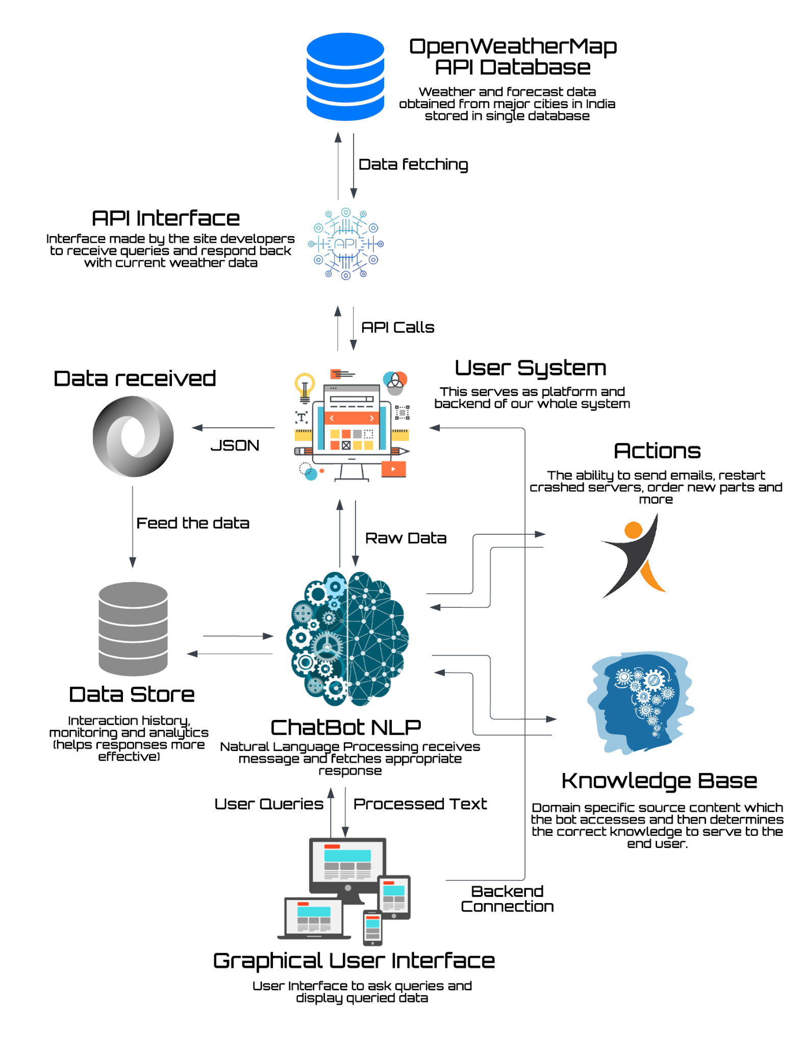
High Level
Architecture

Slide 10
Technology/Tool Stack Used:
OpenWeatherMap api - for getting access to weather details
Python programming language
Tkinter to create our graphical user interface (GUI)
GeoPy library for accessing geographical locations
Nominatim package of GeoPy library to get city coordinates & geocoding
timezonefinder to get timezone details of the city user has searched
requests library to get the json data from OpenWeatherMap api and use it according to our requirements

Slide 11
Mention of usage of Github Copilot
GitHub copilot has been quite useful for us in creating and implementing the prototype as it has auto-suggested pieces of code as per our requirements and in accordance with the flow of our code.
For predicting forecast of the upcoming days, some of the code was repetitive but copilot understood the formation and implementation of our code and accurately suggested the next few lines, saving a lot of time.

Slide 12
For the initial CLI version of our tool, the entire program was written using GitHub Copilot. We gave prompts explaining each function and Coplit wrote entire functions which required minimum to no changes
In the getWeather() function we have used, copilot helped us how to input city name from the user and get it's respective timezone using the geolocator and TimeZoneFinder.
Copilot also helped us retrieve data from then OpenWeatherMap api and use it in a constructive way on the UI. We also utilized copilot for designing the user interface and most importantly for weather forecasting.

Slide 13
Source code in zip file / Github link :
https://github.com/therealsgopi/Weather-Forecasting-using-Python

Slide 14
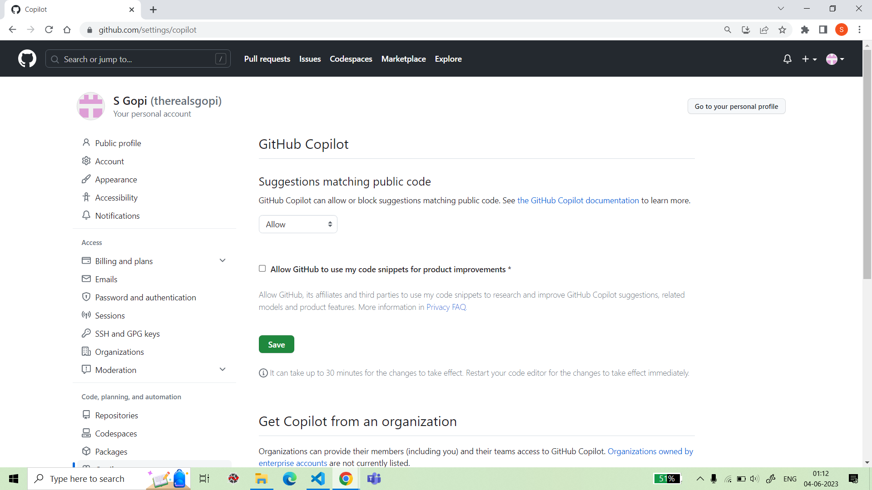
Screenshots showing usage of the
GitHub Copilot Platform :

Slide 15
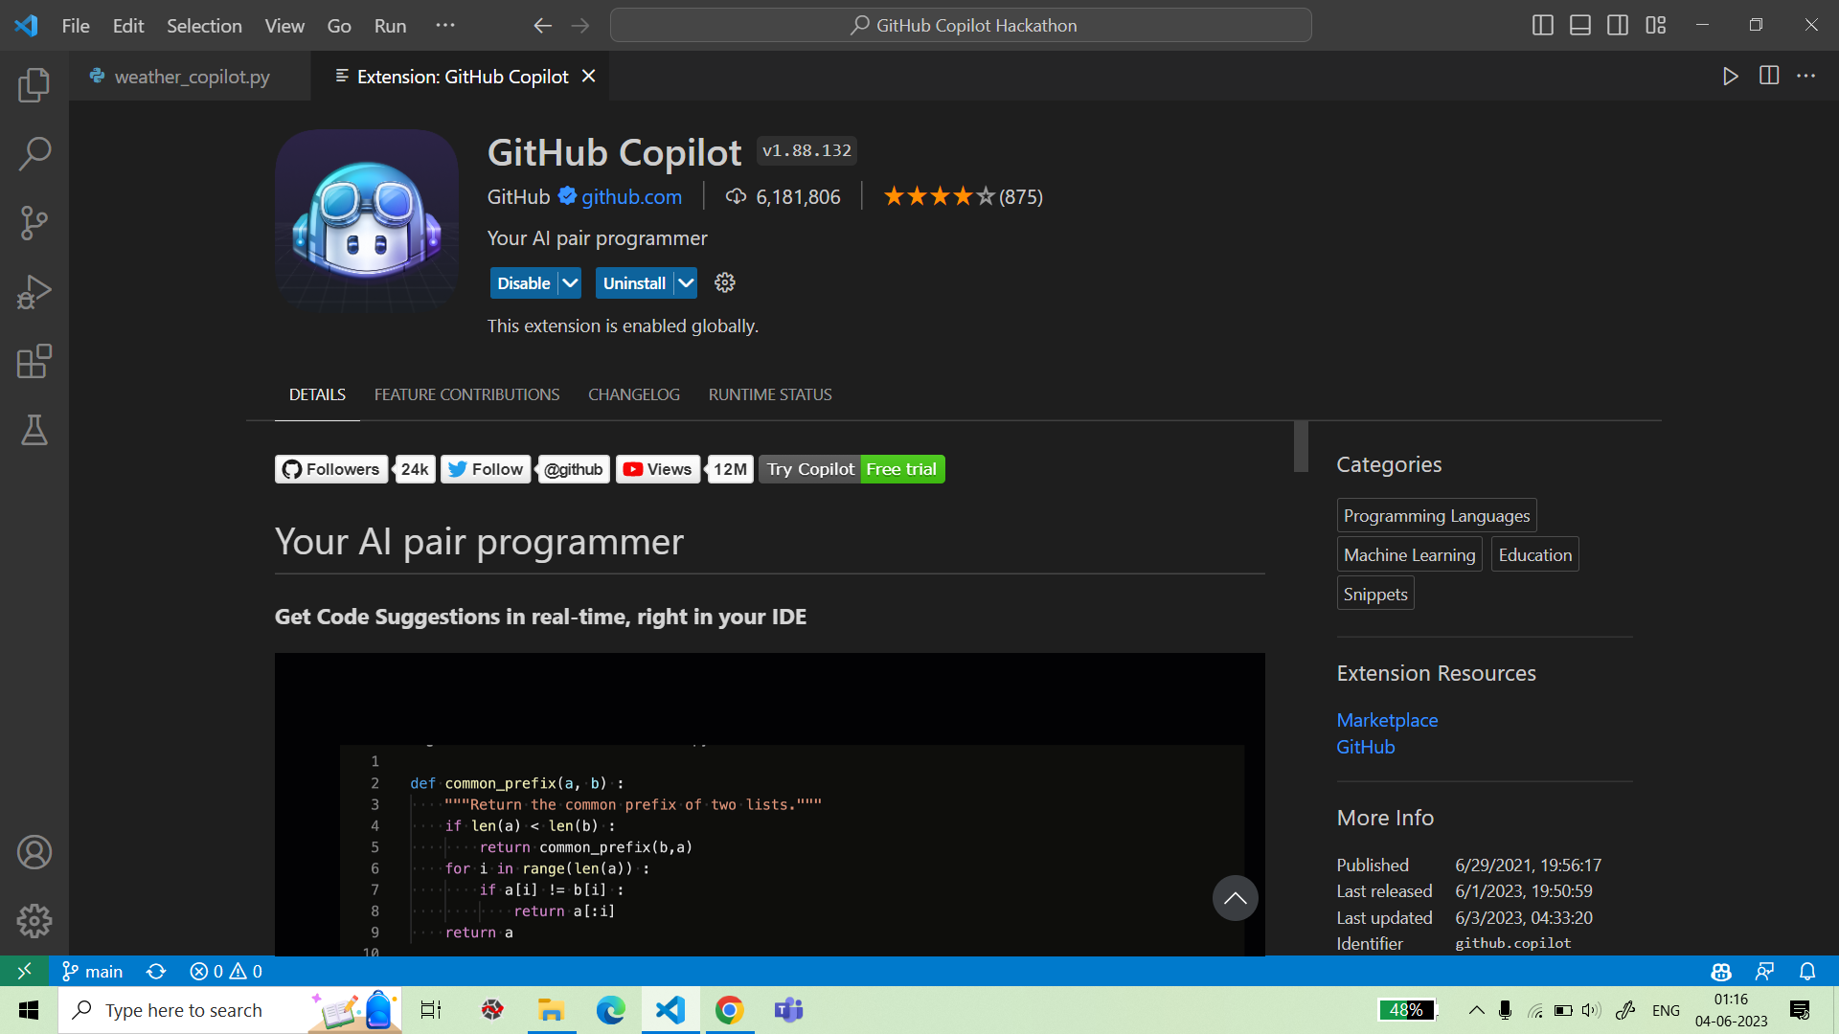
Screenshots showing usage of the
GitHub Copilot Platform :

Slide 16
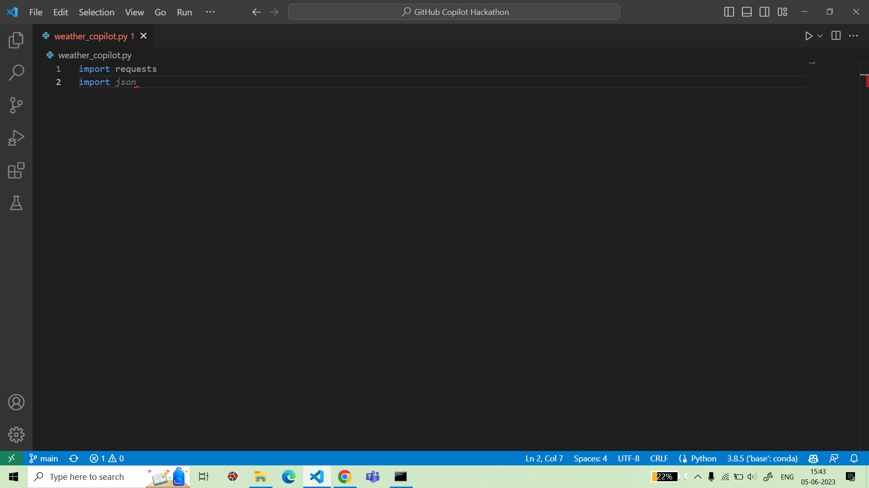
Screenshots showing usage of the
GitHub Copilot Platform :

Slide 17
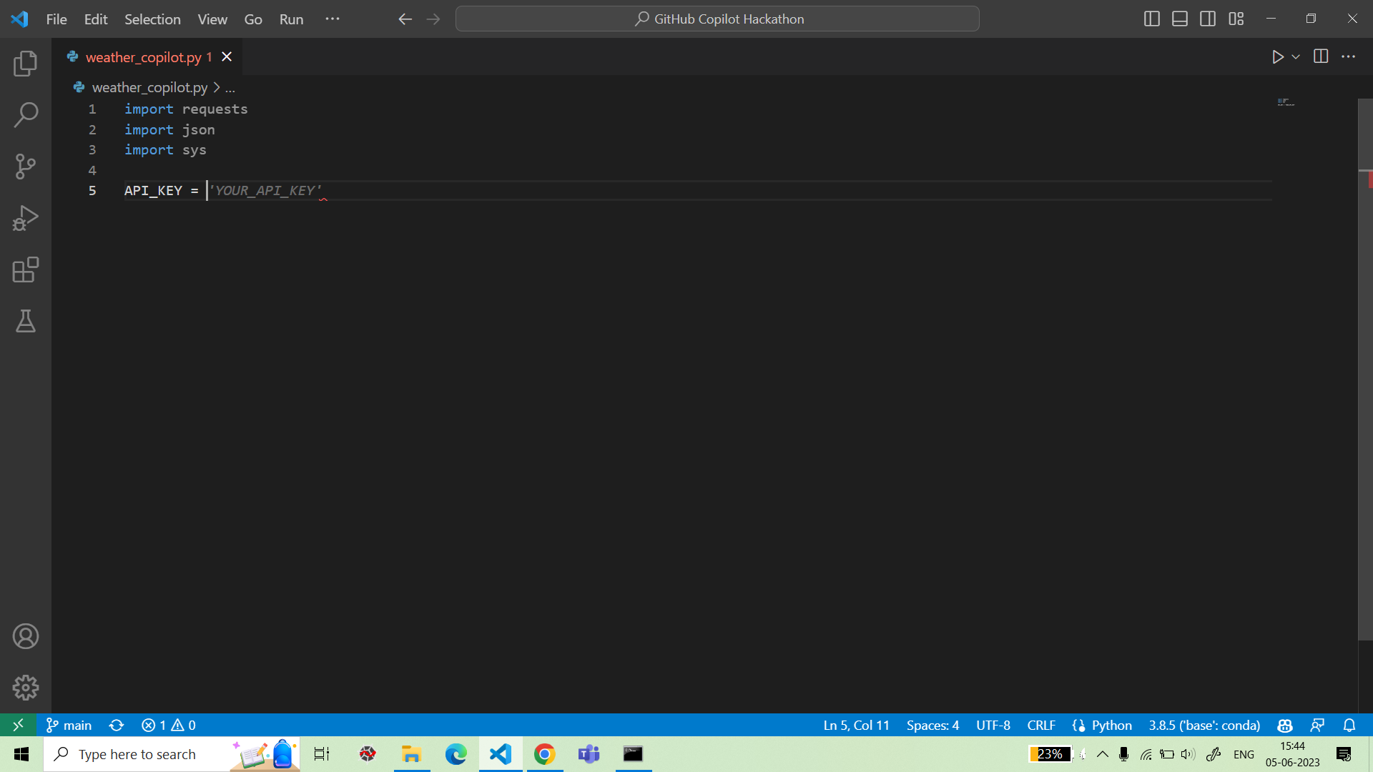
Screenshots showing usage of the
GitHub Copilot Platform :

Slide 18
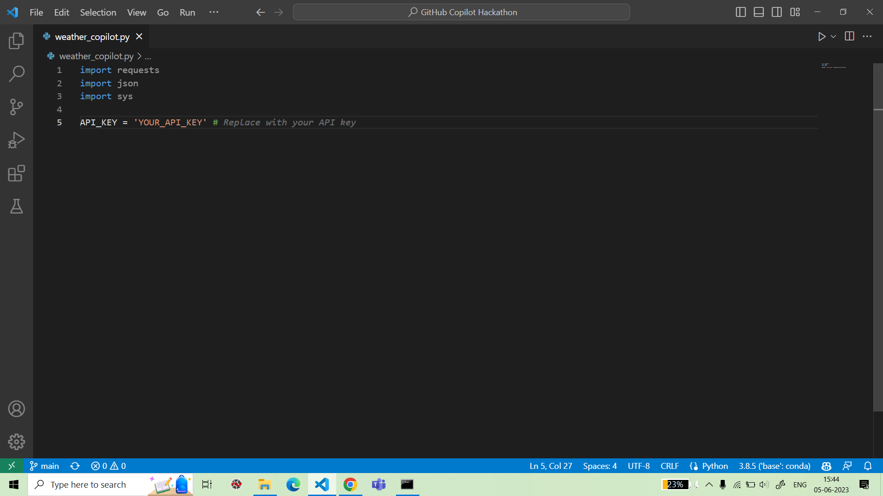
Screenshots showing usage of the
GitHub Copilot Platform :

Slide 19
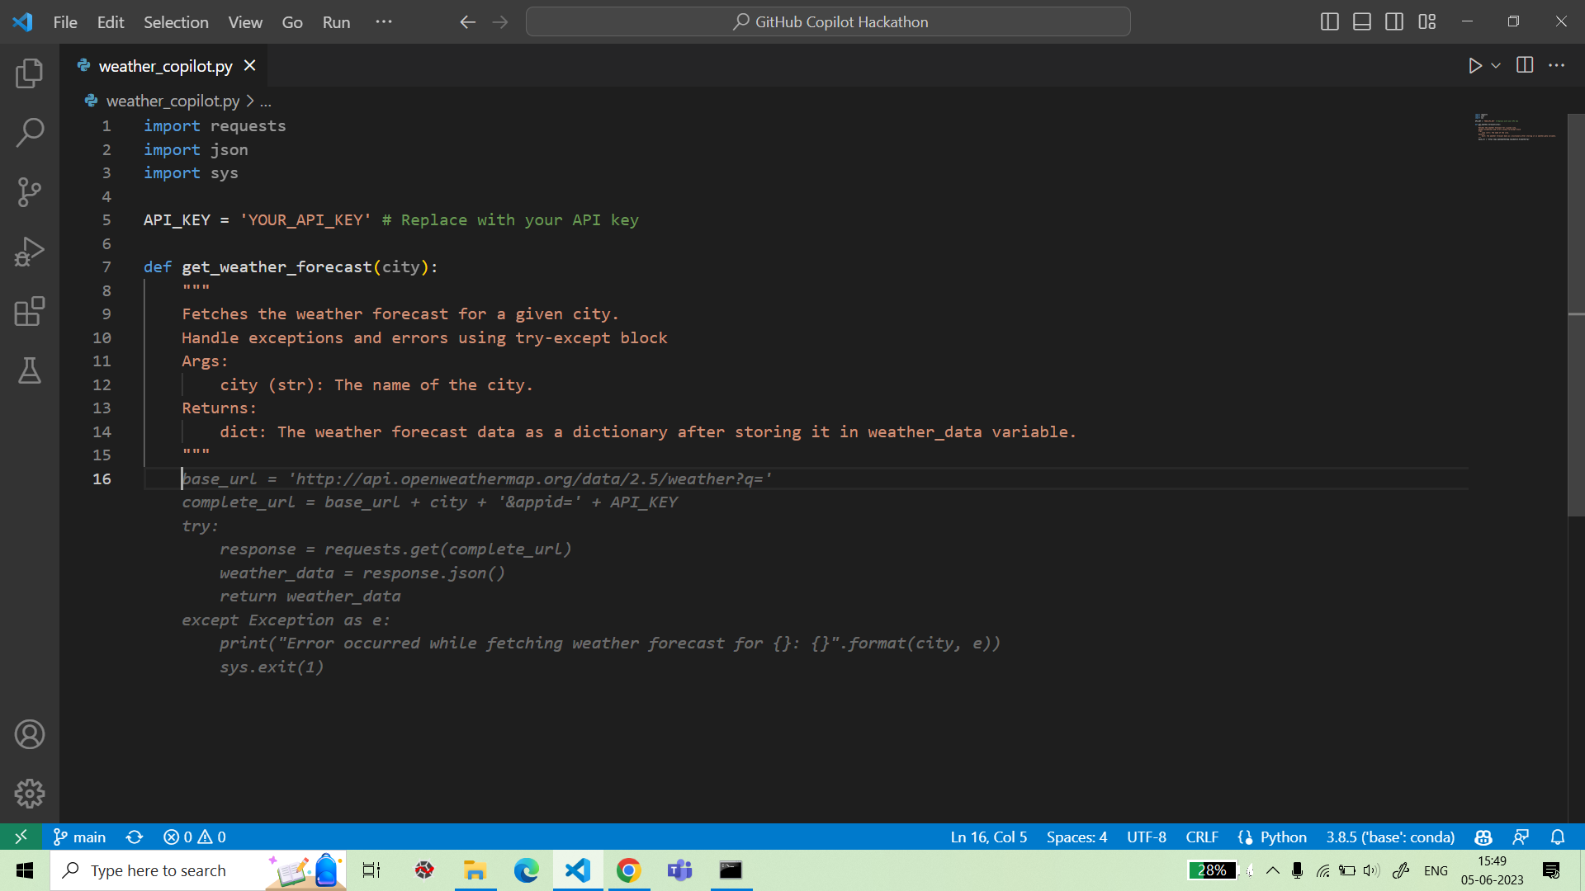
Screenshots showing usage of the
GitHub Copilot Platform :

Slide 20
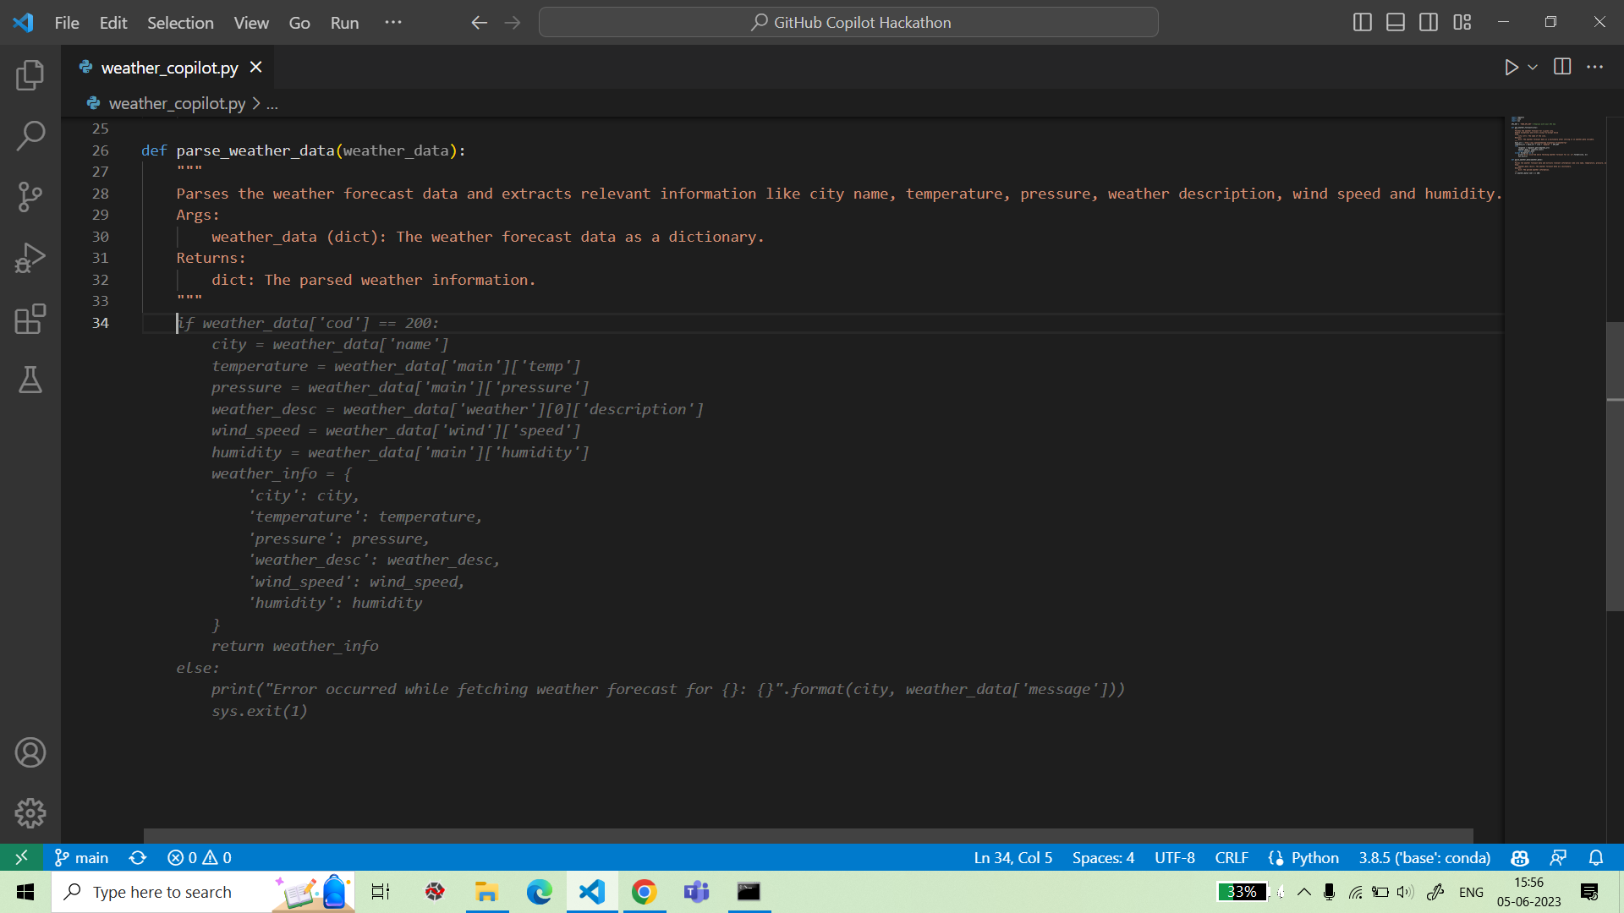
Screenshots showing usage of the
GitHub Copilot Platform :

Slide 21
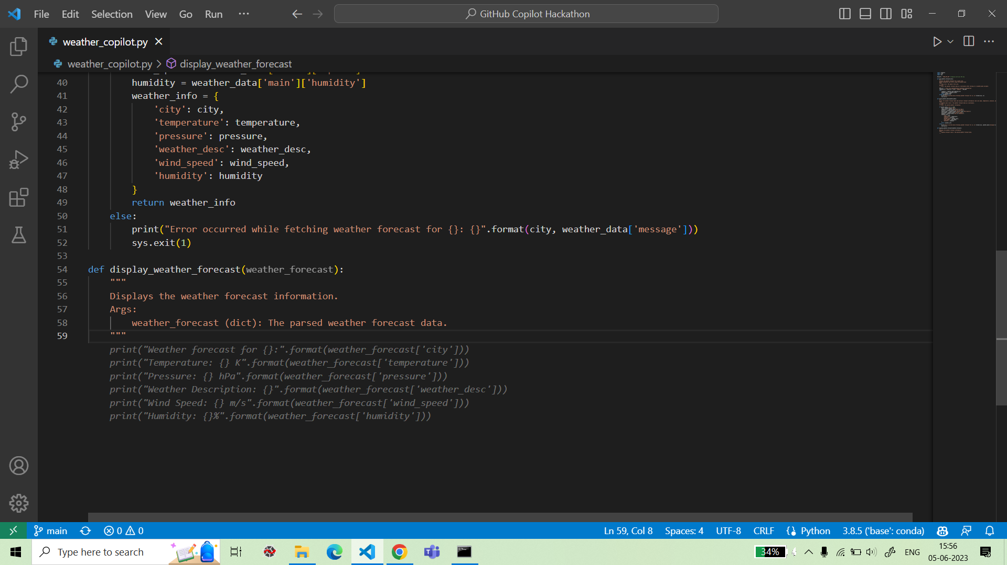
Screenshots showing usage of the
GitHub Copilot Platform :

Slide 22
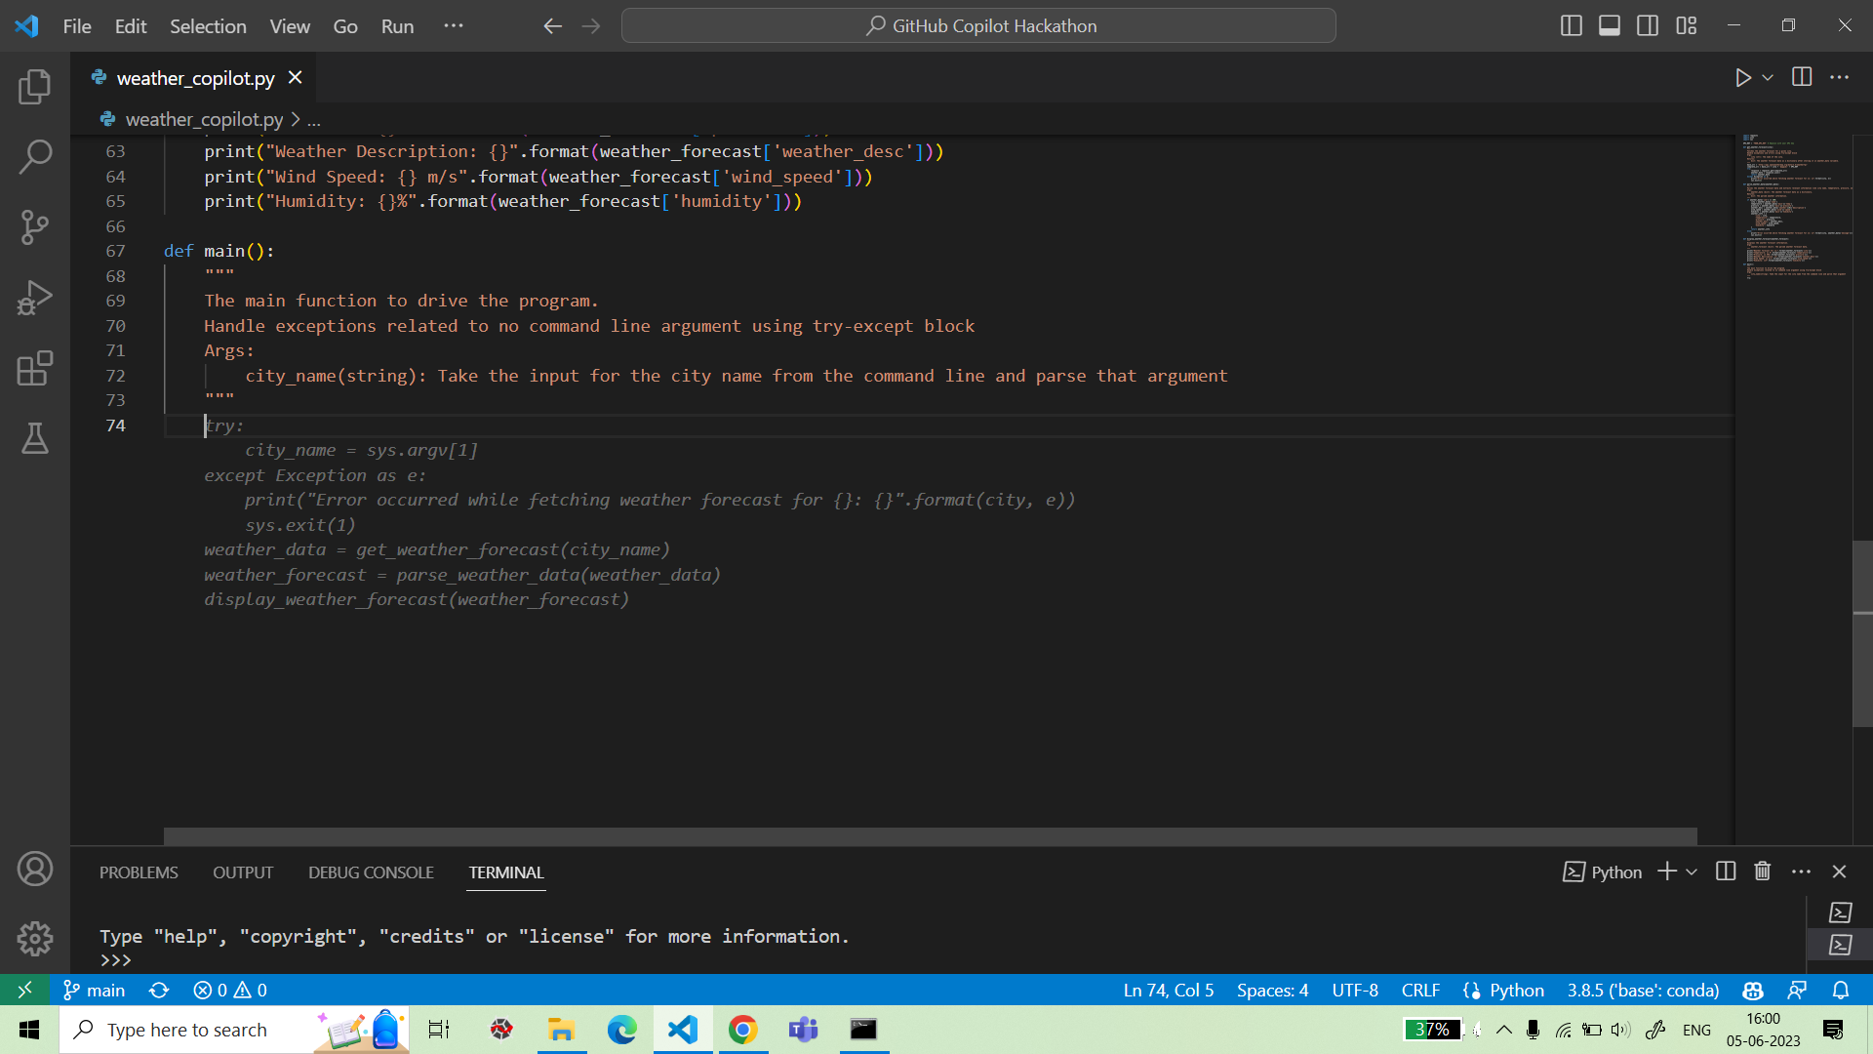
Screenshots showing usage of the
GitHub Copilot Platform :

Slide 23
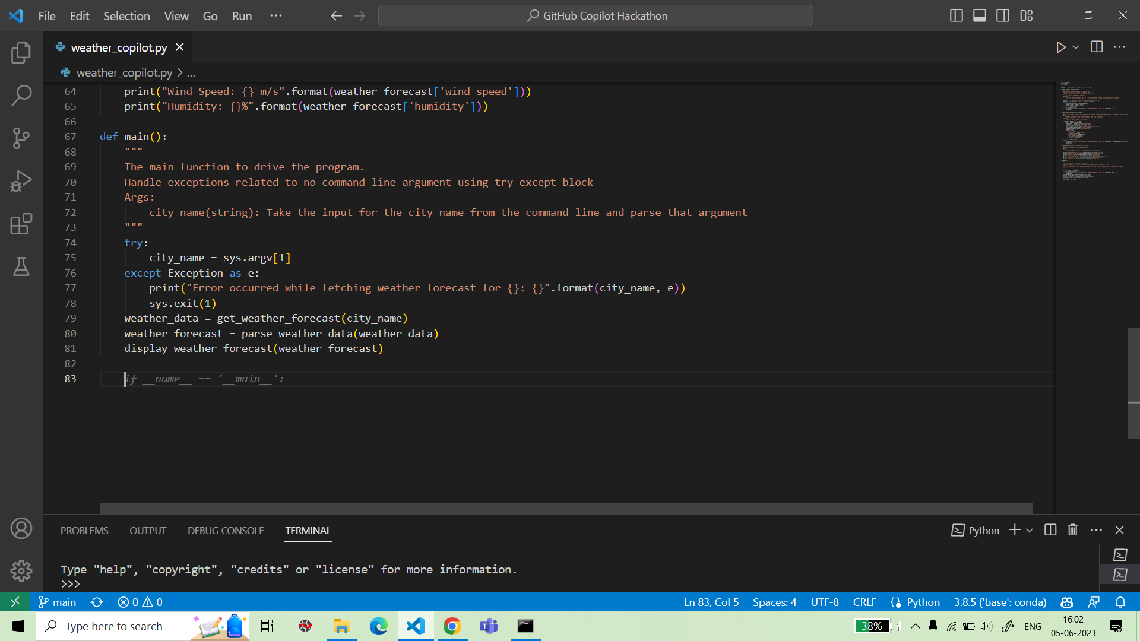
Screenshots showing usage of the
GitHub Copilot Platform :

Slide 24

Screenshots showing usage of the
GitHub Copilot Platform :

Slide 25
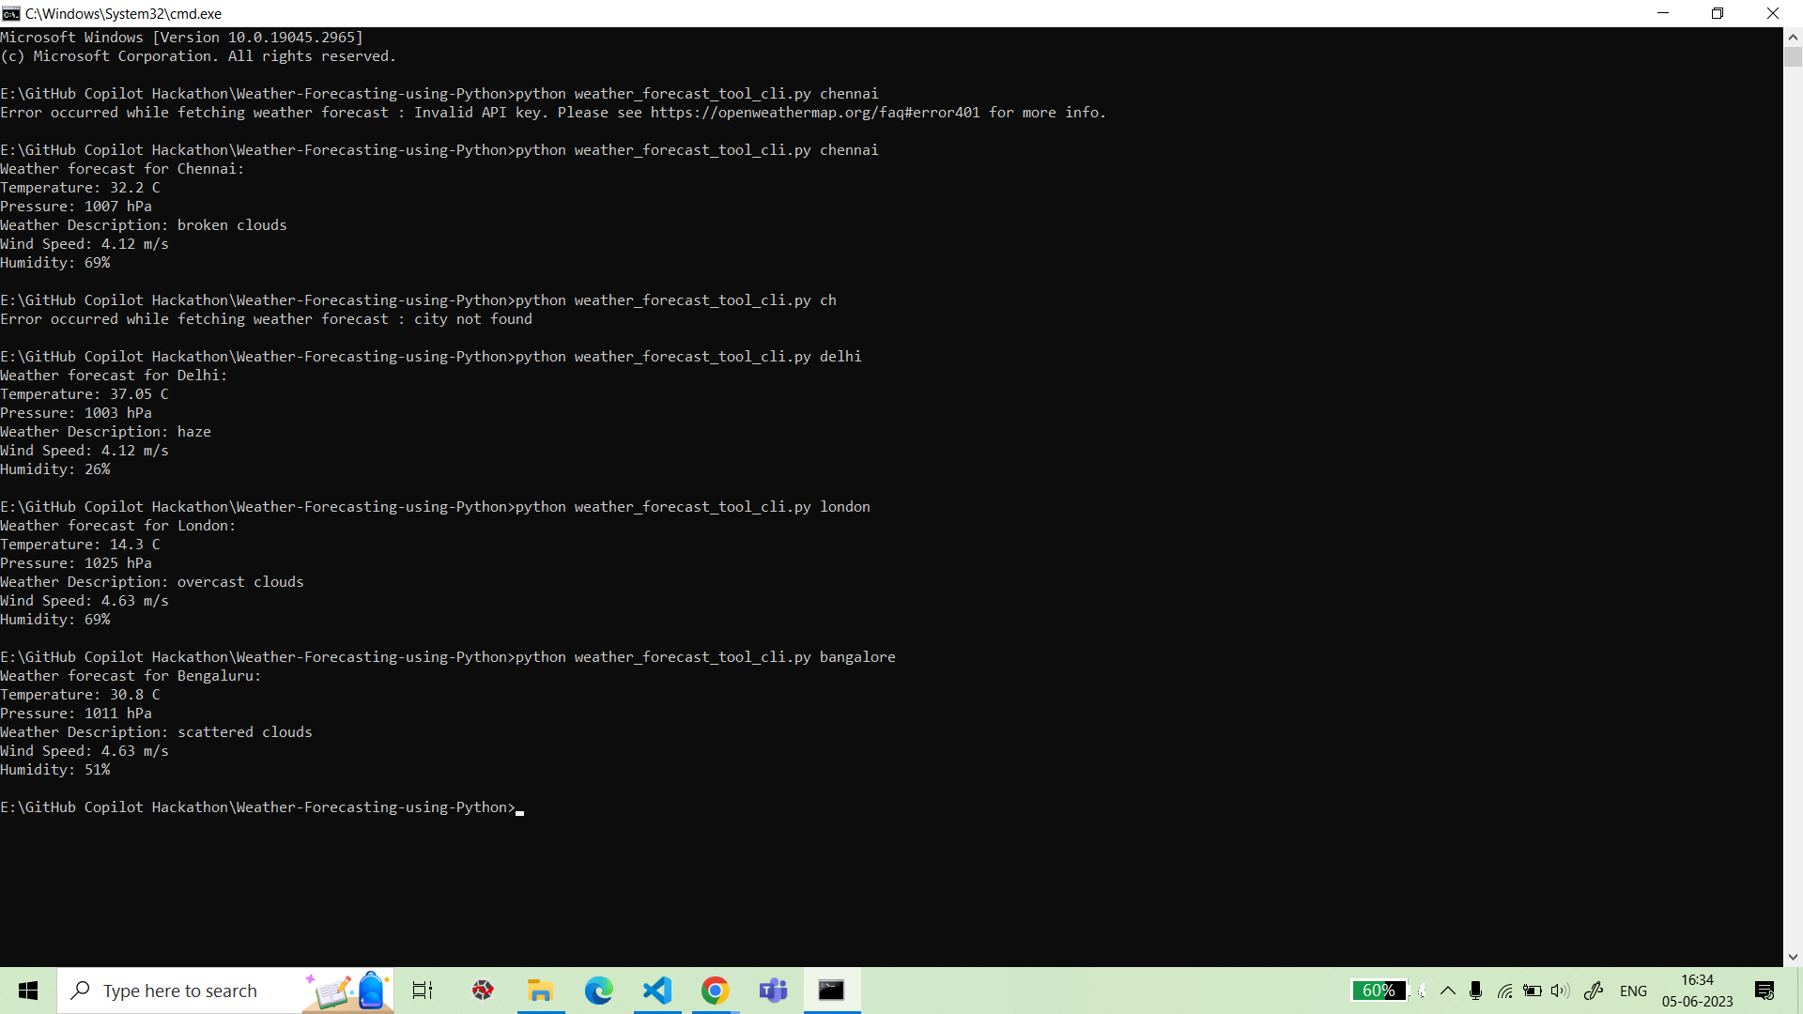
Output Screenshots (CLI):

Slide 26
Demonstration of GUI :

Slide 27
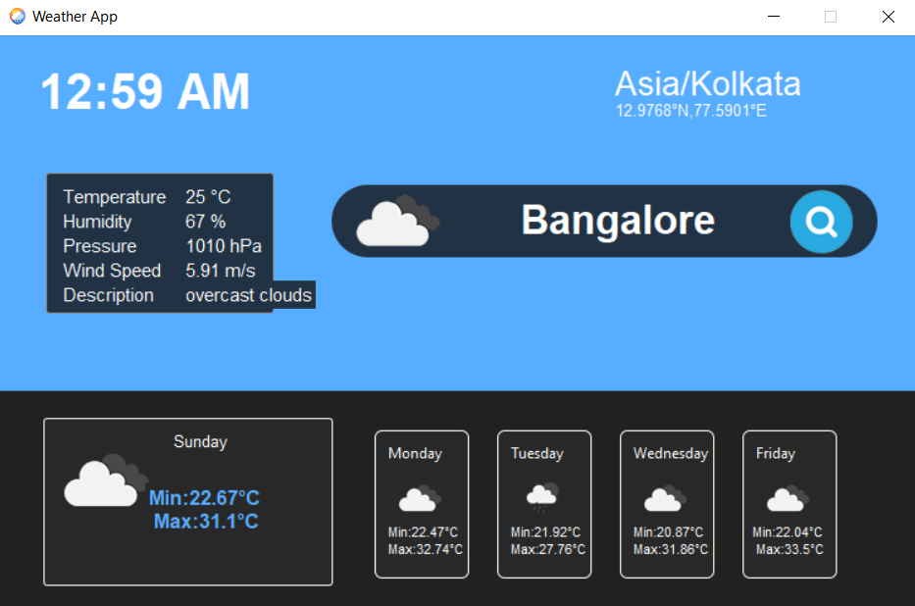
Output Screenshots (GUI):

Slide 28
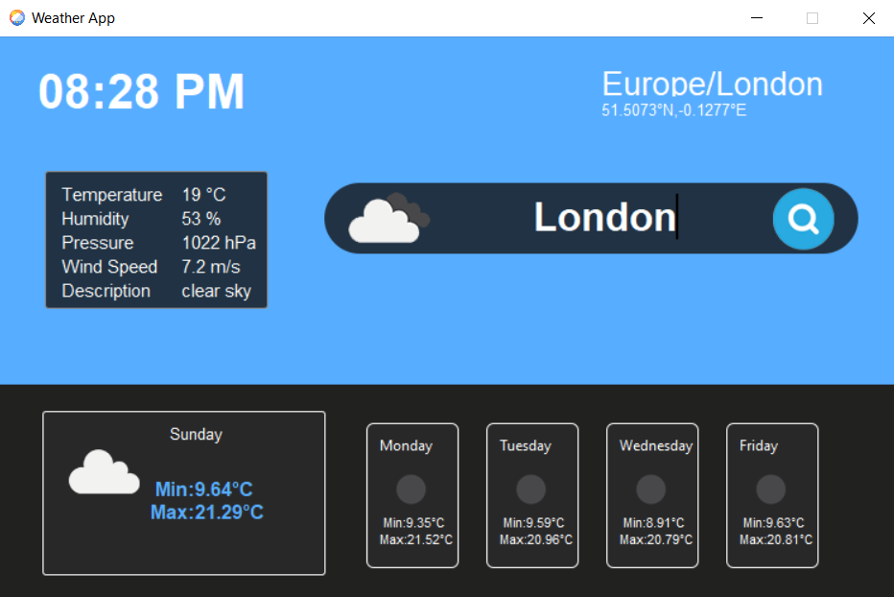
Output Screenshots (GUI):

Slide 29
Additional comments (optional):
Initially, we had planned to design a simple command line interface (CLI) for retrieving weather data based on the city searched by the user.
But we felt a GUI application would be more user-friendly and convenient than a CLI and it would display data to the user in a far more effective way along with weather forecast of the next 5 days.
Although GUI in itself is good enough for the problem statement, we think a ‘weather-personalized chatbot’ can prove to be an even better solution as it would be giving personalized updates to the user based on their location and upcoming weather forecast. This kind of a chatbot will be critical to the user in making their plans and will be their ‘personal weather assistant’.

Slide 30
THANK YOU

