Slide 1
Managing the Application Cycle
Microsoft Technology Associate 98-375 HTML5 Application Development Fundamentals

Slide 2
Lesson Objectives
Skills and Concepts | MTA Exam Objectives
Understanding Platform Fundamentals | Understand the platform fundamentals. (1.1)
Understanding and Managing Application | States Manage the state of an application. (1.2)
Understanding Touch Interfaces and Gestures | Understand the platform fundamentals. (1.1) Debug and test an HTML5-based touch-enabled application. (1.3)
Debugging and Testing HTML5 Apps | Debug and test an HTML5-based touch-enabled application. (1.3)
Publishing an Application to a Store | Publish an application to a store. (1.4)

Slide 3



HyperText Markup Language (HTML)
HTML 4.01 is the current standard
HTML5 is the current draft standard
HTML5 family includes:
HTML5
Cascading Style Sheets v. 3 (CSS3)
JavaScript (ECMA5)
HTML is NOT HyperText Transfer Protocol (HTTP)

Slide 4
New Features of HTML5
Audio and video tags: Embeds audio and video multimedia using the HTML5 markup tags <audio> and <video>
Canvas: An HTML5 element that creates a container for graphics, and uses JavaScript to draw the graphics as needed
Media Queries: A CSS3 feature that detects the user’s type of screen and sizes the output accordingly

Slide 5
New Features of HTML5
New application programming interfaces (APIs): Give apps access to resources, such as files and webcams
Geolocation: Uses JavaScript to detect the location (geographic positioning) of a client device, whether it’s a Windows Phone, Android phone, or a PC
Modernizr: A JavaScript library that helps you deliver the new capabilities of HTML5 and CSS3 in older browsers

Slide 6
What is a Web App?
An application that uses a Web browser as a client
Examples:
Microsoft SkyDrive
Microsoft Hotmail
Online banking application
Online stock investing application
Much more

Slide 7
What is a Web-Based Mobile App?
An HTML5 app that works like a Web page
User navigates to Web page containing the Web-based mobile app
Page content, including graphics, images, and video, are loaded into the Web browser from the Web server

Slide 8
HTML5 and OneSite
HTML5 may someday enable developers to create a single Web site that works for PCs and mobile devices rather than several sites optimized for PCs and various mobile devices

Slide 9









Creating a Packaged App
PLAN
DESIGN UI
UPDATE MANIFEST
TEST AND DEBUG
BUILD APP
WRITE CODE
PACKAGE
VALIDATE
DEPLOY

Slide 10
Creating a Packaged App
Think about the app type
Keep it simple
Create an outline of the main actions
Determine user interactivity type
DESIGN UI
PLAN
UPDATE MANIFEST
TEST AND DEBUG
BUILD APP
WRITE CODE
PACKAGE
VALIDATE
DEPLOY

Slide 11
Creating a Packaged App
Determine how the app should appear to users
Group content logically
Gather images/multimedia
Launcher icon
DESIGN UI
PLAN
UPDATE MANIFEST
TEST AND DEBUG
BUILD APP
WRITE CODE
PACKAGE
VALIDATE
DEPLOY

Slide 12
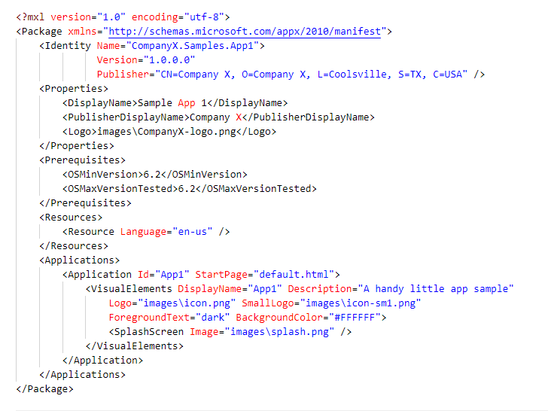
Creating a Packaged App
Every app must have a manifest
Describes app properties
UPDATE MANIFEST
PLAN
DESIGN UI
TEST AND DEBUG
BUILD APP
WRITE CODE
PACKAGE
VALIDATE
DEPLOY

Slide 13
Creating a Packaged App
May include HTML5, CSS3 and JavaScript
WRITE CODE
PLAN
DESIGN UI
UPDATE MANIFEST
TEST AND DEBUG
BUILD APP
PACKAGE
VALIDATE
DEPLOY

Slide 14

Creating a Packaged App
Visual Studio
Convert resources into an actual app
PLAN
DESIGN UI
UPDATE MANIFEST
BUILD APP
TEST AND DEBUG
WRITE CODE
PACKAGE
VALIDATE
DEPLOY

Slide 15
Creating a Packaged App
Test and fix errors
Touch interface emulation
TEST AND DEBUG
PLAN
DESIGN UI
UPDATE MANIFEST
BUILD APP
WRITE CODE
PACKAGE
VALIDATE
DEPLOY

Slide 16
Creating a Packaged App
Creates a container that holds assets
Images, HTML code, JavaScript code, frameworks, etc.
PACKAGE
PLAN
DESIGN UI
UPDATE MANIFEST
TEST AND DEBUG
BUILD APP
WRITE CODE
VALIDATE
DEPLOY

Slide 17
Creating a Packaged App
Validate with an external program
VALIDATE
PLAN
DESIGN UI
UPDATE MANIFEST
TEST AND DEBUG
BUILD APP
WRITE CODE
PACKAGE
DEPLOY

Slide 18

Creating a Packaged App
Upload to an Online Marketplace
Microsoft Windows Store
Apple Store
Google Play
DEPLOY
PLAN
DESIGN UI
UPDATE MANIFEST
TEST AND DEBUG
BUILD APP
WRITE CODE
PACKAGE
VALIDATE

Slide 19
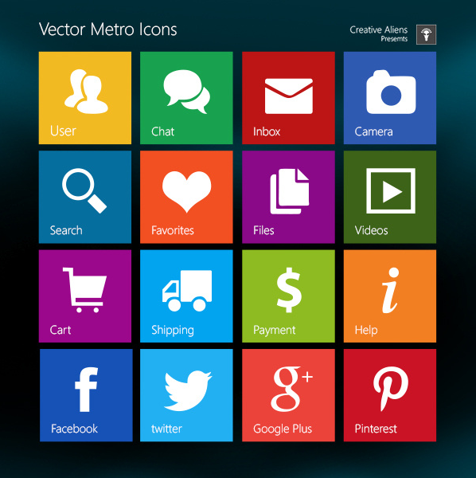
Metro Style User Interface (UI)

Slide 20
Document Object Model (DOM)
Designed for HTML and Extensible Markup Language (XML)
Allows programs and scripts to update content, structure, and styles on the fly
Is neither HTML nor JavaScript—it’s an API— but ties them together

Slide 21
Document Object Model (DOM) Example
Object
Attribute
Object
Text
Text
Attribute

Slide 22
Important Terms and Concepts
The host process a runtime host in the operating system that controls the overall executive of the browser.
The app package is a file that contains an app’s files and folders; created for ease of distribution and deployment.

Slide 23
Important Terms and Concepts
An app container is a separate memory space within a system in which an application runs. It prevents corruption of the operating system if the application fails for some reason and enables a user to cleanly uninstall the app.
A namespace is a collection of related objects (pages, code, etc.).

Slide 24
Windows Runtime (WinRT)
The foundation of the Windows 8 operating system
Made up of layers that provide functionality to Metro style apps and the Windows shell
Provides functionality to Metro style app

Slide 25
Web App Storage Concepts
State management is the process of maintaining Web page information during multiple requests for the same or different Web page.
Session state is created when user first requests access to an application; state ends when the user closes the session.
Application state is created when browser sends first request for Web page to Web server; ends when the user closes the browser.

Slide 26
Web App Storage Concepts
Persistent state information is data that an application needs after the session ends.
Many Web applications need to store data (make it persistent) so that users can pick up where they left off when they return to the site.

Slide 27
Cookies, localStorage, and sessionStorage
Cookies addressed limitations of HTTP protocol but pose security risk
localStorage method allows users to save larger amounts of data from session to session (persistent data)
No time limit as to how long the data exists
sessionStorage method keeps data only for one session (until the browser is closed)
Referred to as “per-tab storage”

Slide 28
AppCache
Application Cache
Stores resources like images, HTML pages, CSS files, and JavaScript
Data would ordinarily be stored on a server
Example of a cache manifest:
index.html
stylesheet.css
images/dot.png
scripts/main.js

Slide 29
Touches and Gestures
Any finger move is a gesture
Single finger, one-touch: press, tap, press and hold, slide to pan
Finger and a thumb, two-touch: pinch and stretch or a turn to rotate
The action an application takes in response to a gesture is a touch event
JavaScript touch events are touchstart, touchend, and touchmove

Slide 30
Tests for Touch-enabled Apps
Overall responsiveness and fluidity
Tapping, pinching, rotating, and other common gestures
Controlled scrolling
Controlled panning
Ability to disabled scrolling and panning
Accuracy of snap points
Unintended zooming or scrolling, especially in a multitouch environment
Proper touch event reaction, especially in a multi-touch environment

Slide 31
Debugging
Detecting, finding, and correcting logical or syntactical errors
A syntax error is a typo in the code or a similar error, which is usually revealed during runtime for interpreted apps.
A logic error results in the app behaving differently than expected.

Slide 32
Validating Code
Detecting, finding, and correcting logical or syntactical errors
A syntax error is a typo in the code or a similar error, which is usually revealed during runtime for interpreted apps.
A logic error results in the app behaving differently than expected.

Slide 33
W3C Markup Validation Service
Checks HTML documents and reports any errors or problems

Slide 34
W3C Markup Validation Service
Checks CSS files and reports any errors or problems

Slide 35
Windows App Certification Kit
Included in the Windows Software Development Kit (SDK)
Checks Metro style apps (Windows 8) that may include HTML5
1. Package and install app locally using an app development tool
2. Use the kit to validate app

Slide 36
Before Publishing to the Windows Store
Sign up and pay for a Windows Store developer account, and reserve a name for your app.
Edit your app’s manifest file.
Go through the app submission checklist at http://bit.ly/HAPmbk.
Name your app, set price, indicate release date, assign an age rating, etc.

Slide 37
Before Publishing to the Windows Store
Test app with Windows App Certification Kit
Capture screen shots of significant or unique features of your app for store listing
Have other testers or developers test your app on different devices and platforms
Include a privacy statement

Slide 38
Publishing to the Windows Store
Use app development tool (such as Visual Studio 12 or Visual Studio 12 Express for Windows 8) to create a final app package
Upload app package to Windows Store
Wait for approval from the store

Slide 39
Recap
HTML 4.0 and HTML5
Web apps vs. Web-based mobile apps
Creating a packaged app
The DOM and WinRT
Storage
Cookies
AppCache
localStorage and sessionStorage
Touches and gestures
Debugging and validation
Publishing an app

Slide 40
Questions
HTML is a _________ language, not a programming language, which means HTML uses markup tags such as <body> and <h1> to describe parts of a Web page.
markup

Slide 41
Questions
________________________ defines styles for HTML in a separate file, so you can easily change fonts, font sizes, and other attributes.
Cascade Style Sheets (CSS)

Slide 42
Questions
Windows 8 users the ___________ user interface (UI).
Metro Style

Slide 43
Questions
The ________________________ is the foundation of the Windows 8 operating system, and is made up of layers that provide functionality to Metro style apps and the Windows shell.
Windows Runtime (WinRT)

Slide 44
Questions
____________________ is the process of bundling an application and its various files into an app container, making it easy to distribute and deploy the app. The app package is the result of this process.
Application Packaging

Slide 45
Questions
The ___________________ is created when the Web browser sends the first request for a Web page to the Web server and it ends when the user closes the browser.
Application State

Slide 46
Questions
The ___________________ method keeps data only for one session (until the browser is closed), which is also referred to as “per-tab storage.”
sessionStorage

Slide 47
Questions
Any finger move is referred to as a _____________, which can involve a single finger (one-touch) or a finger and a thumb (two-touch).
gesture

Slide 48
Questions
A _____________ looks for anything that could cause code to be interpreted incorrectly, such as missing or unclosed tags, an improper DOCTYPE declaration, a trailing slash, deprecated code, and so on.
validator

Slide 49
Questions
The _______________ is an online global marketplace for Metro style apps.
Windows Store

Slide 50
Questions
Which three components are the primary elements of the HTML5 family?
a. XML
b. HTML
c. CSS
d. JavaScript

Slide 51
Questions
JavaScript is a type of:
a. Program compiler
b. Markup language
c. Scripting language
d. Validator

Slide 52
Questions
All of the following are true of HTML5 except:
a. It requires Windows 8
b. It can be used to create Web apps and PC and device apps
c. It is platform-independent
d. It is built on an open standard

Slide 53
Questions
Which operating system environment allows a developer to access a camera or webcam?
a. localStorage
b. WinRT
c. the session state
d. Metro

Slide 54
Questions
You are developing a Metro style app and want the app to access another app. Where do you declare the interaction?
a. App manifest
b. CSS
c. At the top of the HTML file
d. Nowhere; you do not have to declare the interaction

Slide 55
Questions
Which of the following is used to create an app package?
a. JavaScript
b. CSS
c. DOM
d. An app development tool

Slide 56
Questions
Which API allows programs and scripts to update content, structure, and styles on the fly?
a. JavaScript
b. WinRT
c. The DOM
d. RTE

Slide 57
Questions
AppCache, localStorage, and sessionStorage are forms of:
a. Web storage
b. HTML commands
c. Standards
d. Namespaces

Slide 58
Questions
Which of the following does not usually work well with multi-touch environments and should be disabled? (Choose two.)
a. Tracking
b. Zooming
c. Scrolling
d. Gesturing

Slide 59
Questions
Which tool is a type of validator that tests your app on your computer before you attempt to package and publish it to the Windows Store?
a. WinRT
b. Windows 8
c. W3C Markup Validation Service d. Windows App Certification Kit

Slide 60
Questions
True or False
An application programming interface (API) is a list of instructions letting a program communicate with another program.

Slide 61
Questions
True or False
A best practice is to publish your app without validation to perform live online testing.

Slide 62
Questions
True or False
An emulator searches HTML and CSS documents, looking for errors.

Slide 63
Questions
True or False
It’s a best practice to design touch-enabled apps for wider rather than narrower digits.

Slide 64
Questions
True or False
A platform-independent app can run on different desktop and mobile device operating systems.

