Slide 1
Managing Text Flow by Using CSS
Microsoft Technology Associate 98-375 HTML5 Application Development Fundamentals

Slide 2
Lesson Objectives
Skills and Concepts | MTA Exam Objectives
Managing the Graphical Interface with CSS | Manage the graphical interface by using CSS (3.4)

Slide 3
border-radius Property
Creates rounded corners around layout elements, like headers, footers, sidebars, graphics boxes, and outlines around images
border-radius is a length, which is usually expressed in pixels or ems but can be a percentage

Slide 4
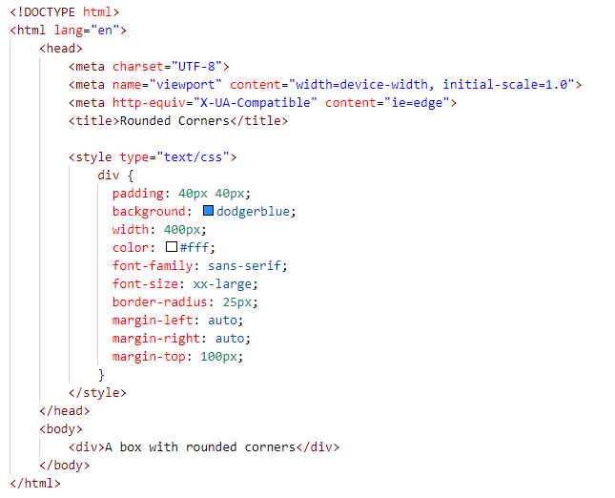
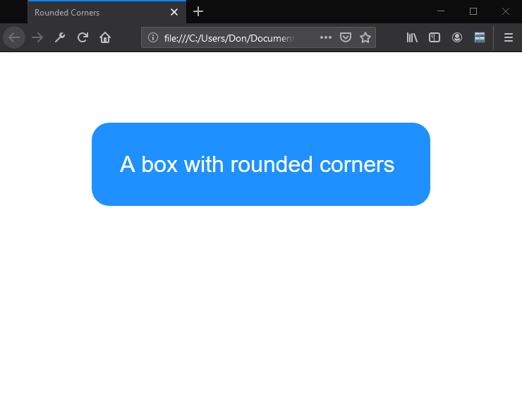
Rounded Corners Example

Slide 5
border-radius Property, Single Corners
Rounding a single corner of a box:
border-top-left-radius
border-top-right-radius
border-bottom-right-radius
border-bottom-left-radius

Slide 6
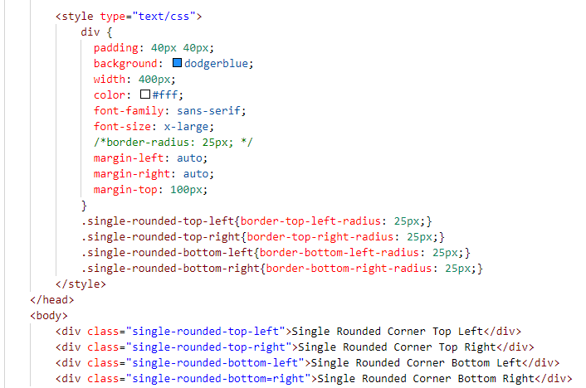
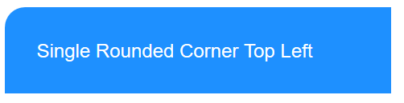
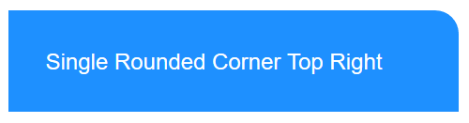
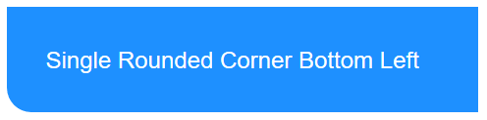
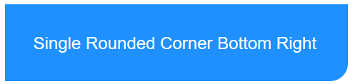
border-radius Property, Single Corners

Slide 7
box-shadow Property
Creates drop shadows around layout elements
CSS syntax for creating a shadow: box-shadow: h-shadow v-shadow blur spread color inset;
Required: h-shadow and v-shadow attributes set the horizontal and vertical position of the shadow in relation to the box
Optional: blur, spread, color, and inset

Slide 8
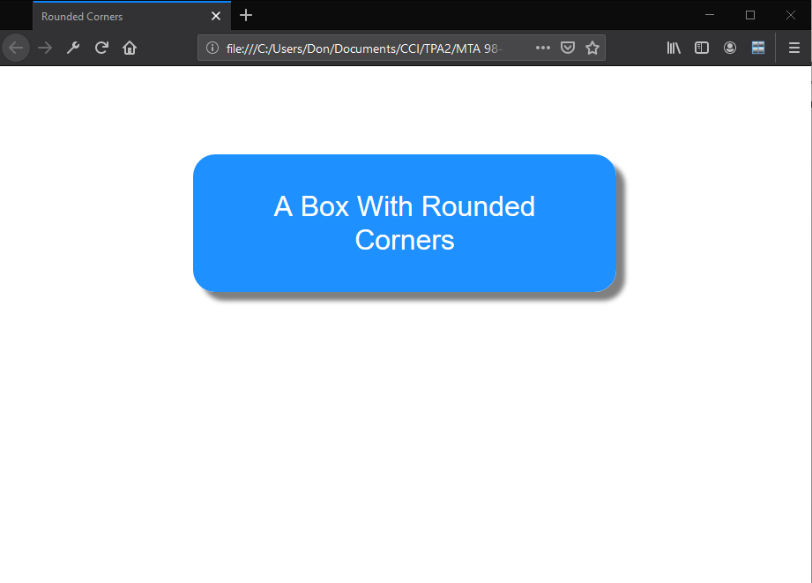
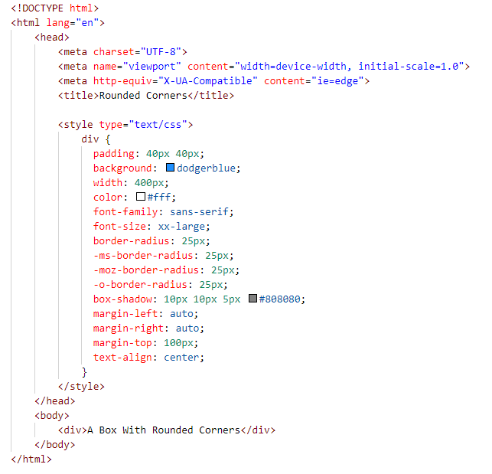
box-shadow Example

Slide 9
Opacity and Transparency
An opaque item does not let light pass through, whereas you can see through a transparent item.
Syntax for applying a transparency to an image or other element: opacity:value
Value is a floating-point value between 0.0 (100% transparent) and 1.0 (100% opaque)

Slide 10
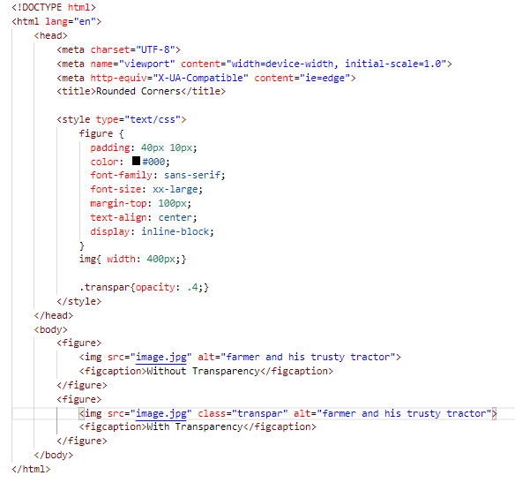
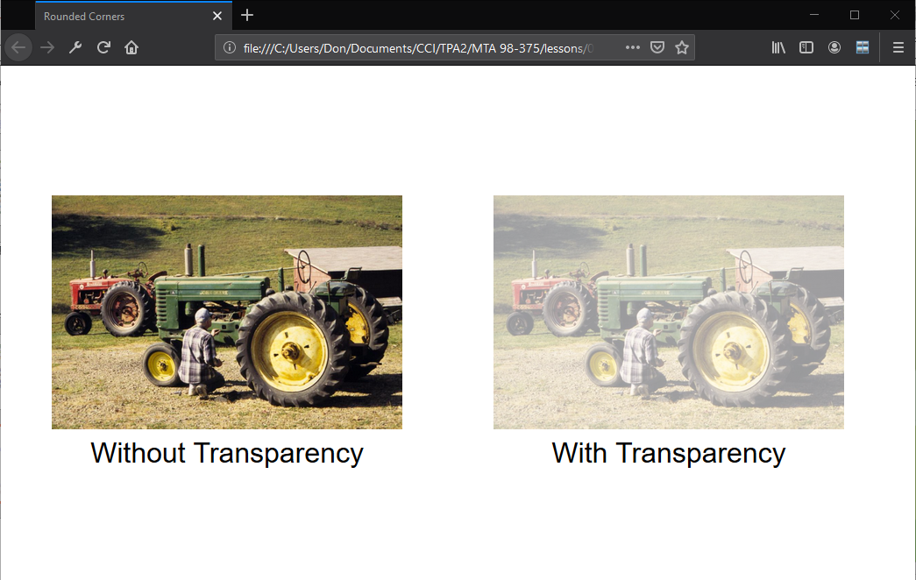
Opacity and Transparency Example

Slide 11
CSS Gradients
Gradient is a smooth change of colors, within the same hue or starting with one color and ending with a different color
Used for subtle shading within backgrounds, button embellishments, and more
Created as methods to the CSS background property

Slide 12
CSS Gradient Methods
CSS3 gradient methods:
linear-gradient: Creates a gradient from top to bottom or vice versa, or from corner to corner
radial-gradient: Creates a gradient that radiates out from a central point
repeating-linear-gradient: Creates a repeating linear gradient, which results in straight bands of gradient color
repeating-radial-gradient: Creates a repeating radial gradient, which results in circular bands of gradient color

Slide 13
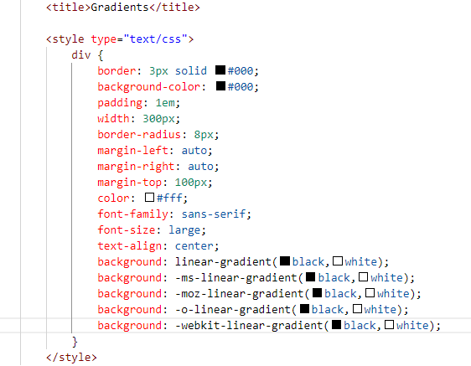
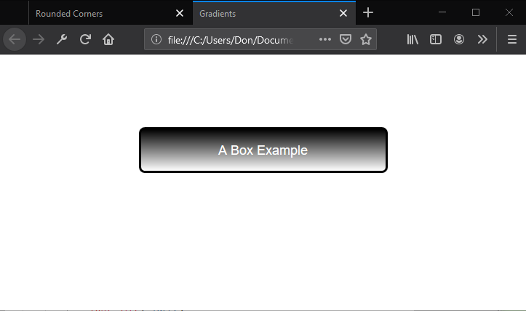

Gradient Examples

Slide 14
Color Interpolation and Color Stops
CSS gradients support color interpolation in the alpha color space
Part of the red blue green alpha (RGBA) color model
Can specify multiple color stops, with an RGBA color and position for each one
Example of the use of rgba colors: linear-gradient(to right, rgba(255,255,255,0)

Slide 15
CSS Font-related Properties
font-family specifies the font for an element
font-size specifies the size of a font
font-style specifies the style of a font, such as normal italics, or oblique
font-variant specifies whether text should be displayed in small caps
font-weight specifies the thickness of font characters

Slide 16
Web-safe Fonts
A set of standard fonts typically located on a user’s computer and that generally render consistently in the majority of browsers
Not appropriate for brand identity for many companies
Limited choices

Slide 17
Web Open Font Format (WOFF)
Allows developers to use almost any font
Are compressed True Type, OpenType, or Open Font Format fonts that contain additional metadata
Are usually hosted on a server; CSS references font and server or URL

Slide 18
Web Open Font Format (WOFF)
To use a WOFF font from a font vendor’s site, for example, include the @font-face rule in CSS:
<style> @font-face { font-family: "font-family-name"; src: url("http://website/fonts/fontfile") } </style>

Slide 19
2D and 3D Transformations
A transform is an effect that lets you change the size, shape, and position of an element.
Transformations use the transform property.
Methods: matrix, perspective, rotate, scale, skew, translate
To see the “action” of a transformation requires JavaScript; using only CSS shows the before and after effects of properties and their values.

Slide 20
2D Translation
To translate an element means to move it without rotating, skewing, or otherwise turning the image.
Use the translate() method in CSS and provide x- and y-axis values to position the element relative to its original or default position.
x-axis value specifies the left position of the element
y-axis value specifies the top position.

Slide 21
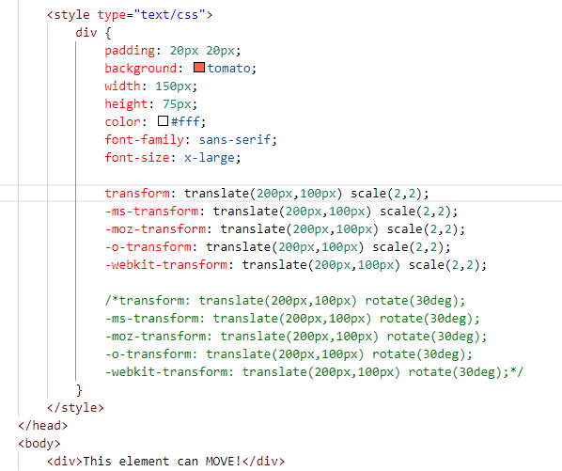
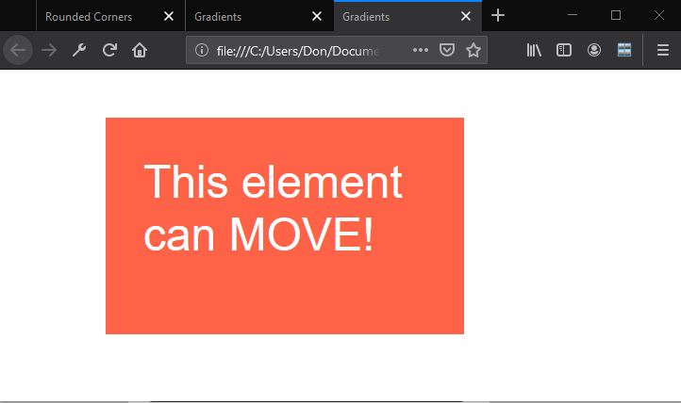
2D Translation Example

Slide 22
2D Scaling
To scale an element is to increase or decrease its size.
Use the scale() method in CSS and provide x-axis (width) and y-axis (height) values.
The example on the following two slides increases the width of the element two times its original size, and increases the height four times its original size: transform: scale(2,4);

Slide 23
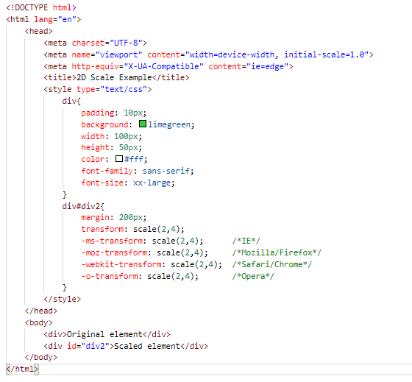
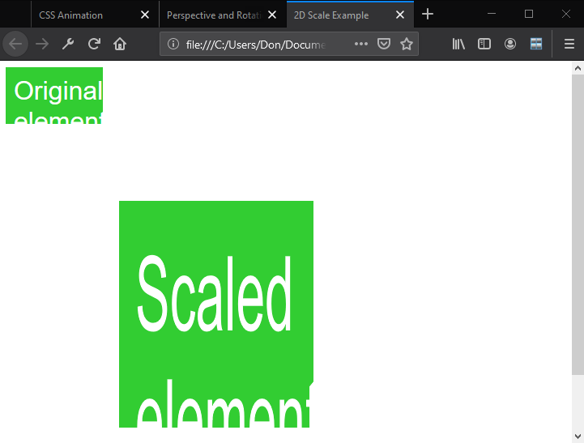
2D Scaling Example

Slide 24
2D Rotation
To rotate an element turns it clockwise by a specified number of degrees.
Use the rotate() method in CSS and specify the degrees of rotation.
The example on the following slide rotates an element by 45 degrees in the 2D plane:
transform: rotate(45deg);

Slide 25
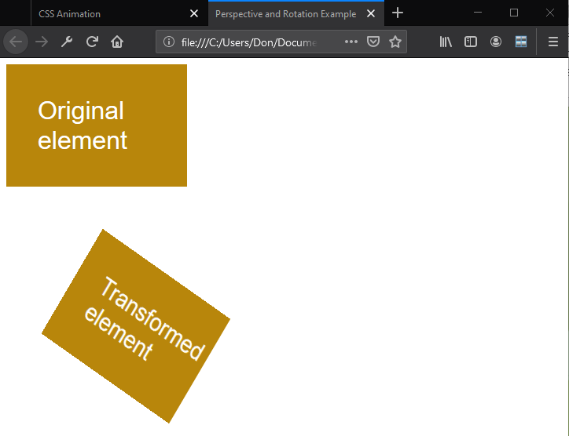
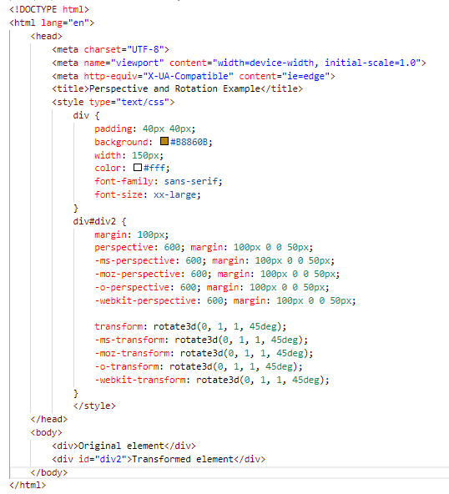
2D Rotation Example

Slide 26
3D Rotation
3D rotation uses the rotateX() and rotateY() methods.
rotateX(): Element rotates around its x-axis
rotateY(): Element rotates around its y-axis

Slide 27
2D Skewing
To skew an element is to stretch it in one or more directions.
Use the skew() method and provide x-axis and y-axis values, in degrees, to create an angular shape.
The example on the following slide turns an element 20 degrees around the x-axis and 30 degrees around the y-axis: transform: skew(20deg,30deg);

Slide 28
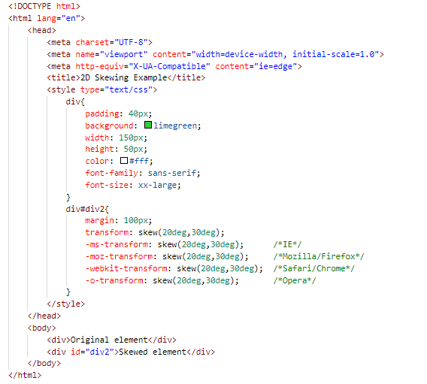
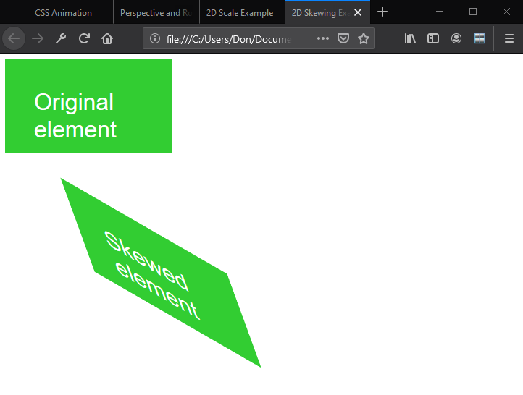
2D Skewing Example

Slide 29
3D Skewing
3D skewing uses the skewX() and skewY() methods to skew an element around its x-axis and y-axis, respectively.
As an example, the following code skews an element 45 degrees: transform: skewX(45deg);

Slide 30
3D Perspective
The CSS3 3D perspective property defines how a browser renders the depth of a 3D transformed element.
The property takes on a number value: lower values (in the range of 1 to 1000) create a more pronounced effect than higher values.

Slide 31
Transition
A transition is a change from one thing to another; in CSS, a transition is the change in an element from one style to another.
In CSS3, the action of a transition renders onscreen—no JavaScript is needed!
The transition property requires the CSS property to be acted upon during the transition.

Slide 32
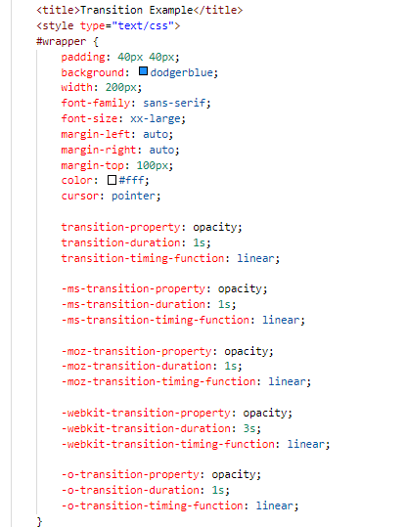
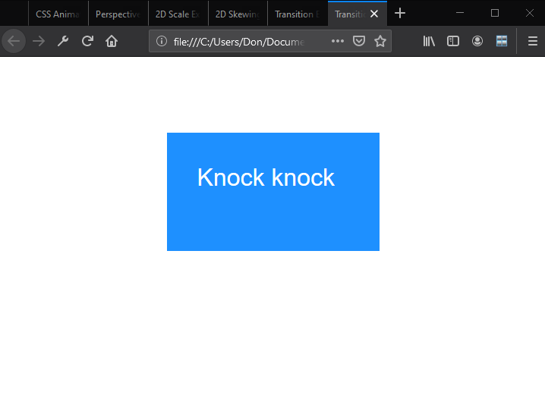
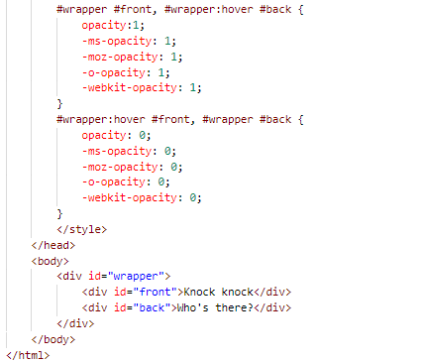
Transistion Example

Slide 33
Animation
An animation is the display of a sequence of static images at a fast enough speed to create the illusion of movement.
Transitions and animations are similar in that they both use timings.
Many properties used in animations are similar to transitions.
An important difference is that animations use keyframes, which give you control over parts of the animation.

Slide 34
Animation
Specify a CSS style within the @keyframes rule
An example of a rule for a fadeout: @keyframes fadeout { from { opacity: 1; } to { opacity: 0; } }

Slide 35
Animation
Code snippet that configures animation properties for a fadeout: div { animation-duration: 3s; animation-delay: 0s; animation-timing-function: ease; } div:hover { animation-name: fadeout; }

Slide 36
SVG Filters
An SVG filter is a set of operations that use CSS to style or otherwise modify an SVG graphic.
The enhanced graphic is displayed in a browser while the original graphic is left alone.

Slide 37
SVG Filters
• feBlend
• feColorMatrix
• feComponentTransfer
• feComposite
• feConvolveMatrix
• feDiffuseLighting
• feDisplacementMap
• feFlood
• feGaussianBlur
• feImage
• feMerge
• feMorphology
• feOffset
• feTile
• feTurbulence
• feDistantLight
• fePointLight
• feSpecularLighting
• feSpotLight

Slide 38
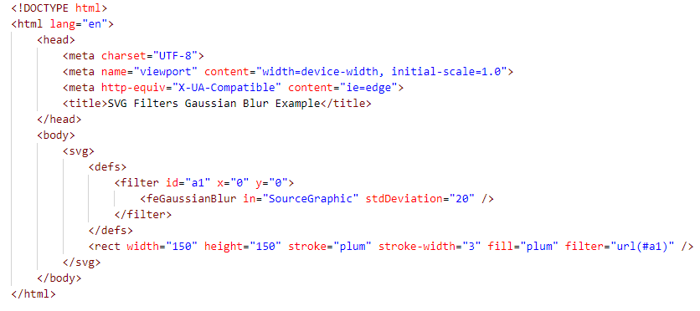
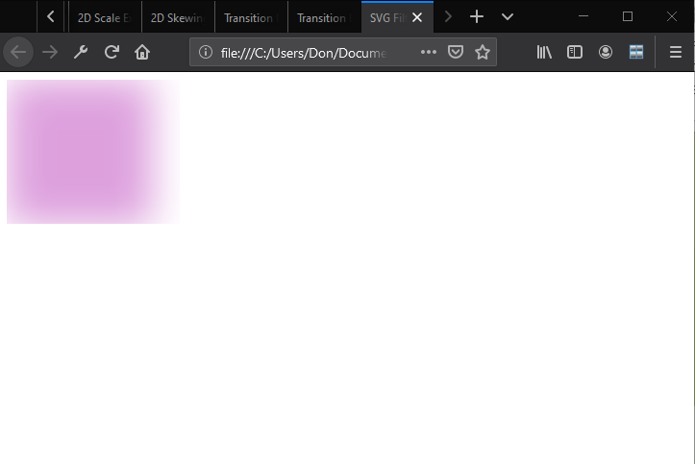
SVG Filters Gaussian Blur Example

Slide 39
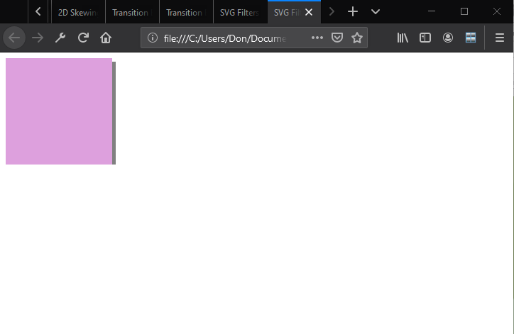
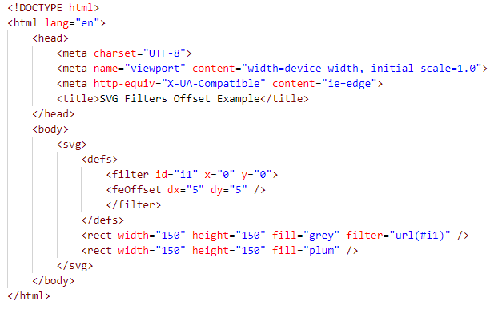
SVG Filters Offset Example

Slide 40
Canvas
Use canvas to draw pixel-based shapes.
The canvas element accepts only two attributes — height and width.
You can use most CSS properties to style the canvas element, adding color, gradients, pattern fills, transformation, animation, and much more.

Slide 41
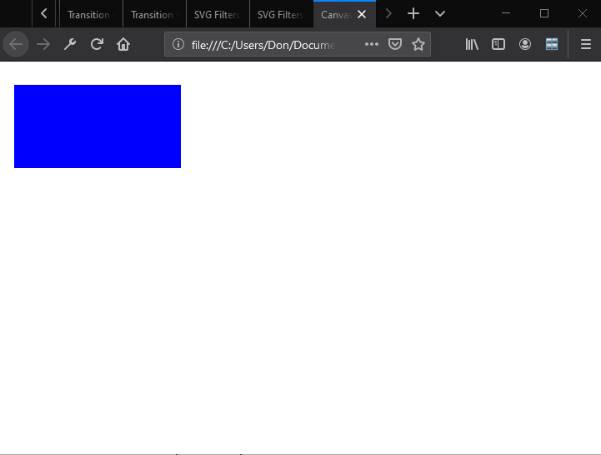
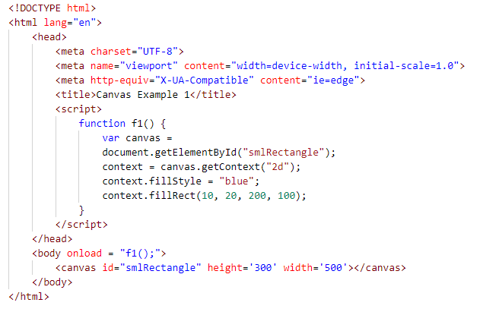
Canvas Example

Slide 42
Recap
Graphics effects
Transparency and opacity
Background gradients
Web-safe fonts and the Web Open Font Format
2D and 3D transformations
Translation
Scaling
Rotation
Skewing
3D perspective
Transitions and animations
SVG filters
Canvas

Slide 43
Questions
A ____________ is a smooth change of colors, either within the same hue or starting with one color and ending with another.
gradient

Slide 44
Questions
To ________ an element is to increase or decrease its size.
scale

Slide 45
Questions
A ____________ is a visual effect in which an object is repeated behind and moved slightly below itself to create the illusion that the object floats over its background.
drop shadow

Slide 46
Questions
A __________ is a change from one thing to another; in CSS, it is the change in an element from one style to another.
transition

Slide 47
Questions
The _______________________________ enables Web developers to use custom fonts—pretty much any font—instead of being limited to the standard Web fonts.
Web Open Font Format (WOFF)

Slide 48
Questions
The ______________ CSS3 property enables you to create rounded corners around layout elements, such as headers, footers, sidebars, graphics boxes, and outlines around images.
border-radius

Slide 49
Questions
________________ is reduced opacity.
Transparency

Slide 50
Questions
To ___________ an element means to move it, without rotating, skewing, or otherwise turning the image.
translate

Slide 51
Questions
In HTML5/CSS3, a ____________ is an effect that lets you change the size, shape, and position of an element.
transform

Slide 52
Questions
An SVG ________ is a set of operations that use CSS to style or otherwise modify an SVG graphic.
filter

Slide 53
Questions
Which of the following creates a gradient from top to bottom, left to right, or from corner to corner, without reiterating colors?
a. linear-gradient
b. radial-gradient
c. repeating-linear-gradient
d. repeating-radial-gradient

Slide 54
Questions
Which of the following is not true of the border-radius property?
a. It creates rounded corners around layout elements.
b. It can be expressed in pixels.
c. It can be expressed as a percentage.
d. It can animate an object.

Slide 55
Questions
To apply a 60% transparency to an image or element, which property do you use?
a. opacity: 40
b. opacity: 0.4
c. transparency: 40
d. transparency: 0.4

Slide 56
Questions
Which of the following are disadvantages of Web-safe fonts? (Choose all that apply.)
a. They must be loaded on a Web server.
b. They are limited in number and variety.
c. They make brand identity difficult to achieve on the Web.
d. They are expensive.

Slide 57
Questions
Keyframes are associated with which of the following?
a. Rounded corners
b. Transitions
c. Animations
d. None of the above

Slide 58
Questions
When creating a transition, which of the following must be specified?
a. A start delay
b. The CSS property to be acted upon during the transition
c. The transition timing function
d. The keyframe

Slide 59
Questions
What is a primary advantage to using color interpolation in the alpha color space?
a. It produces smoother color transitions in gradients.
b. It enables you to add color to SVG drawings.
c. Both a and b
d. Neither a nor b

Slide 60
Questions
Which of the following do you use to add color to canvas text?
a. fillStyle
b. strokeStyle
c. textColor
d. strokeColor

Slide 61
Questions
What are the two play states of an animation?
a. started
b. running
c. paused
d. resumed

Slide 62
Questions
In the following code sample, what controls the amount of blur? <defs> <filter id="a1" x="0" y="0"> <feGaussianBlur in="SourceGraphic" stdDeviation="20" /> </filter> </defs>
a. feGaussianBlur
b. SourceGraphic
c. stdDeviation
d. none of the above

Slide 63
Questions
True or False
An opaque item does not let light pass through, whereas you can see through a transparent item.
TRUE

Slide 64
Questions
True or False
In CSS, to rotate an element turns it counterclockwise by a specified number of degrees.
FALSE

Slide 65
Questions
True or False
An animation is the display of a sequence of static images at a fast enough speed to create the illusion of movement.
TRUE

Slide 66
Questions
True or False
Radial gradients start from a central point and radiate color out to the edges of a container
TRUE

Slide 67
Questions
True or False
Perspective, in terms of drawings and illustrations, is the convergence of lines that give the illusion of depth.
TRUE

