Slide 1
Understanding JavaScript and Coding Essentials
Microsoft Technology Associate 98-375 HTML5 Application Development Fundamentals

Slide 2
Lesson Objectives
Skills and Concepts | MTA Exam Objectives
Managing and Maintaining JavaScript | Manage and maintain JavaScript. (4.1)
Updating the UI by Using JavaScript | Update the UI by using JavaScript. (4.2)

Slide 3
Introduction to JavaScript
JavaScript is a programming language that provides action in applications.
Interactivity enables an end user to take an action in an application, usually by clicking a button or pressing a key.
A dynamic application adjusts and responds to such actions by end users.
JavaScript also expands the opportunities to animate content.

Slide 4
Alert Boxes
Alert boxes are commonly used to test the operation of JavaScript programs.
Generally not used in production code.
An alert box can help you ensure information is displayed to the user.
A user has to click OK to close an alert box.

Slide 5
JavaScript Statements
An ordinary JavaScript program is a sequence of statements.
Statements are separated by semi-colons.
alert('This is the first alert');
alert('This is the second alert');

Slide 6
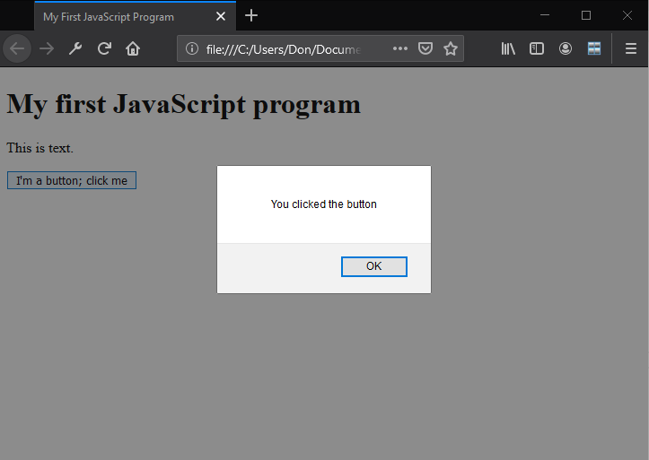
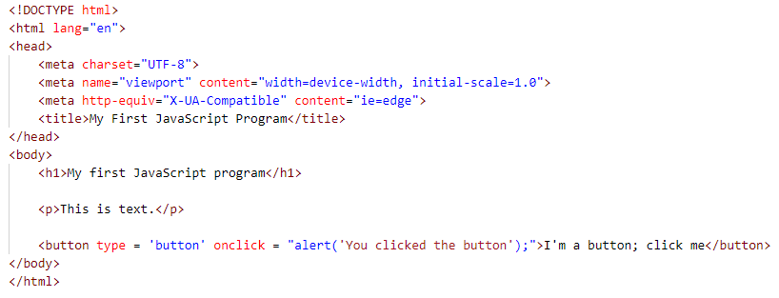
Create a Simple JavaScript Application

Slide 7
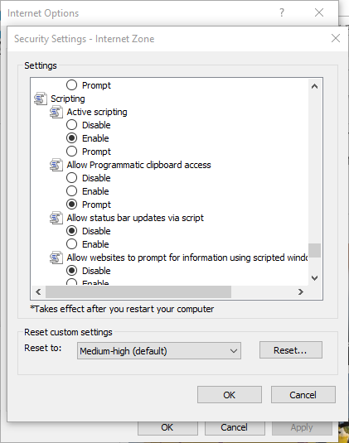
Enabling JavaScript in a Web Browser
Enabling JavaScript in Internet Explorer

Slide 8
Functions
A function is a segment of a program defined and performed in isolation from other parts.
JavaScript programmers sometimes identify functions that return no value as subroutines.

Slide 9
Functions
The expression of a function—the “function example1() {. . .}” part—doesn’t perform any of the code within the function.
What you see in the source code is only the definition of a function.
When the function is invoked, executed, or launched, something useful happen.

Slide 10
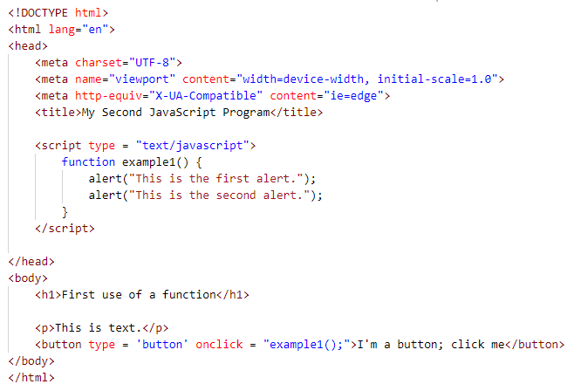
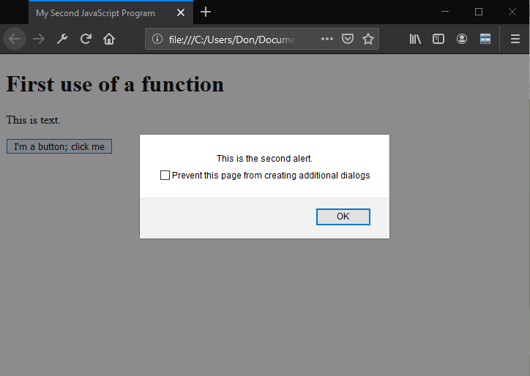
Function Example

Slide 11
Links between HTML and JavaScript
Can include JavaScript code in <script> tags in <head> section of HTML file for small to medium-sized projects
For large amounts of code, reference a separate JavaScript file within the <script> tag:
<script type = "text/javascript" src = path/filename.js"> </script>

Slide 12
Variables
A JavaScript variable stands for a piece of data.
You use the var syntax to define a new variable in JavaScript: var firstname;

Slide 13
Identifiers
JavaScript identifiers are the names of variables and functions.
Identifiers cannot be the same as keywords already used in JavaScript.
For example, “if” has a special meaning in JavaScript statements and is not available as a variable name.

Slide 14
JavaScript Libraries
A library is collection of resources, like prewritten function code and subroutines, that developers use to create programs.
A JavaScript library is pre-written JavaScript code.
jQuery is the leading JavaScript library.
Other popular libraries include Dojo, MooTools, and YUI.

Slide 15
JavaScript Libraries
When using a third-party library, include an element such as the following to reference the library:
<script type = "text/javascript" src = "web or local address of the JavaScript library source"></script>

Slide 16
getElementById() Method
•One important way to access display elements is with the getElementById() method.
•This method returns a reference to the first object with the specified id or NAME attribute.

Slide 17
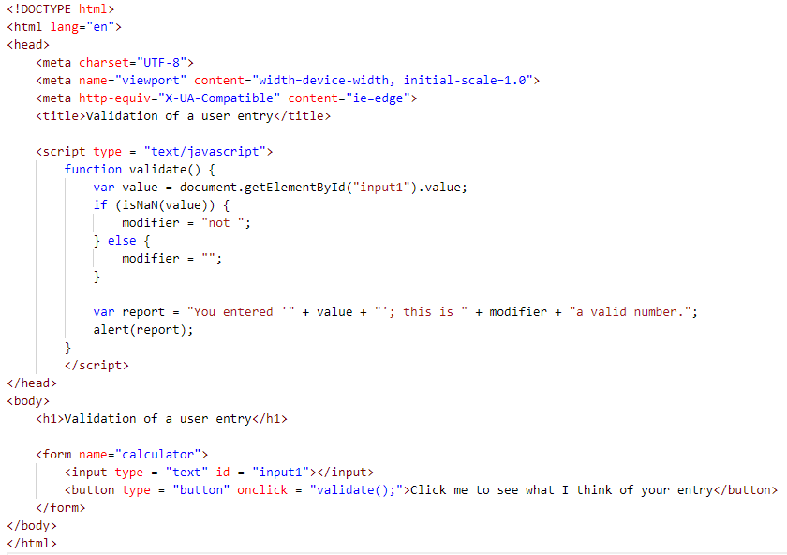
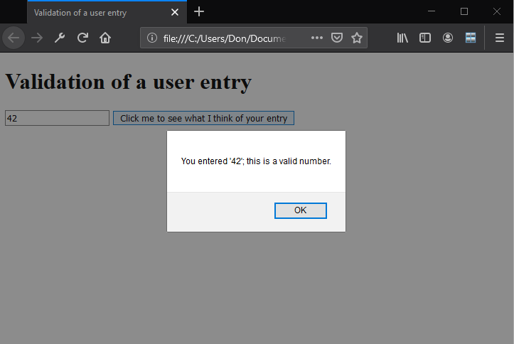
getElementById() Example

Slide 18
Methods
Methods are JavaScript functions that belong to objects.
Methods differ from functions in that methods are always associated and used with a particular object.
isNaN()is an example of a JavaScript function.
Tests for “not a number”; if value = 0 (false), value is a number
document.getElementById() is an example of a JavaScript method; you can effectively only use getElementById with the special document object.

Slide 19
Events
Events are actions that trigger other actions to occur.
An event handler is an optional script or executable that handles input received in a program.
Handlers are JavaScript code inside the <html> tags (rather than the <script> tags) that execute other JavaScript code in response to an event.

Slide 20
Events
A callback is a response to an event, such as a script execution in response to a mouse click.

Slide 21
onLoad Event Handler
The onLoad event handler “belongs” to HTML items; it triggers when its owner is complete.
The onLoad for an <img> image occurs when the image is fully rendered and visible.
The onLoad for a <table> fires once all the cells in that table have been drawn.

Slide 22
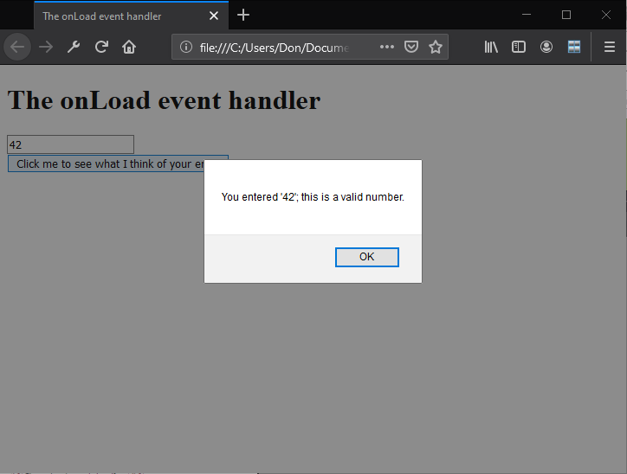
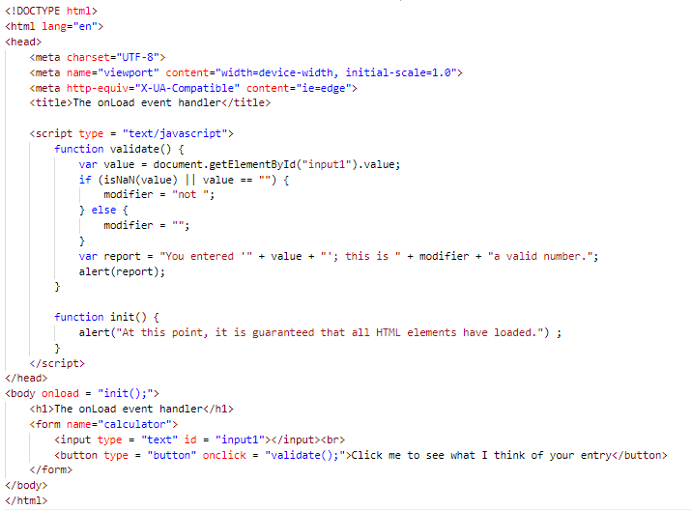
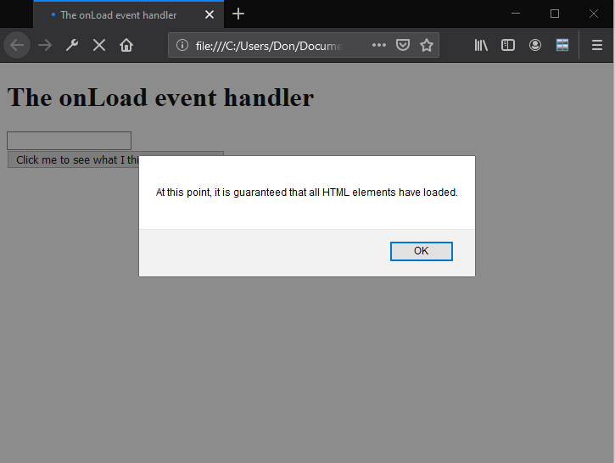
onLoad Example

Slide 23
Flawed JavaScript Programs Are Erratic
Flawed JavaScript programs are erratic—they give different results at different times.
Reasons: –If the program depends on the existence of a particular screen element but doesn’t assure that the element exists
Launching the program at different times, resulting in slightly different loading order
Fix: Begin calculations only after onLoad has fired.

Slide 24
Showing and Hiding Elements
The HTML display attribute shows the user pertinent information and hides the information when no longer needed.

Slide 25
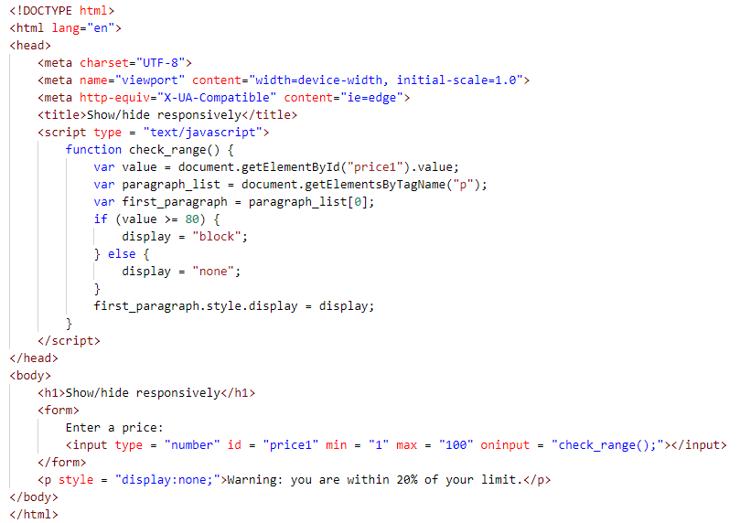
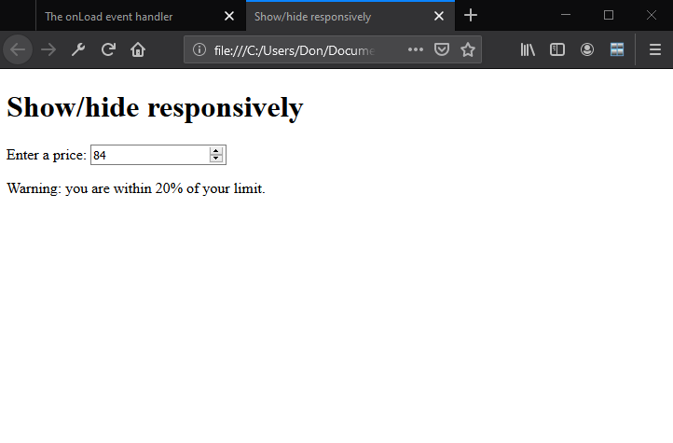
HTML display Attribute Example

Slide 26
Updating the Content of Elements
JavaScript uses the innerHTML property to change the current content of HTML elements (referred to as “inner content”) or insert new content.

Slide 27
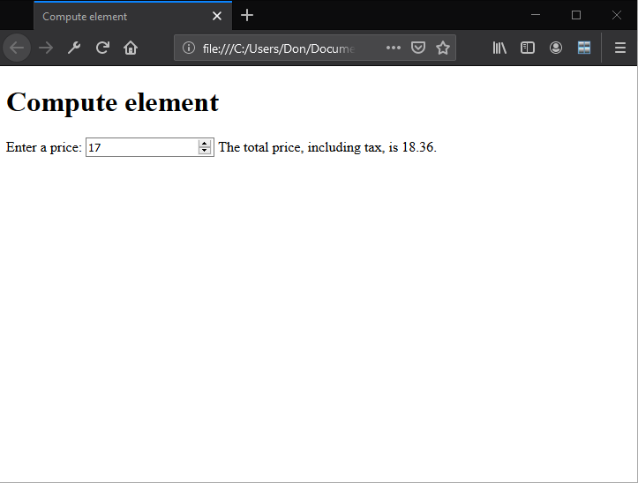
innerHTML Example
See example-7.html for code

Slide 28
Recap
Introduction to JavaScript
Alert boxes
JavaScript statements
Creating a simple JavaScript application
Functions
Links between HTML and JavaScript
Variables
Identifiers
JavaScript libraries
Methods
Events
Showing and hiding elements
Updating the content of elements

Slide 29
Questions
A __________________ is a recipe we direct the computer to execute to result in a particular display or action
computer program

Slide 30
Questions
You use the var syntax to define a new __________ in JavaScript.
variable

Slide 31
Questions
Many application requirements involve __________, which are actions, such as a mouse click, that trigger other actions to occur.
events

Slide 32
Questions
You notice that a part of your JavaScript program represents a sequence of actions that is logically separate from other parts of program. It likely will be useful to define a _________ to perform that specific sequence.
function

Slide 33
Questions
The __________ event associated with <body> constitutes a guarantee that all HTML has been displayed.
onload

Slide 34
Questions
A common coding pattern is to attach an id to a specific HTML element, then access that element through JavaScript with ____________________.
getElementById()

Slide 35
Questions
JavaScript __________ are the names of variables and functions.
identifiers

Slide 36
Questions
A __________ is collection of resources, like pre-written code and subroutines, that developers use to create programs.
library

Slide 37
Questions
A __________________ is pre-written JavaScript code.
JavaScript library

Slide 38
Questions
More than half of leading Web sites use the ________ JavaScript library.
jQuery

Slide 39
Questions
JavaScript programming makes applications which of the following? (Choose all that apply.)
a. static
b. dynamic
c. syntactically correct
d. interactive

Slide 40
Questions
Which of the following are JavaScript libraries? (Choose all that apply.)
a. Dojo
b. MooTools
c. YUI
d. jQuery

Slide 41
Questions
Which of the following names a valid JavaScript variable?
a. my.variable
b. 1st-variable
c. ord['a']
d. [TBC]var1_$

Slide 42
Questions
When can JavaScript not be used?
a. With HTML 4.01 and previous
b. When the user has set a browser preference to disable JavaScript
c. When the user hasn’t installed JavaScript on his or her desktop
d. none of the above

Slide 43
Questions
JavaScript uses which property to change the current content of HTML elements?
a. changeHTML
b. modInnerHTML
c. innerHTML
d. HTMLinner

Slide 44
Questions
A particular Web page has a single <form>. How does JavaScript best reach this?
a. document. getElementsByTagName("form")[0]
b. document. getElementsByTagName("form")[1]
c. document. getElementsByTagName("form")
d. [document. getElementsByTagName("form")]

Slide 45
Questions
The user has checked a box in a form indicating that he has not traveled recently in a country with an elevated incidence of hepatitis. How would you use JavaScript to hide an advisory paragraph?
a. warning.style.display = "none"
b. warning.style.display = 0
c. hide(warning)
d. warning.style.hide()

Slide 46
Questions
An individual statement in JavaScript ends in a ________.
a. hash mark
b. closing parenthesis
c. period
d. semicolon

Slide 47
Questions
Which of the following does JavaScript use to add new elements to a program display? (Choose all that apply.)
a. createElement
b. appendChild
c. getElement
d. addChild

Slide 48
Questions
Which of the following can you use to show and hide elements in a JavaScript program?
a. display attribute
b. show-hide attribute
c. show command
d. innerHTML

Slide 49
Questions
True or False
The names of functions are listed in the JavaScript standard.
FALSE

Slide 50
Questions
True or False
In HTML source, JavaScript typically appears inside a <script> element.
TRUE

Slide 51
Questions
True or False
It is possible to write JavaScript code in such a way that it executes before all images are loaded.
TRUE

Slide 52
Questions
True or False
If function f2() uses function f1(), and the definitions for both functions appear in the same <script>, then the definition for f1() must appear first.
FALSE

Slide 53
Questions
True or False
The getElementByElement() method returns a reference to the first object with the specified id or NAME attribute.
FALSE

