Slide 1
Understanding CSS Essentials: Content Flow, Positioning, and Styling
Microsoft Technology Associate 98-375 HTML5 Application Development Fundamentals

Slide 2
Lesson Objectives
Skills and Concepts | MTA Exam Objectives
Understanding CSS Essentials | Understand the core CSS concepts. (3.1)

Slide 3
Presentation vs. Content
Content is the words and images in an HTML document.
Presentation is related to styles and how words and images "look" in an HTML document.
Content is managed as HTML and style as CSS.
The separation of HTML and CSS generally means keeping CSS styles in a file separate from the HTML file.

Slide 4
CSS
CSS = Cascading Style Sheets
CSS is a sequence of rules.
CSS3 is the latest draft version; corresponds to HTML5
CSS3 is that it’s backward compatible with previous versions of CSS

Slide 5
The <link> Between HTML and CSS
The <link> element in an HTML file links the HTML file to a CSS file.
You can reference more than one CSS file in an HTML page.
Markup example: <link href = "filename.css" rel="stylesheet" type="text/css">
For simple projects, can use the <style> tag to include styles within an HTML document

Slide 6
CSS Selector and Declaration
The selector is usually the HTML element you want to style.
The declaration is the style for a specific selector.
A declaration has a property, which is a style attribute, and a value.
Selector
Declaration
p
{color: brown;}
Property
Value

Slide 7
Styled Web Page Example: HTML File
<!doctype html> <html> <head> <title>Trusty Lawn Care, Inc.</title> <link href="e1.css" rel="stylesheet" type="text/css"> </head> <body> <h1>Trusty Lawn Care, Inc.</h1> <p id="slogan“>We keep you in green.</p> <p>Trusty Lawn Care can keep your lawn looking lush and vigorous all season. We use only natural fertilizers, mulches, and soils to boost the health of your turf.</p> </body> </html>

Slide 8
Styled Web Page Example: CSS File
#slogan { font-size: 20px; color: green; font-style: italic; }

Slide 9
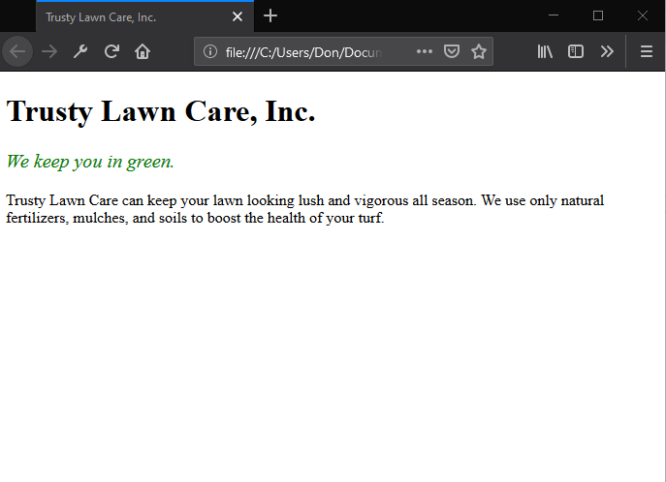
Styled Web Page Example: Rendered Page

Slide 10
Font Basics
A font is a set of characters of a particular size and style.
Examples:
Times New Roman
Eras Bold ITC
Myriad Web Pro
Monospace is often used for technical material such as formulas, numbers, codes, and so on.

Slide 11
Serif and Sans Serif Fonts
Serif
Sans Serif
serif
sans serif

Slide 12
Font Families
The primary way to specify fonts in a CSS file is to use the font-family property.
The property can declare a specific font, like Garamond or Arial, or a family that includes many different fonts, such as “serif.”
Examples: –font-family: Arial, Helvetica, sans-serif –font-family: serif

Slide 13
Web-safe Fonts
Fonts most likely installed on a Web page visitor’s system
List of Web-safe fonts is relatively short and doesn’t offer much variety
http://www.webdesigndev.com/16-gorgeous-web-safe-fonts-to-use-with-css/

Slide 14
@font-face Rule
CSS3 rule that enables developers to use any font they choose
Create a font-face rule by assigning a name to the font
Font must be located on your Web server, or include a URL to font location
Example: @font-face { font-family: TrustyHomePage; src: url('Euphemia.ttf'); }

Slide 15
Inline Flow and Block Flow
Inline flow fills only as much width as required
Block flow fills as much width as is available

Slide 16
Block Flow Example
<!DOCTYPE html> <html lang="en"> <head> <meta charset="UTF-8"> <title>Block and inline flow</title> <link href = "e4.css" rel = "stylesheet" type = "text/css"> <style type = 'text/css'> .toolbar li { } </style> </head> <body> <h1>Block and inline flow</h1> <p>Here are choices you can make:</p> <ul class = "toolbar"> <li>Automobile</li> <li>Bicycle</li> <li>Scooter</li> <li>Taxi</li> <li>Walk</li> </ul> </body> </html>

Slide 17
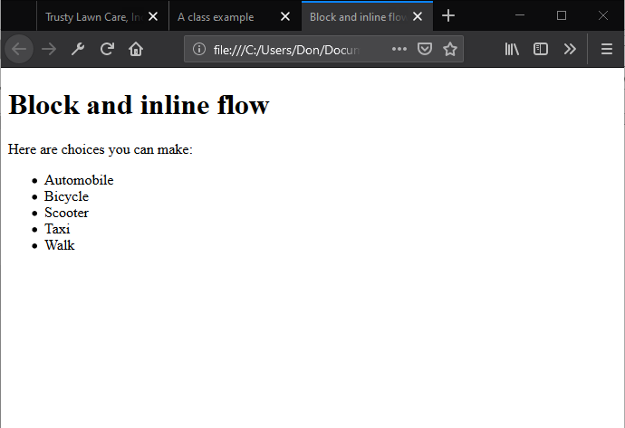
Block Flow Example

Slide 18
Inline Flow Example
<!DOCTYPE html> <html lang="en"> <head> <meta charset="UTF-8"> <title>Block and inline flow</title> <link href = "e4.css" rel = "stylesheet" type = "text/css"> <style type = 'text/css'> .toolbar li { display: inline; background-color: #EEE; border: 1px solid; border-color: #F3F3F3 #BBB #BBB #F3F3F3; margin: 2px; padding: .5em; } </style> </head> <body> <h1>Block and inline flow</h1> <p>Here are choices you can make:</p> <ul class = "toolbar"> <li>Automobile</li> <li>Bicycle</li> <li>Scooter</li> <li>Taxi</li> <li>Walk</li> </ul> </body> </html>

Slide 19
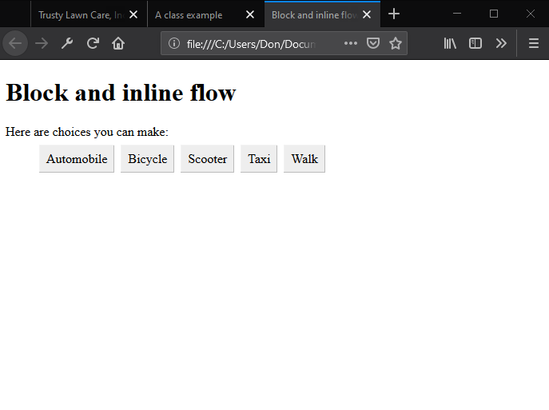
Inline Flow Example

Slide 20
Float vs. Absolute Positioning
Float positioning
Is useful when a layout is in columns, at least in part
To float an element is to have it move as far as possible either to the right or left
Text “wraps” around the element
Absolute positioning
More exact and uses geometric placement

Slide 21
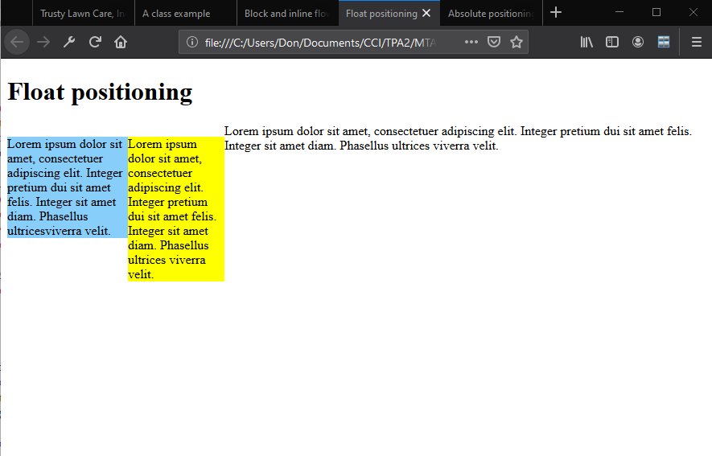
Float Positioning Example

Slide 22
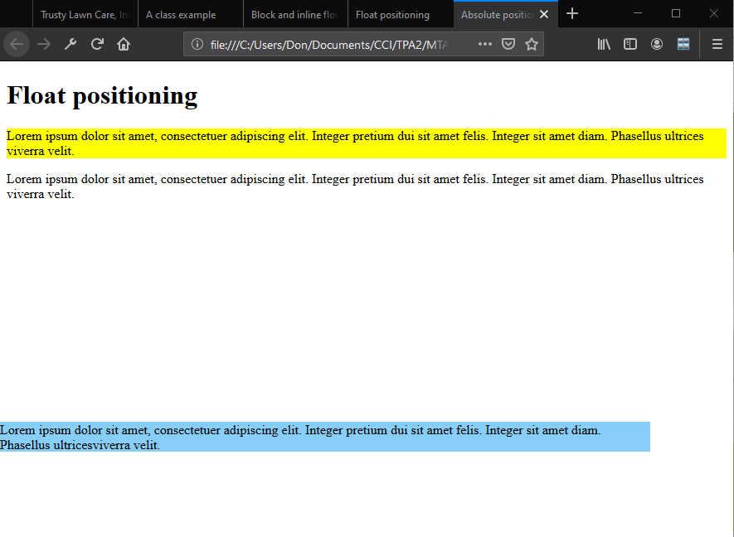
Absolute Positioning Example

Slide 23
Bounding Box
•A bounding box is a rectangular border around content -- text, an image, or a shape -- that enables you to move, rotate, or scale the content of the box.
•Bounding box can be visible or invisible.

Slide 24
Overflow
When an element overflows its bounding box, and its overflow is set to scroll, all the content of the element stays within the box; none of the overflow appears outside the box. This is referred to as scrolling overflow.
Visible overflow writes over the content that follows it.
Hidden overflow makes overflow invisible.

Slide 25
Overflow
Values:
Scroll
Visible
Hidden

Slide 26
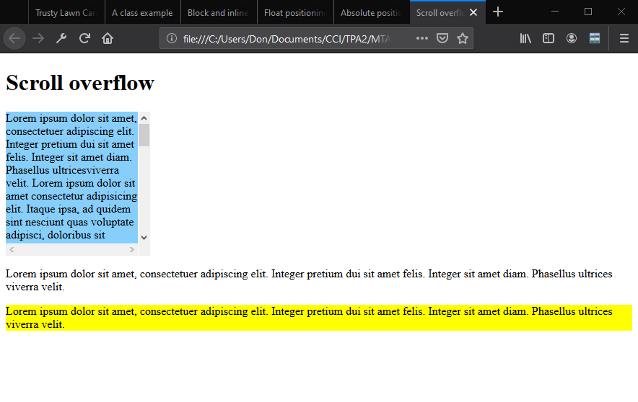
Scrolling Overflow Example

Slide 27
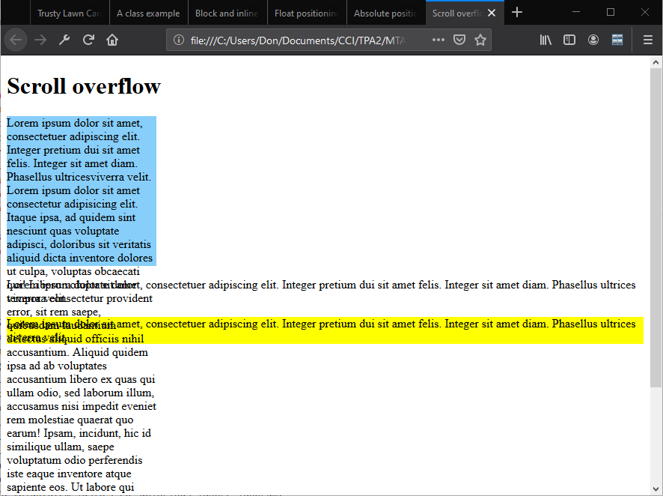
Visible Overflow Example

Slide 28
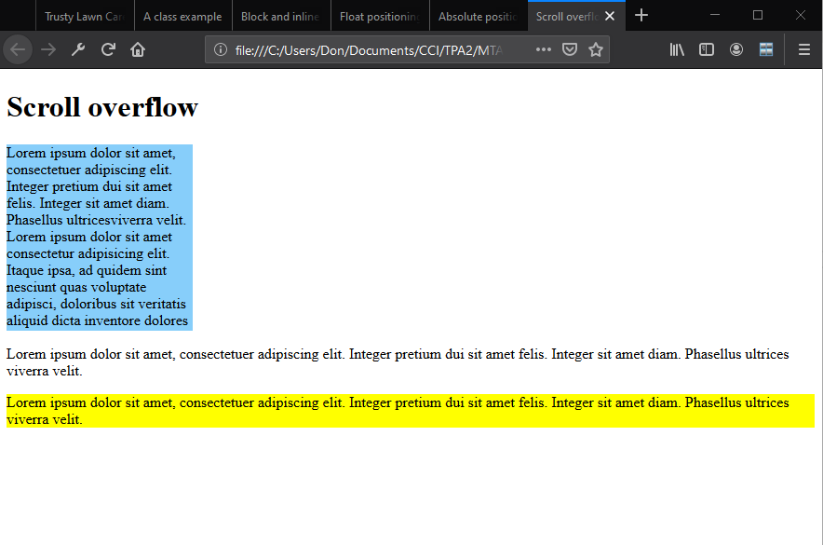
Hidden Overflow Example

Slide 29
Recap
Presentation versus content
CSS basics
– The link between HTML and CSS
– CSS selector and declaration
– Fonts and font families
– Web-safe fonts and @font-face rule
Inline flow and block flow
Float and absolute positioning
Overflow

Slide 30
Questions
HTML has responsibility for content, and CSS for _________.
style

Slide 31
Questions
An HTML source file refers to an external CSS source file with the ________ element.
link

Slide 32
Questions
A CSS source file consists of zero or more individual _________.
rules

Slide 33
Questions
An individual CSS rule has two parts: a __________ and one or more declarations.
selector

Slide 34
Questions
An individual declaration within a CSS rule consists of a _________, followed by a colon, then a value, and a semi-colon terminator.
property

Slide 35
Questions
The most common CSS selectors are: element or type, id, and ________.
class

Slide 36
Questions
The two visible HTML content flows are ________ and ________ .
inline
block

Slide 37
Questions
To make HTML elements appear in columns, it is common to apply ________ positioning.
float

Slide 38
Questions
Suppose an element is subject to overflow: it might grow beyond the size allocated for it on the screen. To give it scrollbars which make it possible for an end user to see the entire element, declare the overflow property to have the ________ value.
scroll

Slide 39
Questions
The most common values for the float property are ______ and ______.
left
right

Slide 40
Questions
Which of the following best summarizes a useful pattern for commercial development?
a. Web pages are written in HTML
b. Designers need to learn Java or Ruby to layout displays
c. CSS takes responsibility for visual style
d. CSS defines structure, and HTML assigns colors and fonts

Slide 41
Questions
Which of the following codes a comment within CSS?
a. <!-- ... -->
b. /* ... */
c. # ... d.
d. // ...

Slide 42
Questions
How many different rules within a single valid CSS source file can declare the style of a paragraph <p> element?
a. 0
b. 1
c. 1 or 2, depending on whether HTML5 is used
d. 0 or more

Slide 43
Questions
Sometimes colors are expressed with English words and sometimes they are expressed with symbolic numbers. Which of the following means “blue”?
a. 009
b. #0000FF
c. !008000
d. (128, 128, 128)

Slide 44
Questions
A paragraph appears on an important display coded as “<p id = 'introduction'>Trusty Lawn Care takes . . .”. You’ve been told this paragraph must appear in the Tahoma font. Which of the following will best help you define an appropriate rule?
a. p {font: Tahoma;}
b. #introduction {font-family: Tahoma;}
c. .introduction {font: Tahoma;}
d. .p {font-family: Tahoma;}

Slide 45
Questions
Someone has set up a Web page with HTML that links to three different CSS source files. The name of one of the source files is misspelled in the HTML. Which of the following is a Web browser most likely to display?
a. It shows a display as though the link to the CSS with a misspelled name is simply missing.
b. It shows the misspelled name of the CSS source along with an error message.
c. It shows as much of the display as possible, using the last CSS correctly linked in place of the CSS with a misspelled name.
d. It displays a warning that the CSS can’t be found and asks whether you want to continue anyway.

Slide 46
Questions
The anchor tag <a > is the HTML element defined for definition of hyperlinks, among other things. Name the default content flow for an anchor.
a. Inline
b. Block
c. Hidden
d. Visible

Slide 47
Questions
Your team is constructing an application that embeds a long license statement end users must have a chance to read and approve. You want to limit the amount of space on the screen the license fills up, at the same time as you make every word of it available to end users who choose to read all of it. Which of the following is most likely to help you code this?
a. {position: scrolling;}
b. {fixed: scrolling;}
c. {overflow: scrolling;}
d. {overflow: scroll;}

Slide 48
Questions
The latest CSS standard that is still under development but widely used is:
a. CSS8
b. CSS5
c. CSS3
d. CSS2

Slide 49
Questions
When HTML links to CSS you have written, which is most likely to be a useful part of the link?
a. type = 'text/css'
b. CSS = “SOME_NAME.css”
c. type = "style/CSS"
d. Web = "style/css"

Slide 50
Questions
True or False
A CSS source file includes two different rules for the font of an h1 element. Your Web browser applies the rule one closer to the top of the source file, and ignores the one that appears closer to the bottom.
FALSE

Slide 51
Questions
True or False
Overflow for a particular element is defined through CSS to scroll. There happens to be no overflow, because the content of the element is unusually short at the moment. Even in this case, the scrollbar is visible.
TRUE

Slide 52
Questions
True or False
You’ve been asked to lay out a design with columns. Float positioning is more likely than absolute positioning to be useful for this situation.
TRUE

Slide 53
Questions
True or False
If you use the latest CSS standard in your coding, end users who rely on old Web browsers will be warned that your pages present security risks.
FALSE

Slide 54
Questions
True or False
Before you can test the CSS you write, you need to make sure a Python compiler is installed on your computer.
FALSE

