Slide 1
Understanding CSS Essentials: Layouts
Microsoft Technology Associate 98-375 HTML5 Application Development Fundamentals

Slide 2
Lesson Objectives
Skills and Concepts | MTA Exam Objectives
Arranging User Interface (UI) Content by Using CSS | Arrange user interface (UI) content by using CSS. (3.2)
Using a Flexible Box to Establish Content Alignment, Direction, and Orientation | Arrange user interface (UI) content by using CSS. (3.2)
Using Grid Layouts to Establish Content Alignment, Direction, and Orientation | Arrange user interface (UI) content by using CSS. (3.2)

Slide 3
User Interface (UI) Design
User interface (UI)is the portion of a Web site or application with which a user interacts
Can be simple, or complex with several sections, buttons, and controls
Positioning and autosizing of UI elements central to good design
Compare Bing.com to Microsoft.com – Look very different – Both follow the elements of good design—clean, easy to use, well-structured

Slide 4
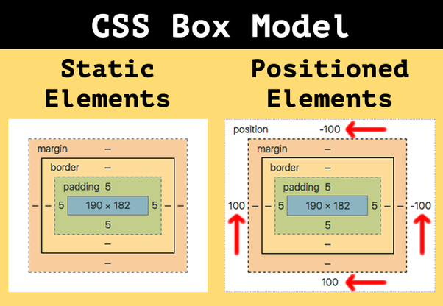
The Traditional CSS Box Model

Slide 5
Block-level and Inline Elements
A block-level element creates boxes that contribute to the layout of the document.
Examples: Sections, articles, paragraphs, lists, and images
Inline elements are designed for laying out text and don’t disrupt the flow of the document.
Examples: Applying boldface and the new HTML5 mark element

Slide 6
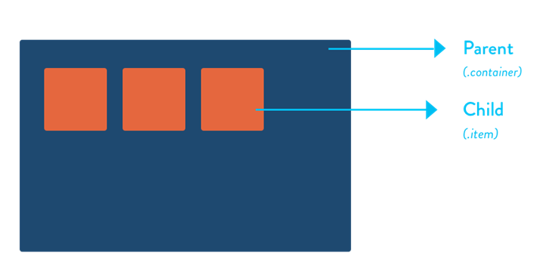
Parent/Child Relationships
A parent box can contain one or more child boxes.
A child can inherit CSS styles from a parent.

Slide 7
UI Challenges
Developers have used float property for relative positioning of UI elements for years
Doesn’t work for most mobile Web applications
CSS3 Flexbox Box model ideal for items that should resize or reposition themselves
CSS3 Grid Layout model good for complex layouts

Slide 8
Vendor Prefixes
CSS3 specification is still in draft format and undergoing modifications
Need to use vendor prefixes with several CSS3 constructs
Internet Explorer uses the -ms- prefix.
Firefox supports the -moz- prefix.
Opera supports the -o- prefix.
Chrome and Safari support the -webkitprefix.

Slide 9
CSS Flexbox Box Model
Good for controls, toolbars, menus, and forms that resize and reposition automatically when the user changes the size of the browser window
Browser takes the available space into account and calculates the dimensions for the user
Enables relative sizes and positioning

Slide 10
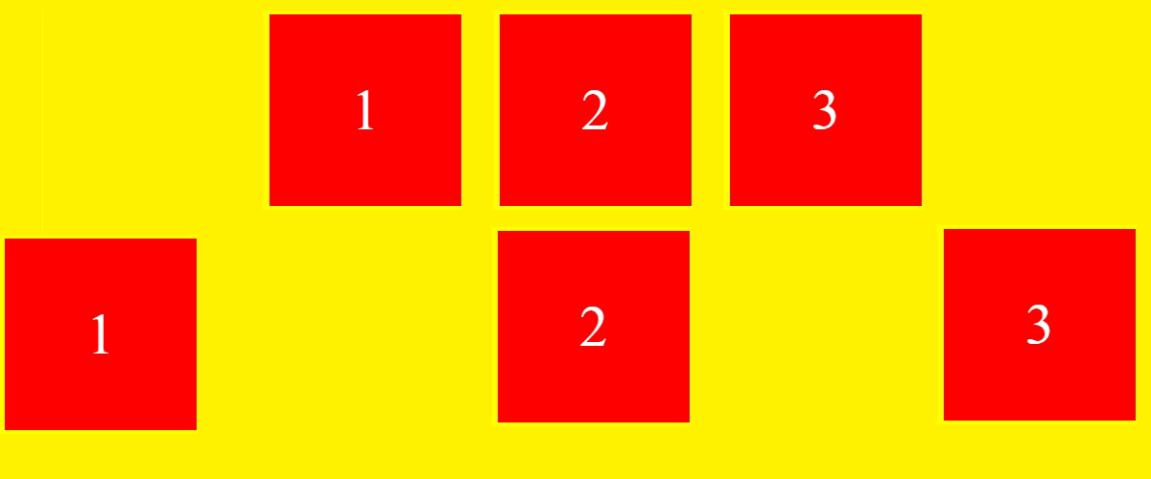
CSS Flexbox Box Model
Example: Parent flexbox indicated by shaded background, icons are child boxes
When user increases screen size horizontally, the flexbox expands, distributing an even amount of space between the children
Before
After

Slide 11
CSS Flexbox Box Model
Define an element as a flexbox using the CSS properties display:flexbox or display:inline-flexbox.
The flexbox attribute sets the flexbox as a block-level element.
The inline-flexbox attribute sets the flexbox as an inline-level element.

Slide 12
CSS Flexbox Box Model
A box within a box is a child box, which can be flexible or not. A child box is referred to as a flexboxitem.
The flex property controls the height and width of flexbox items.
Whereas the display:flexbox property creates a flexible parent box, the flex property is what gives the flexible nature to child boxes.

Slide 13
CSS Flexbox Box Model
Parent
A parent flexbox with three child boxes (flexbox items)
Modifying the third child box to fill the available space
Child 1
Child 2
Child 3
Parent
Child 1
Child 2
Child 3

Slide 14
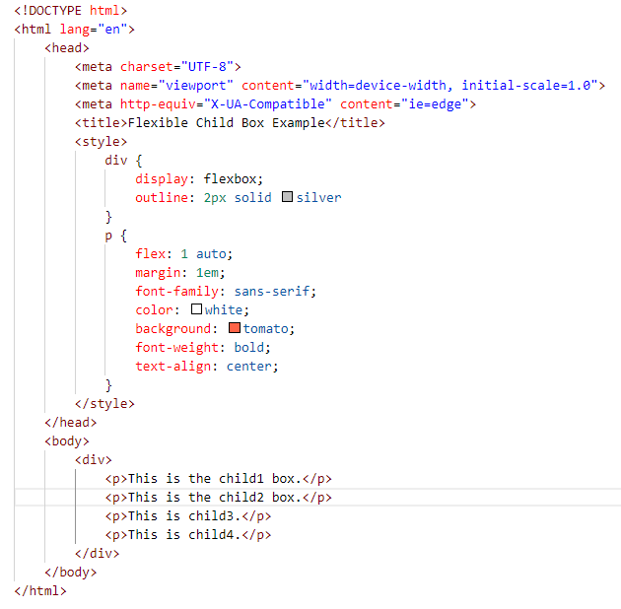
Flexible Child Boxes Example

Slide 15
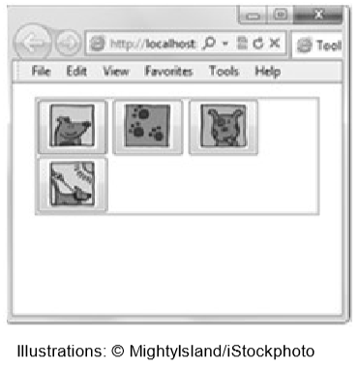
flex-wrap Property
The flex-wrap property determines whether child boxes automatically create a new line and wrap onto it.

Slide 16
flex-pack and flex-align Properties
The flex-pack property justifies the alignment of child boxes within a flexbox and minimizes whitespace in the parent box.
Accepts one of four values: start, end, justify, or center
The flex-align property sets the default alignment for child boxes, but with a twist. If the orientation of the parent box is horizontal, flex-align determines the vertical alignment of the child boxes, and vice versa.

Slide 17
Changing Direction of Child Items
• The flex-direction property affects the direction of child boxes in the parent box. It uses the row, row-reverse, column, and column-reverse values.
• The flex-flow property sets the flex-direction and flex-wrap properties at the same time.
• The flex-order property controls the order and arrangement of child boxes in a flexbox by placing the child boxes in ordered groups.

Slide 18
CSS3 Grid Layout Model
Gives developers greater control over complex layouts than the flexbox model
Lets you control the design of sections or entire HTML-based documents using CSS3
Grid layouts use columns, rows, and cells, but you can move blocks of content from one part of page or application to another by moving code lines in CSS

Slide 19
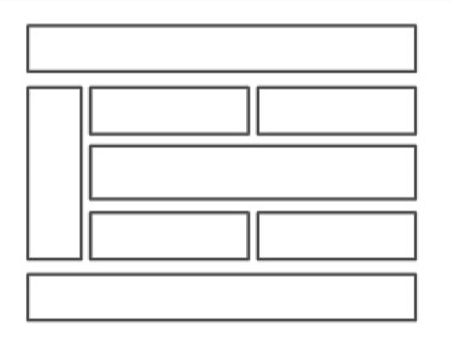
Grid Layout

Slide 20
Newspaper Layout Example Using a Grid
MASTHEAD
NAV
COL 1
COL 2
COL 3
COL 4

Slide 21
Grid Layout CSS Properties
CSS property of a grid layout creates container for the layout:
display:grid
display:inline-grid
Grids also use grid-columns and grid-rows properties
Child elements of a grid are called grid items

Slide 22
Sizing and Positioning of Grid Items
Grid tracks: The columns and rows of the grid; you define grid tracks using the gridrows and grid-columns properties
Grid lines: The horizontal and vertical lines that divide columns or rows
Grid cells: The logical space used to lay out grid items, similar to a cell in a spreadsheet

Slide 23
Grid Layout Example Fixed vs. Fractional
Can define columns and rows with a fixed size or a fractional size relative to the grid
Fractional sizes defined using fr (short for “fraction”)
A row defined as 2fr will be twice the size of a row defined as 1fr

Slide 24
CSS Grid Template Layout Module
Another approach to grid layouts
Creates a grid template, which is like an empty table into which data can be flowed
Template uses alphabetical characters to represent the position of items in a grid

Slide 25
CSS Grid Template Layout Module
Use grid-position property and assign an alphabetical character as a position value
Example of grid-position property defined for four items:
news { grid-position: a; }
weather { grid-position: b; }
sports { grid-position: c; }
events { grid-position: d; }

Slide 26
CSS Grid Template Layout Module
After assigning positions, create layout using strings of characters
A string equals a row
Each character in string is a column
Can use same values as used for grid-rows and grid-columns
Example of grid with one row and four columns that size to fit content: div { grid-template: "abcd"; grid-rows: auto; grid-columns: auto;}

Slide 27
Recap
UI design
Traditional CSS Box model
Block-level and inline element
Parent/child relationships
Vendor prefixes
CSS Flexbox Box model
CSS Grid Layout model
CSS Grid Template Layout model

Slide 28
Questions
A ______________________ is the portion of a Web site or application with which a user interacts.
User Interface (UI)

Slide 29
Questions
In the original W3C CSS box model, the __________ is the space between border and the content of the box.
padding

Slide 30
Questions
In the W3C CSS box model, a _______-level element creates boxes that contribute to the layout of the document.
block

Slide 31
Questions
Flexbox children are called ______________ and are laid out using the flexbox model.
flexbox items

Slide 32
Questions
Child elements of a grid are called ____________.
grid items

Slide 33
Questions
__________ offers flexible layouts for UI design, mainly to create controls, toolbars, menus, and forms that resize and reposition automatically when the user changes the size of the browser window.
Flexbox

Slide 34
Questions
The _______________ relationship describes how a parent box can contain one or more child boxes.
parent/child

Slide 35
Questions
A _____________ is like an empty table into which data can be flowed.
Grid template

Slide 36
Questions
An _______ element is designed for laying out text and doesn’t disrupt the flow of a document. Examples include boldface and the new HTML5 mark element.
inline

Slide 37
Questions
Where the flexbox model is suitable for simple things like buttons, toolbars, and many forms, you can use the _____________ model for more complex layouts.
Grid Layout

Slide 38
Questions
The original W3C CSS Box model does not include which of the following?
a. margin
b. border
c. toolbar
d. padding

Slide 39
Questions
Which of the following is best suited for buttons and toolbars?
a. Flexbox Box model
b. CSS Box model
c. Grid Layout model
d. none of the above

Slide 40
Questions
You are using CSS to create a flexbox in an HTML document for work. Everyone at work uses the Internet Explorer Web browser. Which prefix should be used with the CSS property names to ensure compatibility while viewing the HTML document?
a. -moz-
b. -ms-
c. -webkit-
d. -o-

Slide 41
Questions
Which flexbox property makes child boxes flexible by height and width?
a. flex
b. flex-child
c. flex-wrap
d. flex-align

Slide 42
Questions
You want to ensure that extra space in a browser window is distributed equally to the size of all child boxes in a flexbox. Which CSS property should be used?
a. flex-align
b. flex-wrap
c. flex-order
d. flex-pack

Slide 43
Questions
Which flexbox property assigns child items to groups to control arrangement within a flexbox?
a. flex
b. flex-group
c. flex-direction
d. flex-order

Slide 44
Questions
Which of the following places child items in a grid?
a. grid-columns
b. grid-column
c. grid-flow
d. grid-pack

Slide 45
Questions
Which of the following enables you to adapt an HTML document to end-user devices?
a. Media queries
b. The CSS Box model
c. The grid-template property
d. @import

Slide 46
Questions
Which of the following is the best use of a grid layout?
a. Menu
b. Toolbar
c. Footer
d. Game interface

Slide 47
Questions
What is the primary purpose of a grid template?
a. To style a grid
b. To create a table that will hold data
c. To ensure your grid has equal numbers of columns and rows
d. none of the above

Slide 48
Questions
True or False
A flexbox is defined by an element with the CSS properties display:boxflex or display:inline-boxflex.
FALSE

Slide 49
Questions
True or False
A parent box can contain one or more child boxes.
TRUE

Slide 50
Questions
True or False
You cannot reverse the order of child boxes within a flexbox.
FALSE

Slide 51
Questions
True or False
A flexbox requires an outline or background color.
FALSE

Slide 52
Questions
True or False
An appropriate use for a grid layout is for an online newspaper or a game.
TRUE

