Slide 1
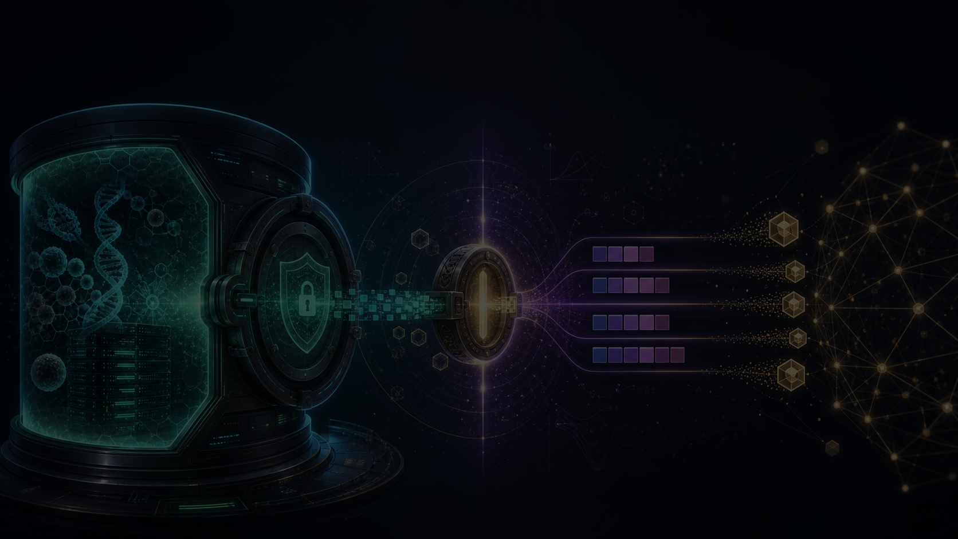
wikigen
Private data can become verified reward without becoming public data.
dnai-wikigen is a private evaluation, private reward, and attested settlement substrate: sealed data and verifiers inside dstack TEEs, bounded outputs and escrow on Base.
project pitch, not a startup pitch
wikigen.me
01

Slide 2

THE PROBLEM
The most valuable data cannot be shared like ordinary data.
Bio datasets, private benchmarks, reward functions, source accounts, and proprietary tests have value because they can evaluate something. Direct disclosure destroys that leverage.
Data owners need proof of utility without handing over the data.
Optimizers need reward signals — but raw rewards, logs, and checkpoints can leak the verifier.
Buyers need evidence the evaluation actually ran: measured code and a quote, not a PDF promise.
wikigen.me
02

Slide 3
THE THESIS
Interaction with private data is not the same as disclosure.
That is only true under a constrained interface: an allowed query family, measured code, authenticated callers, budgeted and reduced outputs, and an attestable transcript.
sealed asset
reward oracle
bounded proof
Raw data, reward functions, account credentials, and browser sessions live only inside the attested TEE.
→
Measured verifier code computes exact rewards over the sealed data — a narrow oracle, not a shell or notebook.
→
Only score bands, pass/hold/deny decisions, hashes, quotes, and settlement events leave the boundary.
wikigen.me
03

Slide 4

WHAT WIKIGEN IS BUILDING
A private verified-reward substrate: four ideas in one boundary.
NDAI economics
TEE custody
private verified rewards
DevProof verification
Reserve price, budget cap, bounded disclosure, and escrow settlement mediate every deal.
Data, credentials, reward functions, and browser sessions are sealed in dstack Intel TDX CVMs — operators get no raw access.
Rewards come from measured code over sealed data, not from a free-form model opinion.
Anyone can check the chain: git SHA → image digest → compose hash → TDX quote → contract.
Two product faces share one core: the Attested Diligence Room values private artifacts; the Private Reward Lab lets optimizers actively test candidates against sealed data.
wikigen.me
04

Slide 5
PRODUCT MODES
One protected interface, four product modes.
A · Diligence Room
B · Private Reward Lab
private artifact → bounded valuation → escrow settlement
sealed verifier + data → reward oracle → optimizer loop → bounded proof
Price memos, code, datasets, SOPs, and model artifacts without disclosure.
RLVR, TTT-style discovery, private benchmarks, reward-function licensing.
C · Source Custody Room
D · Multi-Owner Collaboration
web2 account → TEE browser/export → sealed artifact → policy-gated use
N private corpora → fan-out gates → unanimous or M-of-N consent → joint result
WhatsApp, email, private repos, and data portals become sealed assets.
Biobank collaboration, sponsor/CRO workflows, cross-institution analysis.
The Private Reward Lab is the strongest form of the diligence room: the evaluator does not just read an artifact — it tests candidates against it while the data stays sealed.
wikigen.me
05

Slide 6

THE ONE-LINER
Prime RL meets TEEs.
Community-built RL environments become sealed, attested reward oracles — royalty-bearing assets instead of donated public goods.
envs are assets
usage is provable
inference pays
An environment creator seals data and verifier in a TEE. Anyone can train against it; nobody can copy it.
Every fine-tune that touches the environment is metered by measured code, so royalties are forced by contract, not by trust.
The fine-tuned model stays encumbered inside the boundary — payouts stream from those who use the model, not those who trained it.
Bootstrap: the account-delegated Tinker proxy makes this runnable as a DevProof MVP today — no protocol-level integration required.
wikigen.me
06

Slide 7
CONCRETE EXAMPLE
TTT-Discover-style biology becomes a private reward environment.
Private bio verifier
Candidate computational-bio code is proposed by an optimizer.
The TEE scores it against sealed data with hidden train / reward / final-validation splits.
Exact rewards can drive learning internally; public feedback is quantized, banded, or withheld.
A one-shot final-validation gate and query budgets stop holdout overfitting.
The optimizer is swappable
RLVR • test-time training • LLM repair loop • evolutionary search • manual
The private reward boundary is the product; the optimizer is a plug-in.
wikigen.me
07

Slide 8

SECURITY CLAIM
Only the approved reward transcript leaves the TEE.
Private data can be queried many times inside the boundary, but every query passes through one measured interface.
01
02
03
04
Seal D
Run R_D(c)
Release Q(·)
Account for leakage
Private data and verifier code live inside the attested TEE.
Candidate code is sandboxed and scored against hidden data.
Only reduced feedback leaves: band, hash, hold, or final result.
The public transcript is counted before the system is trusted.
Theorem 1 — leakage-only realization
I(D ; transcript) ≤ n·k + b
Every outside view can be simulated from L(D), the declared leakage. If a fact is not in L(D), it does not appear outside the TEE — up to TEE, attestation, and standard crypto assumptions.
n reward queries × k visible bits + b final-result bits
wikigen.me
08

Slide 9
ENCUMBERED COMPUTE
Delegate the compute, never the account.
The upstream Tinker API key, project id, cookies, and payment state are sealed service configuration inside the CVM. Users and agents only ever hold scoped proxy credentials.
01
02
03
04
scoped JWT
policy gates
spend limits
bounded receipts
Short-lived, signed with CVM-derived key material, delivered encrypted to the recipient's X25519 key.
Hash-only issue policy, verifier-signed identity registry, reviewer-signed grant lifecycle — all fail closed.
Per-scope caps enforced before automation, plus on-chain TinkerAccountEncumbrance approval for spend scopes.
Hashes, bands, booleans, and audit records only — raw_secret_egress=false on every response.
Live today: encrypted token issuance, recipient-side decrypt, and scoped proxy calls run on the operator-validation Phala CVM, gated by an on-chain-approved compose hash — with only hashes leaving the boundary.
wikigen.me
09

Slide 10
WHAT EXISTS NOW
This is a running system, not a concept deck.
real
Three contracts live on Base Sepolia with full test suites: DiligenceRoom escrow, EmailOracleAuth policy, and TinkerAccountEncumbrance spend caps.
real
Private reward stack: environment contract, Python candidate sandbox, hidden-holdout accounting, and a synthetic environment with a bounded demo CLI.
real
Chain watcher, TEE chain submitter, verifier-signed submitResult(), and a local synthetic-room-to-Anvil settlement proof that emits bounded JSON only.
real
Live Phala CVM: sealed Tinker account with full API-key lifecycle (create / list / delete) via in-TEE browser automation, a $20 balance, scoped proxy JWTs, and delegated training driven end-to-end through the real /tinker/train endpoint.
partial
Coordination layer: policy kernel, consent decisions, and reviewer queue are source-real; service wiring and production governance remain open.
Everything public is hashes, bands, booleans, and attestations — the bounded-output rule is enforced in code and tests, not just prose.
wikigen.me
10

Slide 11
HONEST CURRENT STATE
The hard parts are named, not hidden.
Deployed Tinker training
the proxy-mediated delegated-training path is built and validated end-to-end (verify -> scope -> spend-limit -> create -> forward/backward -> checkpoint -> bounded receipt). By design end users reach training only through the proxy, never the account; a billing-active upstream account and a current valid sealed key are operational setup, not a system gap.
Quote verification
verifier signatures and dstack envelope checks are real; full TDX quote parsing and a production verifier service are not.
Account funding
the funded $20 balance and card on file are real; production custody, compliance approval, and a tokenized payment route remain open.
Bio validation
interfaces and toy environments only; real TTT/RL loops and OS-level candidate isolation are still to build.
Production surface
frontend, DLP/egress enforcement, reviewer governance, and Proof-of-Cloud provenance are roadmap items.
wikigen.me
11

Slide 12
WHY THIS BELONGS IN THE ETH CONVERSATION
The trust boundary becomes public infrastructure.
Attestations turn private computation into something users can verify end to end: git SHA → image digest → compose hash → TDX quote.
Contracts enforce reserve prices, budget caps, spend policy, result hashes, and pull-payment settlement.
Private rewards create markets for benchmarks, biology, audits, and RL environments — with contract-forced royalties to their creators — without dumping raw assets on-chain.
The Flashbots / DevProof lesson applies: name every role, freeze the measurements, publish the verification path.
wikigen.me
12

Slide 13
BUILD PLAN
Next work turns the proof model into a demo anyone can verify.
1
2
3
4
5
Provision the upstream account
Production result verifier
Real reward environments
Fail-closed enforcement
Public verifier UI
Delegated training via the proxy is validated end-to-end; provision a billing-active upstream account and a current sealed key — routine operational setup, not a design gap.
Live TDX quote parsing and a deployed-CVM submitResult broadcast on Base Sepolia.
Bio benchmark, hardened OS-level candidate sandbox, and optional DP accounting.
EmailOracleAuth on every OTP request, plus DLP/egress controls.
Compose hash, quote, and tx trail with a transparency log for every run.
wikigen.me
13

Slide 14
WHAT SUPPORT UNLOCKS
This cohort can help make the project legible, verified, and real.
What we need
What it unlocks
Cryptographic critique of the leakage model and Theorem 1 assumptions.
A verifiable end-to-end demo of private reward over sealed data.
TEE / Flashbots / DevProof review of the deployment and provenance story.
An ETH-native template for private benchmarks and data markets.
Tinker project entitlement, compute, and funding-rail support.
Bio diligence without raw disclosure, with leakage counted up front.
wikigen.me
14

Slide 15

wikigen.me
Help us make private rewards verifiable public infrastructure.
The goal is not to sell private data. It is to let private data prove, reward, validate, and settle under a boundary the ETH community can inspect.
Prime RL meets TEEs: environments become royalty-bearing assets, and inference pays their creators.
Shape Rotator project
Flashbots-aligned trust model
ETH-verifiable settlement
wikigen.me
15

