Slide 1
MEBO Ointment
Topical Regenerative Ointment
Product Information for Medical Technology Department Review
医学技术部审阅意见：_______________________________________________

Slide 2
Advanced Cutaneous Regeneration
FDA 510(k) Cleared
[Product Image: 40g Tube]
MEBO Ointment
MEBO REGENERATIVE OINTMENT 40g tube Topical use
MEBO Ointment is a unique topical formulation that combines naturally-derived active ingredients with a pharmaceutical base of beeswax and sesame oil, creating a physiological moist environment that favors the natural regeneration of skin. Designed for the treatment of partial-thickness burns, chronic ulcers, diabetic foot, and skin graft donor sites.
Active Ingredients
Extract of Scutellaria baicalensis, Cortex phellodendri, and Cera flava in a sesame oil base.
医学技术部审阅意见：_______________________________________________

Slide 3
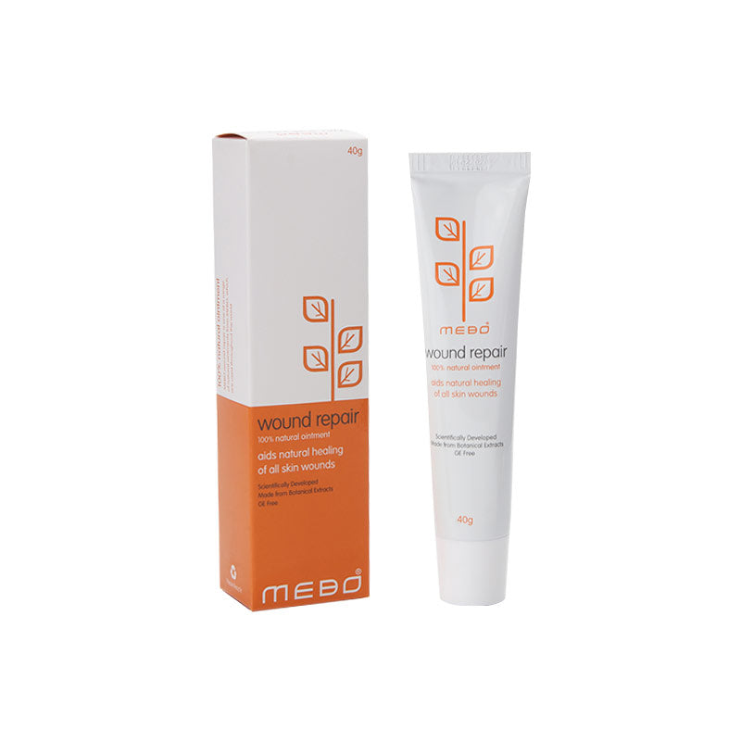
Featured Product: MEBO Wound Repair
MEBO Wound Repair
Specially formulated regenerative ointment to aid the natural healing of skin wounds including ulcers (bedsores, diabetic, chronic), cracked nipples, shingles, fissures, chilblains, impetigo, hemorrhoids, cracked/chafed/grazed skin, and donor-site repair.
No prescription
Pregnancy safe
Children
医学技术部审阅意见：_______________________________________________

Slide 4
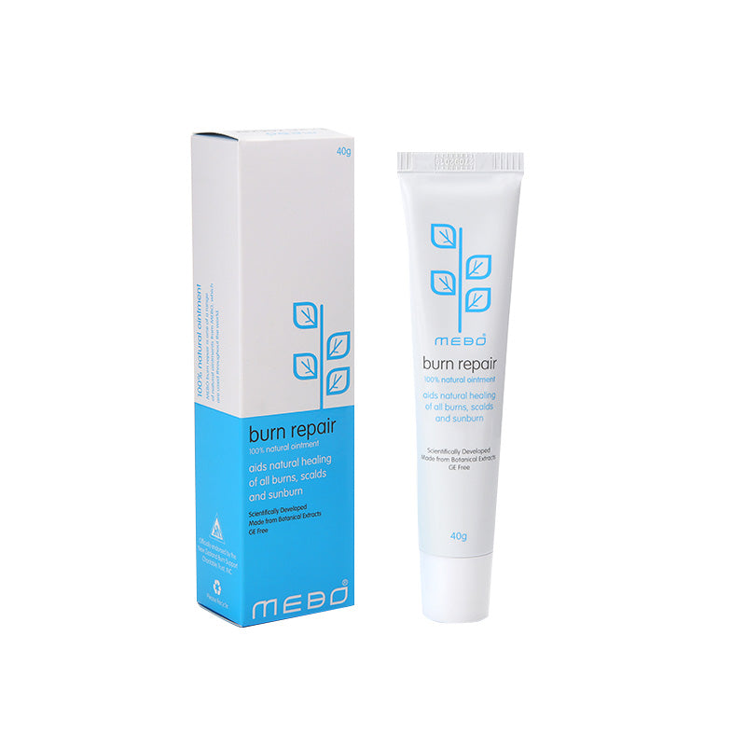
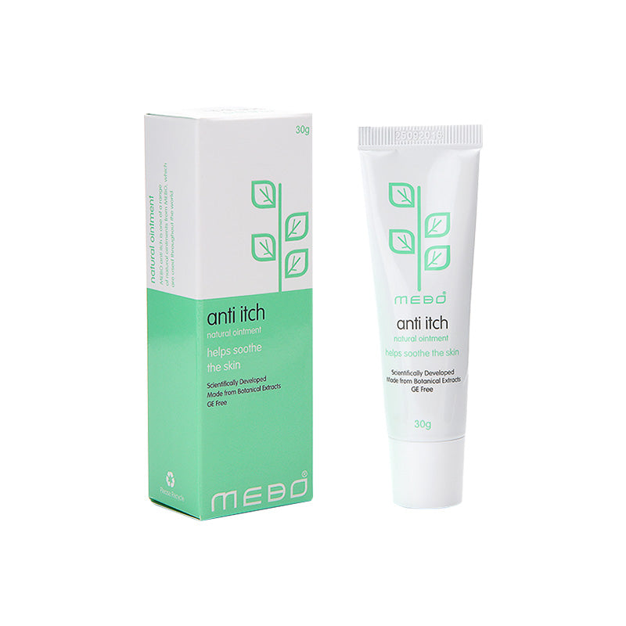
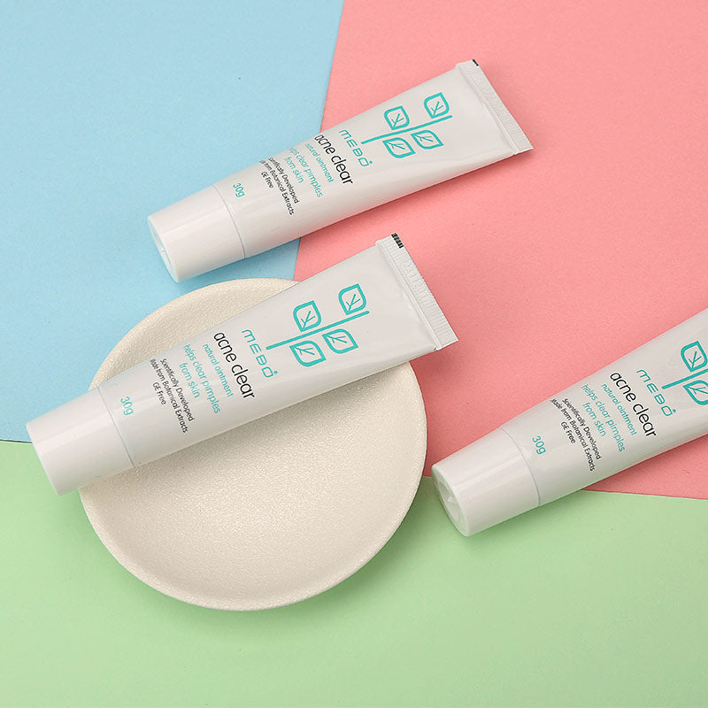
Product Line — Skin Repair
MEBO Burn Repair
MEBO Anti-Itch Cream
MEBO Acne Clear
Burns, scalds, sunburns
Itch relief from scars, allergies
Cleansing and acne recovery
医学技术部审阅意见：_______________________________________________

Slide 5
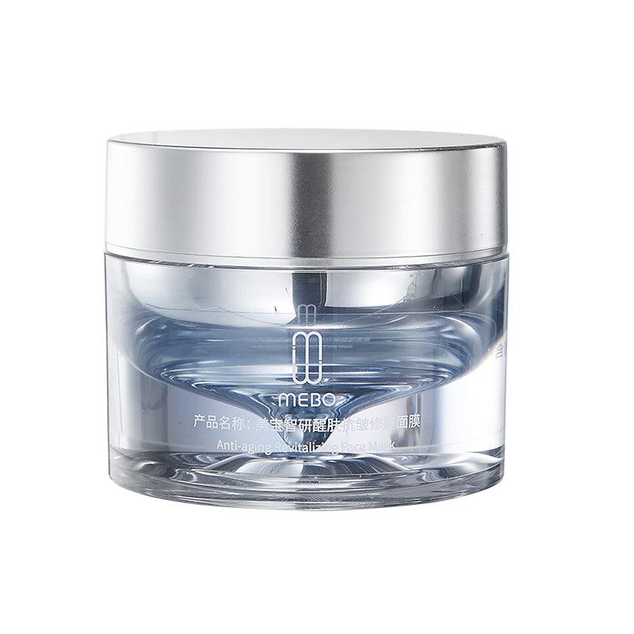
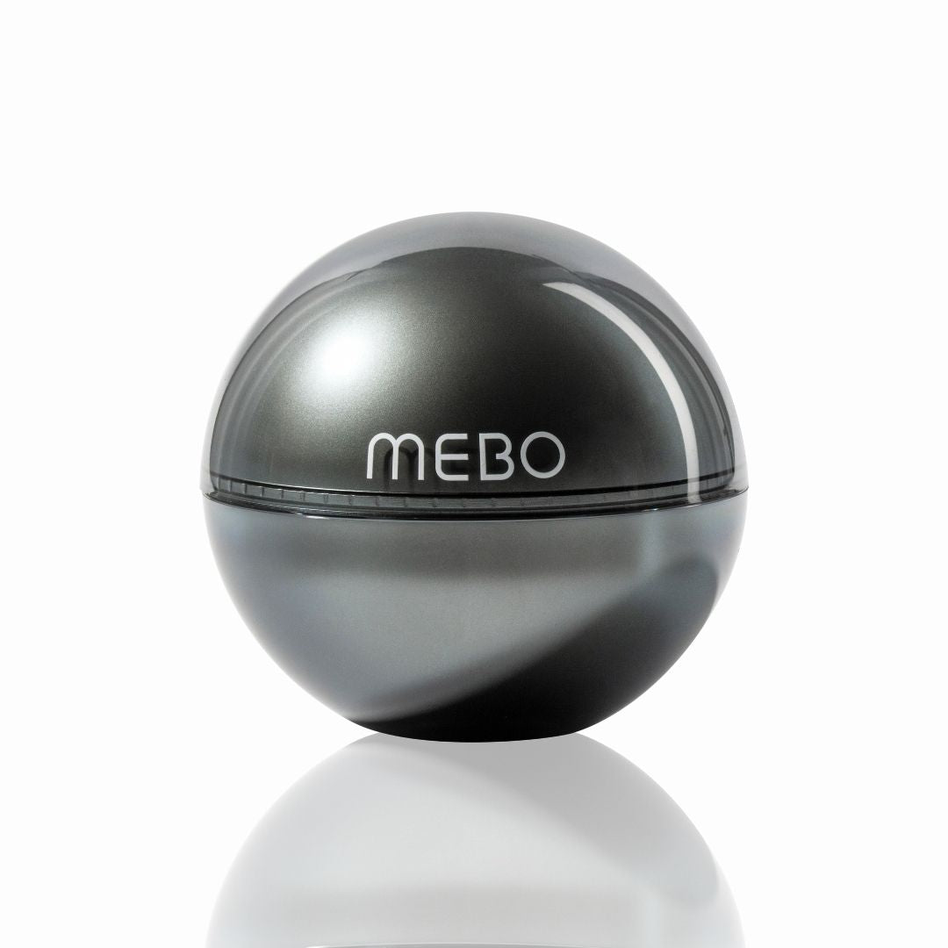
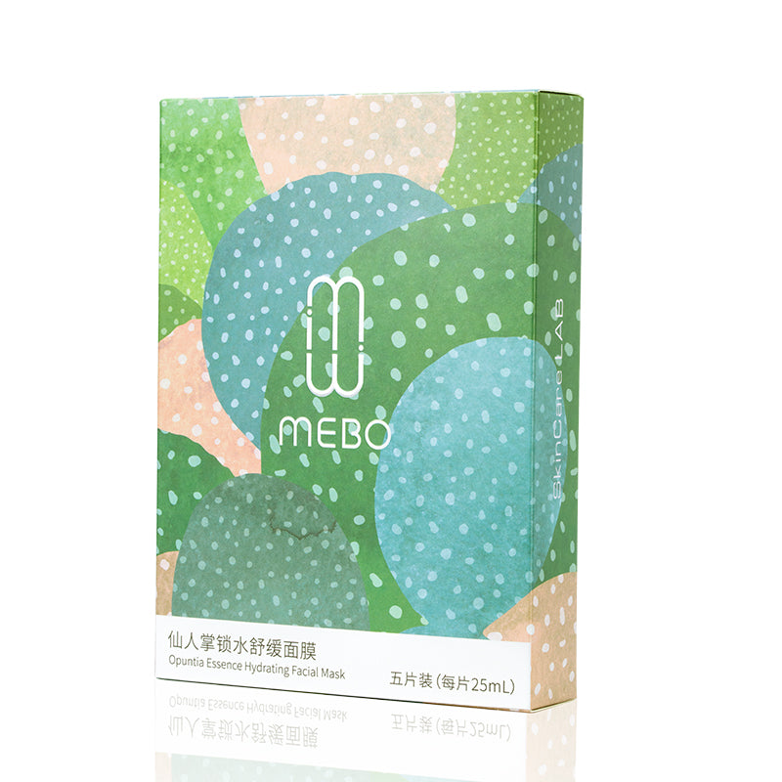
Product Line — Cosmetics
MEBO Anti-aging Sleeping Mask
MEBO Neck & Shoulder Cream
MEBO Opuntia Facial Mask
医学技术部审阅意见：_______________________________________________

Slide 6
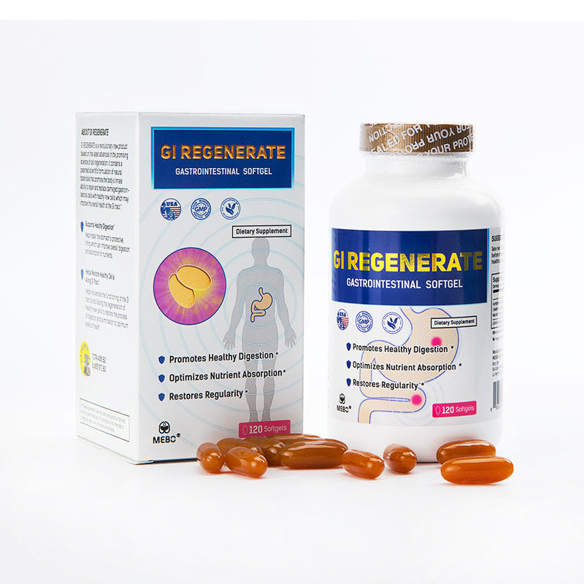
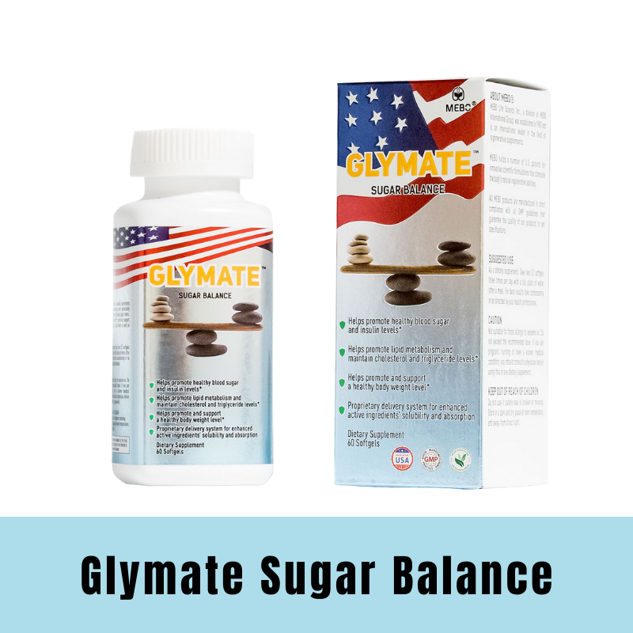
Product Line — Dietary Supplement
MEBO Life GI Regenerate
GLYMATE Sugar Balance
120 regenerative softgel capsules
60 all-natural softgel capsules
医学技术部审阅意见：_______________________________________________

Slide 7
Product Specifications
Product name
MEBO Ointment (MEBO Burn Cream)
Classification
Medical device / Pharmaceutical product for topical use
Active ingredients
β-Sitosterol, Baicalein, Berberine
Pharmaceutical base
Beeswax (Cera flava) and sesame oil (Sesamum indicum)
Presentations
40 g tube · 120 g tube
Route of administration
Topical / External use only
Storage conditions
Store at room temperature (15–30 °C), protect from direct light
Shelf life
36 months from manufacturing date
Health registration
Varies by country. Consult local registration in your jurisdiction
医学技术部审阅意见：_______________________________________________

Slide 8
Indications — What is MEBO Ointment used for?
Burns
Chronic Ulcers
Partial-thickness burns (superficial and deep), thermal and scald burns. Promotes epidermal regeneration with minimal pain and scarring.
Pressure ulcers (bedsores), venous ulcers, and arterial ulcers. Facilitates debridement and tissue granulation.
Diabetic Foot
Donor Sites
Lesions and ulcers of the foot in patients with diabetes. Helps prevent amputation through tissue regeneration.
Skin graft harvesting sites. Accelerates donor area healing and reduces postoperative pain.
医学技术部审阅意见：_______________________________________________

Slide 9
Mode of Use
General MEBO Ointment application protocol. Specific application must be indicated by a healthcare professional.
1. Clean
2. Apply
3. Cover
4. Reapply
Gently clean the affected area with saline solution. Do not use aggressive antiseptics.
Apply a uniform layer of MEBO Ointment 1–2 mm thick over the entire wound surface.
Cover with sterile non-adherent dressing as indicated. Renew every 4–6 hours or as prescribed.
Clean residual ointment from previous application and reapply. Continue until complete re-epithelialization.
Application frequency and treatment duration depend on the type, size, and severity of the lesion. Always follow the instructions of your treating healthcare professional.
医学技术部审阅意见：_______________________________________________

Slide 10
Dressing Change Methods
Exposed Method Every 4-6 hours
Semi-exposed Method Every 8-12 hours
Dressing Method Every 12-24 hours
Spread a 1 mm thick layer of MEBO on the wound. Wound → MEBO 1mm → Exposed
Spread a 1-2 mm thick layer of MEBO on the wound. Cover with 1-2 layers of gauze impregnated with MEBO. Wound → MEBO 1-2mm → Gauze 1-2 layers
Spread a 2-3 mm thick layer of MEBO on the wound. Cover with 2-4 layers of gauze impregnated with MEBO. Secure with cotton pad and bandage. Wound → MEBO 2-3mm → Gauze 2-4 layers → Cotton + Bandage
医学技术部审阅意见：_______________________________________________

Slide 11
Safety Information
Contraindications
Precautions
Adverse Reactions
• Known hypersensitivity to any of the components • Allergy to bee products (beeswax) • Full-thickness burns requiring surgical escharotomy
• External use only. Do not ingest • Avoid contact with eyes • During pregnancy or lactation, consult your doctor • Do not use on penetrating wounds without medical supervision
• Rarely: transient local irritation • Very rarely: cutaneous allergic reaction • In case of adverse reaction, discontinue use and consult your doctor
Important notice: This information is for guidance only and does not replace professional medical advice. Always consult your doctor or pharmacist before using this product. Keep out of the reach of children.
医学技术部审阅意见：_______________________________________________

Slide 12
Need More Information?
Access professional resources, complete clinical data, and technical documentation for healthcare professionals.
Contact Us
医学技术部审阅意见：_______________________________________________

