Slide 1
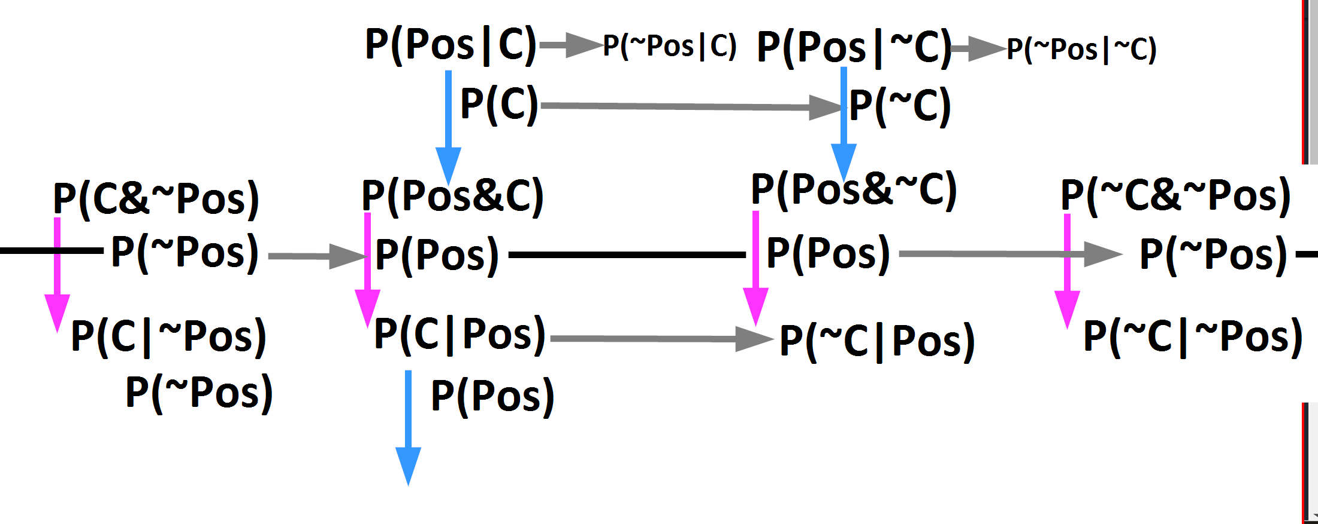
P(~Pos|C)
P(Pos|C)
P(Pos|~C)
P(~Pos|~C)
P(C)
P(C)
P(~C)
P(~C)
P(C&~Pos)
P(Pos&C)
P(Pos&~C)
P(~C&~Pos)
P(~Pos)
P(Pos)
P(Pos)
P(~Pos)
P(C|~Pos)
P(C|Pos)
P(~C|Pos)
P(~C|~Pos)
3 numbers
2 numbers
1 numbers
multiply
divide
add
subtract from one
is the same
no mathematical relation

