Slide 1

Daniel Frederico Lins Leite - 2019/06/24

Slide 2
WASM
What it is
Using it
Why
What it really is
How it runs
How it is generated
Realistic Example

Slide 3
1.
WASM – What it is
WebAssembly encodes a low-level, assembly-like programming language[, that] takes the form of a module that contains definitions for functions, tables, and linear memories, as well as mutable or immutable global variables.
A WebAssembly implementation will typically be embedded into a host environment. This environment defines how loading of modules is initiated, how imports are provided (including host-side definitions), and how exports can be accessed.
The design goals of WebAssembly are the following: fast, safe, and portable.
Fast: executes with near native code performance
Safe: code is validated and executes in a memory-safe, sandboxed environment
Platform-independent: can be embedded in browsers, run as a stand-alone VM, or integrated in other environments.
https://webassembly.github.io/spec/core/intro/overview.html

Slide 4
2.
WASM – Using it
Inside browsers
async function importWASM (fileUrl, imp) {
const wasm = fetch(fileUrl);
const { module, instance } =
await WebAssembly.instantiateStreaming(wasm, imp);
return instance.exports;
};
async function run () {
const { main } = await importWASM(mainUrl);
console.log(main());
};
Outside browsers…
> curl https://get.wasmer.io -sSfL | sh
> wasmer run nginx.wasm
Running Nginx on localhost:8080
Press Ctrl-C to stop...

Slide 5
3.
WASM - Why
Compact: has a binary format that is fast to transmit by being smaller than typical text or native code formats.
Modular: programs can be split up in smaller parts that can be transmitted, cached, and consumed separately.
Efficient: can be decoded, validated, and compiled in a fast single pass, equally with either just-in-time (JIT) or ahead-of-time (AOT) compilation.
Streamable: allows decoding, validation, and compilation to begin as soon as possible, before all data has been seen.
Parallelizable: allows decoding, validation, and compilation to be split into many independent parallel tasks.
Portable: makes no architectural assumptions that are not broadly supported across modern hardware.
https://webassembly.github.io/spec/core/intro/introduction.html#design-goals

Slide 6
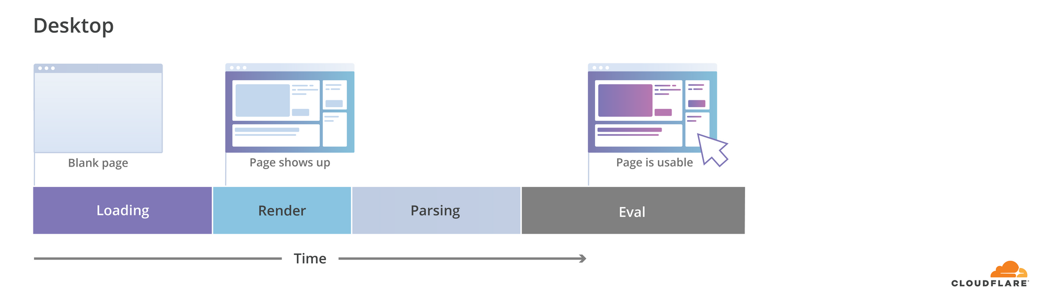
3.
Current Problems
JavaScript Cold starts
The performance of applications on the web platform is becoming increasingly bottlenecked by the startup (load) time. Large amounts of JavaScript code are required to create rich web experiences that we’ve become used to. When we look at the total size of JavaScript requested on mobile devices from HTTPArchive, we see that an average page loads 350KB of JavaScript, while 10% of pages go over the 1MB threshold. The rise of more complex applications can push these numbers even higher.
As networks become faster, parsing and compilation of JavaScript could become the dominant factor. A 1MB JavaScript file will take an order of a 100 ms to parse on a modern desktop or high-end mobile device but can take over a second on an average phone (Moto G4). For example, in the case of news.google.com, it can range from 4s on a Pixel 2 to 28s on a low-end device.
https://blog.cloudflare.com/binary-ast/

Slide 7
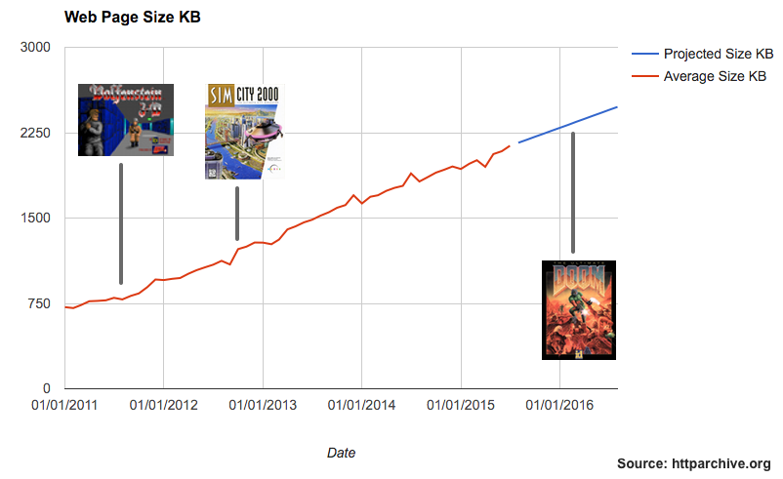
3.
Problem - The web is Doom
https://mobiforge.com/research-analysis/the-web-is-doom

Slide 8
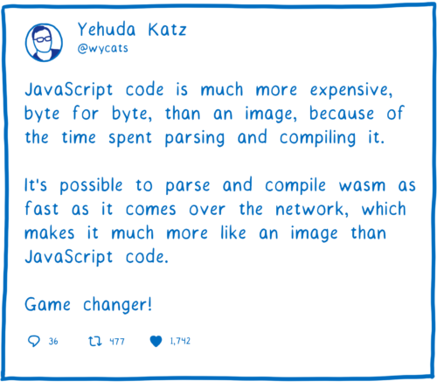
3.
WASM - Streamable/Parallelizable
Streaming compilation: start compiling earlier
If you give WebAssembly.instantiateStreaming a response object, the chunks will go right into the WebAssembly engine as soon as they arrive. Then the compiler can start working on the first chunk while the next one is still being downloaded.
Parallelize: make it all even faster
The unit of parallelization is the function. Each function can be compiled independently, on a different core. This is so fine-grained, in fact, that we actually need to batch these functions up into larger groups of functions. These batches get sent to different cores.
https://hacks.mozilla.org/2018/01/making-webassembly-even-faster-firefoxs-new-streaming-and-tiering-compiler/

Slide 9
4.
WASM – What it really is
WABT: The WebAssembly Binary Toolkit
https://github.com/WebAssembly/wabt
WebAssembly text format - WAT
https://webassembly.github.io/spec/core/text/index.html
WebAssembly binary format - WASM
https://webassembly.github.io/spec/core/binary/index.html

Slide 10
4.
WASM – What it really is
(module)
0000000: 0061 736d ; WASM_BINARY_MAGIC
0000004: 0100 0000 ; WASM_BINARY_VERSION
; section "name"
0000008: 00 ; section code
0000009: 00 ; section size (guess)
000000a: 04 ; string length
000000b: 6e61 6d65 name ; custom section name
000000f: 02 ; local name type
0000010: 00 ; subsection size (guess)
0000011: 00 ; num functions
0000010: 01 ; FIXUP subsection size
0000009: 08 ; FIXUP section size
* https://en.wikipedia.org/wiki/S-expression

Slide 11
4.
WASM – Module
(module)
0000000: 0061 736d ; WASM_BINARY_MAGIC
0000004: 0100 0000 ; WASM_BINARY_VERSION
; section "name"
0000008: 00 ; section code
0000009: 00 ; section size (guess)
000000a: 04 ; string length
000000b: 6e61 6d65 name ; custom section name
000000f: 02 ; local name type
0000010: 00 ; subsection size (guess)
0000011: 00 ; num functions
0000010: 01 ; FIXUP subsection size
0000009: 08 ; FIXUP section size
* https://en.wikipedia.org/wiki/S-expression

Slide 12
4.
WASM – Module
(module)
0000000: 0061 736d ; WASM_BINARY_MAGIC
0000004: 0100 0000 ; WASM_BINARY_VERSION
; section "name"
0000008: 00 ; section code
0000009: 00 ; section size (guess)
000000a: 04 ; string length
000000b: 6e61 6d65 name ; custom section name
000000f: 02 ; local name type
0000010: 00 ; subsection size (guess)
0000011: 00 ; num functions
0000010: 01 ; FIXUP subsection size
0000009: 08 ; FIXUP section size
Modules
WebAssembly programs are organized into modules, which are the unit of deployment, loading, and compilation. A module collects definitions for types, functions, tables, memories, and globals.
https://webassembly.github.io/spec/core/syntax/modules.html
Module =‘(’ ‘module’ id? (m:fields)∗ ‘)’
https://webassembly.github.io/spec/core/text/modules.html

Slide 13
4.
module

Slide 14
4.
WASM – Types
(module
(type $0 (func (param i32) (result i32)))
)
0000000: 0061 736d ; WASM_BINARY_MAGIC
0000004: 0100 0000 ; WASM_BINARY_VERSION
; section "Type" (1)
0000008: 01 ; section code
0000009: 00 ; section size (guess)
000000a: 01 ; num types
; type 0
000000b: 60 ; func
000000c: 01 ; num params
000000d: 7f ; i32
000000e: 01 ; num results
000000f: 7f ; i32
0000009: 06 ; FIXUP section size
; section "name"
0000010: 00 ; section code
0000011: 00 ; section size (guess)
0000012: 04 ; string length
0000013: 6e61 6d65 name ; custom section name
0000017: 02 ; local name type
0000018: 00 ; subsection size (guess)
0000019: 00 ; num functions
0000018: 01 ; FIXUP subsection size
0000011: 08 ; FIXUP section size

Slide 15
4.
WASM – Types
(module
(type $0 (func (param i32) (result i32)))
)
0000000: 0061 736d ; WASM_BINARY_MAGIC
0000004: 0100 0000 ; WASM_BINARY_VERSION
; section "Type" (1)
0000008: 01 ; section code
0000009: 00 ; section size (guess)
000000a: 01 ; num types
; type 0
000000b: 60 ; func
000000c: 01 ; num params
000000d: 7f ; i32
000000e: 01 ; num results
000000f: 7f ; i32
0000009: 06 ; FIXUP section size
; section "name"
0000010: 00 ; section code
0000011: 00 ; section size (guess)
0000012: 04 ; string length
0000013: 6e61 6d65 name ; custom section name
0000017: 02 ; local name type
0000018: 00 ; subsection size (guess)
0000019: 00 ; num functions
0000018: 01 ; FIXUP subsection size
0000011: 08 ; FIXUP section size

Slide 16
4.
WASM – Types
(module
(type $0 (func (param i32) (result i32)))
)
0000000: 0061 736d ; WASM_BINARY_MAGIC
0000004: 0100 0000 ; WASM_BINARY_VERSION
; section "Type" (1)
0000008: 01 ; section code
0000009: 00 ; section size (guess)
000000a: 01 ; num types
; type 0
000000b: 60 ; func
000000c: 01 ; num params
000000d: 7f ; i32
000000e: 01 ; num results
000000f: 7f ; i32
0000009: 06 ; FIXUP section size
; section "name"
0000010: 00 ; section code
0000011: 00 ; section size (guess)
0000012: 04 ; string length
0000013: 6e61 6d65 name ; custom section name
0000017: 02 ; local name type
0000018: 00 ; subsection size (guess)
0000019: 00 ; num functions
0000018: 01 ; FIXUP subsection size
0000011: 08 ; FIXUP section size
Value types classify the individual values that WebAssembly code can compute with and the values that a variable accepts.
valtype = i32 | i64 | f32 | f64
i32 = int 32 bits
i64 = int 64 bits
f32 = float 32 bits
f64 = float 64 bits
https://webassembly.github.io/spec/core/syntax/types.html#syntax-type

Slide 17
4.
WASM – Types
(module
(type $0 (func (param i32) (result i32)))
)
0000000: 0061 736d ; WASM_BINARY_MAGIC
0000004: 0100 0000 ; WASM_BINARY_VERSION
; section "Type" (1)
0000008: 01 ; section code
0000009: 00 ; section size (guess)
000000a: 01 ; num types
; type 0
000000b: 60 ; func
000000c: 01 ; num params
000000d: 7f ; i32
000000e: 01 ; num results
000000f: 7f ; i32
0000009: 06 ; FIXUP section size
; section "name"
0000010: 00 ; section code
0000011: 00 ; section size (guess)
0000012: 04 ; string length
0000013: 6e61 6d65 name ; custom section name
0000017: 02 ; local name type
0000018: 00 ; subsection size (guess)
0000019: 00 ; num functions
0000018: 01 ; FIXUP subsection size
0000011: 08 ; FIXUP section size
Function types classify the signature of functions, mapping a vector of parameters to a vector of results.
https://webassembly.github.io/spec/core/syntax/types.html#syntax-type

Slide 18
4.
WASM – Types
(module
(type $0 (func (param i32) (result i32)))
)
0000000: 0061 736d ; WASM_BINARY_MAGIC
0000004: 0100 0000 ; WASM_BINARY_VERSION
; section "Type" (1)
0000008: 01 ; section code
0000009: 00 ; section size (guess)
000000a: 01 ; num types
; type 0
000000b: 60 ; func
000000c: 01 ; num params
000000d: 7f ; i32
000000e: 01 ; num results
000000f: 7f ; i32
0000009: 06 ; FIXUP section size
; section "name"
0000010: 00 ; section code
0000011: 00 ; section size (guess)
0000012: 04 ; string length
0000013: 6e61 6d65 name ; custom section name
0000017: 02 ; local name type
0000018: 00 ; subsection size (guess)
0000019: 00 ; num functions
0000018: 01 ; FIXUP subsection size
0000011: 08 ; FIXUP section size
The type section [...] decodes into a vector of function types that represent the types component of a module.
Types = type*
Type = ‘(’ ‘type’ id? ft:functype ‘)’
https://webassembly.github.io/spec/core/text/modules.html#types

Slide 19
4.
module
types
$0
(i32) → (i32)

Slide 20
4.
WASM – Funcs
...
; type 0
000000b: 60 ; func
000000c: 00 ; num params
000000d: 01 ; num results
000000e: 7f ; i32
0000009: 05 ; FIXUP section size
; section "Function" (3)
000000f: 03 ; section code
0000010: 00 ; section size (guess)
0000011: 01 ; num functions
0000012: 00 ; function 0 signature index
0000010: 02 ; FIXUP section size
; section "Code" (10)
0000013: 0a ; section code
0000014: 00 ; section size (guess)
0000015: 01 ; num functions
; function body 0
0000016: 00 ; func body size (guess)
0000017: 00 ; local decl count
0000018: 41 ; i32.const
0000019: 00 ; i32 literal
000001a: 0b ; end
0000016: 04 ; FIXUP func body size
0000014: 06 ; FIXUP section size
...
(module
(type $0 (func (result i32)))
(func $main (type $0)
(i32.const 0)
)
)

Slide 21
4.
WASM – Funcs
(module
(type $0 (func (result i32)))
(func $main (type $0)
(i32.const 0)
)
)
...
; type 0
000000b: 60 ; func
000000c: 00 ; num params
000000d: 01 ; num results
000000e: 7f ; i32
0000009: 05 ; FIXUP section size
; section "Function" (3)
000000f: 03 ; section code
0000010: 00 ; section size (guess)
0000011: 01 ; num functions
0000012: 00 ; function 0 signature index
0000010: 02 ; FIXUP section size
; section "Code" (10)
0000013: 0a ; section code
0000014: 00 ; section size (guess)
0000015: 01 ; num functions
; function body 0
0000016: 00 ; func body size (guess)
0000017: 00 ; local decl count
0000018: 41 ; i32.const
0000019: 00 ; i32 literal
000001a: 0b ; end
0000016: 04 ; FIXUP func body size
0000014: 06 ; FIXUP section size
...

Slide 22
4.
WASM – Funcs
(module
(type $0 (func (result i32)))
(func $main (type $0)
(i32.const 0)
)
)
...
; type 0
000000b: 60 ; func
000000c: 00 ; num params
000000d: 01 ; num results
000000e: 7f ; i32
0000009: 05 ; FIXUP section size
; section "Function" (3)
000000f: 03 ; section code
0000010: 00 ; section size (guess)
0000011: 01 ; num functions
0000012: 00 ; function 0 signature index
0000010: 02 ; FIXUP section size
; section "Code" (10)
0000013: 0a ; section code
0000014: 00 ; section size (guess)
0000015: 01 ; num functions
; function body 0
0000016: 00 ; func body size (guess)
0000017: 00 ; local decl count
0000018: 41 ; i32.const
0000019: 00 ; i32 literal
000001a: 0b ; end
0000016: 04 ; FIXUP func body size
0000014: 06 ; FIXUP section size
...
Function definitions can bind a symbolic function identifier, and local identifiers for its parameters and locals.
Func = ‘(’ ‘func’ id? type (t:local)∗ (instruction)∗ ‘)’
https://webassembly.github.io/spec/core/text/modules.html#functions

Slide 23
4.
module
types
functions
$0
(void) → (i32)
$main:
i32.const 0

Slide 24
4.
WASM – Exports
...
; section "Function" (3)
000000f: 03 ; section code
0000010: 00 ; section size (guess)
0000011: 01 ; num functions
0000012: 00 ; function 0 signature index
0000010: 02 ; FIXUP section size
; section "Export" (7)
0000013: 07 ; section code
0000014: 00 ; section size (guess)
0000015: 01 ; num exports
0000016: 04 ; string length
0000017: 6d61 696e main ; export name
000001b: 00 ; export kind
000001c: 00 ; export func index
0000014: 08 ; FIXUP section size
; section "Code" (10)
000001d: 0a ; section code
000001e: 00 ; section size (guess)
000001f: 01 ; num functions
; function body 0
0000020: 00 ; func body size (guess)
0000021: 00 ; local decl count
0000022: 41 ; i32.const
0000023: 00 ; i32 literal
0000024: 0b ; end
0000020: 04 ; FIXUP func body size
000001e: 06 ; FIXUP section size
...
(module
(type $0 (func (result i32)))
(func $main (type $0)
(i32.const 0)
)
(export "main" (func $main))
)

Slide 25
4.
WASM – Exports
...
; section "Function" (3)
000000f: 03 ; section code
0000010: 00 ; section size (guess)
0000011: 01 ; num functions
0000012: 00 ; function 0 signature index
0000010: 02 ; FIXUP section size
; section "Export" (7)
0000013: 07 ; section code
0000014: 00 ; section size (guess)
0000015: 01 ; num exports
0000016: 04 ; string length
0000017: 6d61 696e main ; export name
000001b: 00 ; export kind
000001c: 00 ; export func index
0000014: 08 ; FIXUP section size
; section "Code" (10)
000001d: 0a ; section code
000001e: 00 ; section size (guess)
000001f: 01 ; num functions
; function body 0
0000020: 00 ; func body size (guess)
0000021: 00 ; local decl count
0000022: 41 ; i32.const
0000023: 00 ; i32 literal
0000024: 0b ; end
0000020: 04 ; FIXUP func body size
000001e: 06 ; FIXUP section size
...
(module
(type $0 (func (result i32)))
(func $main (type $0)
(i32.const 0)
)
(export "main" (func $main))
)

Slide 26
4.
WASM – Exports
...
; section "Function" (3)
000000f: 03 ; section code
0000010: 00 ; section size (guess)
0000011: 01 ; num functions
0000012: 00 ; function 0 signature index
0000010: 02 ; FIXUP section size
; section "Export" (7)
0000013: 07 ; section code
0000014: 00 ; section size (guess)
0000015: 01 ; num exports
0000016: 04 ; string length
0000017: 6d61 696e main ; export name
000001b: 00 ; export kind
000001c: 00 ; export func index
0000014: 08 ; FIXUP section size
; section "Code" (10)
000001d: 0a ; section code
000001e: 00 ; section size (guess)
000001f: 01 ; num functions
; function body 0
0000020: 00 ; func body size (guess)
0000021: 00 ; local decl count
0000022: 41 ; i32.const
0000023: 00 ; i32 literal
0000024: 0b ; end
0000020: 04 ; FIXUP func body size
000001e: 06 ; FIXUP section size
...
(module
(type $0 (func (result i32)))
(func $main (type $0)
(i32.const 0)
)
(export "main" (func $main))
)
It decodes into a vector of exports that represent the exports component of a module.
Export = ‘(’ ‘export’ name exported ‘)’
Exported = ‘(’ ‘func’ funcid ‘)’
https://webassembly.github.io/spec/core/text/modules.html#exports

Slide 27
4.
WASM – Exports
...
; section "Function" (3)
000000f: 03 ; section code
0000010: 00 ; section size (guess)
0000011: 01 ; num functions
0000012: 00 ; function 0 signature index
0000010: 02 ; FIXUP section size
; section "Export" (7)
0000013: 07 ; section code
0000014: 00 ; section size (guess)
0000015: 01 ; num exports
0000016: 04 ; string length
0000017: 6d61 696e main ; export name
000001b: 00 ; export kind
000001c: 00 ; export func index
0000014: 08 ; FIXUP section size
; section "Code" (10)
000001d: 0a ; section code
000001e: 00 ; section size (guess)
000001f: 01 ; num functions
; function body 0
0000020: 00 ; func body size (guess)
0000021: 00 ; local decl count
0000022: 41 ; i32.const
0000023: 00 ; i32 literal
0000024: 0b ; end
0000020: 04 ; FIXUP func body size
000001e: 06 ; FIXUP section size
...
(module
(type $0 (func (result i32)))
(func $main (type $0)
(i32.const 0)
)
(export "main" (func $main))
)
It decodes into a vector of exports that represent the exports component of a module.
Export = ‘(’ ‘export’ name exported ‘)’
Exported = ‘(’ ‘func’ funcid ‘)’
https://webassembly.github.io/spec/core/text/modules.html#exports
ASCII Table
m = 6d
a = 61
i = 69
n = 6e

Slide 28
4.
WASM – Exports
...
; section "Function" (3)
000000f: 03 ; section code
0000010: 00 ; section size (guess)
0000011: 01 ; num functions
0000012: 00 ; function 0 signature index
0000010: 02 ; FIXUP section size
; section "Export" (7)
0000013: 07 ; section code
0000014: 00 ; section size (guess)
0000015: 01 ; num exports
0000016: 04 ; string length
0000017: 6d61 696e main ; export name
000001b: 00 ; export kind
000001c: 00 ; export func index
0000014: 08 ; FIXUP section size
; section "Code" (10)
000001d: 0a ; section code
000001e: 00 ; section size (guess)
000001f: 01 ; num functions
; function body 0
0000020: 00 ; func body size (guess)
0000021: 00 ; local decl count
0000022: 41 ; i32.const
0000023: 00 ; i32 literal
0000024: 0b ; end
0000020: 04 ; FIXUP func body size
000001e: 06 ; FIXUP section size
...
(module
(type $0 (func (result i32)))
(func $main (type $0)
(i32.const 0)
)
(export "main" (func $main))
)
It decodes into a vector of exports that represent the exports component of a module.
Export = ‘(’ ‘export’ name exported ‘)’
Exported = ‘(’ ‘func’ funcid ‘)’
https://webassembly.github.io/spec/core/text/modules.html#exports

Slide 29
4.
module
types
functions
exports
$0
(void) → (i32)
$main:
i32.const 0
main

Slide 30
5.
WASM – How it runs
async function importWASM (fileUrl, imp) {
const wasm = fetch(fileUrl);
const { module, instance } =
await WebAssembly.instantiateStreaming(wasm, imp);
return instance.exports;
};
async function run () {
const { main } = await importWASM(mainUrl);
console.log(main());
};

Slide 31
5.
WASM – How it runs
async function importWASM (fileUrl, imp) {
const wasm = fetch(fileUrl);
const { module, instance } =
await WebAssembly.instantiateStreaming(wasm, imp);
return instance.exports;
};
async function run () {
const { main } = await importWASM(mainUrl);
console.log(main());
};

Slide 32
5.
WASM
How WASM virtual machine runs code
Execution behavior is defined in terms of an abstract machine that models the program state. It includes a stack, which records operand values and control constructs, and an abstract store containing global state.
For each instruction, there is a rule that specifies the effect of its execution on the program state.
https://webassembly.github.io/spec/core/exec/conventions.html

Slide 33
5.
WASM – Stack Machine
...
; section "Function" (3)
000000f: 03 ; section code
0000010: 00 ; section size (guess)
0000011: 01 ; num functions
0000012: 00 ; function 0 signature index
0000010: 02 ; FIXUP section size
; section "Export" (7)
0000013: 07 ; section code
0000014: 00 ; section size (guess)
0000015: 01 ; num exports
0000016: 04 ; string length
0000017: 6d61 696e main ; export name
000001b: 00 ; export kind
000001c: 00 ; export func index
0000014: 08 ; FIXUP section size
; section "Code" (10)
000001d: 0a ; section code
000001e: 00 ; section size (guess)
000001f: 01 ; num functions
; function body 0
0000020: 00 ; func body size (guess)
0000021: 00 ; local decl count
0000022: 41 ; i32.const
0000023: 00 ; i32 literal
0000024: 0b ; end
0000020: 04 ; FIXUP func body size
000001e: 06 ; FIXUP section size
...
(module
(type $0 (func (result i32)))
(func $main (type $0)
(i32.const 0)
)
(export "main" (func $main))
)

Slide 34
5.
WASM – Stack Machine
...
; section "Function" (3)
000000f: 03 ; section code
0000010: 00 ; section size (guess)
0000011: 01 ; num functions
0000012: 00 ; function 0 signature index
0000010: 02 ; FIXUP section size
; section "Export" (7)
0000013: 07 ; section code
0000014: 00 ; section size (guess)
0000015: 01 ; num exports
0000016: 04 ; string length
0000017: 6d61 696e main ; export name
000001b: 00 ; export kind
000001c: 00 ; export func index
0000014: 08 ; FIXUP section size
; section "Code" (10)
000001d: 0a ; section code
000001e: 00 ; section size (guess)
000001f: 01 ; num functions
; function body 0
0000020: 00 ; func body size (guess)
0000021: 00 ; local decl count
0000022: 41 ; i32.const
0000023: 00 ; i32 literal
0000024: 0b ; end
0000020: 04 ; FIXUP func body size
000001e: 06 ; FIXUP section size
...
(module
(type $0 (func (result i32)))
(func $main (type $0)
(i32.const 0)
)
(export "main" (func $main))
)

Slide 35
5.
WASM – Stack Machine
...
; section "Function" (3)
000000f: 03 ; section code
0000010: 00 ; section size (guess)
0000011: 01 ; num functions
0000012: 00 ; function 0 signature index
0000010: 02 ; FIXUP section size
; section "Export" (7)
0000013: 07 ; section code
0000014: 00 ; section size (guess)
0000015: 01 ; num exports
0000016: 04 ; string length
0000017: 6d61 696e main ; export name
000001b: 00 ; export kind
000001c: 00 ; export func index
0000014: 08 ; FIXUP section size
; section "Code" (10)
000001d: 0a ; section code
000001e: 00 ; section size (guess)
000001f: 01 ; num functions
; function body 0
0000020: 00 ; func body size (guess)
0000021: 00 ; local decl count
0000022: 41 ; i32.const
0000023: 00 ; i32 literal
0000024: 0b ; end
0000020: 04 ; FIXUP func body size
000001e: 06 ; FIXUP section size
...
(module
(type $0 (func (result i32)))
(func $main (type $0)
(i32.const 0)
)
(export "main" (func $main))
)
Machine not running
Instruction Pointer
Stack
0000000
Stack Pointer
0000000

Slide 36
5.
WASM – Stack Machine
...
; section "Function" (3)
000000f: 03 ; section code
0000010: 00 ; section size (guess)
0000011: 01 ; num functions
0000012: 00 ; function 0 signature index
0000010: 02 ; FIXUP section size
; section "Export" (7)
0000013: 07 ; section code
0000014: 00 ; section size (guess)
0000015: 01 ; num exports
0000016: 04 ; string length
0000017: 6d61 696e main ; export name
000001b: 00 ; export kind
000001c: 00 ; export func index
0000014: 08 ; FIXUP section size
; section "Code" (10)
000001d: 0a ; section code
000001e: 00 ; section size (guess)
000001f: 01 ; num functions
; function body 0
0000020: 00 ; func body size (guess)
0000021: 00 ; local decl count
0000022: 41 ; i32.const
0000023: 00 ; i32 literal
0000024: 0b ; end
0000020: 04 ; FIXUP func body size
000001e: 06 ; FIXUP section size
...
(module
(type $0 (func (result i32)))
(func $main (type $0)
(i32.const 0)
)
(export "main" (func $main))
)
main function called
IP = address of first instruction of main = 22
runNextInstruction()
Instruction Pointer
Stack
0000022
Stack Pointer
0000000

Slide 37
5.
WASM – Stack Machine
...
; section "Function" (3)
000000f: 03 ; section code
0000010: 00 ; section size (guess)
0000011: 01 ; num functions
0000012: 00 ; function 0 signature index
0000010: 02 ; FIXUP section size
; section "Export" (7)
0000013: 07 ; section code
0000014: 00 ; section size (guess)
0000015: 01 ; num exports
0000016: 04 ; string length
0000017: 6d61 696e main ; export name
000001b: 00 ; export kind
000001c: 00 ; export func index
0000014: 08 ; FIXUP section size
; section "Code" (10)
000001d: 0a ; section code
000001e: 00 ; section size (guess)
000001f: 01 ; num functions
; function body 0
0000020: 00 ; func body size (guess)
0000021: 00 ; local decl count
0000022: 41 ; i32.const
0000023: 00 ; i32 literal
0000024: 0b ; end
0000020: 04 ; FIXUP func body size
000001e: 06 ; FIXUP section size
...
(module
(type $0 (func (result i32)))
(func $main (type $0)
(i32.const 0)
)
(export "main" (func $main))
)
code[IP] = 0x41 = i32.const
t.const c
Push the value t.const c to the stack.
https://webassembly.github.io/spec/core/exec/instructions.html#exec-const
Instruction Pointer
Stack
0000022
Stack Pointer
0000000

Slide 38
5.
WASM – Stack Machine
...
; section "Function" (3)
000000f: 03 ; section code
0000010: 00 ; section size (guess)
0000011: 01 ; num functions
0000012: 00 ; function 0 signature index
0000010: 02 ; FIXUP section size
; section "Export" (7)
0000013: 07 ; section code
0000014: 00 ; section size (guess)
0000015: 01 ; num exports
0000016: 04 ; string length
0000017: 6d61 696e main ; export name
000001b: 00 ; export kind
000001c: 00 ; export func index
0000014: 08 ; FIXUP section size
; section "Code" (10)
000001d: 0a ; section code
000001e: 00 ; section size (guess)
000001f: 01 ; num functions
; function body 0
0000020: 00 ; func body size (guess)
0000021: 00 ; local decl count
0000022: 41 ; i32.const
0000023: 00 ; i32 literal
0000024: 0b ; end
0000020: 04 ; FIXUP func body size
000001e: 06 ; FIXUP section size
...
(module
(type $0 (func (result i32)))
(func $main (type $0)
(i32.const 0)
)
(export "main" (func $main))
)
++IP
c = code[IP] = 0x00
Instruction Pointer
Stack
0000023
c
0000000
Stack Pointer
0000000

Slide 39
5.
WASM – Stack Machine
...
; section "Function" (3)
000000f: 03 ; section code
0000010: 00 ; section size (guess)
0000011: 01 ; num functions
0000012: 00 ; function 0 signature index
0000010: 02 ; FIXUP section size
; section "Export" (7)
0000013: 07 ; section code
0000014: 00 ; section size (guess)
0000015: 01 ; num exports
0000016: 04 ; string length
0000017: 6d61 696e main ; export name
000001b: 00 ; export kind
000001c: 00 ; export func index
0000014: 08 ; FIXUP section size
; section "Code" (10)
000001d: 0a ; section code
000001e: 00 ; section size (guess)
000001f: 01 ; num functions
; function body 0
0000020: 00 ; func body size (guess)
0000021: 00 ; local decl count
0000022: 41 ; i32.const
0000023: 00 ; i32 literal
0000024: 0b ; end
0000020: 04 ; FIXUP func body size
000001e: 06 ; FIXUP section size
...
(module
(type $0 (func (result i32)))
(func $main (type $0)
(i32.const 0)
)
(export "main" (func $main))
)
stack.push(c)
remove c
Instruction Pointer
Stack
0000023
Stack Pointer
0000001
0000000

Slide 40
5.
WASM – Stack Machine
...
; section "Function" (3)
000000f: 03 ; section code
0000010: 00 ; section size (guess)
0000011: 01 ; num functions
0000012: 00 ; function 0 signature index
0000010: 02 ; FIXUP section size
; section "Export" (7)
0000013: 07 ; section code
0000014: 00 ; section size (guess)
0000015: 01 ; num exports
0000016: 04 ; string length
0000017: 6d61 696e main ; export name
000001b: 00 ; export kind
000001c: 00 ; export func index
0000014: 08 ; FIXUP section size
; section "Code" (10)
000001d: 0a ; section code
000001e: 00 ; section size (guess)
000001f: 01 ; num functions
; function body 0
0000020: 00 ; func body size (guess)
0000021: 00 ; local decl count
0000022: 41 ; i32.const
0000023: 00 ; i32 literal
0000024: 0b ; end
0000020: 04 ; FIXUP func body size
000001e: 06 ; FIXUP section size
...
(module
(type $0 (func (result i32)))
(func $main (type $0)
(i32.const 0)
)
(export "main" (func $main))
)
++IP
runNextInstruction()
Instruction Pointer
Stack
0000024
Stack Pointer
0000001
0000000

Slide 41
5.
WASM – Stack Machine
code[IP] = 0x0b = end
main is of type $0 that returns 1 value
verify if at least 1 value on the stack
pop 1 value from stack and return
Once the function has returned, the following steps are executed:
Assert: due to validation, m values are on the top of the stack.
Pop valmres from the stack.
https://webassembly.github.io/spec/core/exec/modules.html#invocation
...
; section "Function" (3)
000000f: 03 ; section code
0000010: 00 ; section size (guess)
0000011: 01 ; num functions
0000012: 00 ; function 0 signature index
0000010: 02 ; FIXUP section size
; section "Export" (7)
0000013: 07 ; section code
0000014: 00 ; section size (guess)
0000015: 01 ; num exports
0000016: 04 ; string length
0000017: 6d61 696e main ; export name
000001b: 00 ; export kind
000001c: 00 ; export func index
0000014: 08 ; FIXUP section size
; section "Code" (10)
000001d: 0a ; section code
000001e: 00 ; section size (guess)
000001f: 01 ; num functions
; function body 0
0000020: 00 ; func body size (guess)
0000021: 00 ; local decl count
0000022: 41 ; i32.const
0000023: 00 ; i32 literal
0000024: 0b ; end
0000020: 04 ; FIXUP func body size
000001e: 06 ; FIXUP section size
...
(module
(type $0 (func (result i32)))
(func $main (type $0)
(i32.const 0)
)
(export "main" (func $main))
)
Instruction Pointer
Stack
0000024
Stack Pointer
0000001
0000000

Slide 42
5.
WASM – Stack Machine
...
; section "Function" (3)
000000f: 03 ; section code
0000010: 00 ; section size (guess)
0000011: 01 ; num functions
0000012: 00 ; function 0 signature index
0000010: 02 ; FIXUP section size
; section "Export" (7)
0000013: 07 ; section code
0000014: 00 ; section size (guess)
0000015: 01 ; num exports
0000016: 04 ; string length
0000017: 6d61 696e main ; export name
000001b: 00 ; export kind
000001c: 00 ; export func index
0000014: 08 ; FIXUP section size
; section "Code" (10)
000001d: 0a ; section code
000001e: 00 ; section size (guess)
000001f: 01 ; num functions
; function body 0
0000020: 00 ; func body size (guess)
0000021: 00 ; local decl count
0000022: 41 ; i32.const
0000023: 00 ; i32 literal
0000024: 0b ; end
0000020: 04 ; FIXUP func body size
000001e: 06 ; FIXUP section size
...
(module
(type $0 (func (result i32)))
(func $main (type $0)
(i32.const 0)
)
(export "main" (func $main))
)
RunReturn()
IP = 0
Instruction Pointer
Stack
0000000
return
0000000
Stack Pointer
0000000

Slide 43
5.
WASM – Stack Machine
...
; section "Function" (3)
000000f: 03 ; section code
0000010: 00 ; section size (guess)
0000011: 01 ; num functions
0000012: 00 ; function 0 signature index
0000010: 02 ; FIXUP section size
; section "Export" (7)
0000013: 07 ; section code
0000014: 00 ; section size (guess)
0000015: 01 ; num exports
0000016: 04 ; string length
0000017: 6d61 696e main ; export name
000001b: 00 ; export kind
000001c: 00 ; export func index
0000014: 08 ; FIXUP section size
; section "Code" (10)
000001d: 0a ; section code
000001e: 00 ; section size (guess)
000001f: 01 ; num functions
; function body 0
0000020: 00 ; func body size (guess)
0000021: 00 ; local decl count
0000022: 41 ; i32.const
0000023: 00 ; i32 literal
0000024: 0b ; end
0000020: 04 ; FIXUP func body size
000001e: 06 ; FIXUP section size
...
(module
(type $0 (func (result i32)))
(func $main (type $0)
(i32.const 0)
)
(export "main" (func $main))
)
Machine not running
Instruction Pointer
Stack
0000000
return
0000000
Stack Pointer
0000000

Slide 44
6.
WASM - How it is generated
a.wat
./wat2wasm
a.wasm
> ./wat2wasm a.wat -o a.wasm -v
0000000: 0061 736d ; WASM_BINARY_MAGIC
0000004: 0100 0000 ; WASM_BINARY_VERSION
...
https://github.com/WebAssembly/wabt
https://webassembly.github.io/wabt/demo/wat2wasm/

Slide 45
6.
WASM - How it is generated
a.wat
./wat2wasm
a.cpp
llvm
a.wasm
int main()
{
return 0;
}
> clang ./a.c --compile --target=wasm32-unknown-unknown-wasm -o a.wasm
https://github.com/xunilrj/sandbox/blob/master/sources/webassembly/wasm.001.md

Slide 46
6.
WASM - How it is generated
a.wat
./wat2wasm
a.cpp
clang
lld
a.wasm
a.o
int main()
{
return 0;
}
> clang --target=wasm32-unknown-unknown-wasm a.c -c -o a.o -O3
> lld -flavor wasm -export a.o -o a.wasm --no-entry
https://github.com/xunilrj/sandbox/blob/master/sources/webassembly/wasm.001.md

Slide 47
6.
WASM - How it is generated
a.wat
./wat2wasm
frontend
backend
a.cpp
clang
lld
a.wasm
a.o
int main()
{
return 0;
}
> clang --target=wasm32-unknown-unknown-wasm a.c -c -o a.o -O3
> lld -flavor wasm -export a.o -o a.wasm --no-entry
https://github.com/xunilrj/sandbox/blob/master/sources/webassembly/wasm.001.md

Slide 48
6.
WASM - How it is generated
a.wat
./wat2wasm
frontend
backend
a.cpp
clang
lld
a.wasm
a.o
int main()
{
return 0;
}
> clang --target=wasm32-unknown-unknown-wasm a.c -c -o a.o -O3
> lld -flavor wasm -export a.o -o a.wasm --no-entry
There are a lot of “other” frontends to the LLVM:
“TinyGo is a project to bring the Go programming
language to microcontrollers and modern web browsers
by creating a new compiler based on LLVM.”
https://tinygo.org/
https://github.com/xunilrj/sandbox/blob/master/sources/webassembly/wasm.001.md

Slide 49
6.
WASM - TinyGO
package main
func multiply(x, y int) int {
return x * y;
}
> tinygo build -o a.wasm -target wasm ./a.go
How it is compiled
The Go [...] is then transformed into LLVM IR by the compiler package. This LLVM IR is then optimized by the LLVM optimize. Finally, the resulting machine code is emitted by LLVM to an object file.
https://tinygo.org/compiler-internals/pipeline/
https://tinygo.org/webassembly/webassembly/

Slide 50
6.
WASM - How it is generated
a.wat
./wat2wasm
a.cpp
clang
lld
a.wasm
a.o
a.go
tinygo
For more:
https://github.com/appcypher/awesome-wasm-langs

Slide 51
6.
WASM - How it is generated
a.wat
./wat2wasm
a.cpp
clang
lld
a.wasm
a.o
a.go
tinygo
And of course (almost)-Javascript to WASM
https://github.com/AssemblyScript/assemblyscript
https://github.com/01alchemist/TurboScript
https://github.com/MichaReiser/speedy.js
a.ts
asc

Slide 52
6.
WASM – emscripten
Emscripten is an LLVM compiler. It takes LLVM bitcode - which can be generated from C/C++, using llvm-gcc (DragonEgg) or clang, or any other language that can be converted into LLVM - and compiles that into JavaScript, which can be run on the web (or anywhere else JavaScript can run).
https://github.com/emscripten-core/emscripten
#include <stdio.h>
int main()
{
printf("hello world!\n");
return 0;
}
> emcc em.main.cpp -o em.main.html

Slide 53
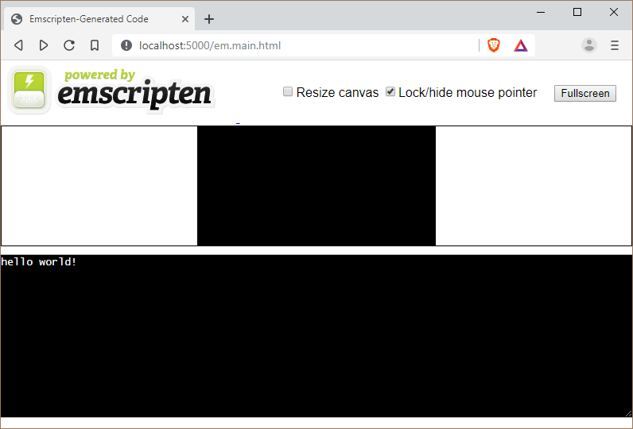
6.
WASM – emscripten
Emscripten is an LLVM compiler. It takes LLVM bitcode - which can be generated from C/C++, using llvm-gcc (DragonEgg) or clang, or any other language that can be converted into LLVM - and compiles that into JavaScript, which can be run on the web (or anywhere else JavaScript can run).
https://github.com/emscripten-core/emscripten
#include <stdio.h>
int main()
{
printf("hello world!\n");
return 0;
}
> emcc em.main.cpp -o em.main.html

Slide 54
6.
WASM – emscripten
OK… but what smscripten brings to the table?
Runtime!
How printf actually works?

Slide 55
6.
WASM – emscripten
OK… but what smscripten brings to the table?
Runtime!
How printf actually works?

Slide 56
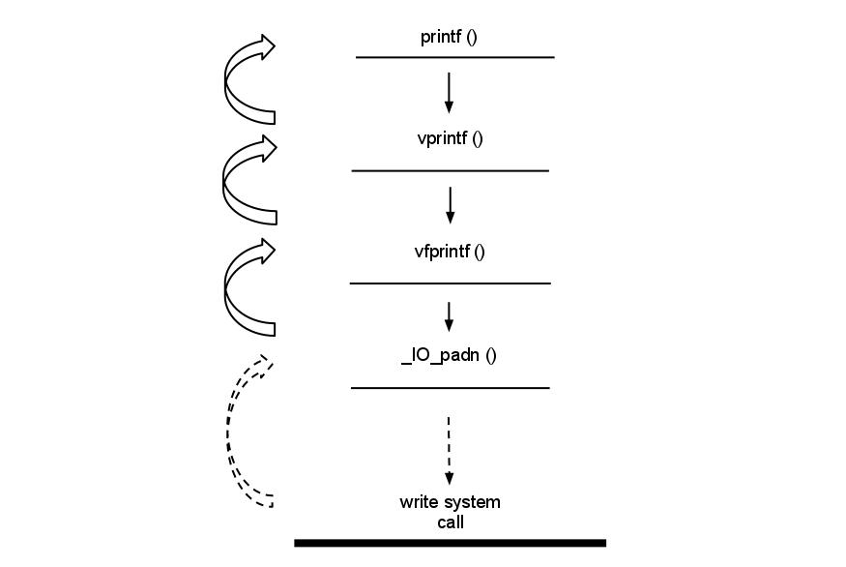
6.
WASM – emscripten
http://osteras.info/personal/2013/10/11/hello-world-analysis.html
C runtime (ucrt.dll (windows) or libc.so (linux) )
https://github.com/lattera/glibc/blob/895ef79e04a953cac1493863bcae29ad85657ee1/stdio-common/vprintf.c#L30
https://github.com/lattera/glibc/blob/895ef79e04a953cac1493863bcae29ad85657ee1/stdio-common/vfprintf.c#L81
https://github.com/lattera/glibc/blob/895ef79e04a953cac1493863bcae29ad85657ee1/stdio-common/vfprintf.c#L81
https://github.com/lattera/glibc/blob/895ef79e04a953cac1493863bcae29ad85657ee1/stdio-common/vfprintf.c#L95
https://github.com/lattera/glibc/blob/895ef79e04a953cac1493863bcae29ad85657ee1/libio/iopadn.c#L36
https://github.com/lattera/glibc/blob/895ef79e04a953cac1493863bcae29ad85657ee1/libio/libioP.h#L374
https://github.com/lattera/glibc/blob/895ef79e04a953cac1493863bcae29ad85657ee1/libio/libioP.h#L171
https://github.com/lattera/glibc/blob/895ef79e04a953cac1493863bcae29ad85657ee1/libio/fileops.c#L1262
https://github.com/lattera/glibc/blob/895ef79e04a953cac1493863bcae29ad85657ee1/stdio-common/printf.c#L33
https://github.com/lattera/glibc/blob/895ef79e04a953cac1493863bcae29ad85657ee1/libio/fileops.c#L456
https://github.com/lattera/glibc/blob/895ef79e04a953cac1493863bcae29ad85657ee1/libio/libioP.h#L244
https://github.com/lattera/glibc/blob/895ef79e04a953cac1493863bcae29ad85657ee1/libio/fileops.c#L1185
Call syscall
https://github.com/lattera/glibc/blob/895ef79e04a953cac1493863bcae29ad85657ee1/sysdeps/unix/sysv/linux/write.c#L26
https://github.com/lattera/glibc/blob/895ef79e04a953cac1493863bcae29ad85657ee1/sysdeps/unix/syscalls.list#L99
Kernel code
https://github.com/torvalds/linux/blob/2f4c53349961c8ca480193e47da4d44fdb8335a8/fs/read_write.c#L620
https://github.com/torvalds/linux/blob/2f4c53349961c8ca480193e47da4d44fdb8335a8/fs/read_write.c#L600
https://github.com/torvalds/linux/blob/2f4c53349961c8ca480193e47da4d44fdb8335a8/fs/read_write.c#L494
OK… but what smscripten brings to the table?
Runtime!
How printf actually works?

Slide 57
6.
global _start
_start:
; Write.
mov rax, 1 ; use the write syscall
mov rdi, 1 ; write to stdout
mov rsi, hello_world ; use string at hello_world
mov rdx, hello_world_len ; size = hello_world_len
syscall
; Exit.
mov rax, 60 ; use the _exit syscall
mov rdi, 0 ; error code 0
syscall
hello_world db "hello world", 10
hello_world_len equ $ - hello_world
Syscall
> nasm -felf64 write.asm && ld write.o && ./a.out
hello world
or
https://rextester.com/l/nasm_online_compiler

Slide 58
6.
global _start
_start:
; Write.
mov rax, 1 ; use the write syscall
mov rdi, 1 ; write to stdout
mov rsi, hello_world ; pointer to hello_world
mov rdx, hello_world_len ; size = hello_world_len
syscall
; Exit.
mov rax, 60 ; use the _exit syscall
mov rdi, 0 ; error code 0
syscall
hello_world db "hello world", 10
hello_world_len equ $ - hello_world
Syscall
> nasm -felf64 write.asm && ld write.o && ./a.out
hello world
or
https://rextester.com/l/nasm_online_compiler

Slide 59
6.
WASM – emscripten
#include <stdio.h>
int main()
{
printf("hello world!\n");
return 0;
}
// fake pseudo code
#include <syscalls.h>
int main()
{
char * str = “hello world!\n”;
int i = syscalls[“write”];
call(i , str, 13);
return 0;
}

Slide 60
6.
WASM – emscripten
Syscall table vary by architecture. Emscripten syscall is at:
./system/lib/libc/musl/arch/emscripten/bits/syscall.h
...
#define __NR_msync 144
#define __NR_readv 145
#define __NR_writev 146
#define __NR_getsid 147
#define __NR_fdatasync 148
...
// fake pseudo code
#include <syscalls.h>
int main()
{
char * str = “hello world!\n”;
int i = syscalls[“write”];
call(i , str, 13);
return 0;
}

Slide 61
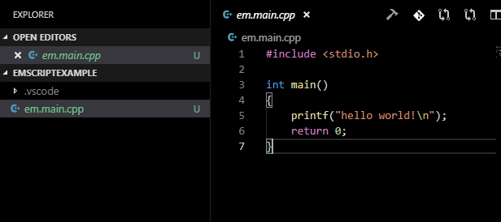
6.
WASM – emscripten
Now we can understand what emscripten does. Before compilation.

Slide 62
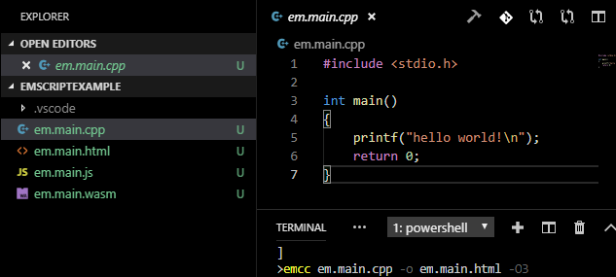
6.
WASM – emscripten
Now we can understand what emscripten does. After compilation.
It generated a .html, a .js and a .wasm files.

Slide 63
6.
WASM – emscripten
The interesting part is the .js file.
var env = {
"a": abort,
"f": ___syscall140,
"b": ___syscall146,
"e": ___syscall54,
"d": ___syscall6,
"c": _emscripten_memcpy_big
};
...
return WebAssembly.instantiate(wasmFile, {env});
...
function ___syscall146(which, varargs) {
SYSCALLS.varargs = varargs;
try {
var stream = SYSCALLS.get(),
iov = SYSCALLS.get(),
iovcnt = SYSCALLS.get();
var ret = 0;
for (var i = 0; i < iovcnt; i++) {
var ptr = HEAP32[iov + i * 8 >> 2];
var len = HEAP32[iov + (i * 8 + 4) >> 2];
for (var j = 0; j < len; j++) {
SYSCALLS.printChar(stream, HEAPU8[ptr + j])
}
ret += len
}
return ret
} catch (e) {
if (typeof FS === "undefined" || !(e instanceof FS.ErrnoError)) abort(e);
return -e.errno
}
}

Slide 64
6.
WASM – emscripten
The interesting part is the .js file.
var env = {
"a": abort,
"f": ___syscall140,
"b": ___syscall146,
"e": ___syscall54,
"d": ___syscall6,
"c": _emscripten_memcpy_big
};
...
return WebAssembly.instantiate(wasmFile, {env});
...
function ___syscall146(which, varargs) {
SYSCALLS.varargs = varargs;
try {
var stream = SYSCALLS.get(),
iov = SYSCALLS.get(),
iovcnt = SYSCALLS.get();
var ret = 0;
for (var i = 0; i < iovcnt; i++) {
var ptr = HEAP32[iov + i * 8 >> 2];
var len = HEAP32[iov + (i * 8 + 4) >> 2];
for (var j = 0; j < len; j++) {
SYSCALLS.printChar(stream, HEAPU8[ptr + j])
}
ret += len
}
return ret
} catch (e) {
if (typeof FS === "undefined" || !(e instanceof FS.ErrnoError)) abort(e);
return -e.errno
}
}
WASM Imports!
Allow wasm code to call external
functions

Slide 65
6.
WASM - emscripten
and the WASM file.
var env = {
"a": abort,
"f": ___syscall140,
"b": ___syscall146,
"e": ___syscall54,
"d": ___syscall6,
"c": _emscripten_memcpy_big
};
...
return WebAssembly.instantiate(wasmFile, {env});
...
(module
(type (;0;) (func (param i32 i32 i32) (result i32)))
(type (;1;) (func (param i32) (result i32)))
(type (;2;) (func (param i32 i64 i32) (result i64)))
(type (;3;) (func (param i32)))
(type (;4;) (func (param i32 i32) (result i32)))
(type (;5;) (func (result i32)))
(type (;6;) (func))
(import "env" "a" (func (;0;) (type 3)))
(import "env" "b" (func (;1;) (type 4)))
(import "env" "c" (func (;2;) (type 0)))
(import "env" "d" (func (;3;) (type 4)))
(import "env" "e" (func (;4;) (type 4)))
(import "env" "f" (func (;5;) (type 4)))
...

Slide 66
THE END

Slide 67
6.
Wasm - emscripten
Just kidding!
What emscripten offer:
Emscripten provides a virtual file system that simulates the local file system, so that native code using synchronous file APIs can be compiled and run with little or no change.
https://emscripten.org/docs/porting/files/index.html
By default, Emscripten targets the WebGL-friendly subset of OpenGL ES 2.0. This is the set of GL ES commands that map directly to WebGL, so that each GL command has a roughly direct mapping to WebGL.
https://emscripten.org/docs/porting/multimedia_and_graphics/OpenGL-support.html
Emscripten ships with its own implementation of the OpenAL 1.1 API, using the Web Audio API as a backend.
https://emscripten.org/docs/porting/Audio.html
Emscripten has support for multithreading using the new SharedArrayBuffer capability in browsers. That API allows sharing memory between the main thread and web workers
https://emscripten.org/docs/porting/pthreads.html

Slide 68
6.
WASM - emscripten
“I don’t believe it!”
> git clone https://github.com/dondido/zombie-breakout
> cd zombie-breakout
> make
gcc -c main.c -g -Wall -O3 -D_GNU_SOURCE=1 -D_REENTRANT -pedantic -lm -I/usr/include/SDL2 -lSDL2 -lSDL2_image -lSDL2_mixer -lSDL2_ttf
gcc -o zombie-breakout main.o -g -Wall -O3 -D_GNU_SOURCE=1 -D_REENTRANT -pedantic -lm -I/usr/include/SDL2 -lSDL2 -lSDL2_image -lSDL2_mixer -lSDL2_ttf
> make emcc
emcc main.c -s USE_SDL=2 -s USE_SDL_TTF=2 -s USE_SDL_IMAGE=2 -s SDL2_IMAGE_FORMATS='["png"]' -s USE_SDL_MIXER=2 -s WASM=1 --shell-file html_template/resize-with-aspect-ratio.html -s USE_OGG=1 -s USE_VORBIS=1 -o docs/index.html -O2 --preload-file assets
* with minor adjustments

Slide 69
6.
WASM – ports
Projects
https://github.com/kripken/sql.js
SQLite compiled to JavaScript through Emscripten
https://github.com/jvail/spatiasql.js
https://github.com/kripken/llvm.js
LLVM compiled to WASM using Emscripten
https://github.com/Kagami/ffmpeg.js
https://github.com/KnicKnic/WASM-ImageMagick
https://github.com/richardassar/zpipe
https://github.com/libgit2/libgit2/pull/4400
Git inside the browser
Doom 3 (The web IS Doom!)
http://www.continuation-labs.com/projects/d3wasm/
https://github.com/torch2424/wasmBoy
Gameboy Emulator Library written in Web Assembly using AssemblyScript.

