Slide 1






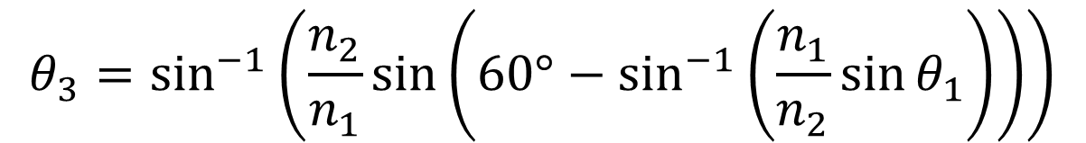







$$60°$$
$$n_{1}$$
$$n_{2}$$
$$n_{1}$$
$$90°−θ_{2}$$
$$30°+θ_{2}$$
$$θ_{1}$$
$$θ_{2}$$
$$θ_{3}$$
$$60°−θ_{2}$$
$$60°$$
$$60°$$
$$n_{1}\sin{θ_{1}}=n_{2}\sin{θ_{2}}$$
$$θ_{3}=\sin^{−1}\left(\frac{n_{2}}{n_{1}}\sin\left(60°−\sin^{−1}\left(\frac{n_{1}}{n_{2}}\sin{θ_{1}}\right)\right)\right)$$
$$n_{2}\sin\left(60°−θ_{2}\right)=n_{1}\sin{θ_{3}}$$

Slide 2










$$60°$$
$$60°−θ_{1}$$
$$θ_{1}$$
$$θ_{1}−θ_{2}$$
$$θ_{2}$$
$$θ_{1}−θ_{2}$$
$$θ_{3}+θ_{1}−60°$$
$$60°−θ_{1}$$
$$60°$$
$$60°$$

Slide 3
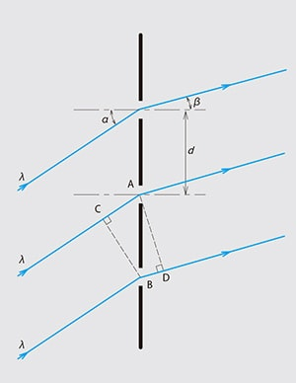

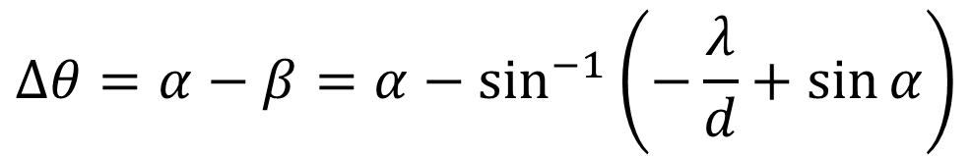
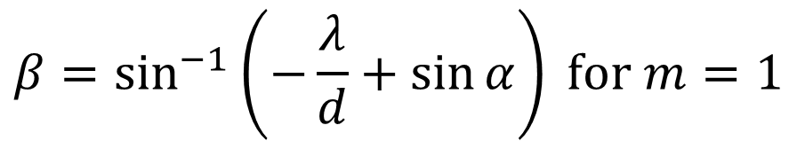
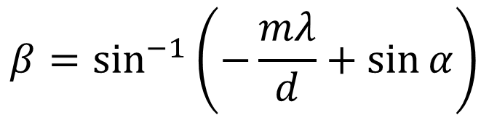
$$mλ=d\left(\sin{α}−\sin{β}\right)$$
$$β=\sin^{−1}\left(−\frac{mλ}{d}+\sin{α}\right)$$
$$β=\sin^{−1}\left(−\frac{λ}{d}+\sin{α}\right) for m=1$$
$$∆θ=α−β=α−\sin^{−1}\left(−\frac{λ}{d}+\sin{α}\right)$$
https://www.shimadzu.com/opt/guide/diffraction/02.html

