Slide 1
GLUCOSE MONITORING
DEVICE
Peter Baccarella, Amy Leong, Catherine Chen, Vincent Wang, Jonathan Lam, Emily Yasharpour
Notes:
Person 3

Slide 2
Objective /
Background
Problem Formulation
Colorimetric test strips and an accompanying app for diabetics in Kampala within constraints of cost, manufacturability, and user-friendliness
Notes:
Person #1- Emily

Slide 3
Background
Needs Assessment
4.2% or 63,297
Diabetic Prevalence and Diagnosed Diabetic Population
$287.62
Average Household Income

Slide 4
Design Criteria
Cost
Functionality
Usability
Locally reproducible

Slide 5
Glucose Testing Process
Needs Assessment
Blood is placed on a strip and changes color based on the concentration of the glucose.

Slide 6
Methodology/Solution
Abstraction & Synthesis
Colorimetric test strips with emphasis on:
Different Enzymes & Indicators
Improved Image Processing
RBC Separation
Notes:
Person #2- Vincent

Slide 7
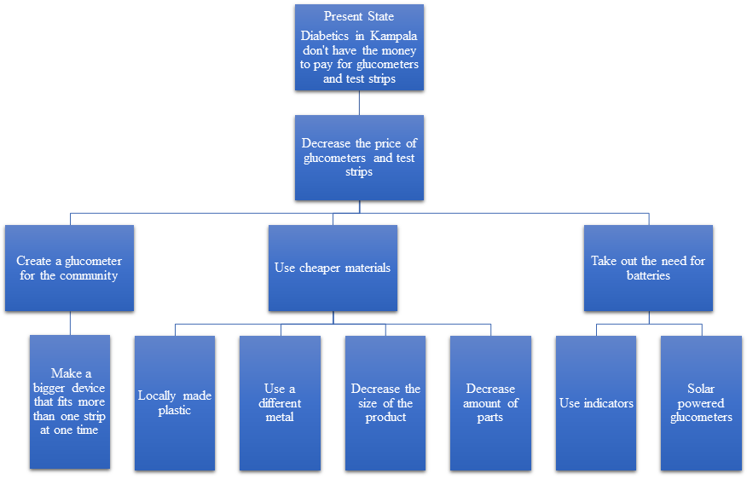
Figure 1A: Duncker Diagram (Present State)
Abstraction & Synthesis
Notes:
Person #3 amy

Slide 8
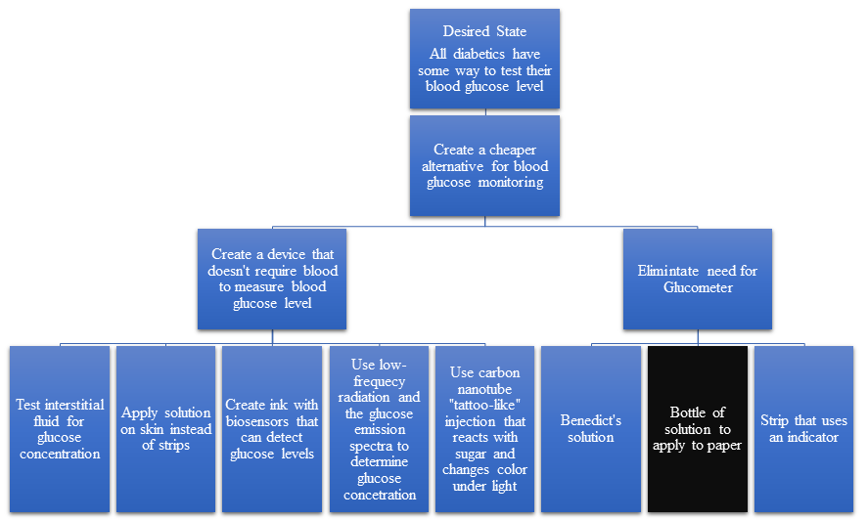
Figure 1B: Duncker Diagram (Desired State)
Abstraction & Synthesis
Notes:
Person #4

Slide 9
Decision Matrix
 | Cost | Portability | Performance | Ease of Use | Sustainability | Locally reproducible
Weighting | 100 | 50 | 100 | 85 | 60 | 70 | Total
Design Alternatives
Bottled Solution | 9 900 | 9 450 | 9 900 | 7 595 | 6 360 | 5 475 | 3680
Community glucometer | 5 500 | 0 0 | 9 900 | 8 680 | 6 360 | 4 280 | 2720
Carbon nanotube tattoo | 1 100 | 9 450 | 9 900 | 8 680 | 8 480 | 0 0 | 2610

Slide 10
Proposed Design
Abstraction & Synthesis
Indicators:
Iodine-starch (control), Redox, Acid/base
Primary chemical reaction:
Glucose oxidase, Yeast
Software:
Control (eliminate RBC color and lighting)
Statistical analyses
Notes:
Person 5 - jon?

Slide 11
Proposed Design
Abstraction & Synthesis
Other improvements:
Glass Fiber Mesh
Different Papers
Models:
Glucose solutions
Marker and paper optical calibration
Occam’s Razor
Reject Glucometer for Test Strips
Reject Centrifuge for Glass Fiber Mesh
Notes:
Person 5

Slide 12
Detailed Approach
Abstraction & Synthesis
Create standardized glucose solutions
Systematically test all pairs of reagents and indicators
Test an indicator with each indicator, at same glucose concentration, for every glucose concentration
Repeat for every glucose concentration
Take picture for future analysis
Do once for every reagent at every glucose concentration, take picture
control
indicator 1
indicator 2
indicator 3

Slide 13
Cost Analysis
Abstraction & Synthesis
Item | Cost of Item
Chemicals/Materials | <$0.01 per strip
Software and Information Distribution | $0

Slide 14
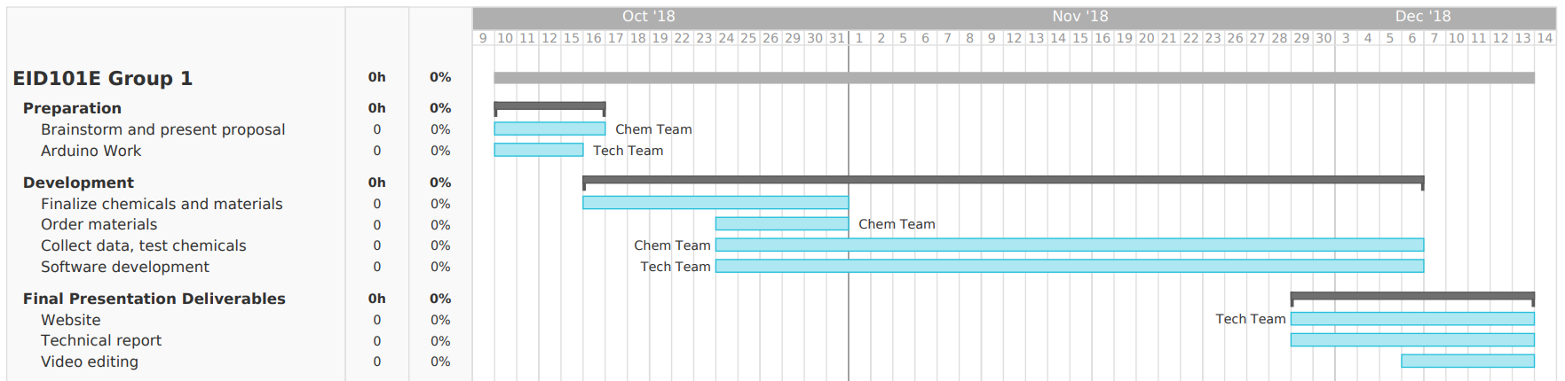
Figure 2.2A: GANTT Chart
Notes:
Person 6

Slide 15
Figure 2.2B: Primary Responsibility Chart
Role | People
Leaders / Primary spokespeople | Vincent, Emily, Peter
Note-taking | Amy
Designing, modeling, prototyping (chemicals) | Catherine, Emily, Peter, Vincent
Designing, modeling, prototyping (data analysis and software) | Amy, Jon
Webmaster | Jon, Peter
Technical Report | Jon, Vincent, Catherine, Amy
Notes:
Person 6

Slide 16
Challenges
Analysis
Finding a non-toxic, low-cost, locally sustainable alternative chemical indicator
Accurately and reliably analyzing the color to determine blood glucose concentration
Notes:
Person 4

Slide 17
References
Ofek, Yuval et al. “The Colorimetric Test Strip.” G Cubed Solutions, Wix.com, 2017, https://minhtyyufa.wixsite.com/gcubedsolutions/the-strip. Accessed 1 Oct 2018.
Gebel, Erika. “Anatomy of a Test Strip.” Diabetes Forecast, July 2012, www.diabetesforecast.org/2012/jul/anatomy-of-a-test-strip.html. Accessed 1 Oct. 2018.
“Glucometer Test Kit.” How Products Are Made, www.madehow.com/Volume-7/GlucometerTest-Kit.html. Accessed 1 Oct. 2018.
Jensen, Sarah. “How Do Glucometers Work?” Mit Engineering, 18 Oct. 2011, engineering.mit.edu/engage/ask-an-engineer/how-do-glucometers-work/. Accessed 1 Oct. 2018.
Katz, Laurence B., Mike Grady, Steven J. Setford, and Brian L. Levy. "OneTouch Blood Glucose Monitoring Systems - Impact of New Technologies on the Efficacy of Self-monitoring Blood Glucose." (n.d.): n. pag. Print.
Notes:
Person 2

