Slide 1
TokenTalk
Social Forum For Today’s Most Popular BRC-20 Tokens

Slide 2

Bitcoin Olympics Hackathon Submission
Project Initiated by One Individual
Initial Prototype Only…For Now ☺
Non-Competitive

Slide 3
TokenTalk? Why?
Awareness and Education
Real-Time Token Metric Data
Community Spaces

Slide 4
Key Features
Real-time CoinGecko public API fetching most popular BRC-20 data
Account management to configure personalized watch-lists and chat usernames
Rating system and chat box per each token

Slide 5
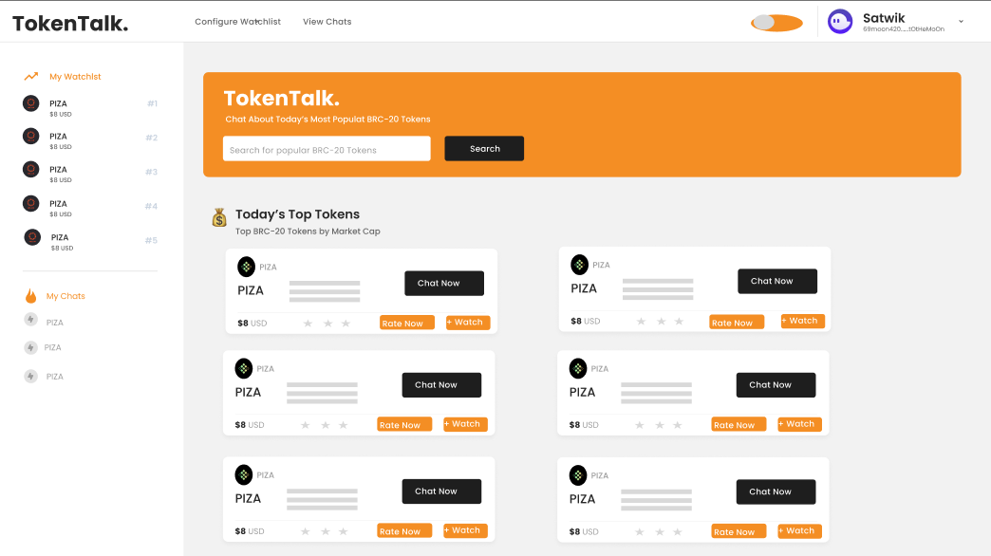
User Interface – Initial Prototype

