Slide 1
Go here
https://tinyurl.com/mumford-files

Slide 2
Modeling Group fMRI Data

Slide 3
Overview
What is a mixed effects model
  Fixed effects
  Random effects
2-stage summary statistics approach
How do different software packages work?
Overview FSL modeling options

Slide 4
Overview
What is a mixed effects model
  Fixed effects
  Random effects
2-stage summary statistics approach
How do different software packages work?
Overview FSL modeling options

Slide 5
Mixed Model Motivation
Start with a simple ANOVA example
Study: Is hair length different between males and females?

Slide 6
Start: 1 hair per person
Two sources of variability
  Variance of hair length within person
  Variance of hair length between people
Assume within-subject variance is 1

Slide 7
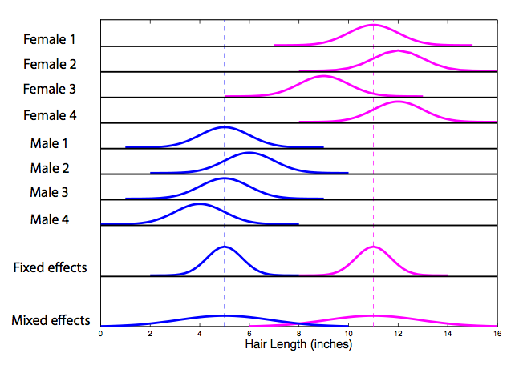
Each distribution has a variance of 1

Slide 8

Fixed effects analysis
We’re only interested in these exact 4 men and 4 women

Slide 10


Mixed effects
Include both within and between subject variances
Adding a between subject means subject is random
  Anything with a variance is random!

Slide 12


Multiple hairs per subject
Fixed effects variance
Mixed effects variance

Slide 13
Multiple hairs per subject
Fixed effects variance
Mixed effects variance
Between subject variance typically dominates

Slide 14
Wrong model leads to wrong conclusion
Scenario 1: Fixed effects model
  Significant difference in hair length
  Result only applies to these 8 subjects

Slide 15
Wrong model leads to wrong conclusion
Scenario 2: Mixed effects model
  Cannot conclude there is a difference in hair length

Slide 16
Mixed Model Comments
If you fail to include a random effect when there is one
  Results only apply to that data sample
  P-values are smaller than mixed model p-values

Slide 17
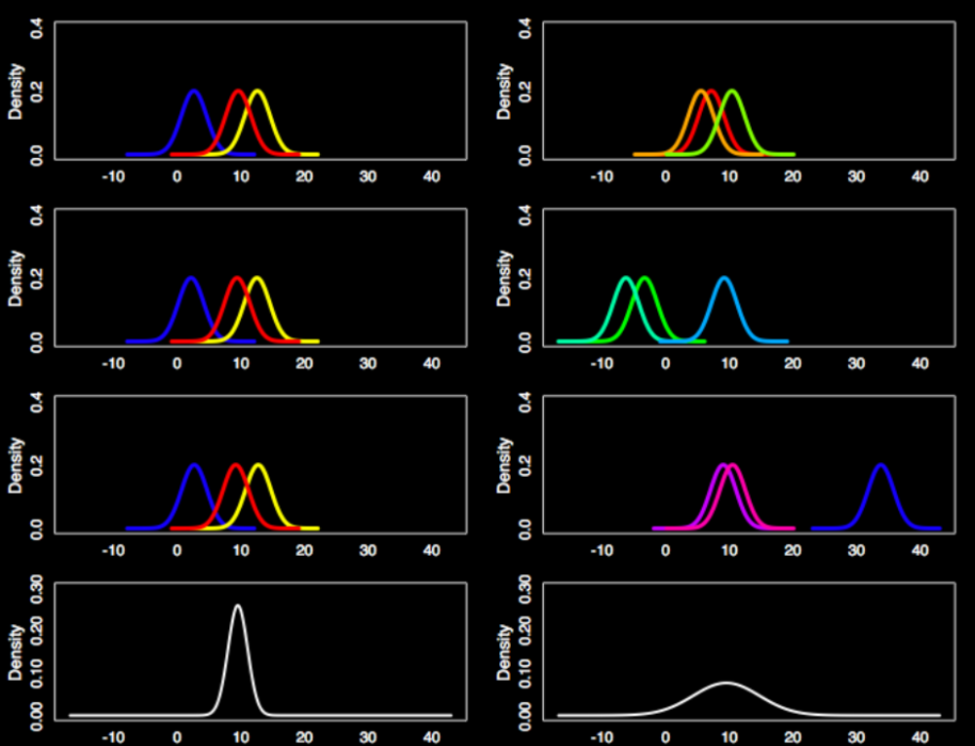
Fixed
Mixed
Sample 1
Sample 2
Sample 3
Group Distribution

Slide 18
Fixed
Mixed
Sample 1
Sample 2
Sample 3
Group Distribution

Slide 19
Fixed
Mixed
Sample 1
Sample 2
Sample 3
Group Distribution

Slide 20
Fixed
Mixed
Sample 1
Sample 2
Sample 3
Group Distribution

Slide 21
Important points so far…
Ignoring random subject effect means that you’re ignoring the fact that these subjects were randomly sampled
  Inference only applies to sample you collected
Including random subject effect always increases your variance

Slide 22
Important points so far…
What has a bigger impact in reducing variance?
  Adding more hairs per subject?
  Adding more subjects?

Slide 23
Important points so far…
What has a bigger impact in reducing variance?
  Adding more hairs per subject?
  Adding more subjects?
1 hair per subject
25 hairs per subject

Slide 24
Overview
What is a mixed effects model
  Fixed effects
  Random effects
2-stage summary statistics approach
How do different software packages work?
Overview FSL modeling options

Slide 25
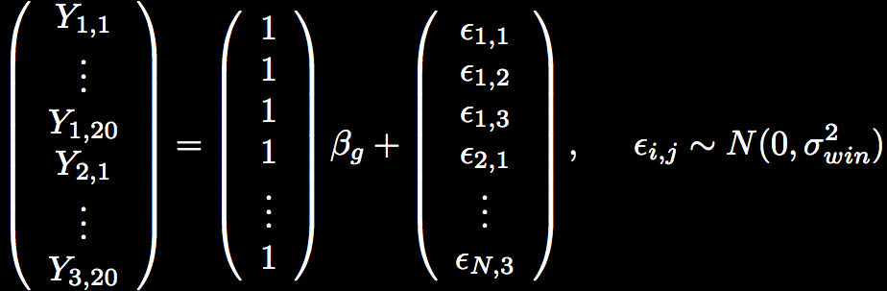
Fixed effects model: modeling the mean of 3 females, 20 hairs
Fixed effect
Residual error

Slide 26
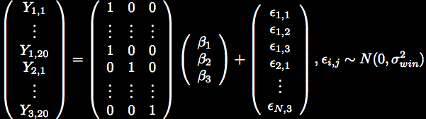


Mixed Effects Model
Stage 1
Stage 2
Random effect

Slide 27
Mixed Effects Model
Stage 1
Stage 2
Random effect

Slide 28
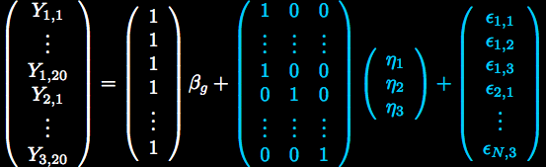
Mixed Effects Model:
All-In-One
Variance Terms

Slide 29



How does this relate to fMRI?
Subject 1
Subject 2
. . .
. . .
Subject N
Each time series is a collection of data grouped by subject
A random subject effect is necessary to apply inference to total population

Slide 30
Mixed Model for fMRI Data
fMRI data are more complicated than the hair length example
  Not typically estimating an intercept
  Time series are temporally autocorrelated
  Time series can be quite long
Let’s take a look at the model!
  A study with 2 stimuli of interest

Slide 31

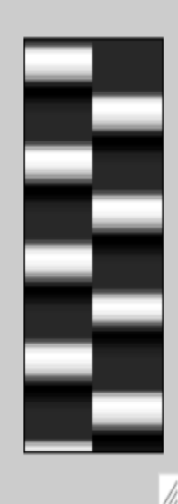

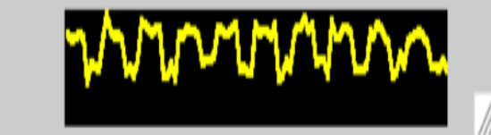

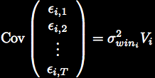

Subject 1
Subject 2
=
+
+
. . .
. . .
. . .
Subject N

Slide 32
Yuck!
Computationally intensive
  Large matrices that need to be inverted
What if we add another subject?
  Must estimate whole model for all subjects

Slide 33
Recall the two stages
Stage 1
Stage 2

Slide 34



Two-Stage Summary Statistics
Stage 1

Slide 35


Two-Stage Summary Statistics
Stage 1
Stage 2
Use first stage estimates

Slide 36
Two-Stage Summary Statistics
Stage 1
between
Stage 2
within

Slide 37
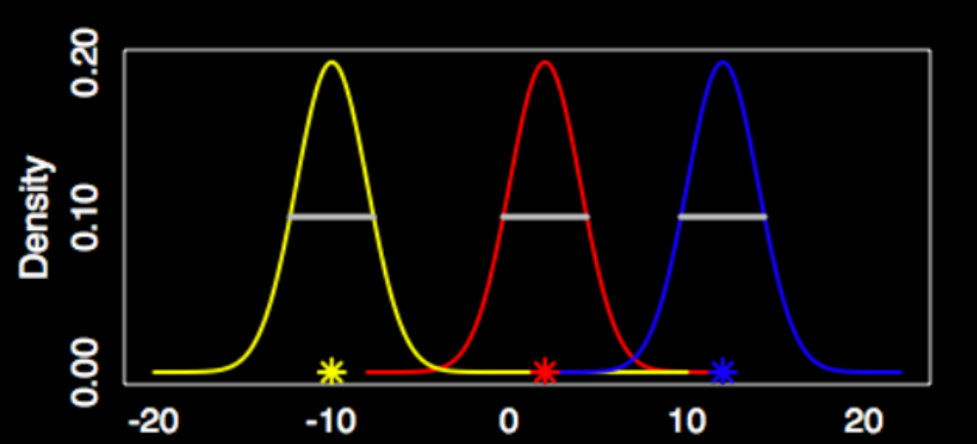
Two-Stage Model
Stage 1
  Means

Slide 38

Two-Stage Model
Stage 1
  Means
  (same across subjects here)

Slide 39

Two-Stage Model
Stage 1
  Means
  (same across subjects here)
Stage 2

Slide 40
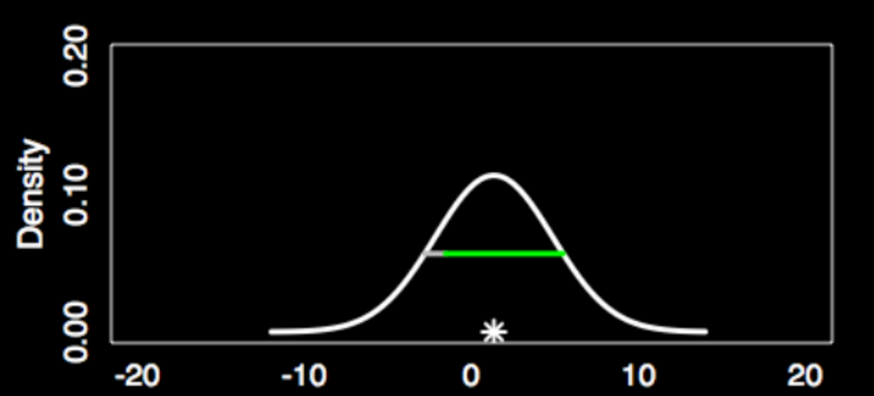


Two-Stage Model
Stage 1
  Means
  (same across subjects here)
Stage 2
    20 hairs/subject

Slide 41
Two-Stage Model
Stage 1
  Means
  (same across subjects here)
Stage 2
    20 hairs/subject
Pop mean

Slide 42
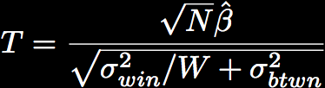
Two-Stage Model
  N = # subjects
  W = # measures within subject
If new data are added, only run first stage for new data

Slide 43



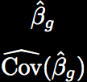
Two Stage Model fMRI
Stage 1
. . .
Estimate N
subject models
. . .
Stage 2
Estimate between subject variance, combine with Stage 1 results

Slide 44

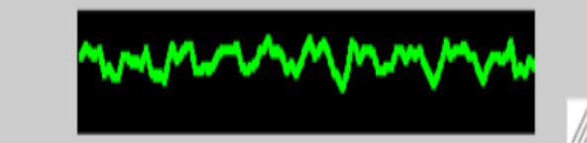

Stage 1: Subject Model
+
=

Slide 45
Stage 1: Estimation
such that

Slide 46

Stage 1: Estimation
such that
Whitened model

Slide 47
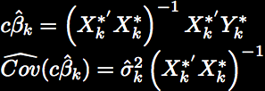
Stage 1: Estimation
such that
Whitened model
Use OLS on whitened model

Slide 48






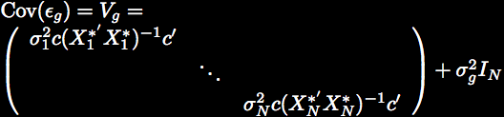
Stage 2: Group Model
=
+

Slide 49
Stage 2: Estimation

Slide 50

Stage 2: Estimation

Slide 51
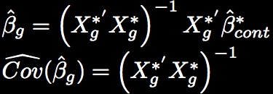
Stage 2: Estimation

Slide 52

Stage 2: Estimation

Slide 53
Overview so far…
The mixed model can be thought of as a two stage process
  Stats software estimates both stages simultaneously
  In fMRI it is computationally easier and more convenient to keep the stages separate
    Easier to add new subjects
    Not exactly the same as the stats software results

Slide 54
Overview so far
When the model is estimated how is a subject with a high mfx variance treated differently than a subject with a low mfx variance?

Slide 55
Overview so far
When the model is estimated how is a subject with a high mfx variance treated differently than a subject with a low mfx variance?
  Subjects with higher variability are down-weighted in the analysis!

Slide 56
Overview
What is a mixed effects model
  Fixed effects
  Random effects
2-stage summary statistics approach
How do different software packages work?
Overview FSL modeling options

Slide 57

How is the model estimated?
Depends on software
  SPM: Does not estimate
    Due to a set of assumptions, estimation of is unnecessary
  FSL: Bayesian approach to estimating

Slide 58
SPM2
Does not estimate
  Assumes homogeneous variance across subjects
  Assumes first level design is same across subjects
OLS can be used

Slide 59


SPM2 : Single contrast per subject
=
+
A one-sample T-test!

Slide 60





SPM2 : Multiple contrasts per subject
=
+
Global correlation estimate

Slide 61
SPM2 : Summary
Multiple contrasts per subject can enter second level
  Contrasts can be correlated
  T and F-tests are possible
Special case
  One contrast per subject…Reduces to T-test!

Slide 62
SPM2
Pros
  Model is easy to estimate
  Model is easy to understand
  Multiple contrasts can enter the group model and are not considered independent
Cons
  Global covariance estimate (same across voxels)
  Assumes variance is homogeneous across subjects

Slide 63

FSL: FMRIB Software Library
Bayesian approach to estimating model
Inference is based on posterior distribution of the data
  Parameters of interest are treated as random

Slide 64

FSL : Second Level Estimation
Flame 1: Maximum a posteriori (MAP) estimate of found iteratively
  Assumes degrees of freedom,
Flame 2: Slower MCMC method of estimation
    Applied to voxels close to threshold in step 1
    Fine tunes estimates of
Details
  Woolrich et al. NI (2004) 1732-47

Slide 65
FSL
Pros
  When single contrast is taken to the second level, equivalent to all-in-one model
  Within-subject variances are carried to the second level
    Heterogeneity across subjects is modeled
Cons
  Multiple contrasts in the group model are assumed to be independent

Slide 66
Which software?
FSL and FMRIstat best for heteroscedastic variances
    Different number of trials per subject
SPM best for multiple correlated contrasts at group level
Other differences in first level modeling may sway users one way or another

Slide 67
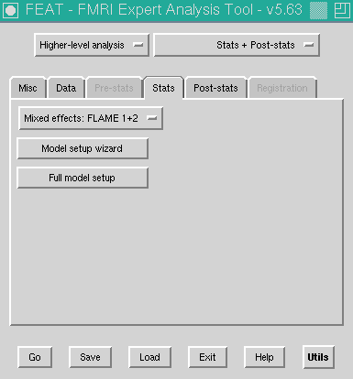
FSL Group Model Options

Slide 68
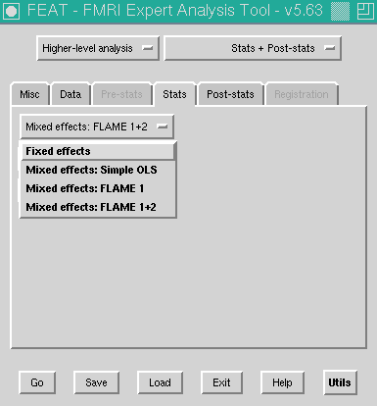
FSL Group Model Options
Fixed effects
  Only uses w/in sub variance
Simple OLS
  Assumes w/in sub variances are equal
Flame 1& 2
  w/in sub var and btwn sub var

Slide 69
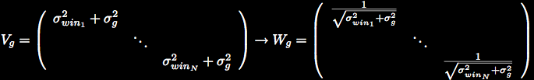
W_{g} Matrix
Recall we pre-multiply by W_{g} so our errors are uncorrelated and constant variance
Act as weights
0
0
0
0

Slide 70

V_{g} Matrix Assumptions
Fixed effects analysis
  Only appropriate for
  intermediate levels
  Assumes the between-run variability=0
Why would we do this?
    What if df are low?
      has high variance
      If is too large, it will override differences in
0
0

Slide 71
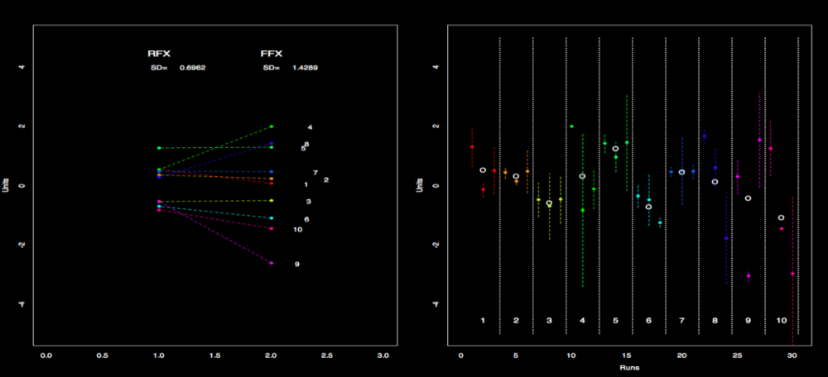
3 contrast estimates from 3 runs for 1 subject
Dotted line indicates variance
“o” marks unweighted mean

Slide 73
*
MFX
FFX
SD=0.6962
SD=1.4289
*Assuming overestimate of

Slide 74
Fixed Effects
Use to improve your mean estimates
  eg correct trials
Since variance is underestimated, you *must* only run this at an intermediate level
  Higher level analysis soaks up rest of variance

Slide 75
Third Level Analysis
Typically Flame and OLS have similar results
  Flame is probably the best choice, since it adjusts for heterogeneous variance
  OLS runs faster
  OLS stats can be larger or smaller than Flame stats
FE at level 3 is bad
  Variance is underestimated
  High risk of false positives

Slide 76
What is the “group” column for?
This is the first column in the 2nd level Feat analysis design
Assigns groups for estimating different between subject variances
Must have a separable design
Typically best if left to all 1’s

Slide 77
Concluding Remarks
Mixed models are appropriate for fMRI data
  Include between-subject variance
  Allows inference to be applied to entire population
The two-stage summary statistics model
  Computationally easier to estimate
  Easier to add new subjects
Software packages use the same basic model, but estimate differently
Use FE at intermediate levels and Flame at the top level in FSL

