Slide 1
Report on Git and Github operations
THERESA GEORGE

Slide 2
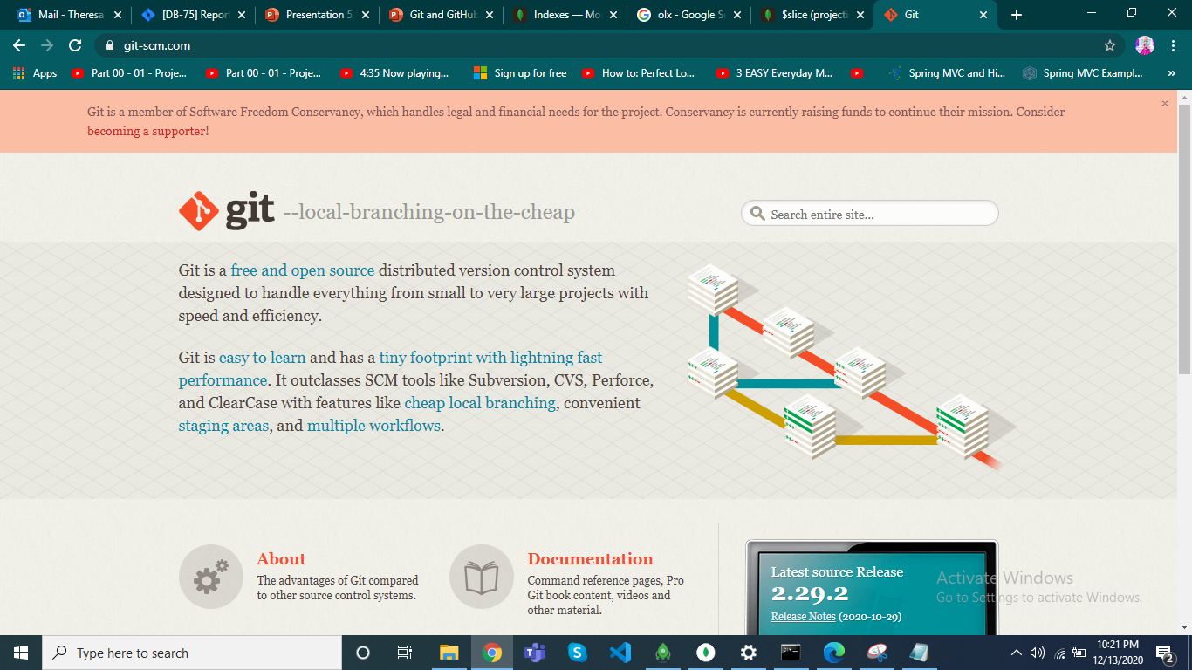
Git Website

Slide 3
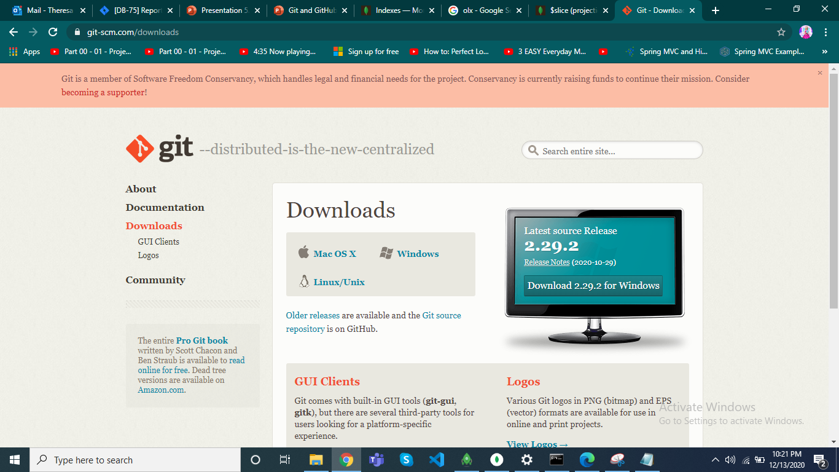
Download and Install Git

Slide 4
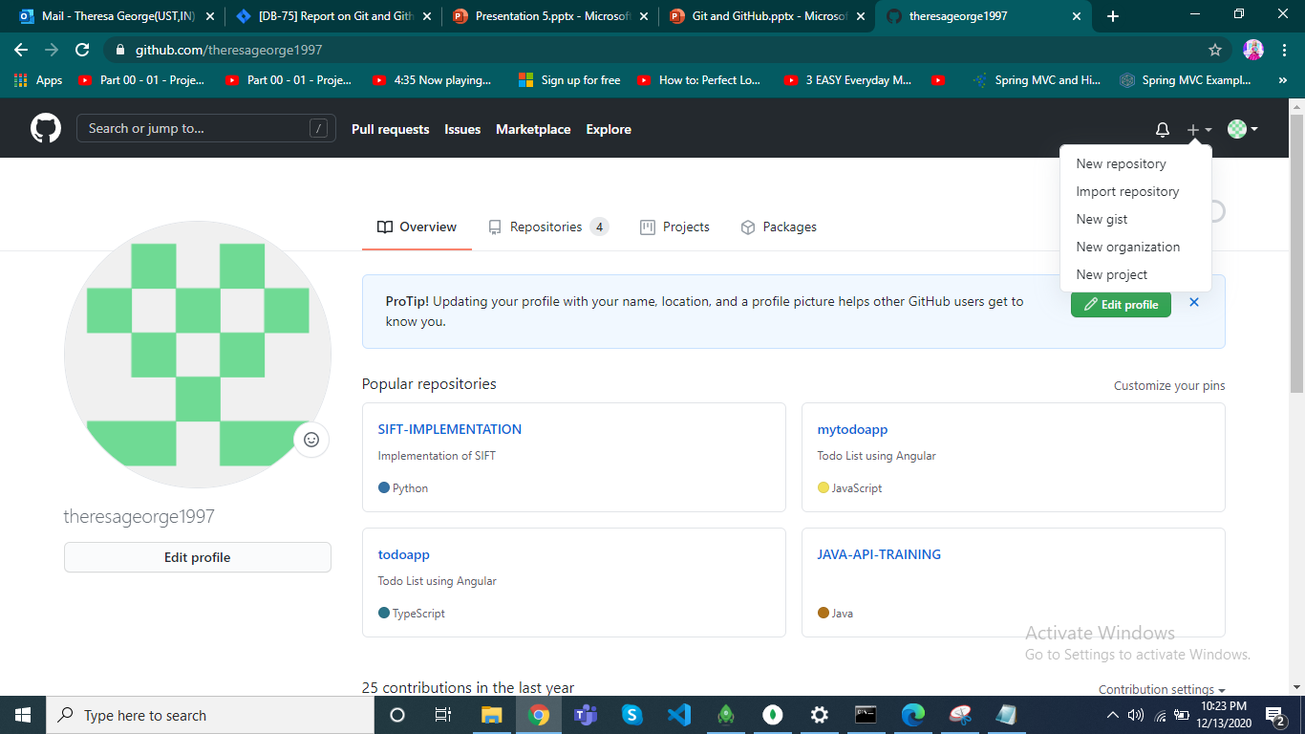
New Repository

Slide 5
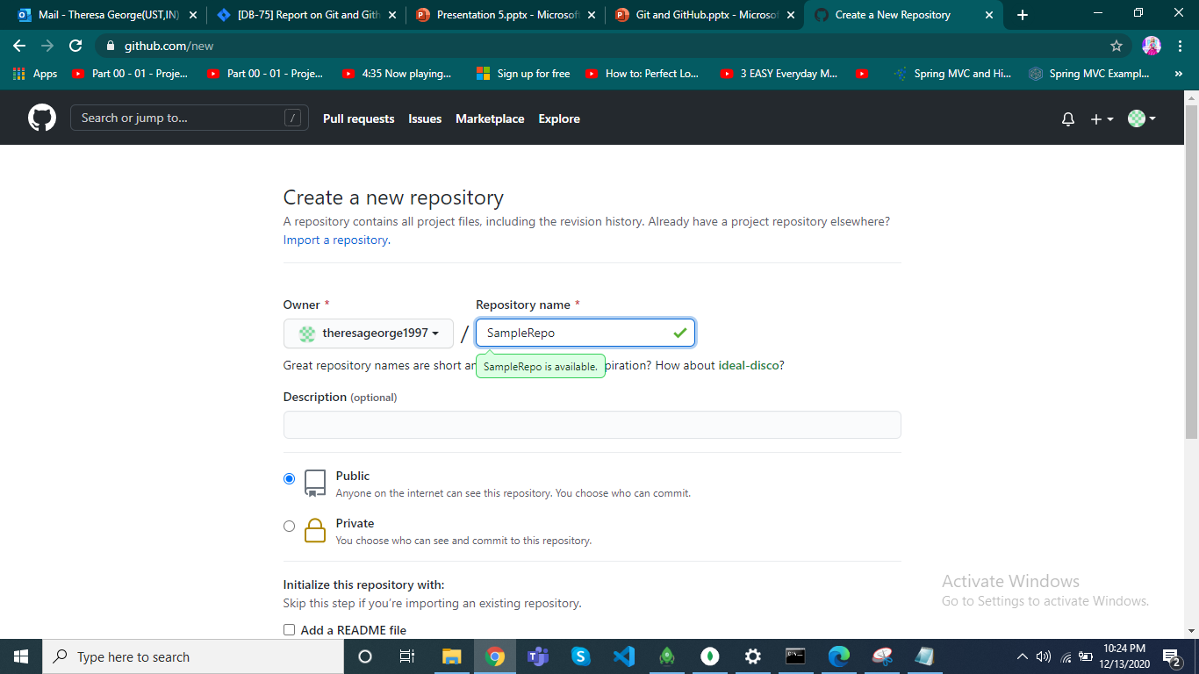
Add name and Create repo

Slide 6
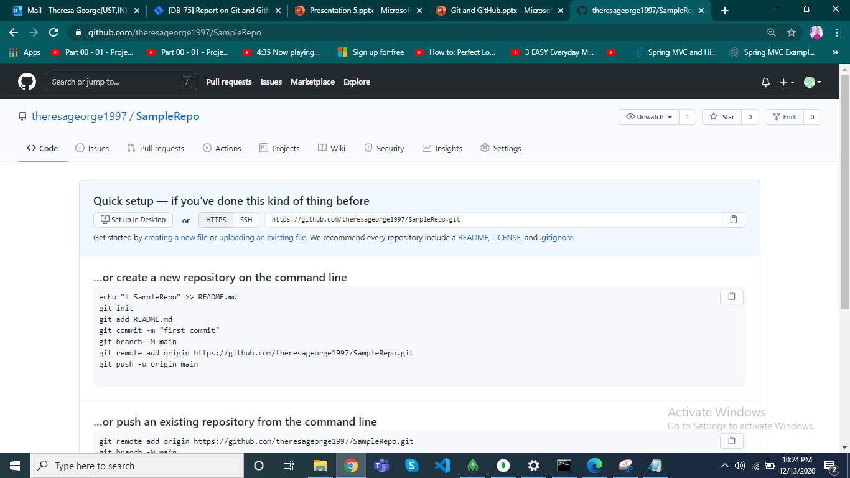
Empty Repo

Slide 7
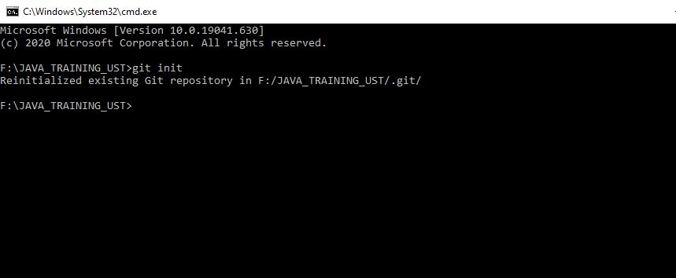
Git Initialisation

Slide 8
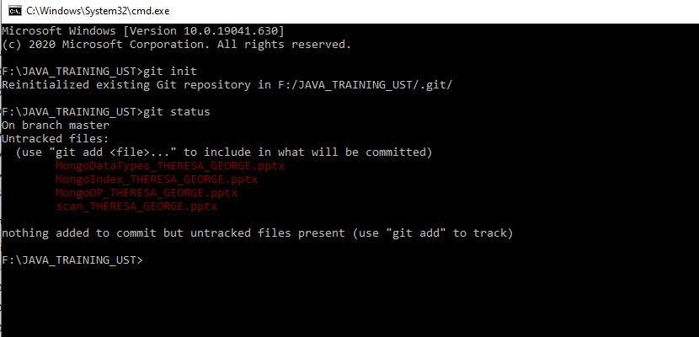
Git Status

Slide 9
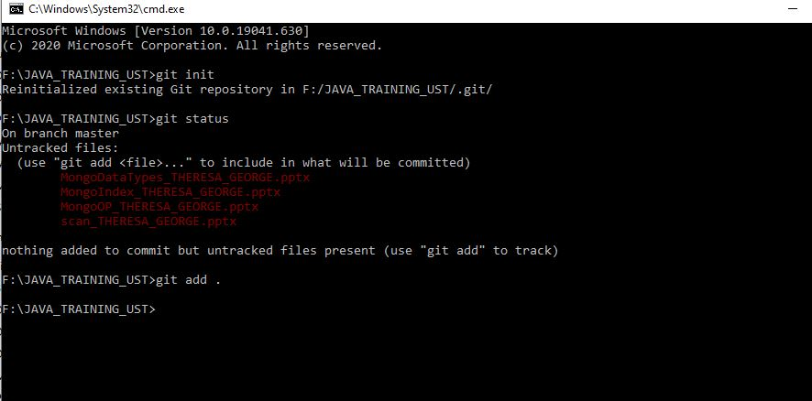
Git Add Files

Slide 10
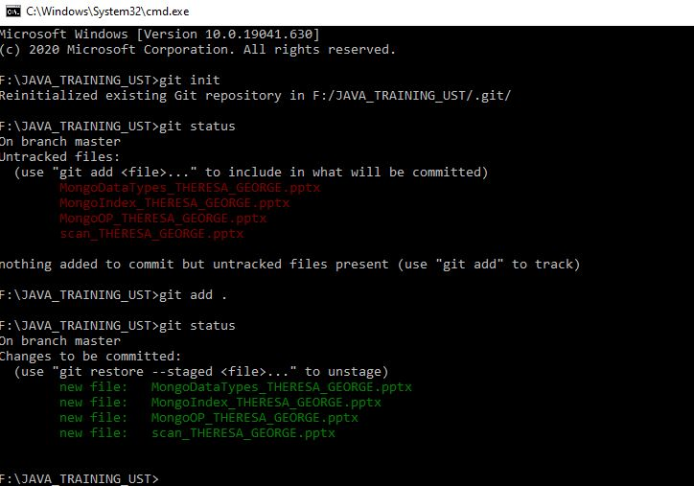
Git Status

Slide 11
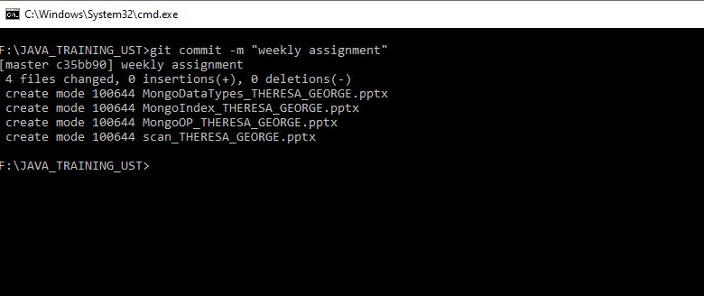
Git Commit with a Message

Slide 12
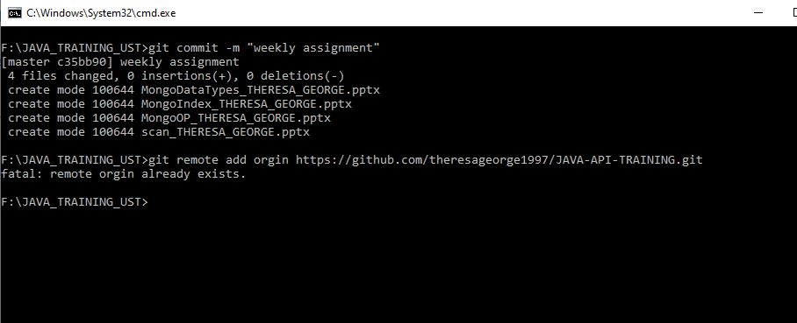
Link Repository

Slide 13
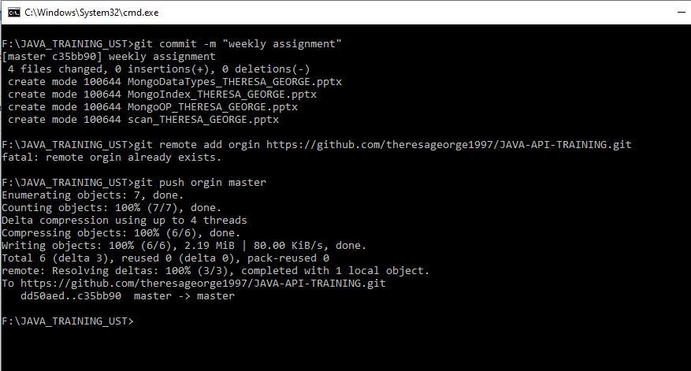
Push to Git

