Slide 1
MongoDB Data Types
THERESA GEORGE

Slide 2
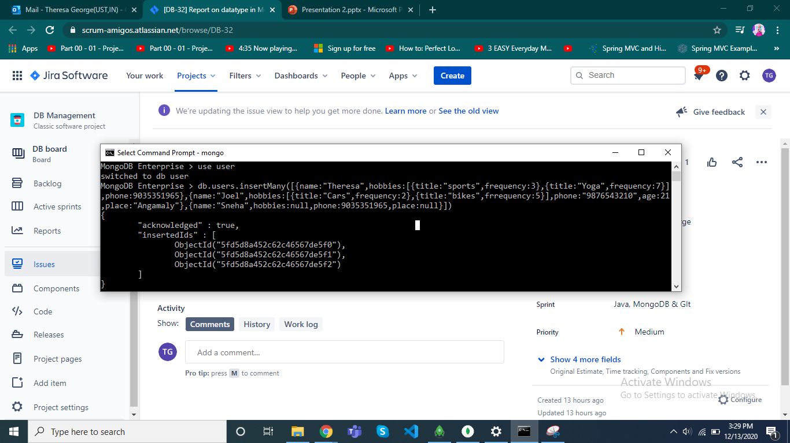

Slide 3
MongoDB Enterprise > use user
switched to db user
MongoDB Enterprise > db.users.insertMany([{name:"Theresa",hobbies:[{title:"sports",frequency:3},{title:"Yoga",frequency:7}],phone:9035351965},{name:"Joel",hobbies:[{title:"Cars",frequency:2},{title:"bikes",frrequency:5}],phone:"9876543210",age:21,place:"Angamaly"},{name:"Sneha",hobbies:null,phone:9035351965,place:null}])
{
"acknowledged" : true,
"insertedIds" : [
ObjectId("5fd5d8a452c62c46567de5f0"),
ObjectId("5fd5d8a452c62c46567de5f1"),
ObjectId("5fd5d8a452c62c46567de5f2")
]
}

Slide 4
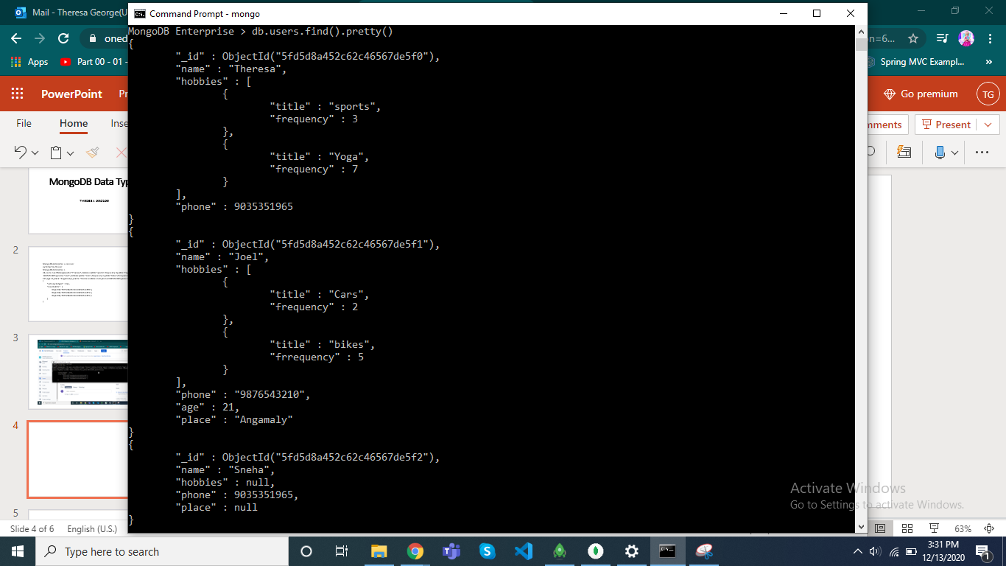

Slide 5
MongoDB Enterprise > db.users.find().pretty()
{
"_id" : ObjectId("5fd5d8a452c62c46567de5f0"),
"name" : "Theresa",
"hobbies" : [
{
"title" : "sports",
"frequency" : 3
},
{
"title" : "Yoga",
"frequency" : 7
}
],
"phone" : 9035351965
}
{
"_id" : ObjectId("5fd5d8a452c62c46567de5f1"),
"name" : "Joel",
"hobbies" : [
{
"title" : "Cars",
"frequency" : 2
},
{
"title" : "bikes",
"frrequency" : 5
}
],
"phone" : "9876543210",
"age" : 21,
"place" : "Angamaly"
}
{
"_id" : ObjectId("5fd5d8a452c62c46567de5f2"),
"name" : "Sneha",
"hobbies" : null,
"phone" : 9035351965,
"place" : null
}

Slide 6
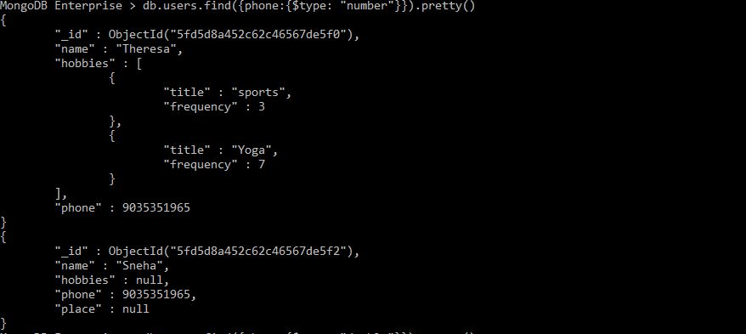
NUMBER

Slide 7
MongoDB Enterprise > db.users.find({phone:{$type: "number"}}).pretty()
{
"_id" : ObjectId("5fd5d8a452c62c46567de5f0"),
"name" : "Theresa",
"hobbies" : [
{
"title" : "sports",
"frequency" : 3
},
{
"title" : "Yoga",
"frequency" : 7
}
],
"phone" : 9035351965
}
{
"_id" : ObjectId("5fd5d8a452c62c46567de5f2"),
"name" : "Sneha",
"hobbies" : null,
"phone" : 9035351965,
"place" : null
}

Slide 8
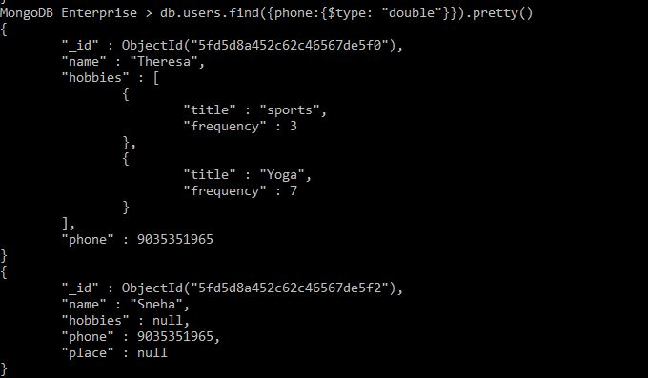
DOUBLE

Slide 9
MongoDB Enterprise > db.users.find({phone:{$type: "double"}}).pretty()
{
"_id" : ObjectId("5fd5d8a452c62c46567de5f0"),
"name" : "Theresa",
"hobbies" : [
{
"title" : "sports",
"frequency" : 3
},
{
"title" : "Yoga",
"frequency" : 7
}
],
"phone" : 9035351965
}
{
"_id" : ObjectId("5fd5d8a452c62c46567de5f2"),
"name" : "Sneha",
"hobbies" : null,
"phone" : 9035351965,
"place" : null
}

Slide 10
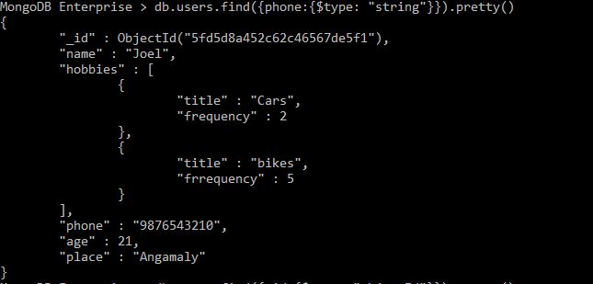
STRING

Slide 11
MongoDB Enterprise > db.users.find({phone:{$type: "string"}}).pretty()
{
"_id" : ObjectId("5fd5d8a452c62c46567de5f1"),
"name" : "Joel",
"hobbies" : [
{
"title" : "Cars",
"frequency" : 2
},
{
"title" : "bikes",
"frrequency" : 5
}
],
"phone" : "9876543210",
"age" : 21,
"place" : "Angamaly"
}

Slide 12
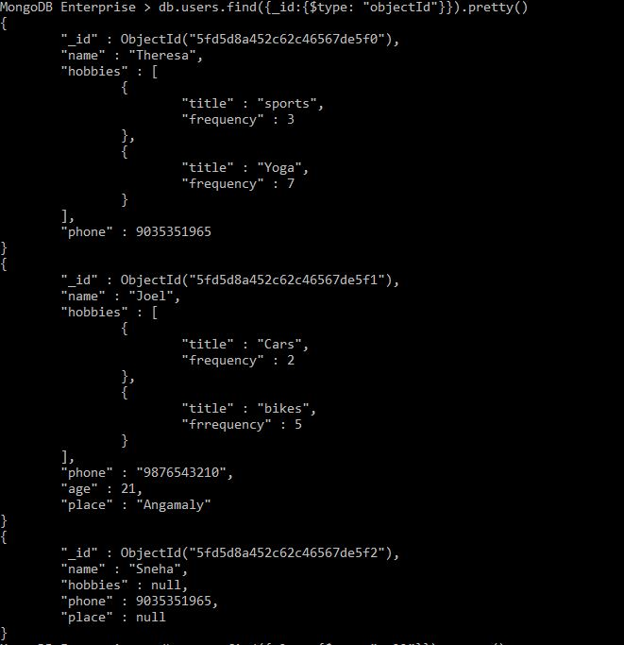
OBJECTID

Slide 13
MongoDB Enterprise > db.users.find({_id:{$type: "objectId"}}).pretty()
{
"_id" : ObjectId("5fd5d8a452c62c46567de5f0"),
"name" : "Theresa",
"hobbies" : [
{
"title" : "sports",
"frequency" : 3
},
{
"title" : "Yoga",
"frequency" : 7
}
],
"phone" : 9035351965
}
{
"_id" : ObjectId("5fd5d8a452c62c46567de5f1"),
"name" : "Joel",
"hobbies" : [
{
"title" : "Cars",
"frequency" : 2
},
{
"title" : "bikes",
"frrequency" : 5
}
],
"phone" : "9876543210",
"age" : 21,
"place" : "Angamaly"
}
{
"_id" : ObjectId("5fd5d8a452c62c46567de5f2"),
"name" : "Sneha",
"hobbies" : null,
"phone" : 9035351965,
"place" : null
}

Slide 14
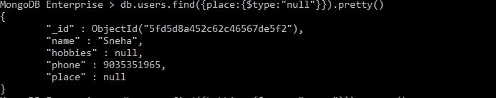
NULL

Slide 15
MongoDB Enterprise > db.users.find({place:{$type:"null"}}).pretty()
{
"_id" : ObjectId("5fd5d8a452c62c46567de5f2"),
"name" : "Sneha",
"hobbies" : null,
"phone" : 9035351965,
"place" : null
}

Slide 16
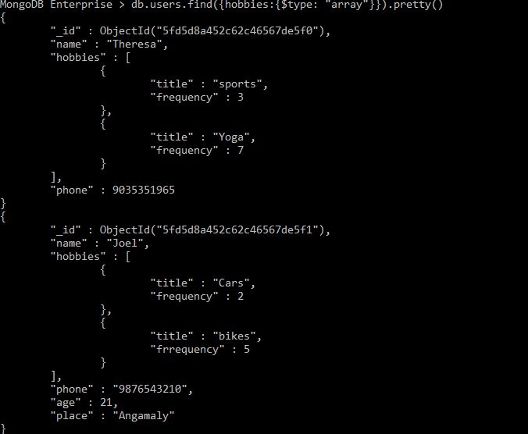
ARRAY

Slide 17
MongoDB Enterprise > db.users.find({hobbies:{$type: "array"}}).pretty()
{
"_id" : ObjectId("5fd5d8a452c62c46567de5f0"),
"name" : "Theresa",
"hobbies" : [
{
"title" : "sports",
"frequency" : 3
},
{
"title" : "Yoga",
"frequency" : 7
}
],
"phone" : 9035351965
}
{
"_id" : ObjectId("5fd5d8a452c62c46567de5f1"),
"name" : "Joel",
"hobbies" : [
{
"title" : "Cars",
"frequency" : 2
},
{
"title" : "bikes",
"frrequency" : 5
}
],
"phone" : "9876543210",
"age" : 21,
"place" : "Angamaly"
}

Slide 18
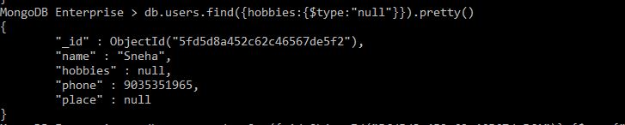
NULL

Slide 19
MongoDB Enterprise > db.users.find({hobbies:{$type:"null"}}).pretty()
{
"_id" : ObjectId("5fd5d8a452c62c46567de5f2"),
"name" : "Sneha",
"hobbies" : null,
"phone" : 9035351965,
"place" : null
}

Slide 20
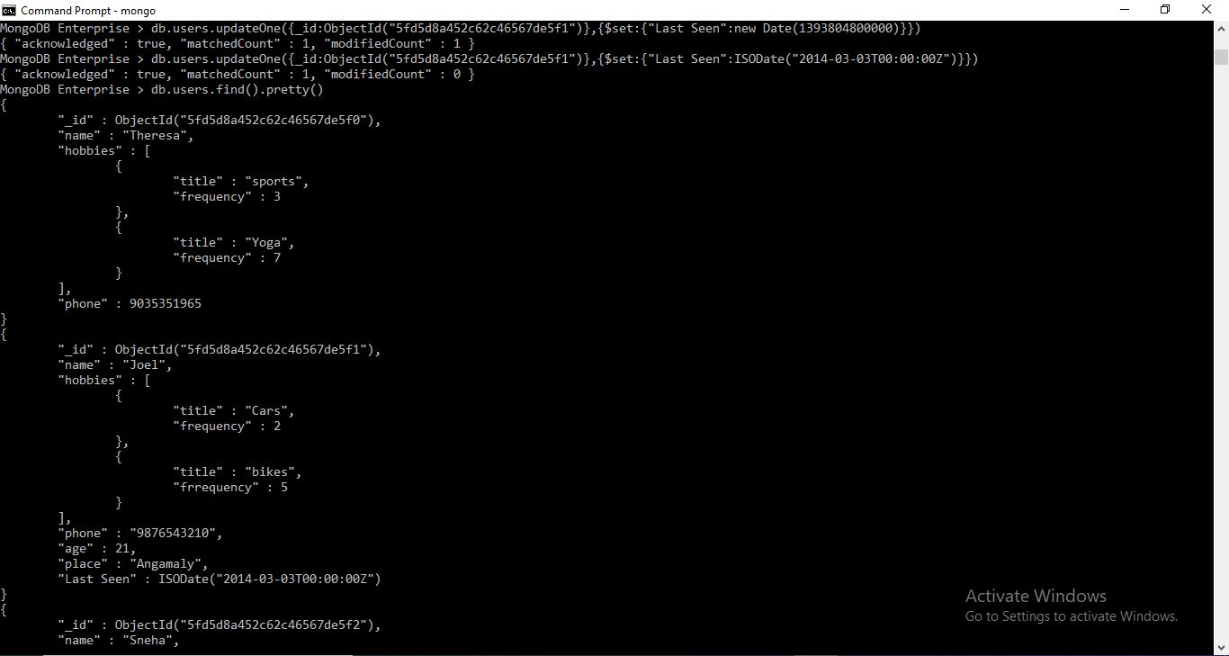

Slide 21
MongoDB Enterprise > db.users.updateOne({_id:ObjectId("5fd5d8a452c62c46567de5f1")},{$set:{"Last Seen":new Date(1393804800000)}})
{ "acknowledged" : true, "matchedCount" : 1, "modifiedCount" : 1 }
MongoDB Enterprise > db.users.updateOne({_id:ObjectId("5fd5d8a452c62c46567de5f1")},{$set:{"Last Seen":ISODate("2014-03-03T00:00:00Z")}})
{ "acknowledged" : true, "matchedCount" : 1, "modifiedCount" : 0 }
MongoDB Enterprise > db.users.find().pretty()
{
"_id" : ObjectId("5fd5d8a452c62c46567de5f0"),
"name" : "Theresa",
"hobbies" : [
{
"title" : "sports",
"frequency" : 3
},
{
"title" : "Yoga",
"frequency" : 7
}
],
"phone" : 9035351965
}
{
"_id" : ObjectId("5fd5d8a452c62c46567de5f1"),
"name" : "Joel",
"hobbies" : [
{
"title" : "Cars",
"frequency" : 2
},
{
"title" : "bikes",
"frrequency" : 5
}
],
"phone" : "9876543210",
"age" : 21,
"place" : "Angamaly",
"Last Seen" : ISODate("2014-03-03T00:00:00Z")
}
{
"_id" : ObjectId("5fd5d8a452c62c46567de5f2"),
"name" : "Sneha",
"hobbies" : null,
"phone" : 9035351965,
"place" : null
}

Slide 22
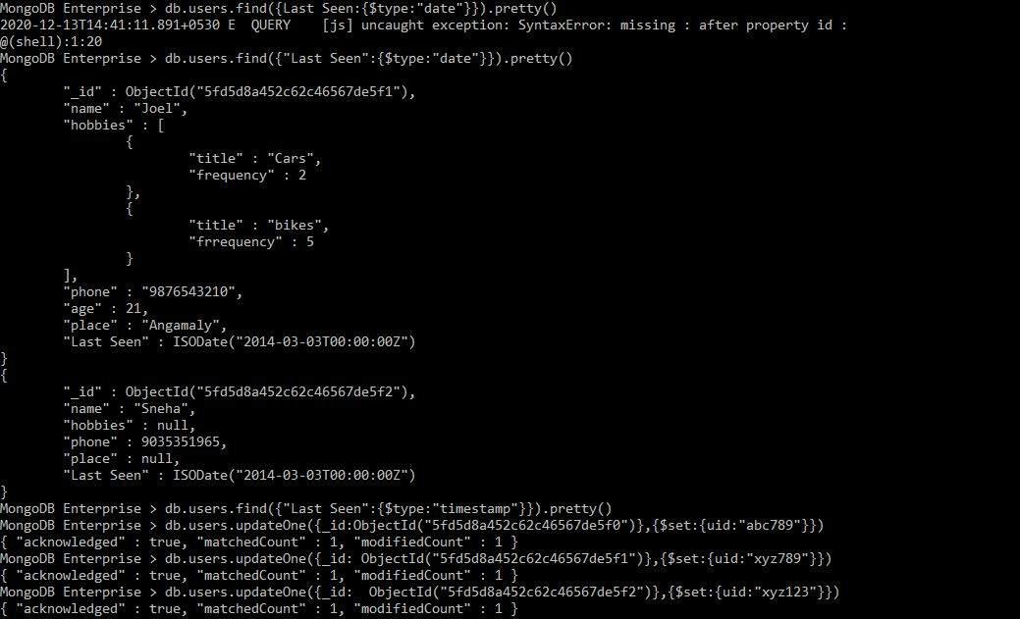
DATE AND TIMESTAMP

Slide 23
MongoDB Enterprise > db.users.find({Last Seen:{$type:"date"}}).pretty()
2020-12-13T14:41:11.891+0530 E QUERY [js] uncaught exception: SyntaxError: missing : after property id :
@(shell):1:20
MongoDB Enterprise > db.users.find({"Last Seen":{$type:"date"}}).pretty()
{
"_id" : ObjectId("5fd5d8a452c62c46567de5f1"),
"name" : "Joel",
"hobbies" : [
{
"title" : "Cars",
"frequency" : 2
},
{
"title" : "bikes",
"frrequency" : 5
}
],
"phone" : "9876543210",
"age" : 21,
"place" : "Angamaly",
"Last Seen" : ISODate("2014-03-03T00:00:00Z")
}
{
"_id" : ObjectId("5fd5d8a452c62c46567de5f2"),
"name" : "Sneha",
"hobbies" : null,
"phone" : 9035351965,
"place" : null,
"Last Seen" : ISODate("2014-03-03T00:00:00Z")
}

Slide 24
MongoDB Enterprise > db.users.find({"Last Seen":{$type:"timestamp"}}).pretty()​
MongoDB Enterprise > db.users.updateOne({_id:ObjectId("5fd5d8a452c62c46567de5f0")},{$set:{uid:"abc789"}})​
{ "acknowledged" : true, "matchedCount" : 1, "modifiedCount" : 1 }​
MongoDB Enterprise > db.users.updateOne({_id: ObjectId("5fd5d8a452c62c46567de5f1")},{$set:{uid:"xyz789"}})​
{ "acknowledged" : true, "matchedCount" : 1, "modifiedCount" : 1 }​
MongoDB Enterprise > db.users.updateOne({_id: ObjectId("5fd5d8a452c62c46567de5f2")},{$set:{uid:"xyz123"}})​
{ "acknowledged" : true, "matchedCount" : 1, "modifiedCount" : 1 }

Slide 25
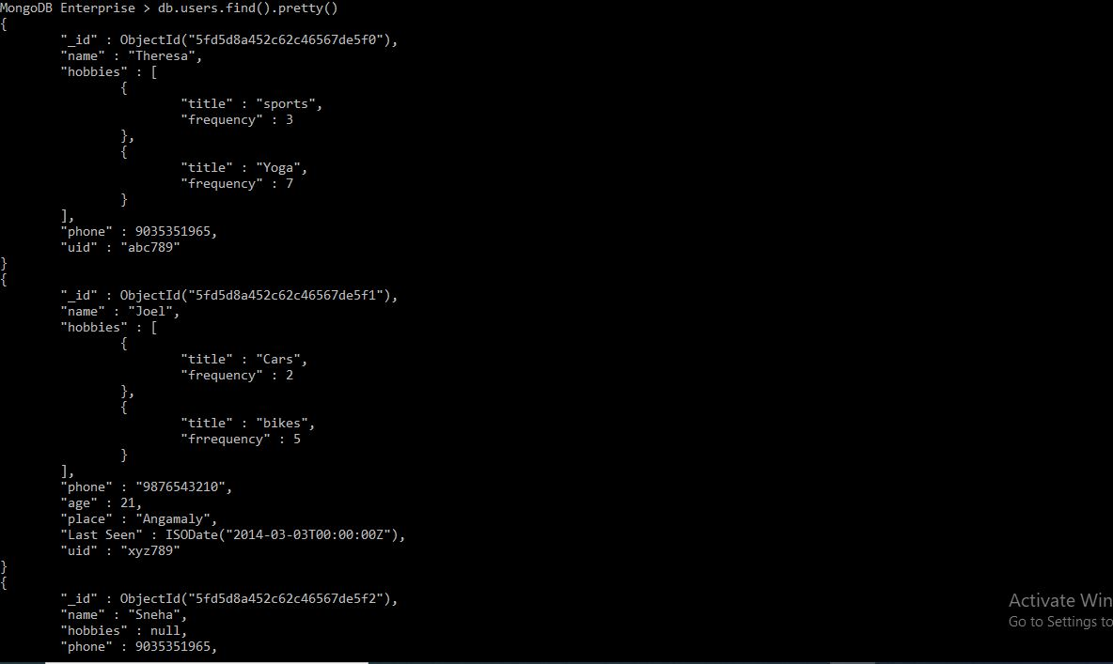

Slide 26
MongoDB Enterprise > db.users.find().pretty()
{
"_id" : ObjectId("5fd5d8a452c62c46567de5f0"),
"name" : "Theresa",
"hobbies" : [
{
"title" : "sports",
"frequency" : 3
},
{
"title" : "Yoga",
"frequency" : 7
}
],
"phone" : 9035351965,
"uid" : "abc789"
}
{
"_id" : ObjectId("5fd5d8a452c62c46567de5f1"),
"name" : "Joel",
"hobbies" : [
{
"title" : "Cars",
"frequency" : 2
},
{
"title" : "bikes",
"frrequency" : 5
}
],
"phone" : "9876543210",
"age" : 21,
"place" : "Angamaly",
"Last Seen" : ISODate("2014-03-03T00:00:00Z"),
"uid" : "xyz789"
}
{
"_id" : ObjectId("5fd5d8a452c62c46567de5f2"),
"name" : "Sneha",
"hobbies" : null,
"phone" : 9035351965,
"place" : null,
"Last Seen" : ISODate("2014-03-03T00:00:00Z"),
"uid" : "xyz123"
}

Slide 27
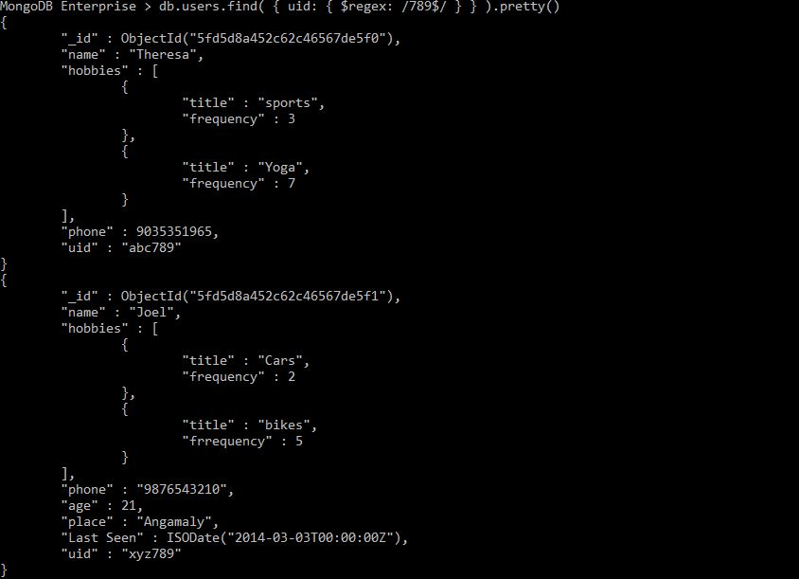
REGEX

Slide 28
MongoDB Enterprise > db.users.find( { uid: { $regex: /789$/ } } ).pretty()
{
"_id" : ObjectId("5fd5d8a452c62c46567de5f0"),
"name" : "Theresa",
"hobbies" : [
{
"title" : "sports",
"frequency" : 3
},
{
"title" : "Yoga",
"frequency" : 7
}
],
"phone" : 9035351965,
"uid" : "abc789"
}
{
"_id" : ObjectId("5fd5d8a452c62c46567de5f1"),
"name" : "Joel",
"hobbies" : [
{
"title" : "Cars",
"frequency" : 2
},
{
"title" : "bikes",
"frrequency" : 5
}
],
"phone" : "9876543210",
"age" : 21,
"place" : "Angamaly",
"Last Seen" : ISODate("2014-03-03T00:00:00Z"),
"uid" : "xyz789"
}

Slide 29
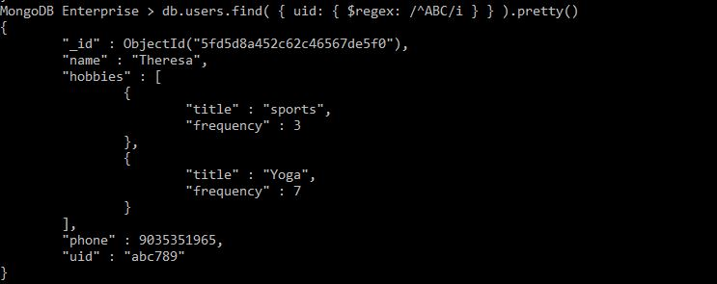

Slide 30
MongoDB Enterprise > db.users.find( { uid: { $regex: /^ABC/i } } ).pretty()
{
"_id" : ObjectId("5fd5d8a452c62c46567de5f0"),
"name" : "Theresa",
"hobbies" : [
{
"title" : "sports",
"frequency" : 3
},
{
"title" : "Yoga",
"frequency" : 7
}
],
"phone" : 9035351965,
"uid" : "abc789"
}

