Slide 1
Report on MongoDB Indexes
THERESA GEORGE

Slide 2
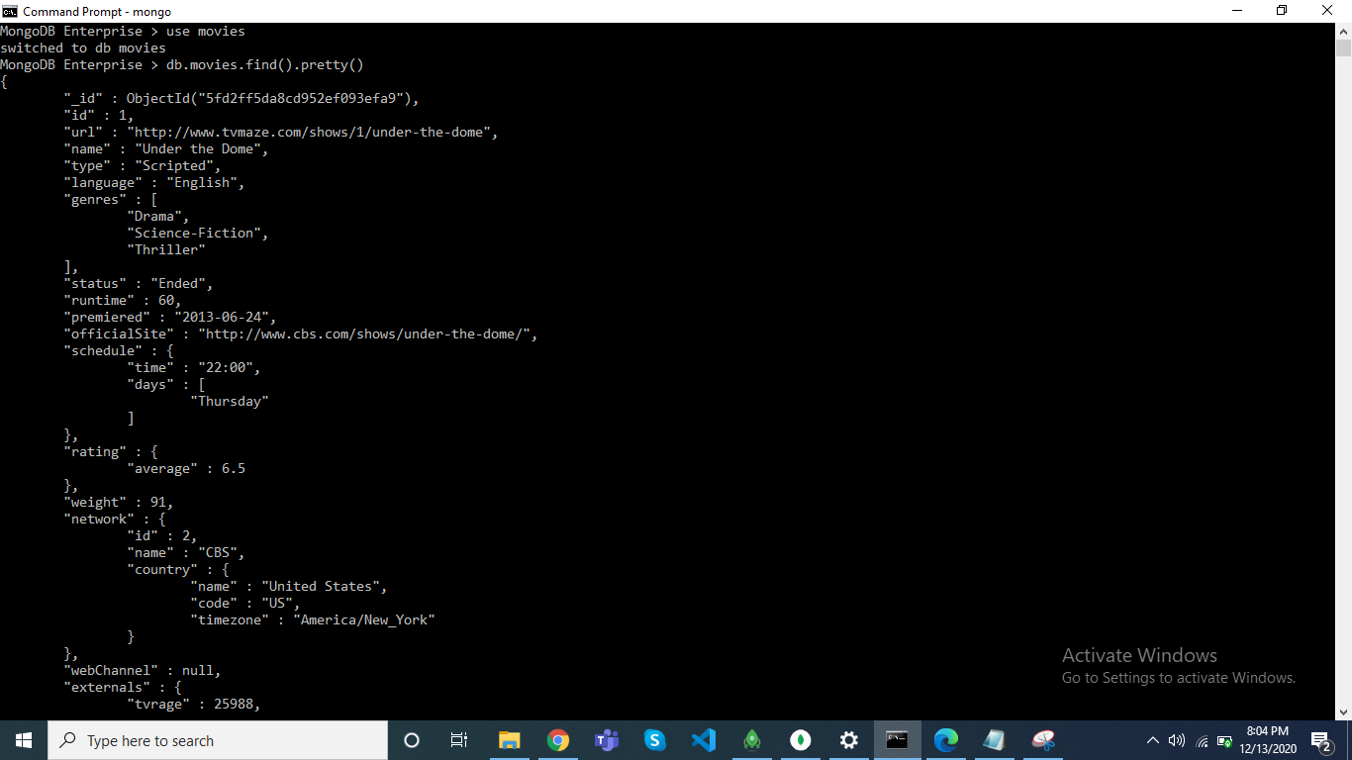
CREATING DB AND COLLECTION

Slide 3
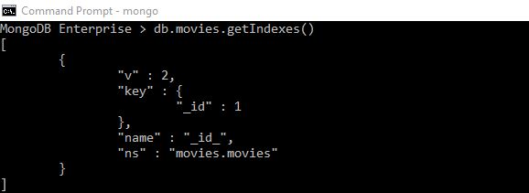
getIndexes()

Slide 4
MongoDB Enterprise > db.movies.getIndexes()
[
{
"v" : 2,
"key" : {
"_id" : 1
},
"name" : "_id_",
"ns" : "movies.movies"
}
]

Slide 5
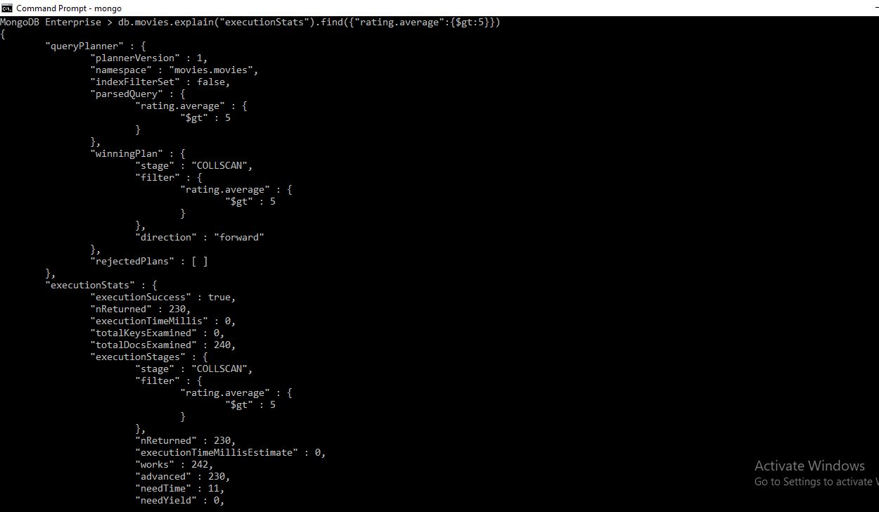
explain()

Slide 6
{
"queryPlanner" : {
"plannerVersion" : 1,
"namespace" : "movies.movies",
"indexFilterSet" : false,
"parsedQuery" : {
"rating.average" : {
"$gt" : 5
}
},
"winningPlan" : {
"stage" : "COLLSCAN",
"filter" : {
"rating.average" : {
"$gt" : 5
}
},
"direction" : "forward"
},
"rejectedPlans" : [ ]
},

Slide 7
"executionStats" : {
"executionSuccess" : true,
"nReturned" : 230,
"executionTimeMillis" : 0,
"totalKeysExamined" : 0,
"totalDocsExamined" : 240,
"executionStages" : {
"stage" : "COLLSCAN",
"filter" : {
"rating.average" : {
"$gt" : 5
}
},
"nReturned" : 230,
"executionTimeMillisEstimate" : 0,
"works" : 242,
"advanced" : 230,
"needTime" : 11,
"needYield" : 0,
"saveState" : 1,
"restoreState" : 1,
"isEOF" : 1,
"direction" : "forward",
"docsExamined" : 240
}
},

Slide 8
"serverInfo" : {​
"host" : "DESKTOP-990EOIL",​
"port" : 27017,​
"version" : "4.2.8",​
"gitVersion" : "43d25964249164d76d5e04dd6cf38f6111e21f5f"​
},​
"ok" : 1​
}​

Slide 9
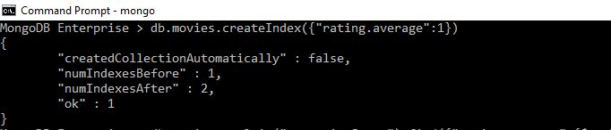
createIndex()

Slide 10
db.movies.createIndex({"rating.average":1})
{
"createdCollectionAutomatically" : false,
"numIndexesBefore" : 1,
"numIndexesAfter" : 2,
"ok" : 1
}

Slide 11
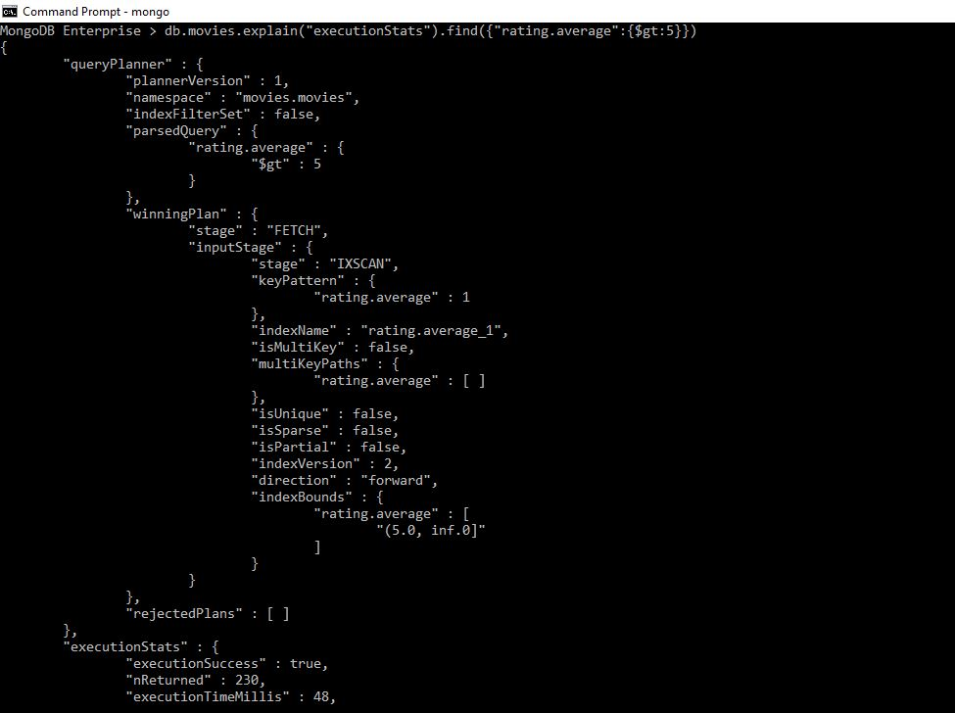
explain()

Slide 12
db.movies.explain("executionStats").find({"rating.average":{$gt:5}})
{
"queryPlanner" : {
"plannerVersion" : 1,
"namespace" : "movies.movies",
"indexFilterSet" : false,
"parsedQuery" : {
"rating.average" : {
"$gt" : 5
}
},
"winningPlan" : {
"stage" : "FETCH",
"inputStage" : {
"stage" : "IXSCAN",
"keyPattern" : {
"rating.average" : 1
},
"indexName" : "rating.average_1",
"isMultiKey" : false,
"multiKeyPaths" : {
"rating.average" : [ ]
},
"isUnique" : false,
"isSparse" : false,
"isPartial" : false,
"indexVersion" : 2,
"direction" : "forward",
"indexBounds" : {
"rating.average" : [
"(5.0, inf.0]"
]
}
}
},
"rejectedPlans" : [ ]
},

Slide 13
"executionStats" : {
"executionSuccess" : true,
"nReturned" : 230,
"executionTimeMillis" : 48,
"totalKeysExamined" : 230,
"totalDocsExamined" : 230,
"executionStages" : {
"stage" : "FETCH",
"nReturned" : 230,
"executionTimeMillisEstimate" : 48,
"works" : 231,
"advanced" : 230,
"needTime" : 0,
"needYield" : 0,
"saveState" : 2,
"restoreState" : 2,
"isEOF" : 1,
"docsExamined" : 230,
"alreadyHasObj" : 0,
"inputStage" : {
"stage" : "IXSCAN",
"nReturned" : 230,
"executionTimeMillisEstimate" : 48,
"works" : 231,
"advanced" : 230,
"needTime" : 0,
"needYield" : 0,
"saveState" : 2,
"restoreState" : 2,
"isEOF" : 1,
"keyPattern" : {
"rating.average" : 1
},

Slide 14
"indexName" : "rating.average_1",
"isMultiKey" : false,
"multiKeyPaths" : {
"rating.average" : [ ]
},
"isUnique" : false,
"isSparse" : false,
"isPartial" : false,
"indexVersion" : 2,
"direction" : "forward",
"indexBounds" : {
"rating.average" : [
"(5.0, inf.0]"
]
},
"keysExamined" : 230,
"seeks" : 1,
"dupsTested" : 0,
"dupsDropped" : 0
}
}
},
"serverInfo" : {
"host" : "DESKTOP-990EOIL",
"port" : 27017,
"version" : "4.2.8",
"gitVersion" : "43d25964249164d76d5e04dd6cf38f6111e21f5f"
},
"ok" : 1
}

Slide 15

dropIndex()

Slide 16
MongoDB Enterprise > db.movies.dropIndex({"rating.average":1})
{ "nIndexesWas" : 2, "ok" : 1 }

Slide 17
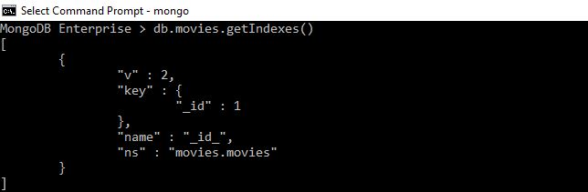
getIndexes()

Slide 18
MongoDB Enterprise > db.movies.getIndexes()
[
{
"v" : 2,
"key" : {
"_id" : 1
},
"name" : "_id_",
"ns" : "movies.movies"
}
]

Slide 19
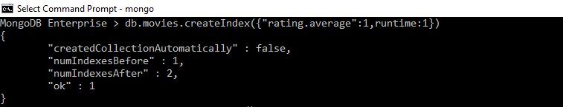
createIndex() with two fields

Slide 20
MongoDB Enterprise > db.movies.createIndex({"rating.average":1,runtime:1})
{
"createdCollectionAutomatically" : false,
"numIndexesBefore" : 1,
"numIndexesAfter" : 2,
"ok" : 1
}

Slide 21
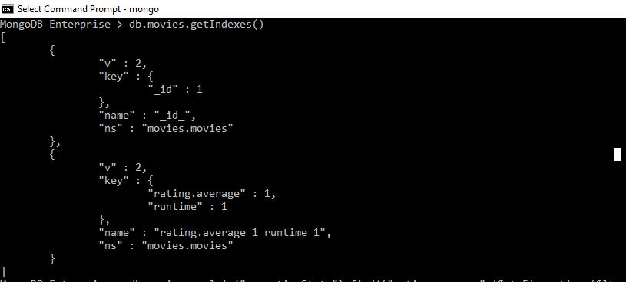
getIndexes()

Slide 22
MongoDB Enterprise > db.movies.getIndexes()
[
{
"v" : 2,
"key" : {
"_id" : 1
},
"name" : "_id_",
"ns" : "movies.movies"
},
{
"v" : 2,
"key" : {
"rating.average" : 1,
"runtime" : 1
},
"name" : "rating.average_1_runtime_1",
"ns" : "movies.movies"
}
]

Slide 23
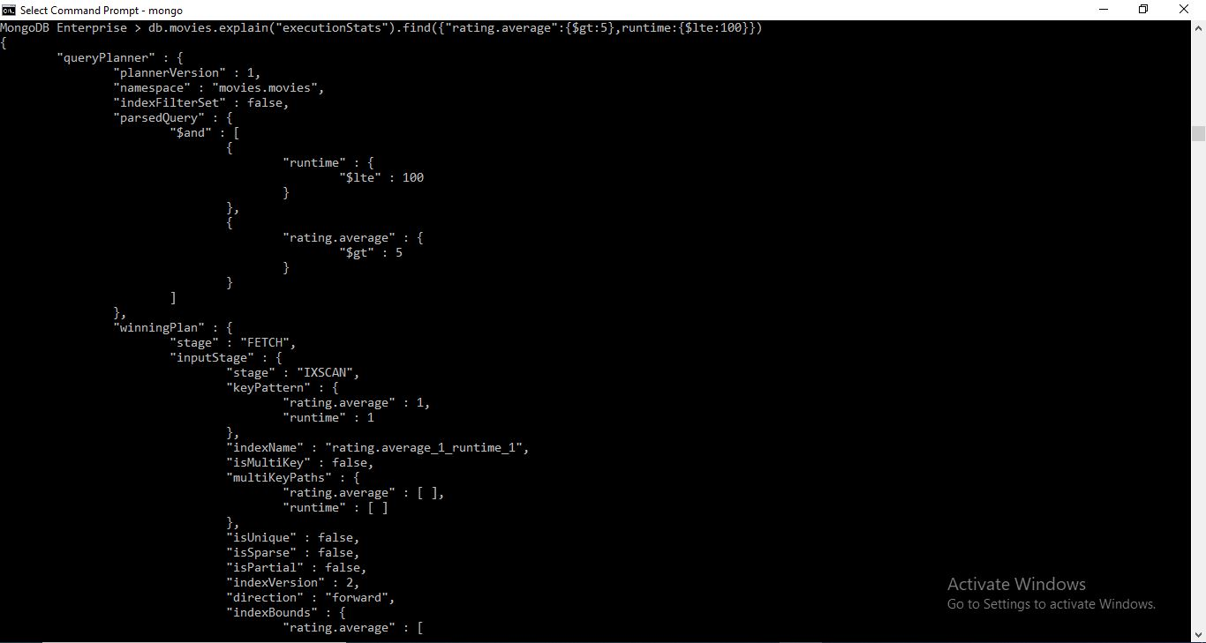
explain()

Slide 24
{
"queryPlanner" : {
"plannerVersion" : 1,
"namespace" : "movies.movies",
"indexFilterSet" : false,
"parsedQuery" : {
"$and" : [
{
"runtime" : {
"$lte" : 100
}
},
{
"rating.average" : {
"$gt" : 5
}
}
]
},

Slide 25
"winningPlan" : {
"stage" : "FETCH",
"inputStage" : {
"stage" : "IXSCAN",
"keyPattern" : {
"rating.average" : 1,
"runtime" : 1
},
"indexName" : "rating.average_1_runtime_1",
"isMultiKey" : false,
"multiKeyPaths" : {
"rating.average" : [ ],
"runtime" : [ ]
},
"isUnique" : false,
"isSparse" : false,
"isPartial" : false,
"indexVersion" : 2,
"direction" : "forward",
"indexBounds" : {
"rating.average" : [
"(5.0, inf.0]"
],
"runtime" : [
"[-inf.0, 100.0]"
]
}
}
},
"rejectedPlans" : [ ]
},

Slide 26
"executionStats" : {
"executionSuccess" : true,
"nReturned" : 229,
"executionTimeMillis" : 82,
"totalKeysExamined" : 230,
"totalDocsExamined" : 229,
"executionStages" : {
"stage" : "FETCH",
"nReturned" : 229,
"executionTimeMillisEstimate" : 81,
"works" : 231,
"advanced" : 229,
"needTime" : 1,
"needYield" : 0,
"saveState" : 2,
"restoreState" : 2,
"isEOF" : 1,
"docsExamined" : 229,
"alreadyHasObj" : 0,
"inputStage" : {
"stage" : "IXSCAN",
"nReturned" : 229,
"executionTimeMillisEstimate" : 81,
"works" : 231,
"advanced" : 229,
"needTime" : 1,
"needYield" : 0,
"saveState" : 2,
"restoreState" : 2,
"isEOF" : 1,
"keyPattern" : {
"rating.average" : 1,
"runtime" : 1
},

Slide 27
},
"indexName" : "rating.average_1_runtime_1",
"isMultiKey" : false,
"multiKeyPaths" : {
"rating.average" : [ ],
"runtime" : [ ]
},
"isUnique" : false,
"isSparse" : false,
"isPartial" : false,
"indexVersion" : 2,
"direction" : "forward",
"indexBounds" : {
"rating.average" : [
"(5.0, inf.0]"
],
"runtime" : [
"[-inf.0, 100.0]"
]
},
"keysExamined" : 230,
"seeks" : 2,
"dupsTested" : 0,
"dupsDropped" : 0
}
}
},
"serverInfo" : {
"host" : "DESKTOP-990EOIL",
"port" : 27017,
"version" : "4.2.8",
"gitVersion" : "43d25964249164d76d5e04dd6cf38f6111e21f5f"
},
"ok" : 1
}

Slide 28
dropIndex() with two fields

Slide 29
MongoDB Enterprise > db.movies.dropIndex({"rating.average":1,runtime:1})
{ "nIndexesWas" : 2, "ok" : 1 }

Slide 30
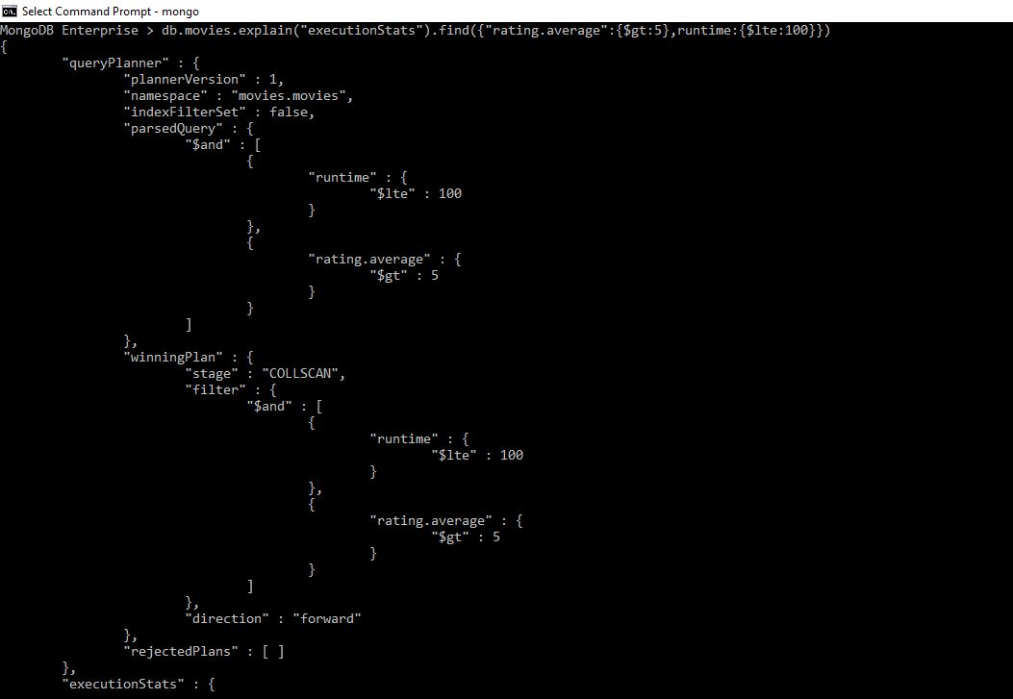
explain()

Slide 31
MongoDB Enterprise > db.movies.explain("executionStats").find({"rating.average":{$gt:5},runtime:{$lte:100}})
{
"queryPlanner" : {
"plannerVersion" : 1,
"namespace" : "movies.movies",
"indexFilterSet" : false,
"parsedQuery" : {
"$and" : [
{
"runtime" : {
"$lte" : 100
}
},
{
"rating.average" : {
"$gt" : 5
}
}
]
},

Slide 32
"winningPlan" : {
"stage" : "COLLSCAN",
"filter" : {
"$and" : [
{
"runtime" : {
"$lte" : 100
}
},
{
"rating.average" : {
"$gt" : 5
}
}
]
},
"direction" : "forward"
},
"rejectedPlans" : [ ]
},

Slide 33
"executionStats" : {
"executionSuccess" : true,
"nReturned" : 229,
"executionTimeMillis" : 0,
"totalKeysExamined" : 0,
"totalDocsExamined" : 240,
"executionStages" : {
"stage" : "COLLSCAN",
"filter" : {
"$and" : [
{
"runtime" : {
"$lte" : 100
}
},
{
"rating.average" : {
"$gt" : 5
}
}
]
},

Slide 34
"nReturned" : 229,
"executionTimeMillisEstimate" : 0,
"works" : 242,
"advanced" : 229,
"needTime" : 12,
"needYield" : 0,
"saveState" : 1,
"restoreState" : 1,
"isEOF" : 1,
"direction" : "forward",
"docsExamined" : 240
}
},
"serverInfo" : {
"host" : "DESKTOP-990EOIL",
"port" : 27017,
"version" : "4.2.8",
"gitVersion" : "43d25964249164d76d5e04dd6cf38f6111e21f5f"
},
"ok" : 1
}

