Slide 1
Report on various MongoDB Operators
THERESA GEORGE

Slide 2
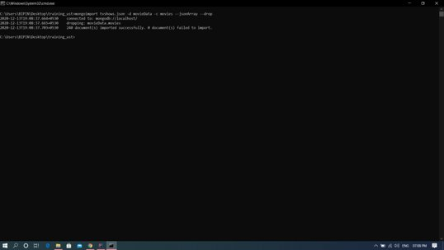
MONGOOIMPORT

Slide 3
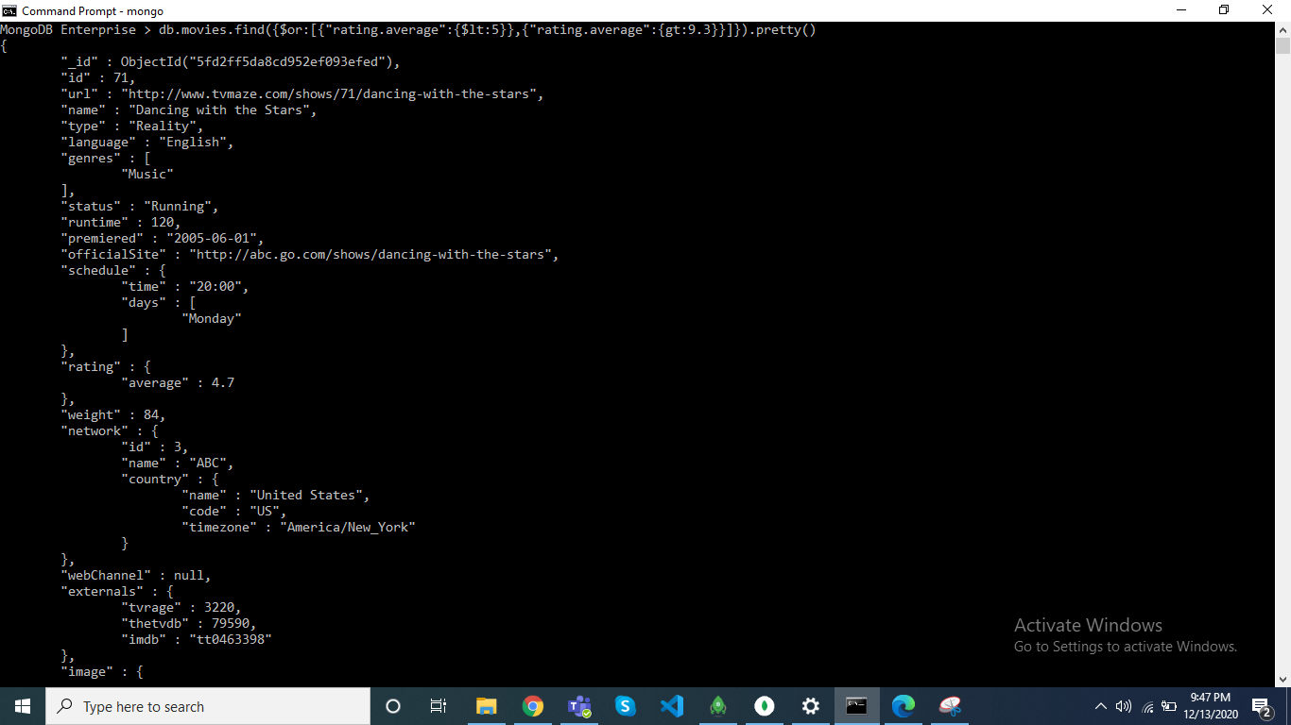
$or

Slide 4
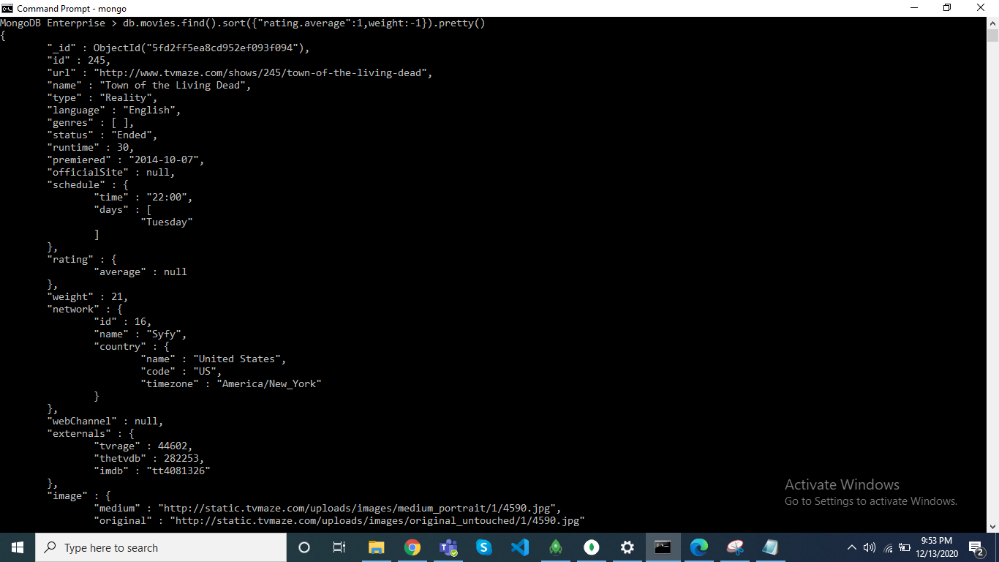
sort

Slide 5
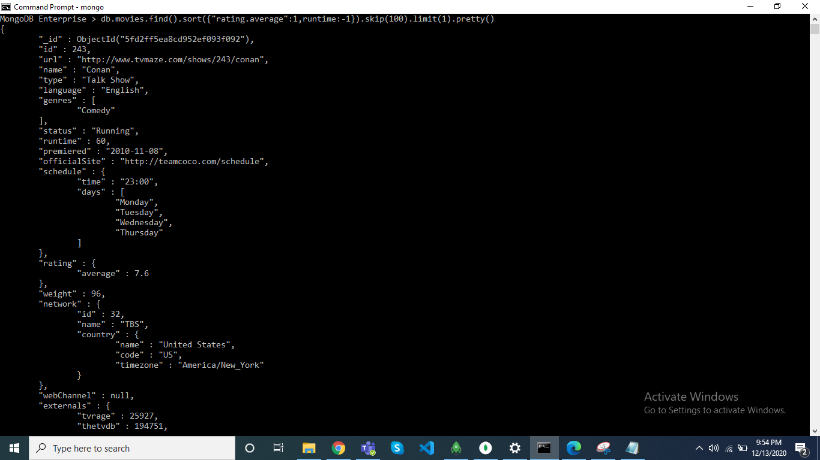
Skip and limit

Slide 6
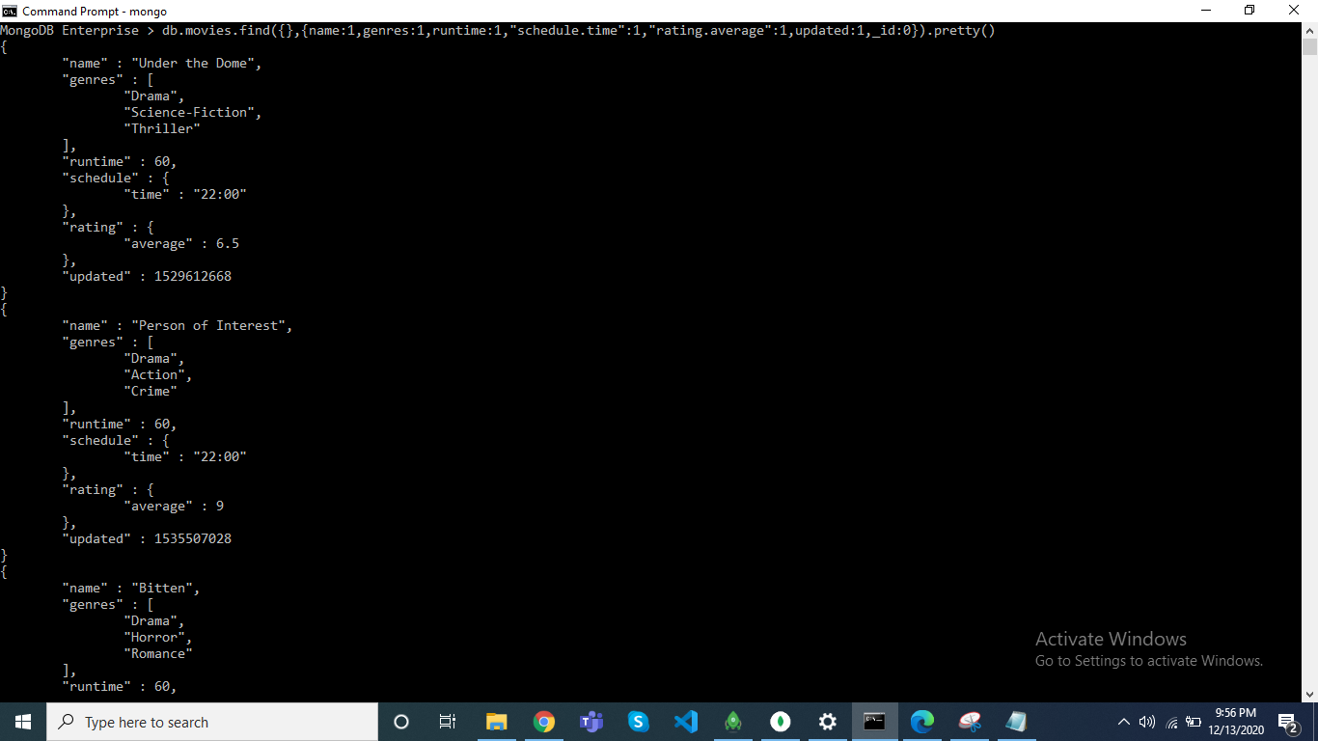
Project

Slide 7
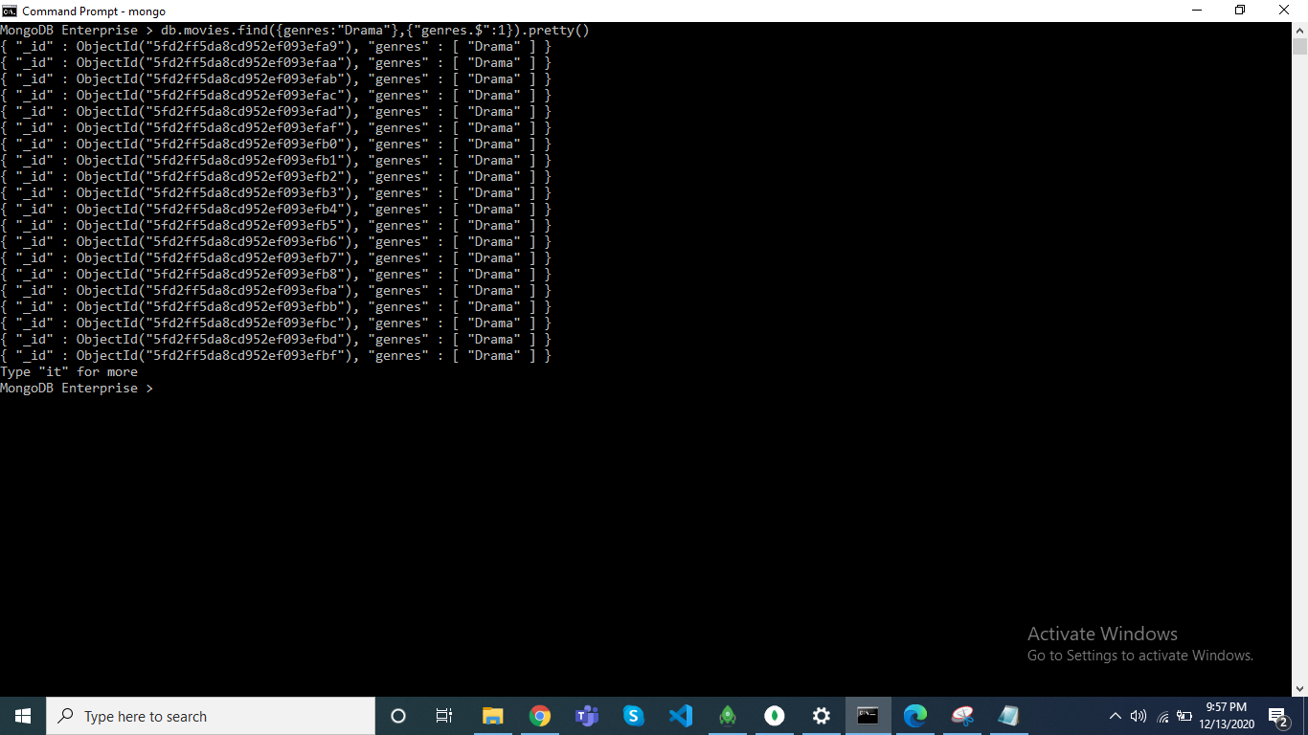
Array Projection

Slide 8
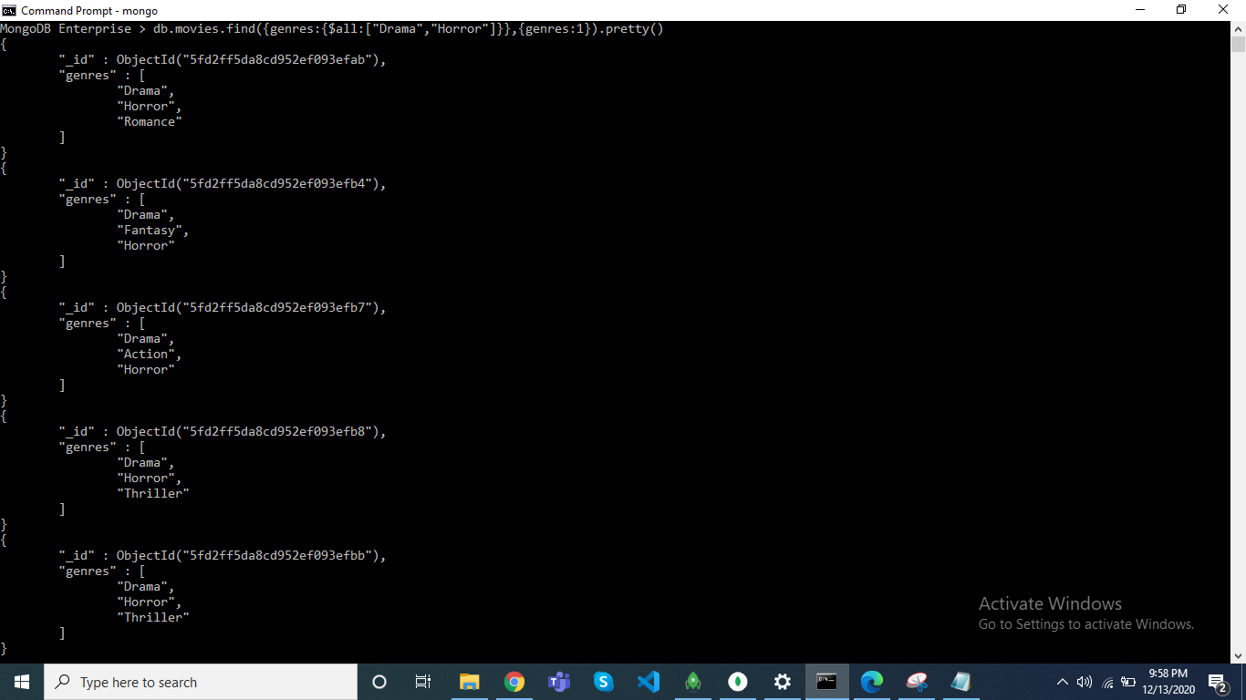
$all

Slide 9

$slice

Slide 10
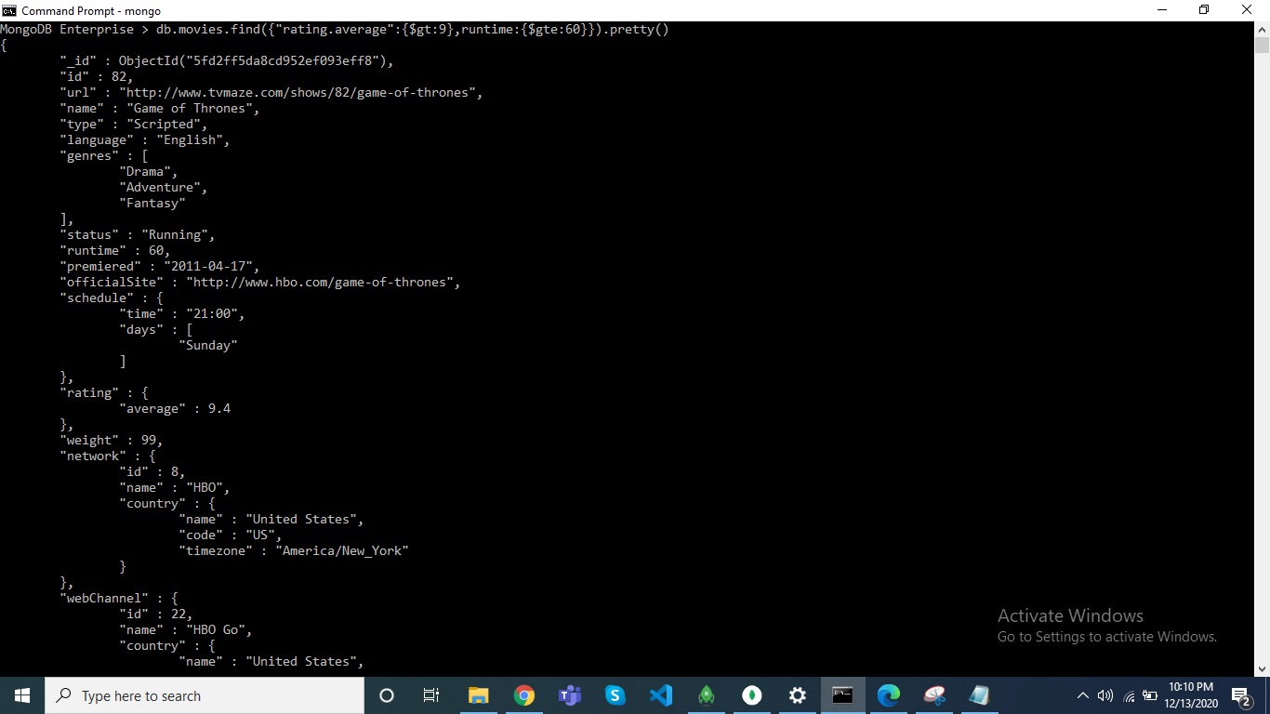
$gt and $gte

Slide 11

$lt and $lte

Slide 12
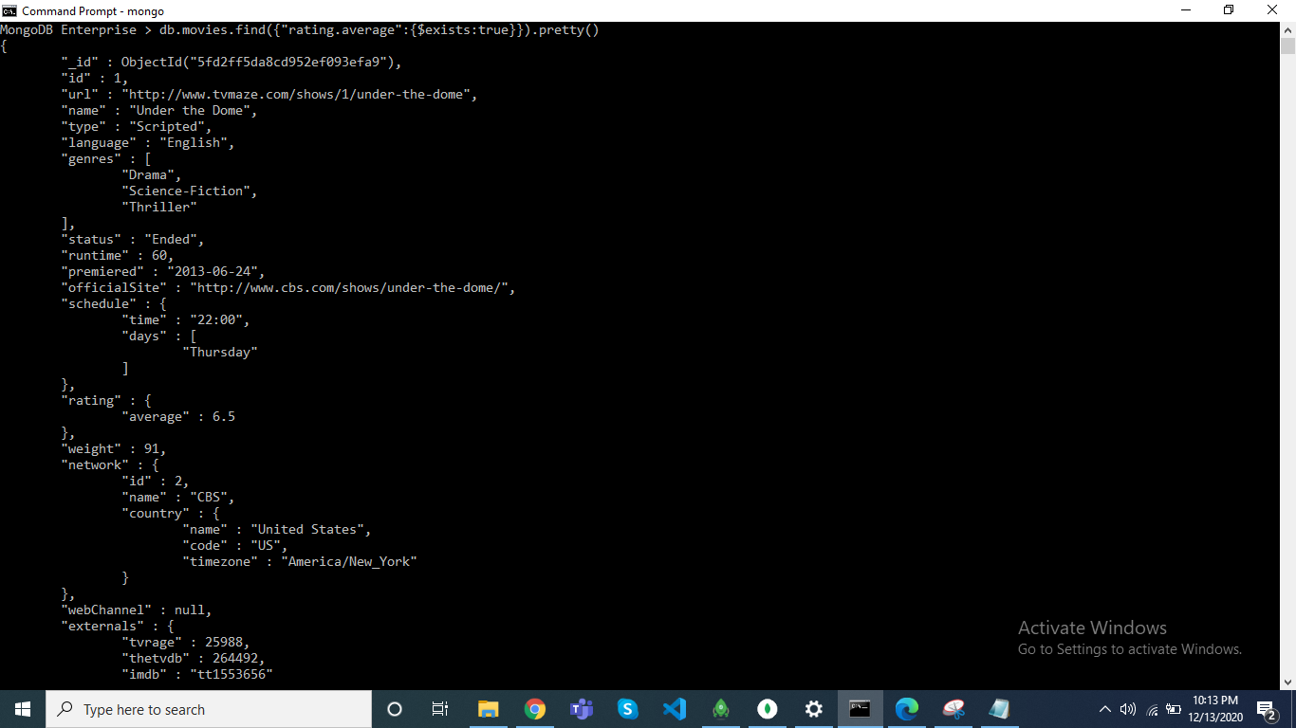
$exists

Slide 13
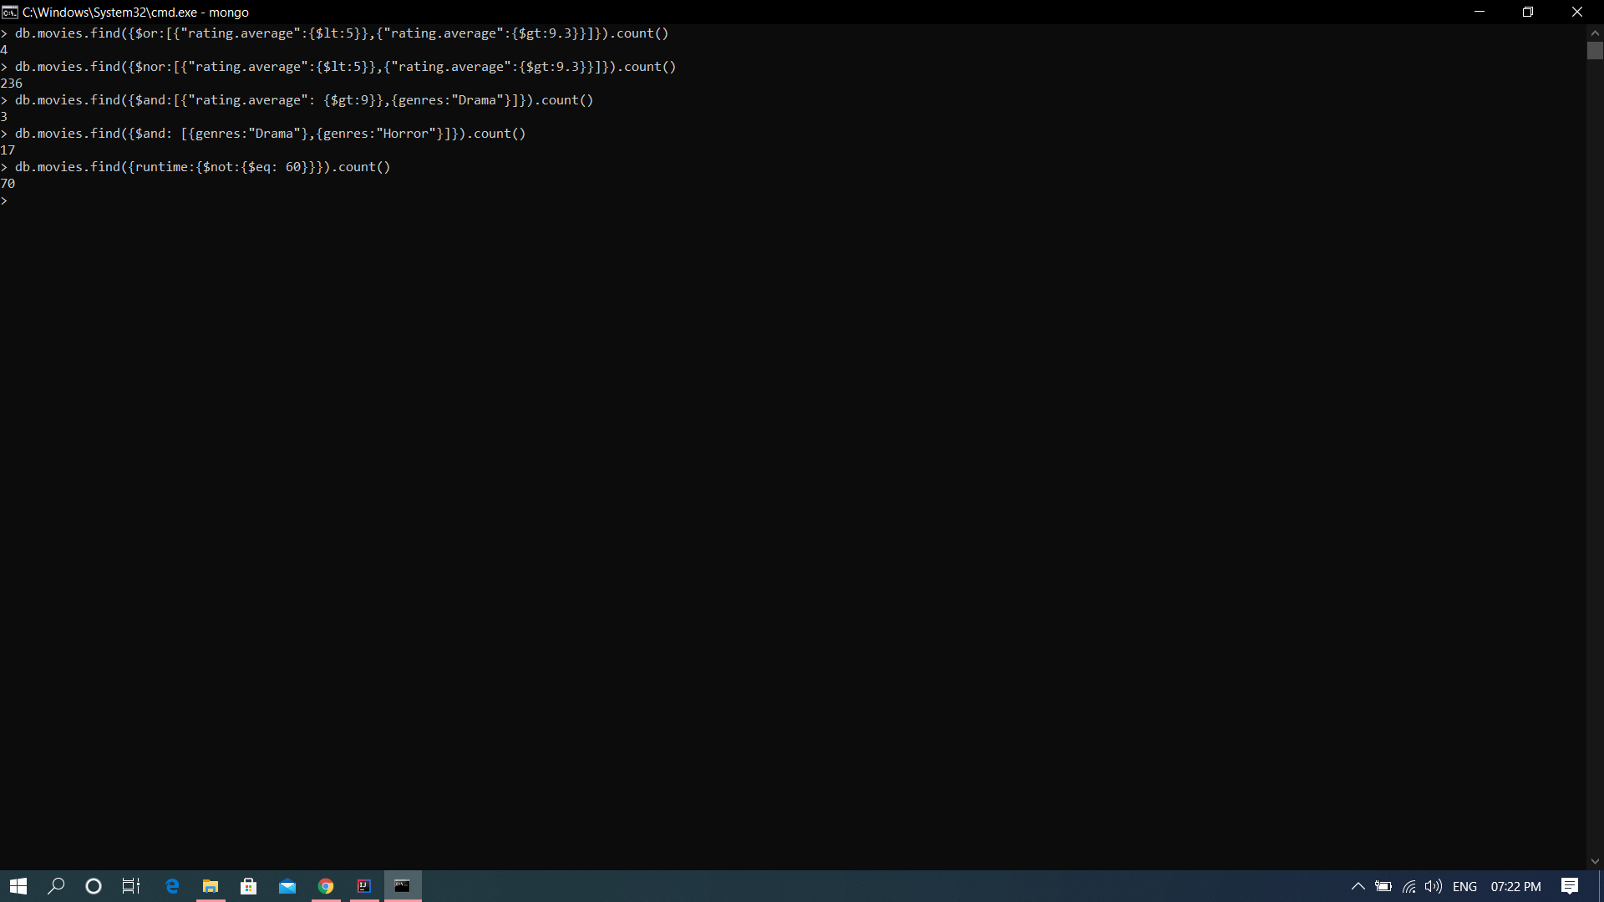
$or ,$nor, $and, $eq

Slide 14
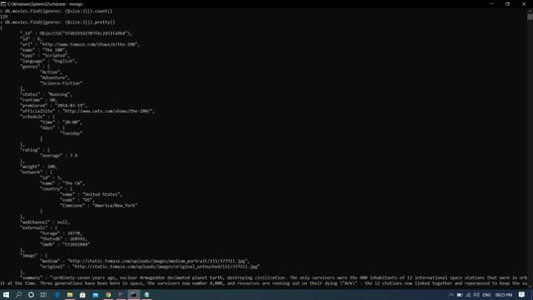
$size

Slide 15
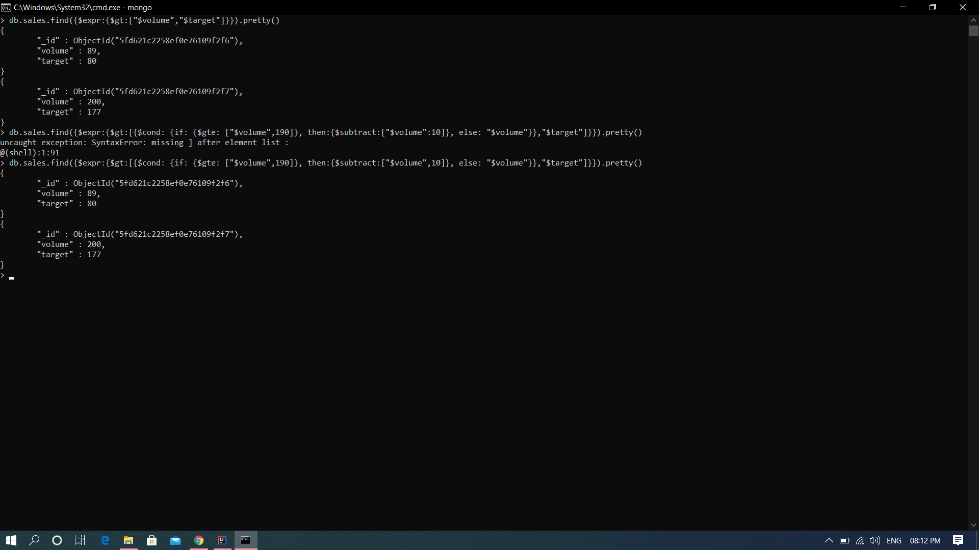
$expr, $cond (if.. then.. else..)

Slide 16
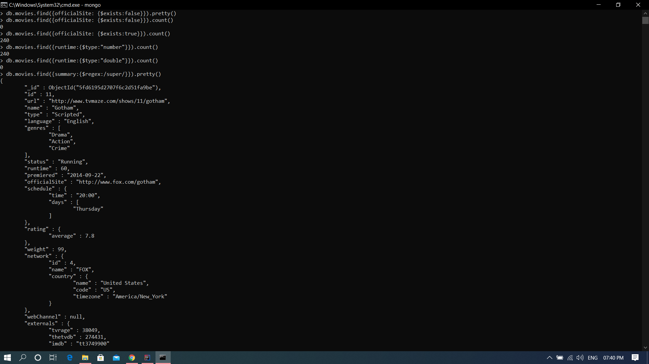
$type, $regex

