Slide 1
Report on SCANS
THERESA GEORGE

Slide 2
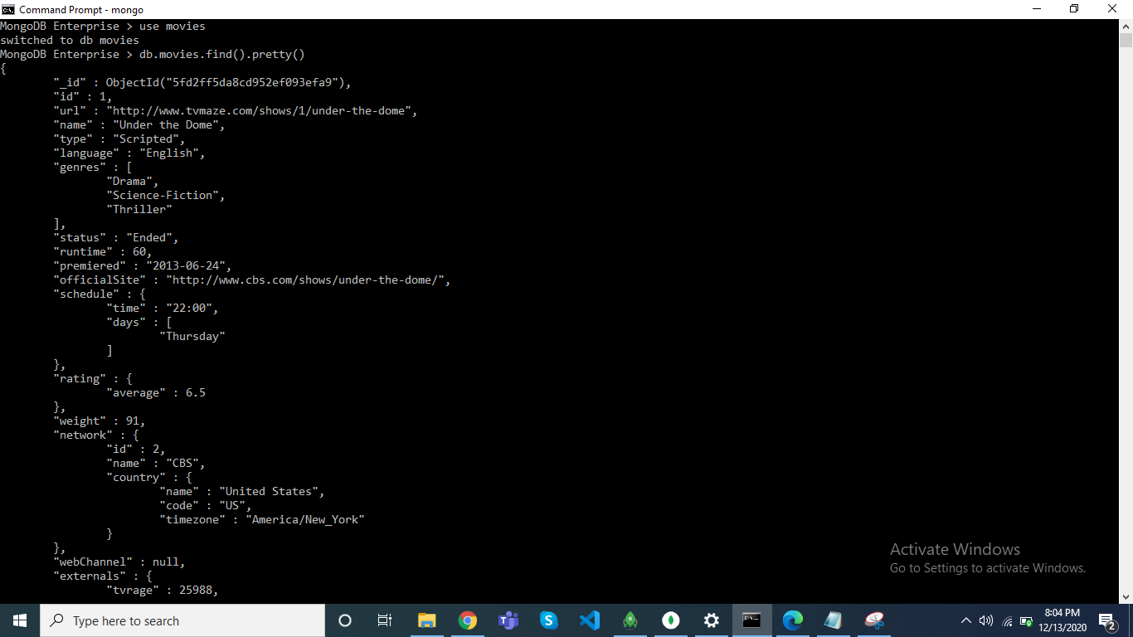
CREATING DB AND COLLECTION

Slide 3
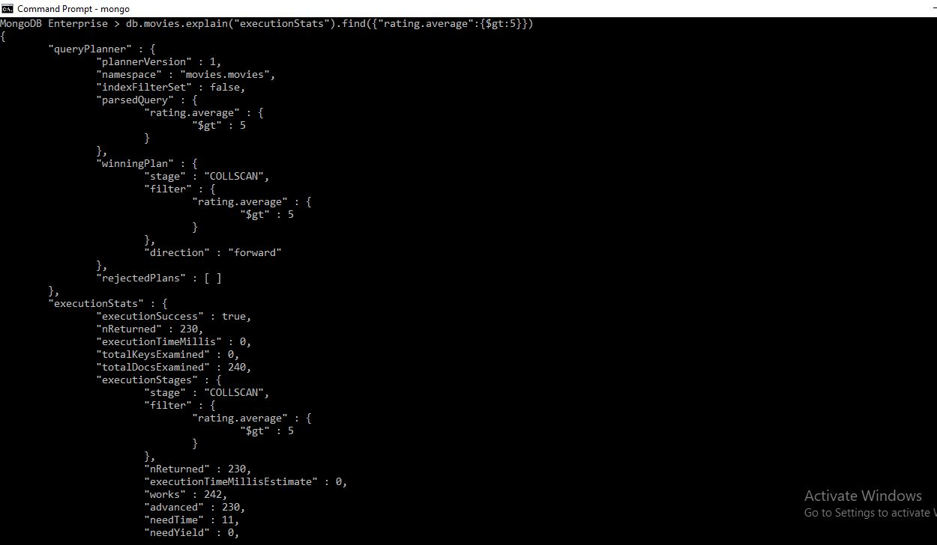
explain() - COLLECTION SCAN

Slide 4
{
"queryPlanner" : {
"plannerVersion" : 1,
"namespace" : "movies.movies",
"indexFilterSet" : false,
"parsedQuery" : {
"rating.average" : {
"$gt" : 5
}
},
"winningPlan" : {
"stage" : "COLLSCAN",
"filter" : {
"rating.average" : {
"$gt" : 5
}
},
"direction" : "forward"
},
"rejectedPlans" : [ ]
},

Slide 5
"executionStats" : {
"executionSuccess" : true,
"nReturned" : 230,
"executionTimeMillis" : 0,
"totalKeysExamined" : 0,
"totalDocsExamined" : 240,
"executionStages" : {
"stage" : "COLLSCAN",
"filter" : {
"rating.average" : {
"$gt" : 5
}
},
"nReturned" : 230,
"executionTimeMillisEstimate" : 0,
"works" : 242,
"advanced" : 230,
"needTime" : 11,
"needYield" : 0,
"saveState" : 1,
"restoreState" : 1,
"isEOF" : 1,
"direction" : "forward",
"docsExamined" : 240
}
},

Slide 6
"serverInfo" : {​
"host" : "DESKTOP-990EOIL",​
"port" : 27017,​
"version" : "4.2.8",​
"gitVersion" : "43d25964249164d76d5e04dd6cf38f6111e21f5f"​
},​
"ok" : 1​
}​

Slide 7
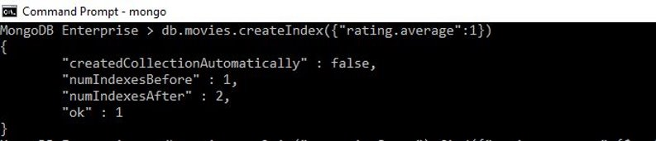
createIndex()

Slide 8
db.movies.createIndex({"rating.average":1})
{
"createdCollectionAutomatically" : false,
"numIndexesBefore" : 1,
"numIndexesAfter" : 2,
"ok" : 1
}

Slide 9
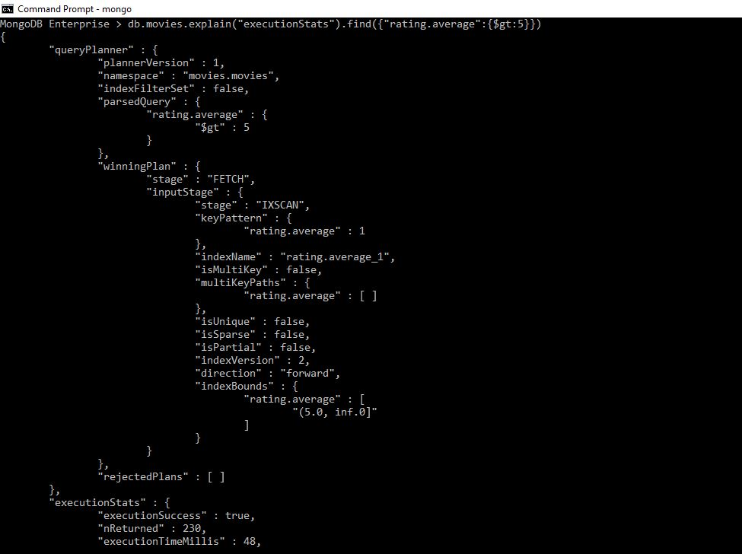
explain() -INDEX SCAN

Slide 10
db.movies.explain("executionStats").find({"rating.average":{$gt:5}})
{
"queryPlanner" : {
"plannerVersion" : 1,
"namespace" : "movies.movies",
"indexFilterSet" : false,
"parsedQuery" : {
"rating.average" : {
"$gt" : 5
}
},
"winningPlan" : {
"stage" : "FETCH",
"inputStage" : {
"stage" : "IXSCAN",
"keyPattern" : {
"rating.average" : 1
},
"indexName" : "rating.average_1",
"isMultiKey" : false,
"multiKeyPaths" : {
"rating.average" : [ ]
},
"isUnique" : false,
"isSparse" : false,
"isPartial" : false,
"indexVersion" : 2,
"direction" : "forward",
"indexBounds" : {
"rating.average" : [
"(5.0, inf.0]"
]
}
}
},
"rejectedPlans" : [ ]
},

Slide 11
"indexName" : "rating.average_1",
"isMultiKey" : false,
"multiKeyPaths" : {
"rating.average" : [ ]
},
"isUnique" : false,
"isSparse" : false,
"isPartial" : false,
"indexVersion" : 2,
"direction" : "forward",
"indexBounds" : {
"rating.average" : [
"(5.0, inf.0]"
]
},
"keysExamined" : 230,
"seeks" : 1,
"dupsTested" : 0,
"dupsDropped" : 0
}
}
},
"serverInfo" : {
"host" : "DESKTOP-990EOIL",
"port" : 27017,
"version" : "4.2.8",
"gitVersion" : "43d25964249164d76d5e04dd6cf38f6111e21f5f"
},
"ok" : 1
}

Slide 12
"executionStats" : {
"executionSuccess" : true,
"nReturned" : 230,
"executionTimeMillis" : 48,
"totalKeysExamined" : 230,
"totalDocsExamined" : 230,
"executionStages" : {
"stage" : "FETCH",
"nReturned" : 230,
"executionTimeMillisEstimate" : 48,
"works" : 231,
"advanced" : 230,
"needTime" : 0,
"needYield" : 0,
"saveState" : 2,
"restoreState" : 2,
"isEOF" : 1,
"docsExamined" : 230,
"alreadyHasObj" : 0,
"inputStage" : {
"stage" : "IXSCAN",
"nReturned" : 230,
"executionTimeMillisEstimate" : 48,
"works" : 231,
"advanced" : 230,
"needTime" : 0,
"needYield" : 0,
"saveState" : 2,
"restoreState" : 2,
"isEOF" : 1,
"keyPattern" : {
"rating.average" : 1
},

