Slide 1
MongoDB Schema and Relations
THERESA GEORGE

Slide 2
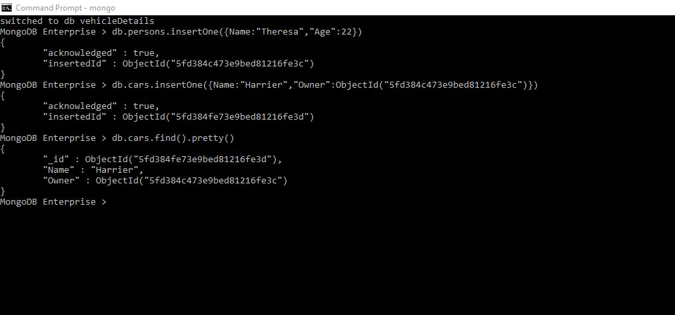
ONE TO ONE

Slide 3
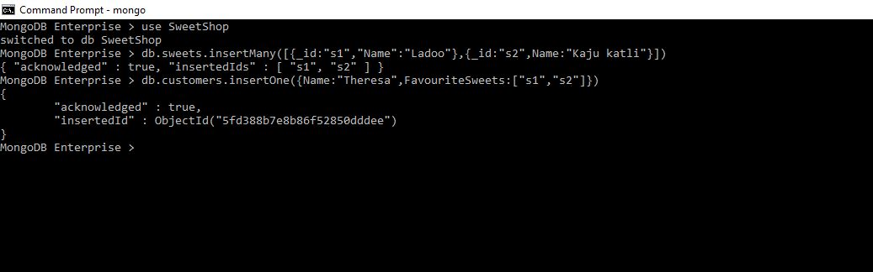
ONE TO MANY - EXAMPLE1

Slide 4
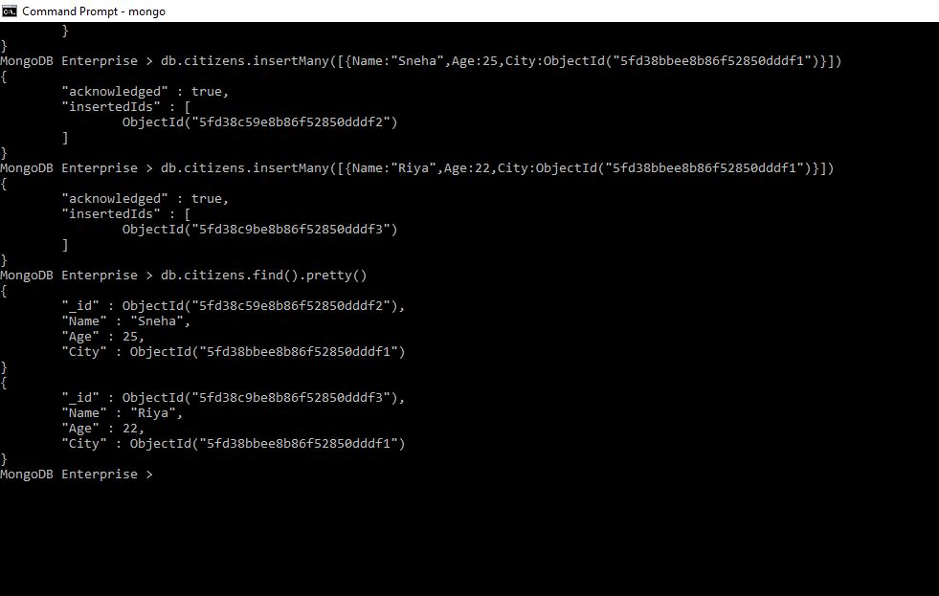
ONE TO MANY - EXAMPLE2

Slide 5
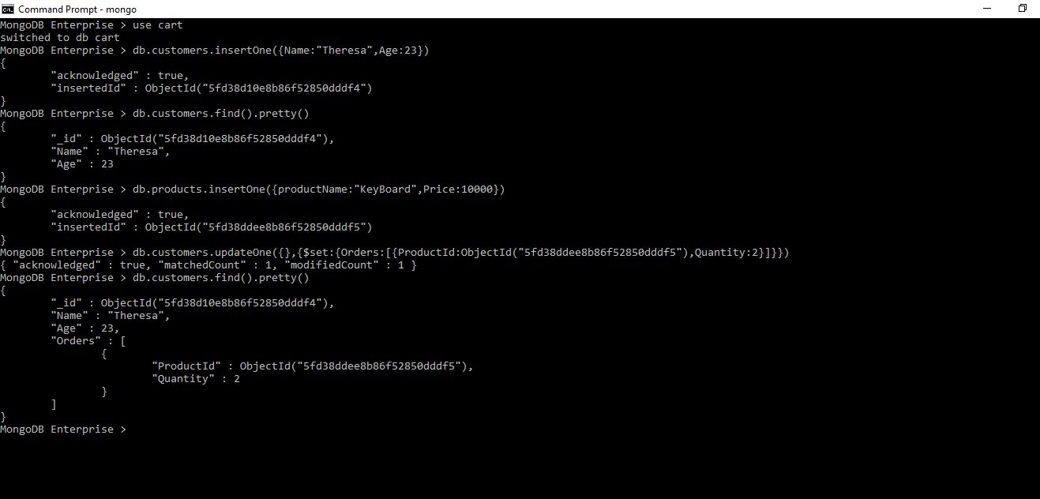
ANOTHER EXAMPLE

Slide 6
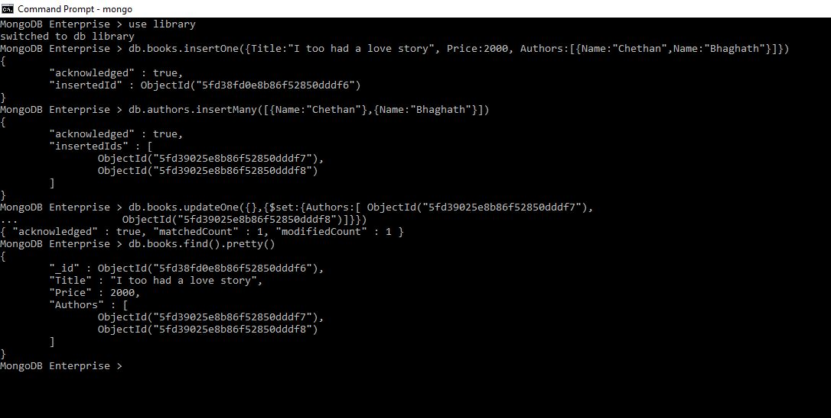
MANY TO MANY

Slide 7
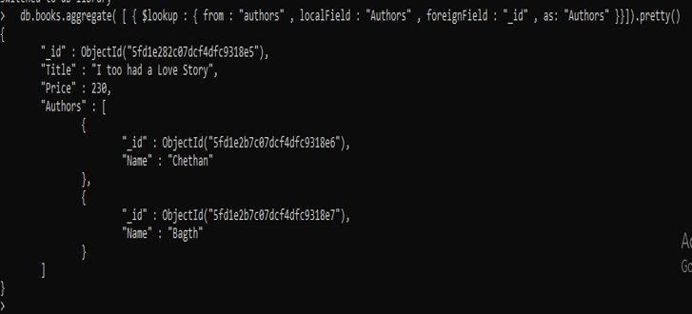
JOINING USING LOOKUP

Slide 8
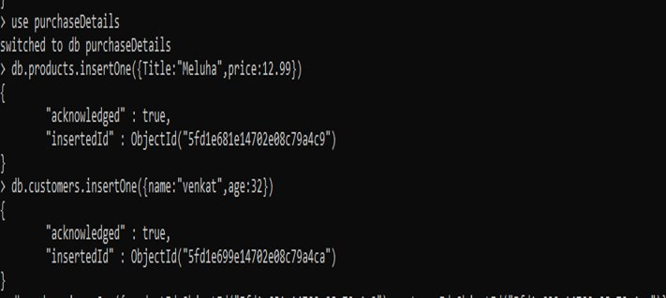
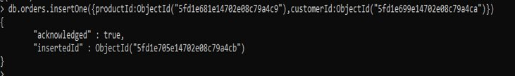
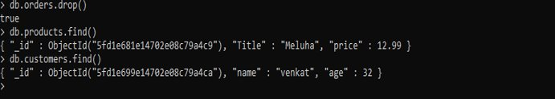
MANY TO MANY – EXAMPLE 2

Slide 9
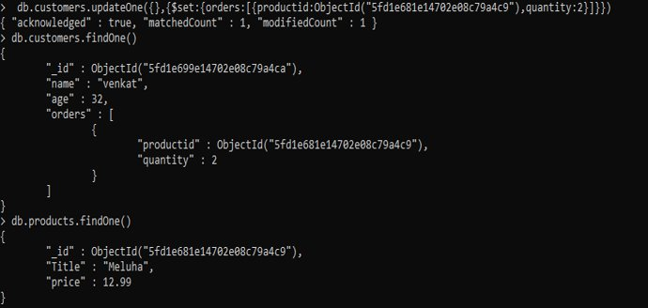
MANY TO MANY

Slide 10
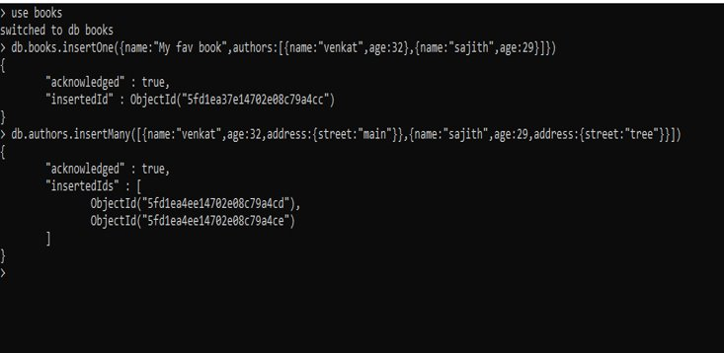
ANOTHER EXAMPLE

Slide 11
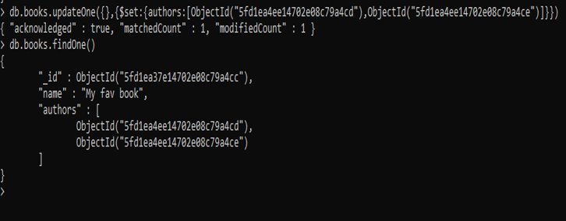

Slide 12
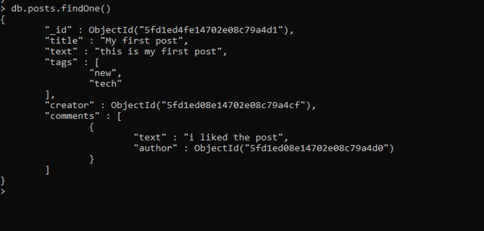
BLOG

Slide 13
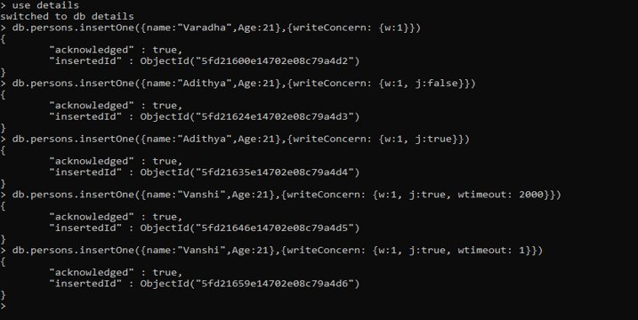
INSERT – WRITE CONCERN

Slide 14
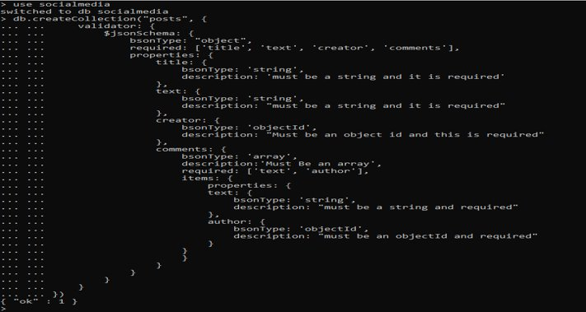
VALIDATIONS

Slide 15
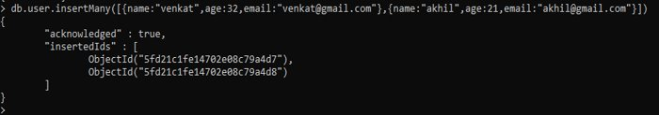

Slide 16
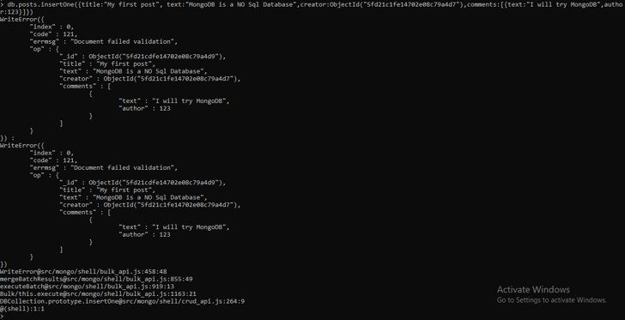
VALIDATOR SCHEMA TEST

Slide 17
