Slide 2
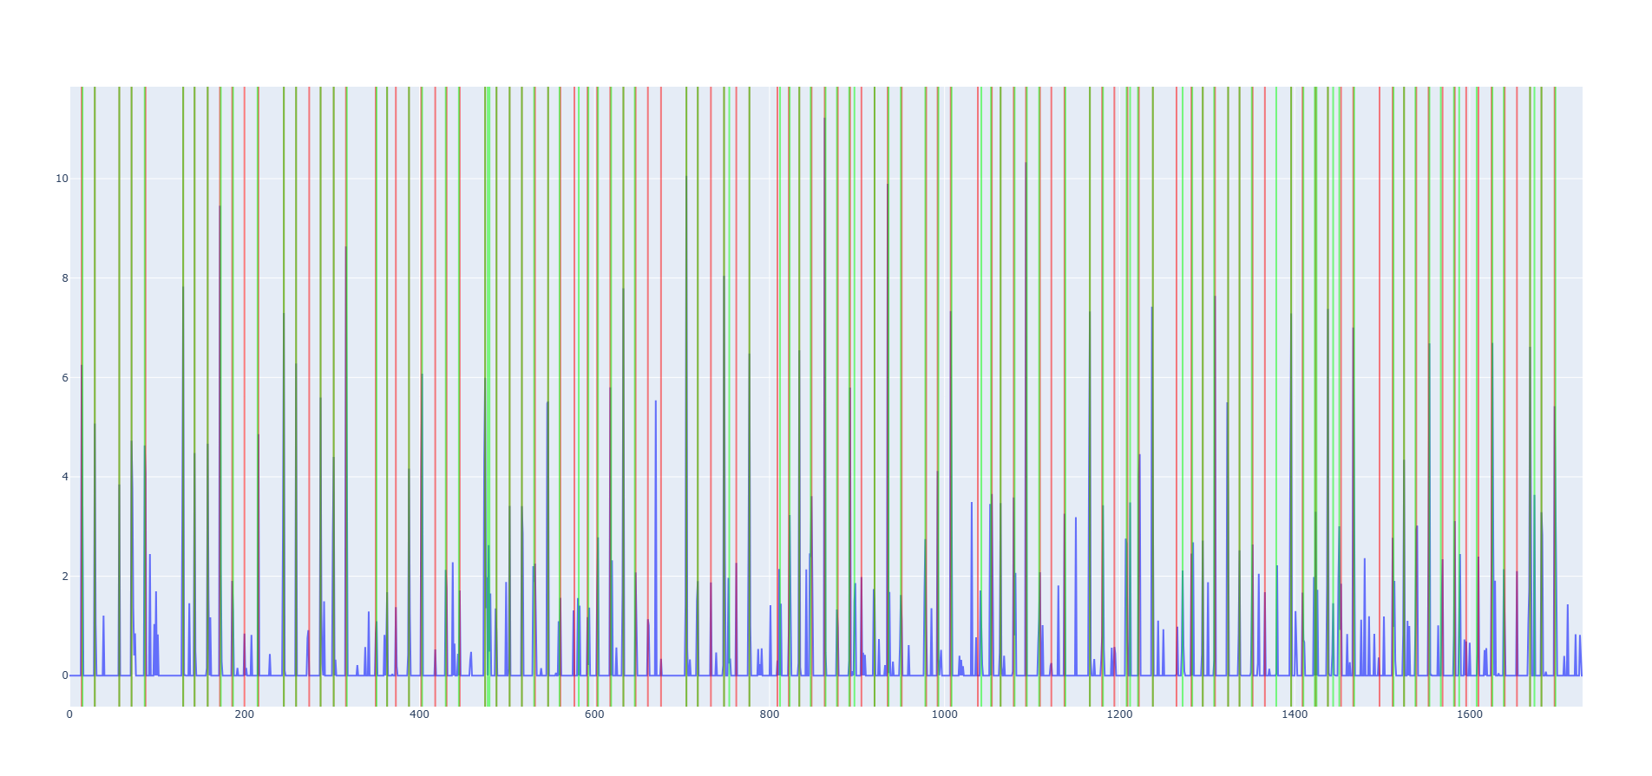
Team C by Tobias Halmdienst, Jakob Seibezeder, Theresa König
Onset detection
CNN architecture
4 convolutional layers
Max Pooling, Batch Normalization, GELU activation
Weighted loss in training
Custom peak detection
Constant threshold
Moving average smoothing
Tempo Estimation
Autocorrelation function on learned onset function
Experiments with spectral flux and autocorrelation on mel-spectrograms
Beat detection
CNN architecture (same as for onsets)
Weighted loss in training
Experiments with multiple agent beat detection algorithms

Slide 3
Team C by Tobias Halmdienst, Jakob Seibezeder, Theresa König
Onset detection
CNN architecture
4 convolutional layers
Max Pooling, Batch Normalization, GELU activation
Weighted loss in training
Custom peak detection
Constant threshold
Moving average smoothing
Beat detection
CNN architecture (same as for onsets)
Weighted loss in training
Experiments with multiple agent beat detection algorithms
Tempo Estimation
Autocorrelation function on learned onset function

Slide 4
Team C by Tobias Halmdienst, Jakob Seibezeder, Theresa König
Onset detection
CNN architecture
4 convolutional layers
Max Pooling, Batch Normalization, GELU activation
Weighted loss in training
Custom peak detection
Constant threshold
Moving average smoothing
Beat detection
CNN architecture (same as for onsets)
Weighted loss in training
Experiments with multiple agent beat detection algorithms
Tempo Estimation
Autocorrelation function on learned onset function
Experiments with spectral flux

Slide 5
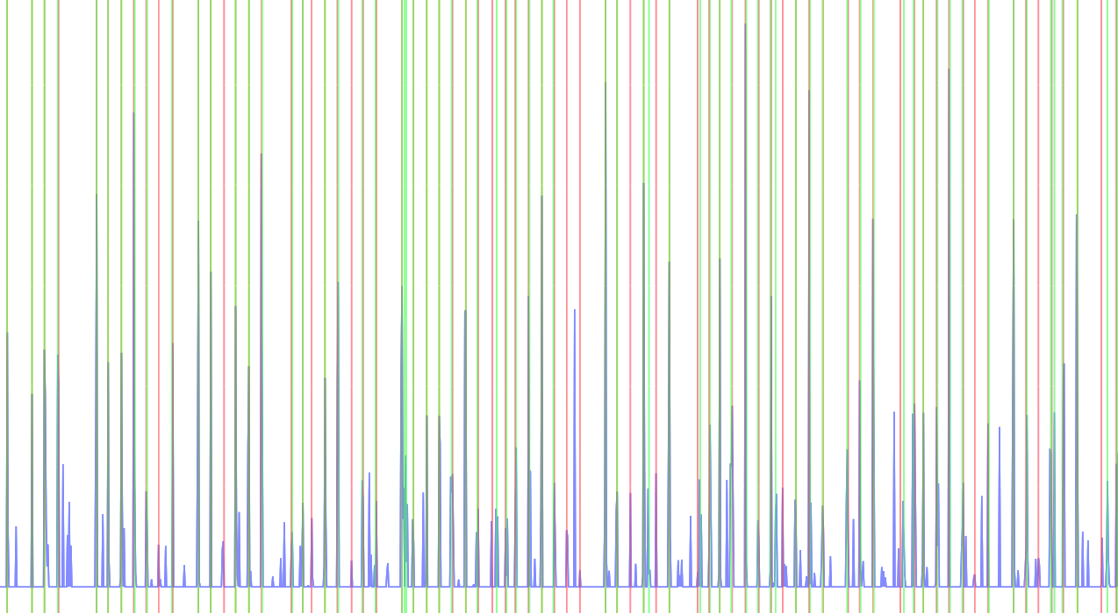
Team C by Tobias Halmdienst, Jakob Seibezeder, Theresa König
Beat Detection
CNN architecture
4 convolutional layers
Max Pooling, Batch Normalization, GELU activation
Weighted loss in training
Custom peak detection
Constant threshold
Moving average smoothing
Tempo Estimation
asdf
Beat Detection
CNN architecture (same as for onsets)
Weighted loss in training
Experiments with multiple agent beat detection algorithms

