Slide 1
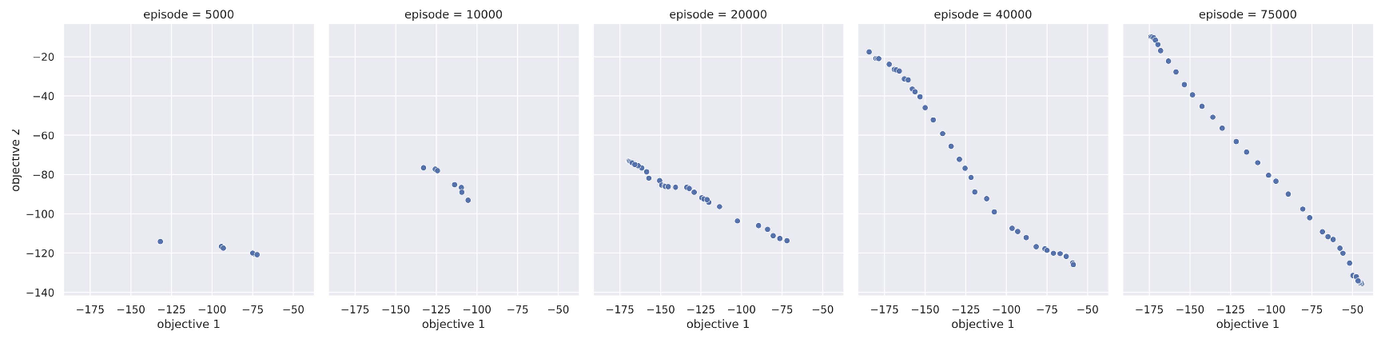
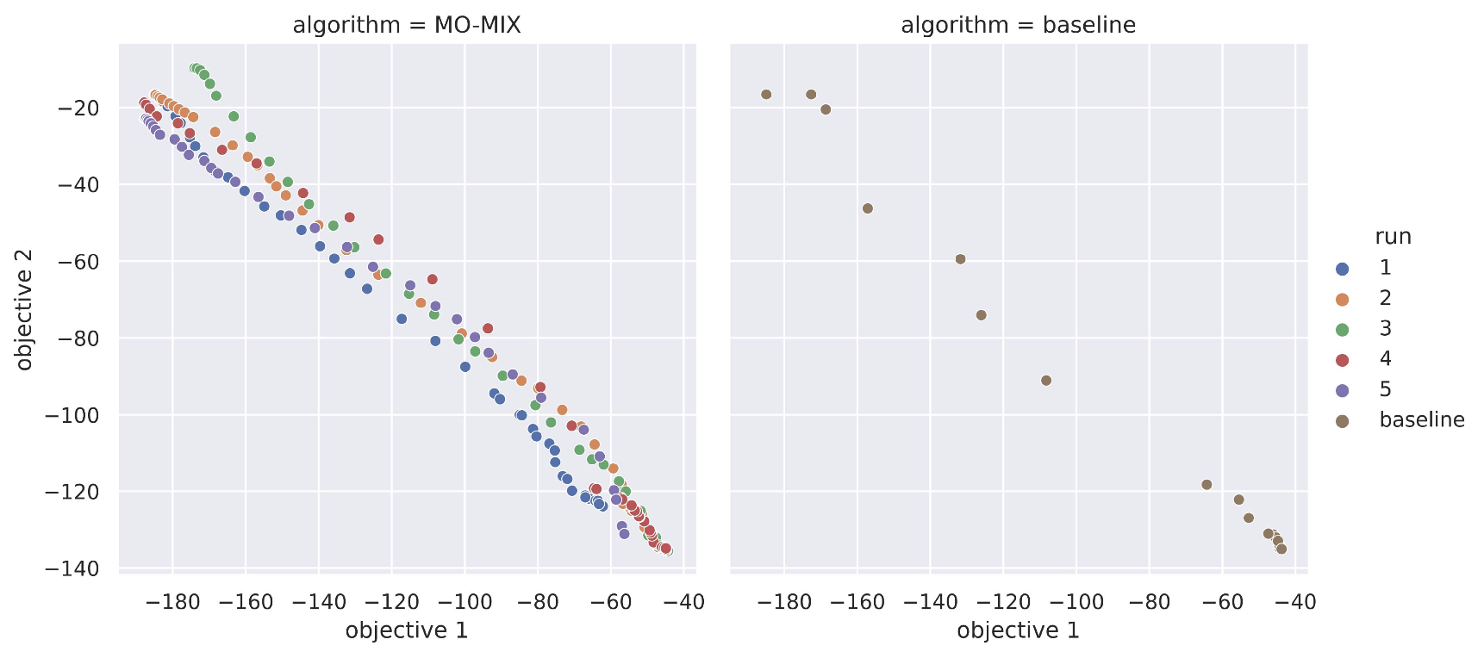
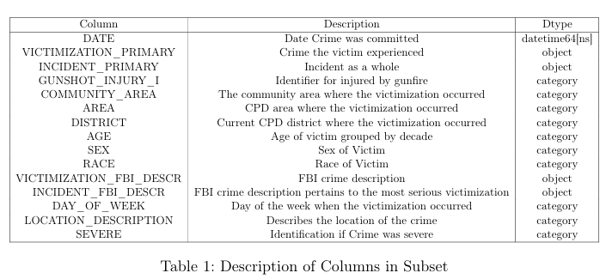
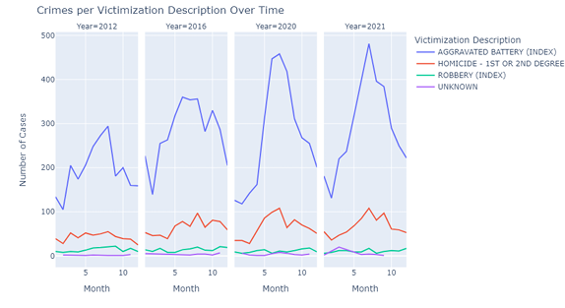
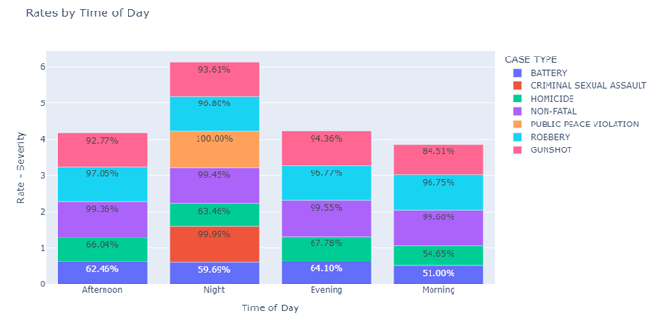
Title such as Victims of Homicides and Non-Fatal Shootings
Group 0
Mira Musterfrau¹, Max Mustermann¹, Mee Too¹, … Last Author¹
¹University of Applied Sciences Technikum Wien
Introduction
Title of Hypothesis 2
Crime victimization data in Chicago serves as a critical window into urban safety dynamics. Several research has been conducted in …
We design an outer-loop multi-objective approach for comparison. It uses an outer loop to search for preferences and uses QMIX to learn policies. To ensure a fair comparison, both the baseline method and our proposed method are tested and compared in the same environment settings.
The movement of the non-dominated set during the entire training process. The figure shows the non-dominated set for episodes 5,000, 10,000, 20,000, 40,000, and 75,000 respectively.
Dataset Description
The Dataset [1]
Many real-world problems have multiple conflicting objectives, which cannot be optimal at the same time. Therefore, single RL policy must trade-off between different objectives.
Several research has been conducted in the field of single-agent multi-objective RL, but existing approaches cannot solve the multi-agent multi-objective decision-making problem.
Hypothesis N
When assessing yearly total counts per Victimization Description, there are distinct spikes that remain consistent across all crime types. Notably, these peaks are observed in the years 2012, 2016, and 2020, coinciding with presidential election years. However, the surge observed in 2021 requires further scrutiny. Notably, the most significant disparities between the mentioned years are observed in crimes categorized as "Aggravated Battery".
Demographics and Incident Severity
Many real-world problems have multiple conflicting objectives, which cannot be optimal at the same time. Therefore, single RL policy must trade-off between different objectives.
Conclusion
We propose MO-MIX, a novel MOMARL method which aims to solve the multi-objective multi-agent cooperative decision-making problem with continuous state space. In the experiments, the MO-MIX algorithm clearly outperforms the baseline in all evaluation metrics, while requiring much fewer training steps.
Currently, our algorithm is tested in the case with two con- flicting objectives. For three or more objectives, the algorithm is theoretically able to be applied.
In future work, we aim to explore more complex multi-objective multi-agent problems with more difficult tasks or more diversity of objectives.
References:
Eurostat European Union. Healthy life years from birth. 2023. URL: https://ec.europa.eu/eurostat/databrowser/view/HLTH_HLYE/default/table?lang=en (visited on 09/12/2023).

