Slide 1
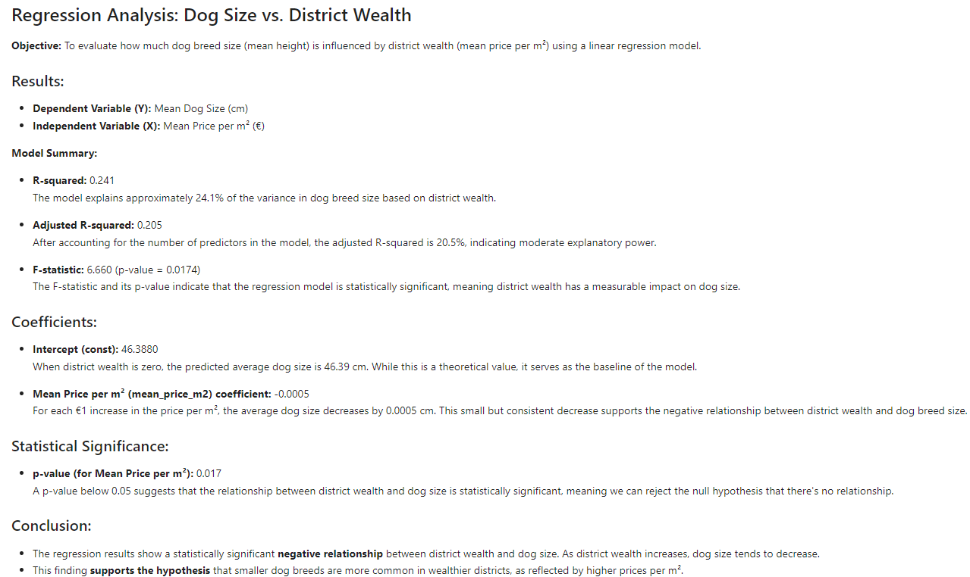
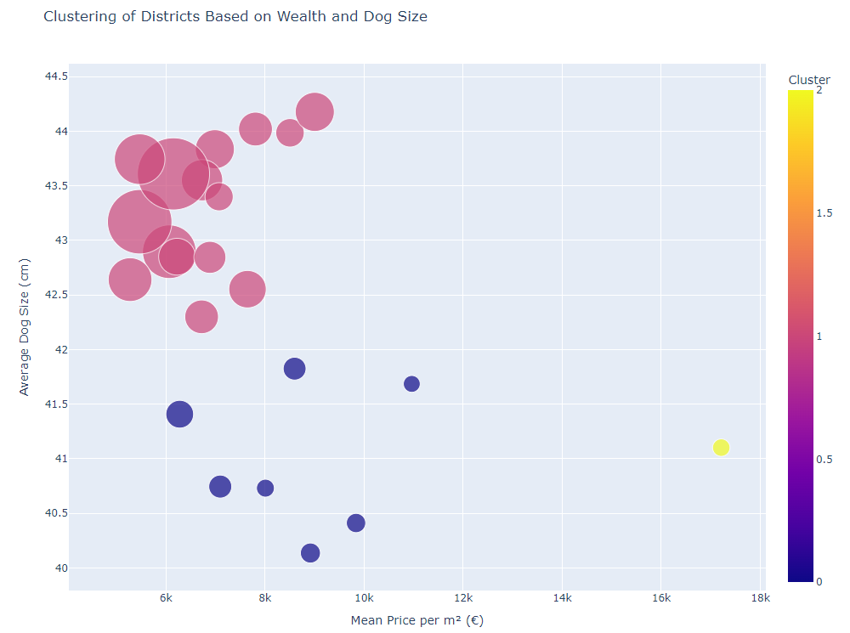
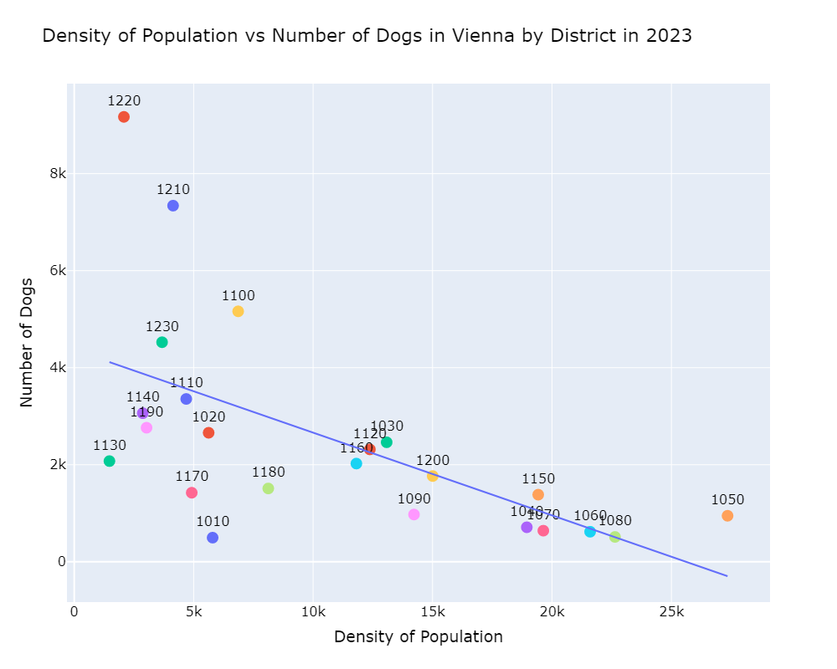
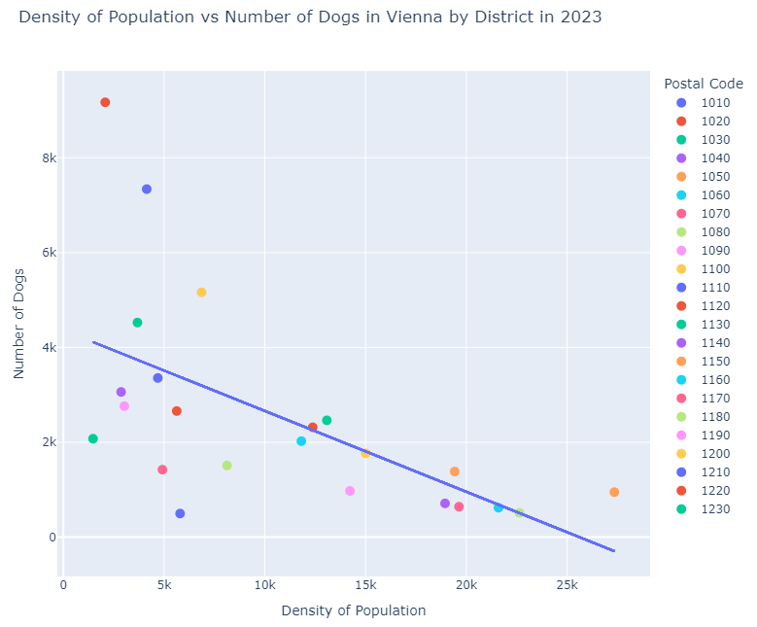
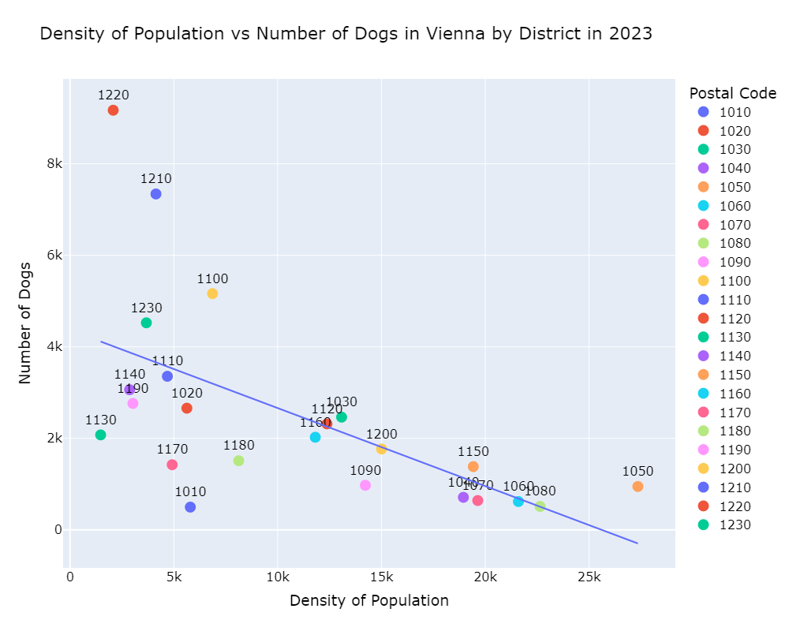
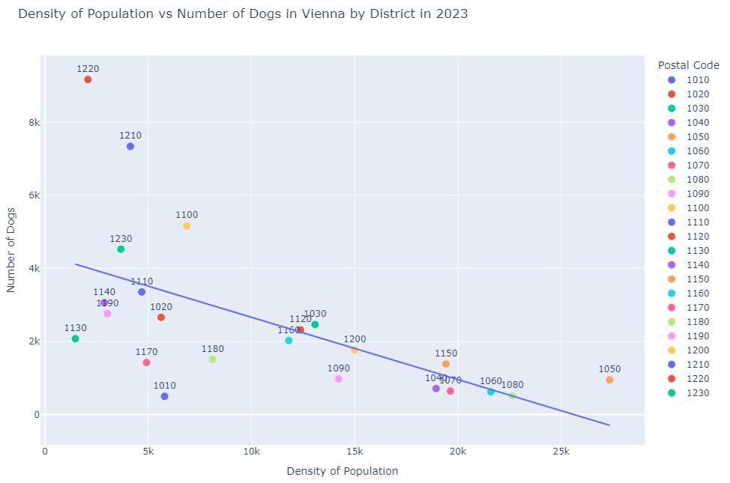
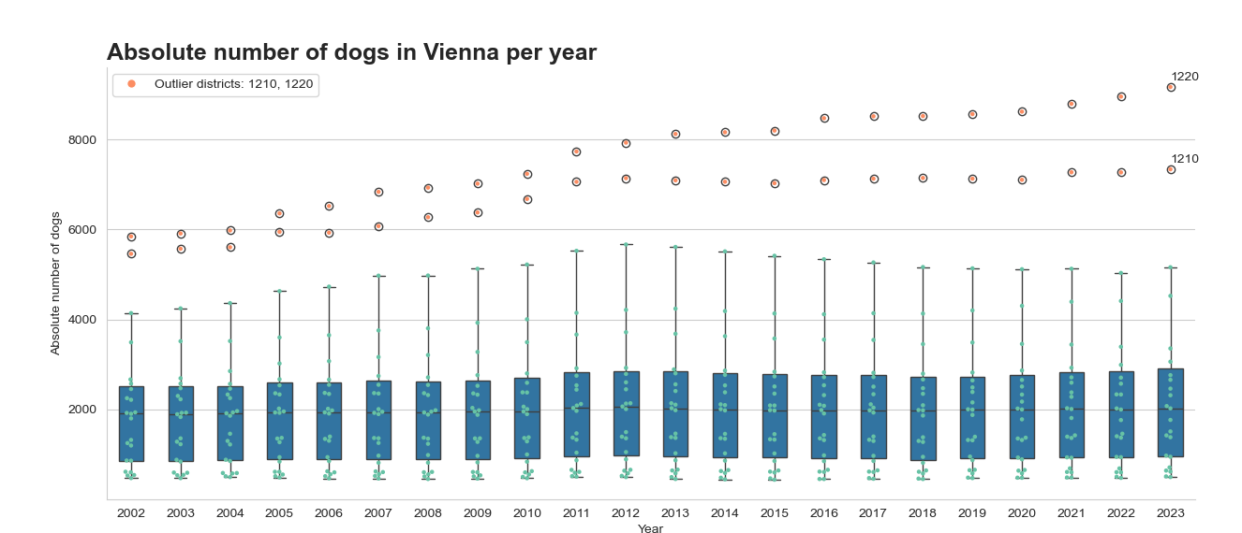
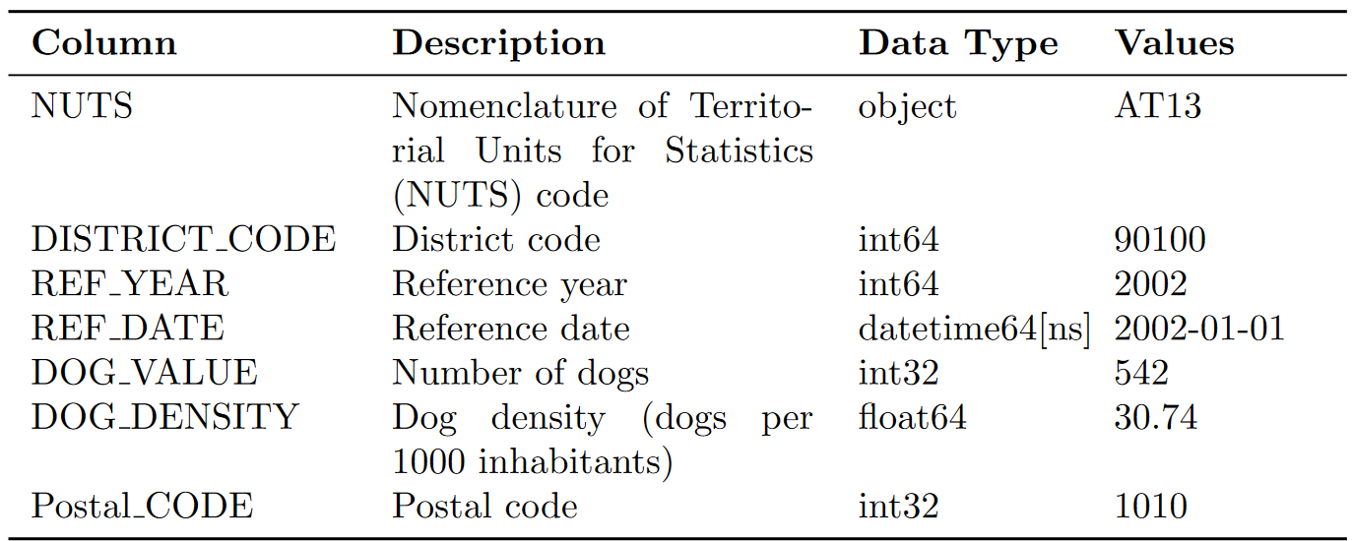
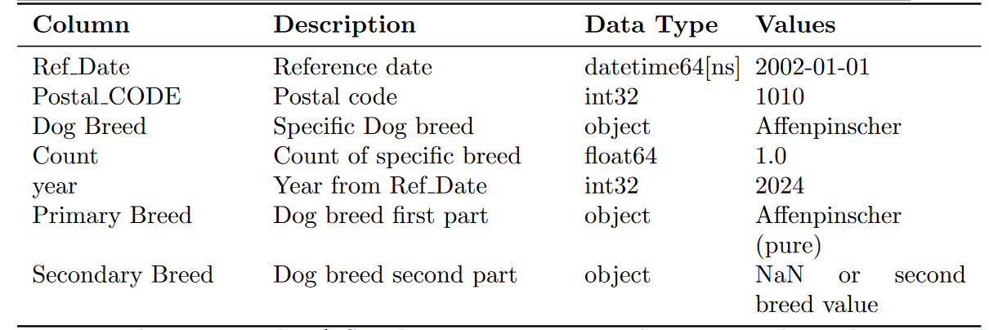
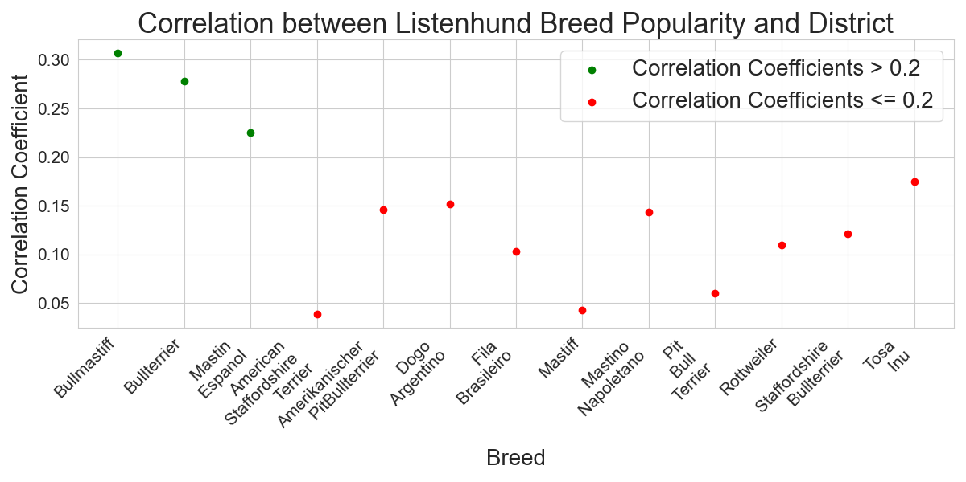
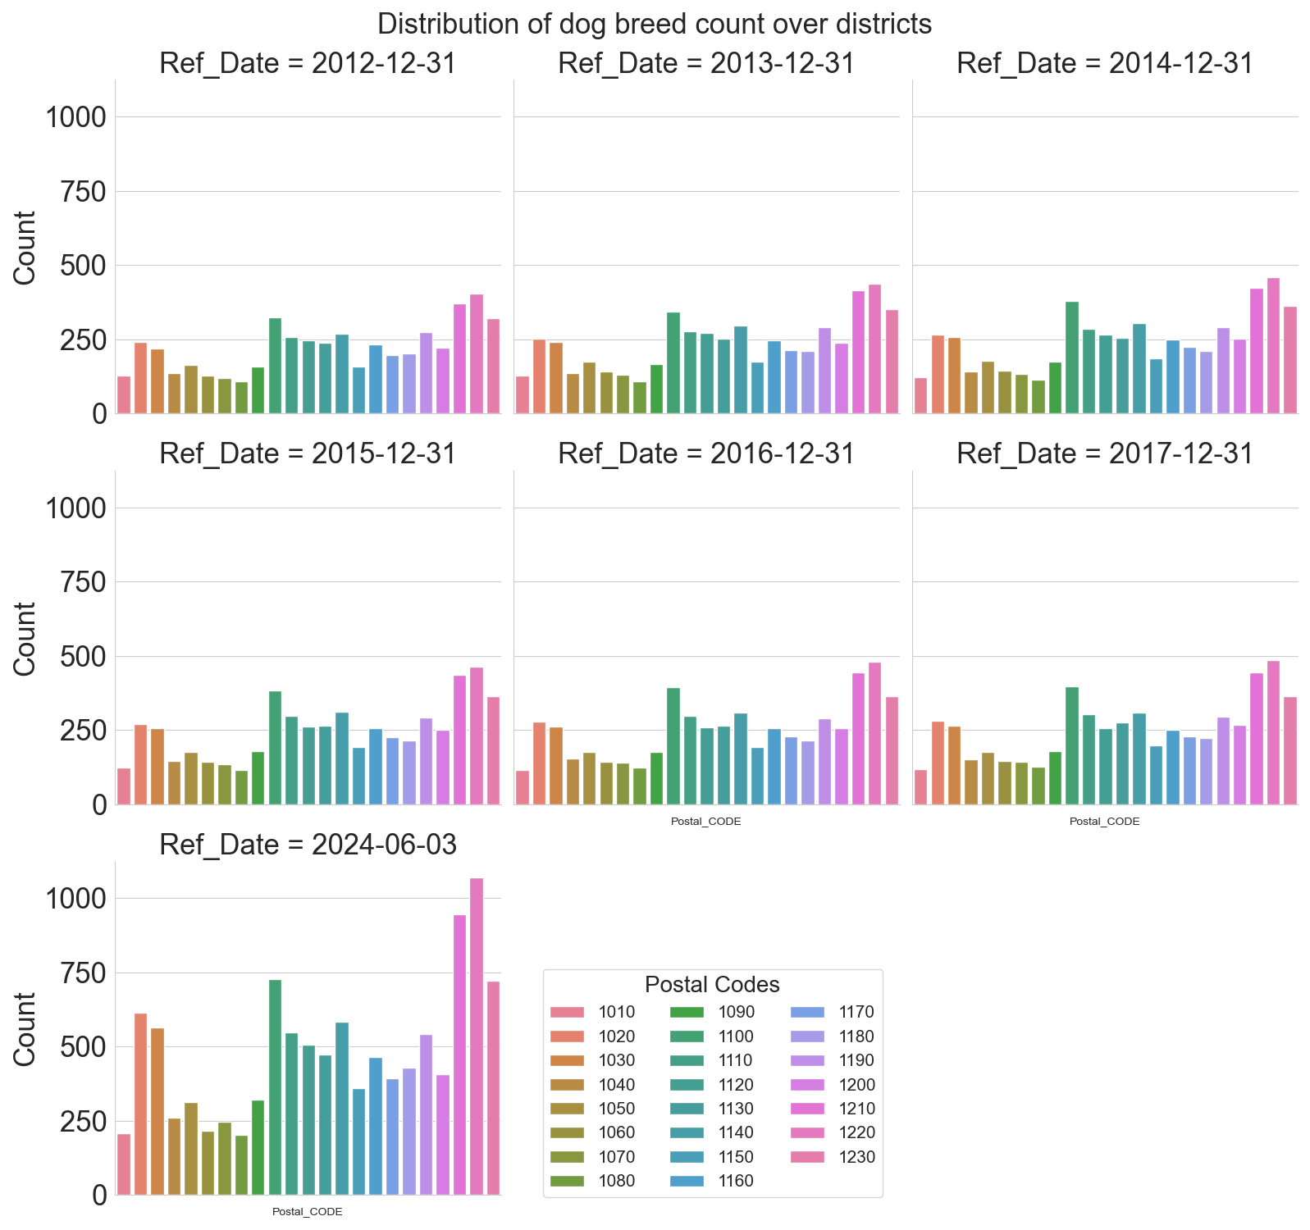
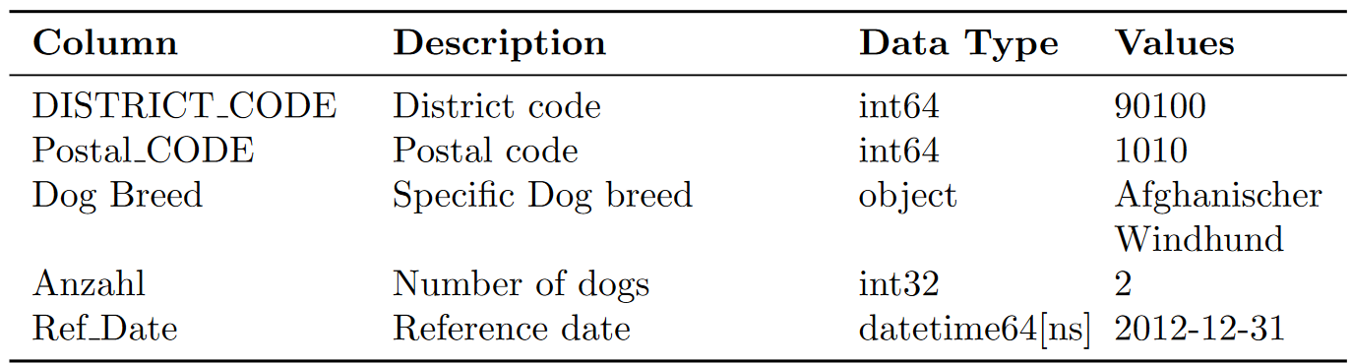
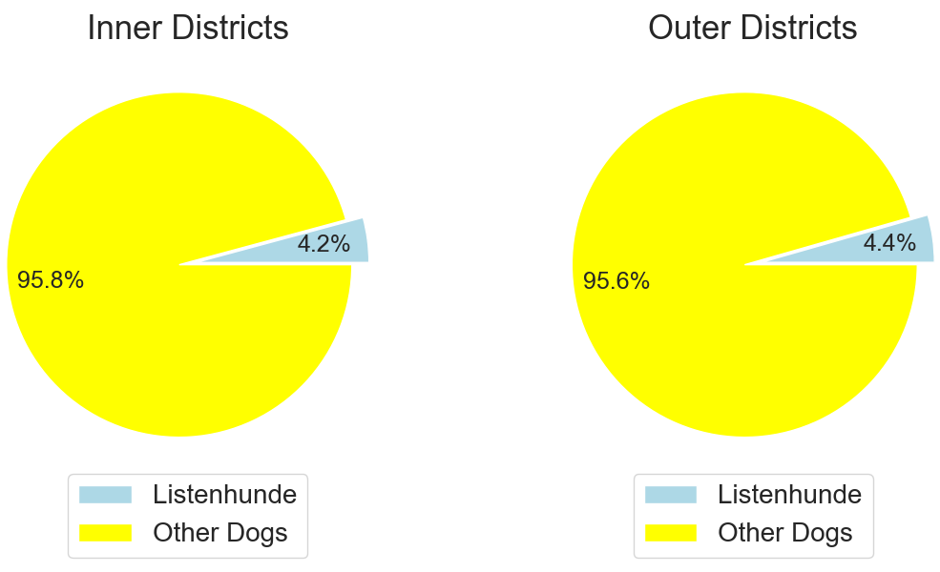
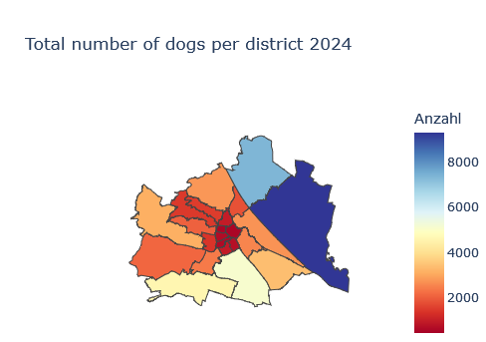
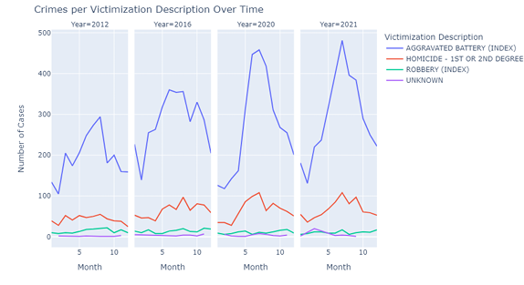
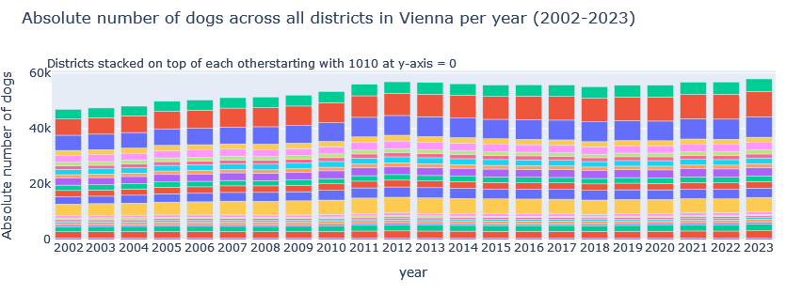
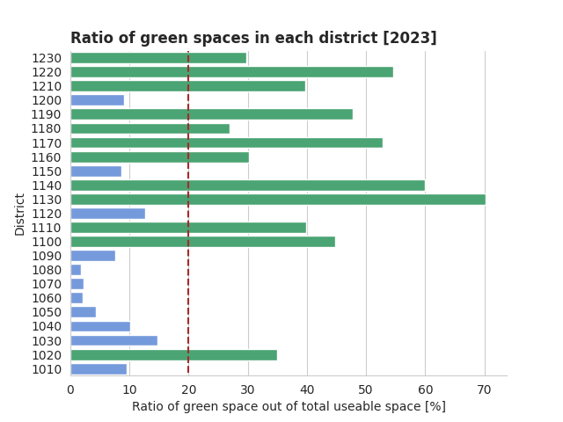
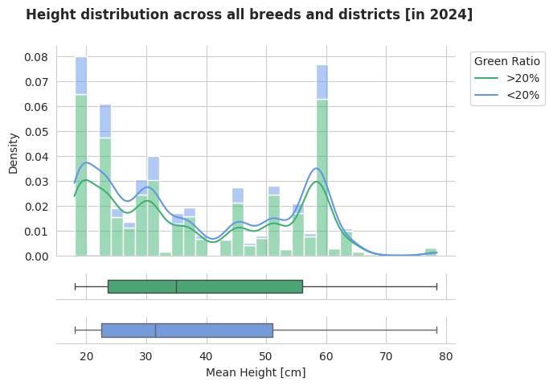
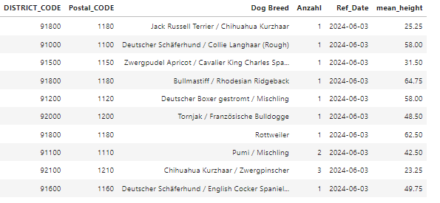
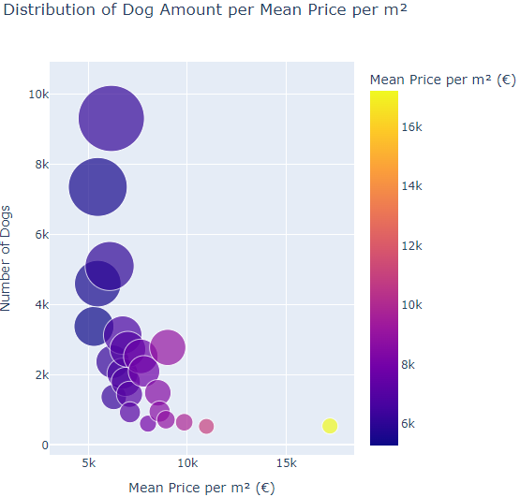
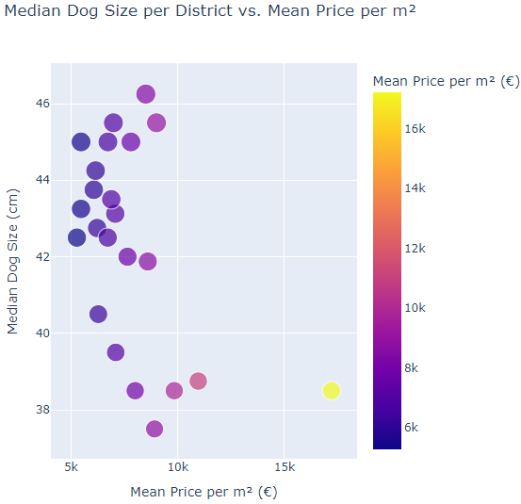
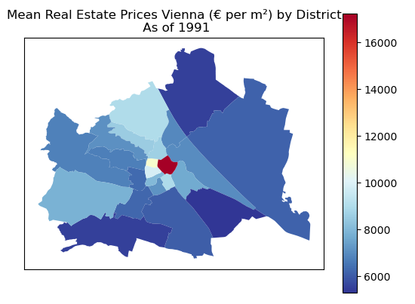
Dogs in Vienna – an Exploration
Group 4
Carlos Eduardo Tichy, Theresa Spiel, Martin Stasek, Anna Marie Punzengruber, Anna Till
University of Applied Sciences Technikum Wien
Introduction
Hypothesis 1 - Continuation
Hypothesis 4
Dog ownership in Vienna is very popular. In order to explore this Group’s several hypotheses, three Datasets were explored: One containing the aggregated density of dogs per district as well as absolute number since 2002, the other two containing the count of individual dog breeds per district. The latter were combined to one dataset, since it contained the same info for different reference years.
Dog ownership is inversely correlated with population density in Vienna districts
To confirm the inverse correlation, the Pearson correlation coefficient was calculated, resulting in a value of -0.61.
Conclusion:
The graph shows a negative correlation between the population density and the number of dogs in the districts of Vienna.
Datasets Description
Dataset 1:
Structure description
Dog distribution (absolute)
Hypothesis 2
Assumption: There is a positive correlation between the ownership of Listenhunde and district, with a higher prevalence of Listenhunde ownership in outer Viennese districts compared to inner districts.
Dataset 2 & 3
Hypothesis 5
2) The difference of relative percentage of Listenhunde in outer vs. inner districts is only ~ 0.2 %.
When assessing yearly total counts per Victimization Description, there are distinct spikes that remain consistent across all crime types. Notably, these peaks are observed in the years 2012, 2016, and 2020, coinciding with presidential election years. However, the surge observed in 2021 requires further scrutiny. Notably, the most significant disparities between the mentioned years are observed in crimes categorized as "Aggravated Battery".
1) There is only a weak correlation between district and Listenhund for three Listenhund breeds (0.2 – 0.35) and less for the others.
Answer:
There is no positive correlation between the ownership of Listenhunde and the district.
Hypothesis 3
The height of registered dogs correlates positively with the ratio of green
space in a district.
Conclusion
Hypothesis 1
We propose MO-MIX, a novel MOMARL method which aims to solve the multi-objective multi-agent cooperative decision-making problem with continuous state space. In the experiments, the MO-MIX algorithm clearly outperforms the baseline in all evaluation metrics, while requiring much fewer training steps.
Currently, our algorithm is tested in the case with two con- flicting objectives. For three or more objectives, the algorithm is theoretically able to be applied.
In future work, we aim to explore more complex multi-objective multi-agent problems with more difficult tasks or more diversity of objectives.
The prevalence of specific dog breeds in Vienna is strongly influenced by real estate prices.
Green districts: Threshold chosen at 20% green space => 12 vs. 11 districts
Results:
Slight shift of 1st, 2nd and 3rd quartile to higher heights in greener districts
Pearson-Coefficient: only 0.072 (!)
But: Significant difference in abs. number of dogs
Conclusion:
No significant correlation
Deeper investigation necessary
References:
Eurostat European Union. Healthy life years from birth. 2023. URL: https://ec.europa.eu/eurostat/databrowser/view/HLTH_HLYE/default/table?lang=en (visited on 09/12/2023).

