Slide 1
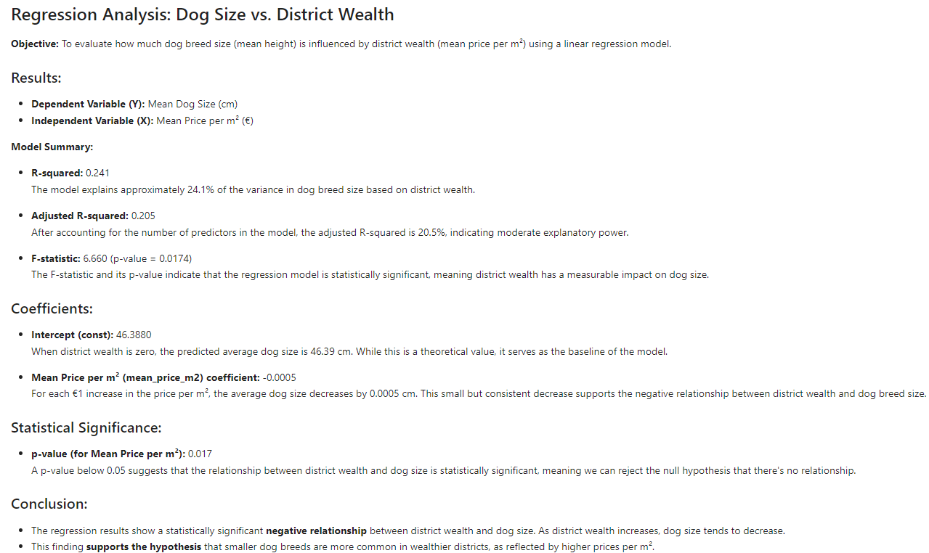
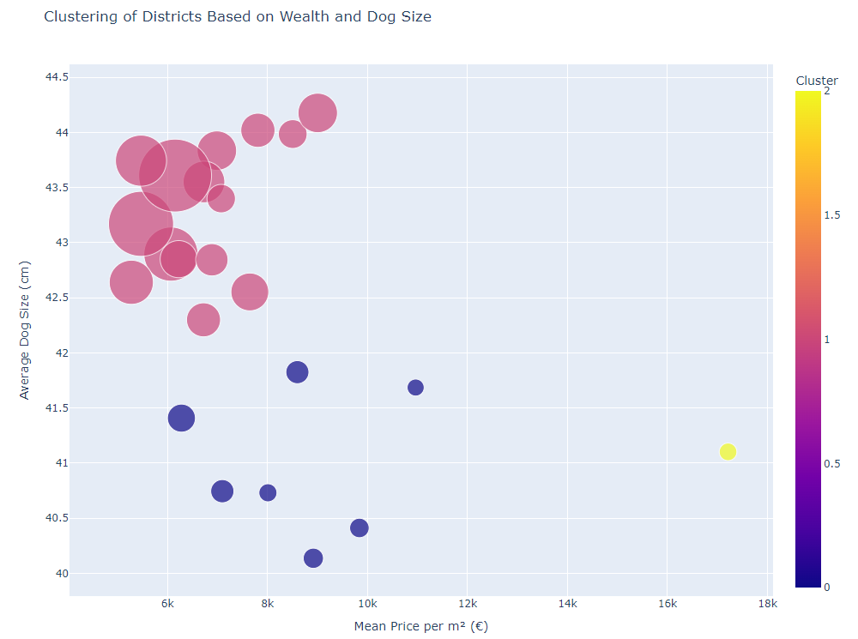
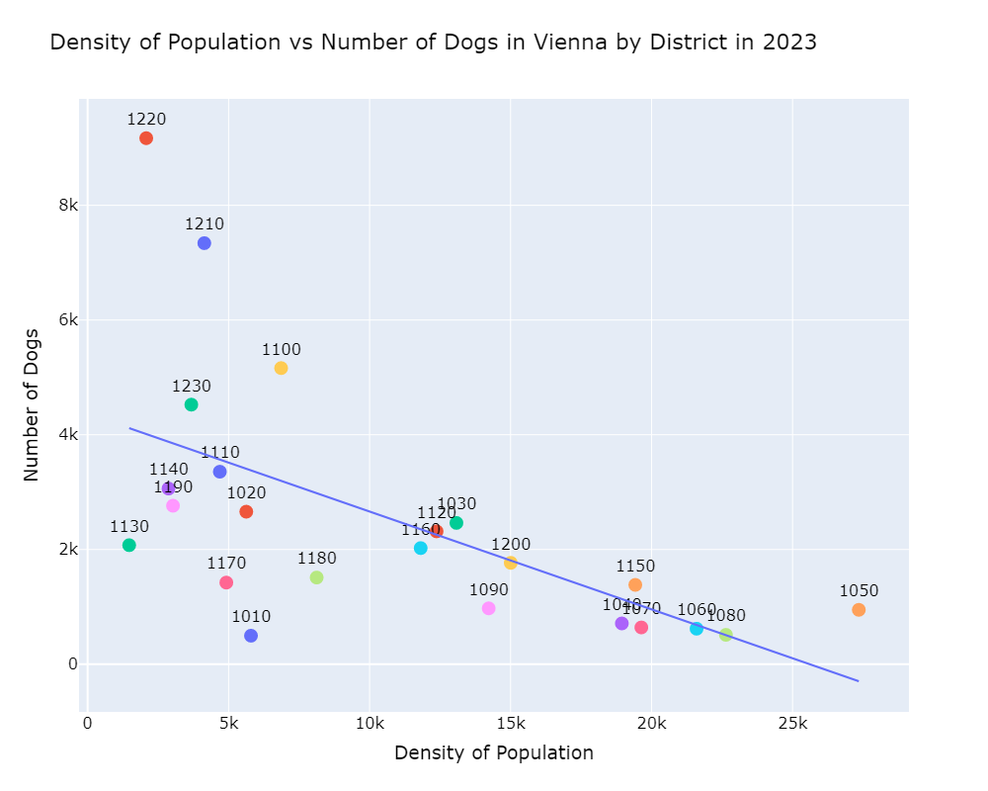
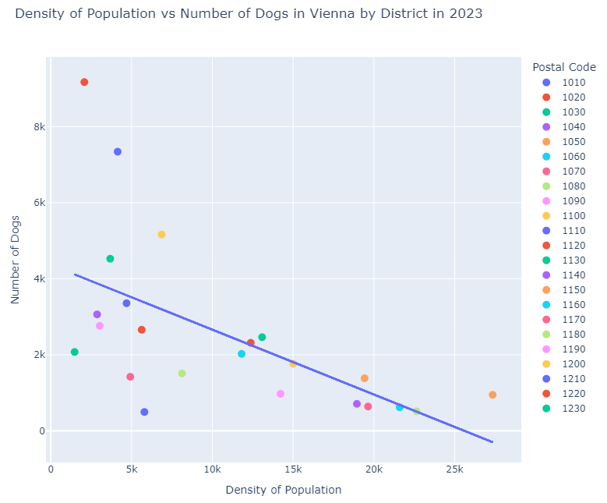
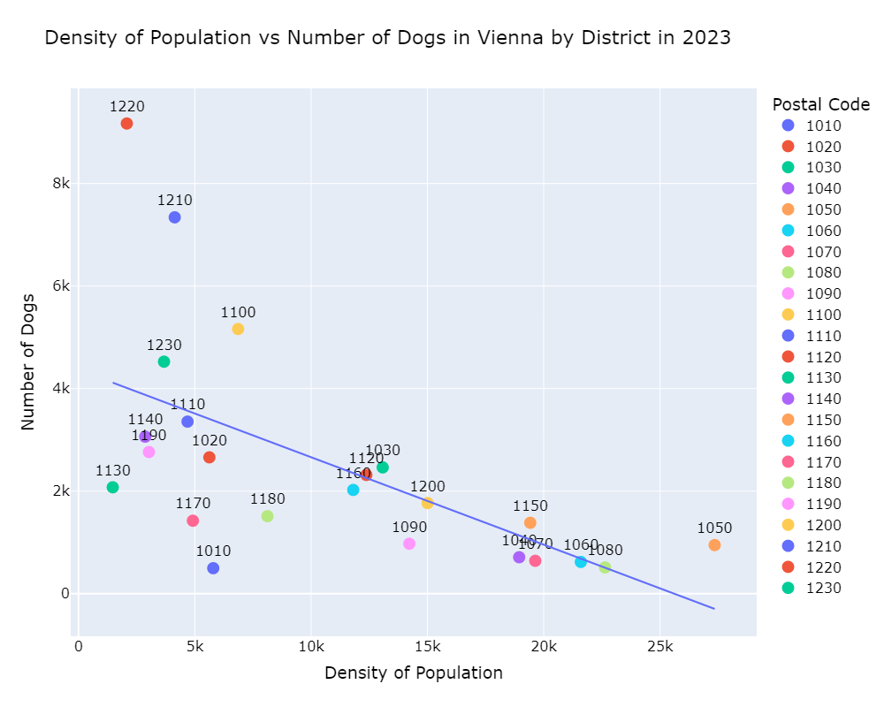
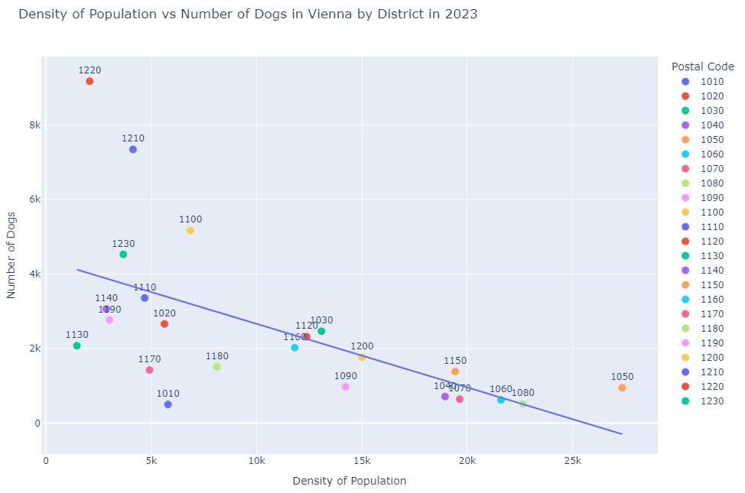
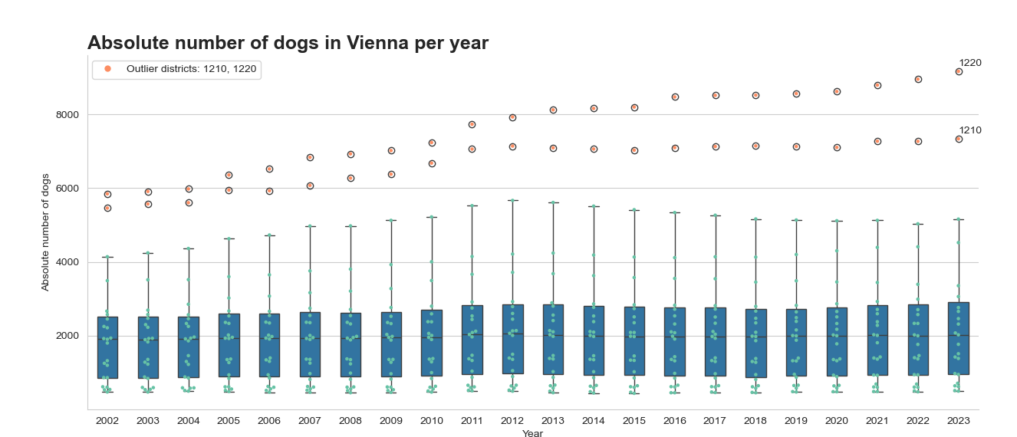
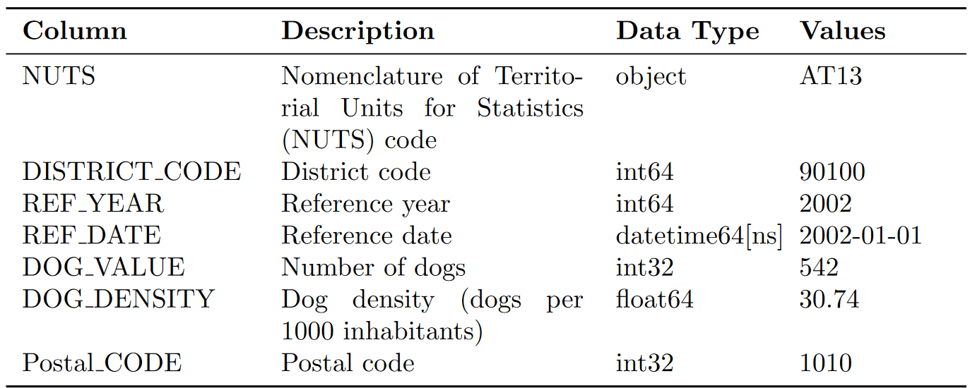
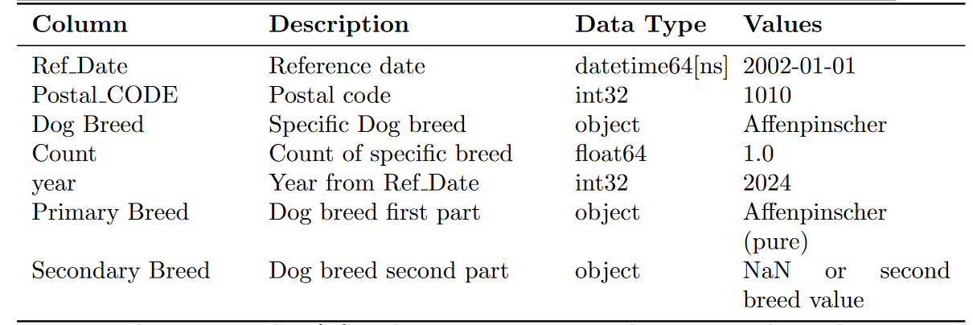
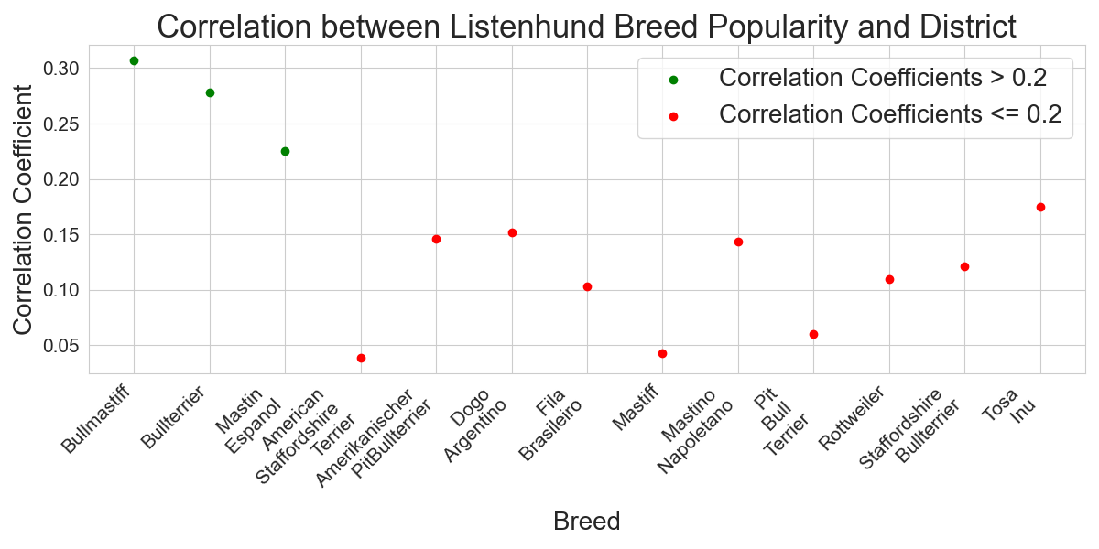
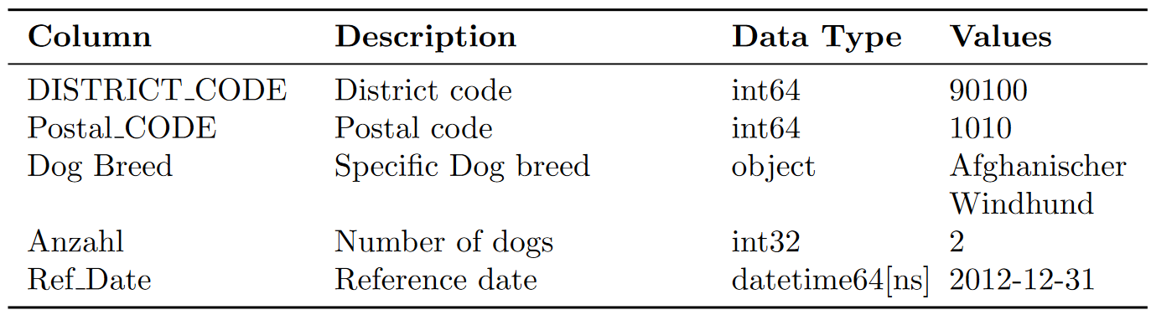
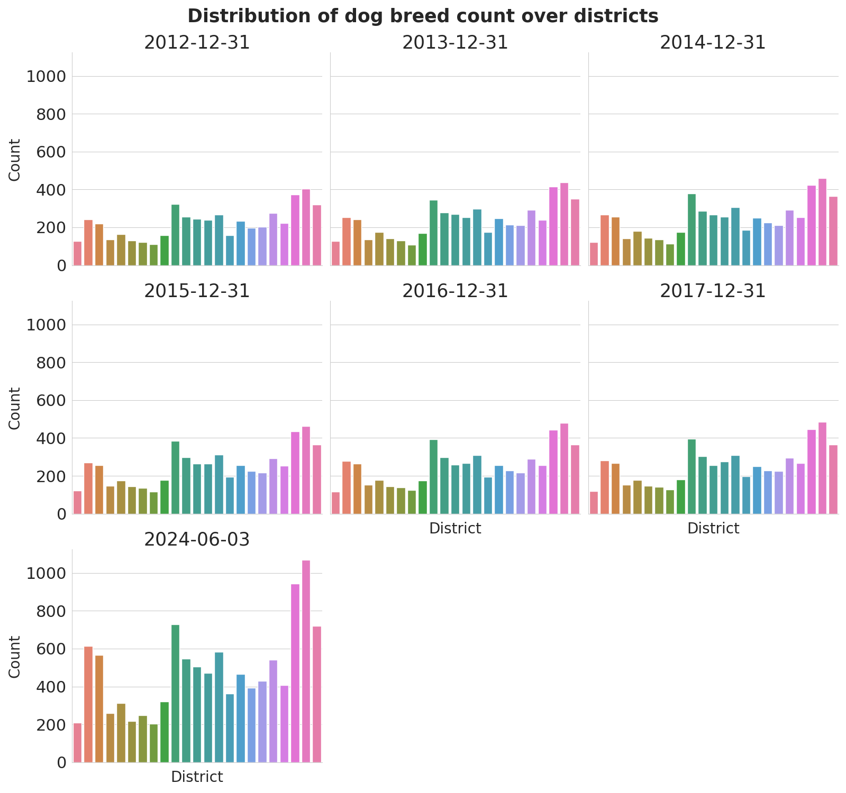
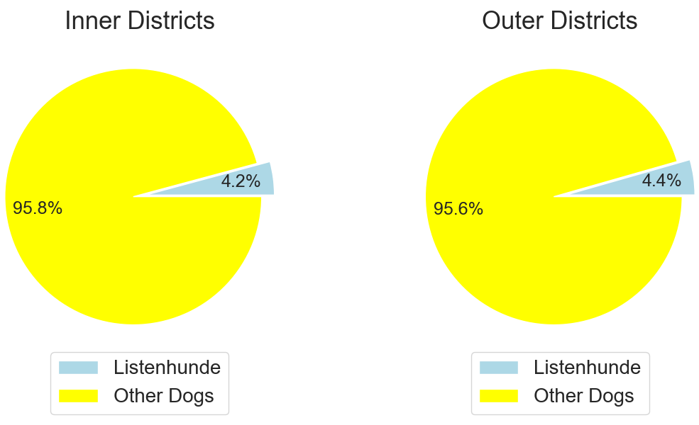
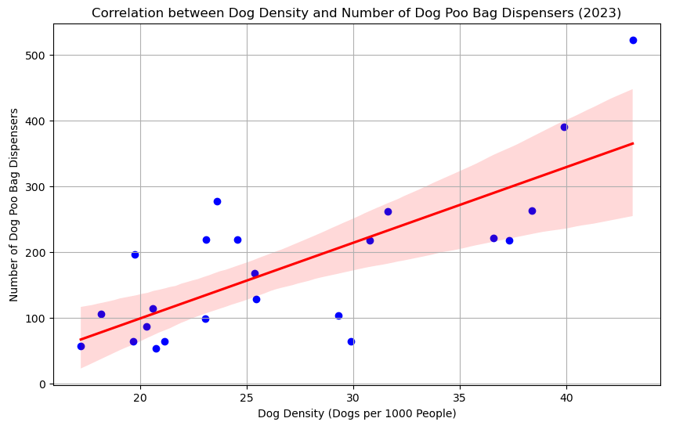
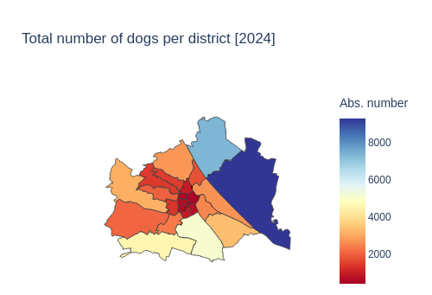
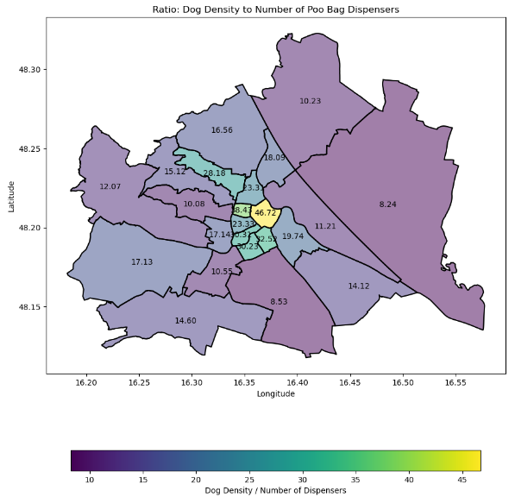
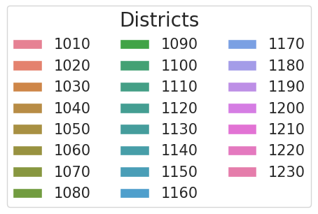
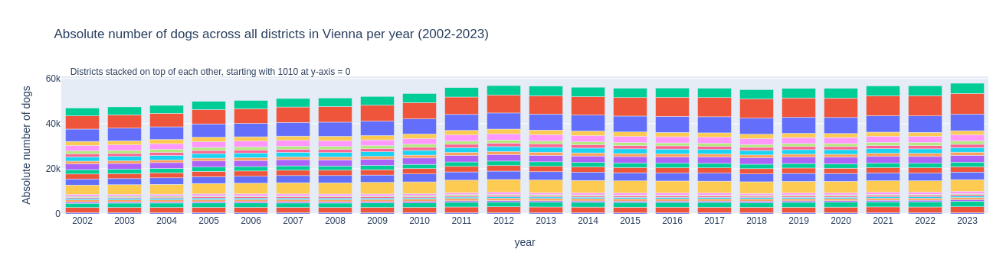
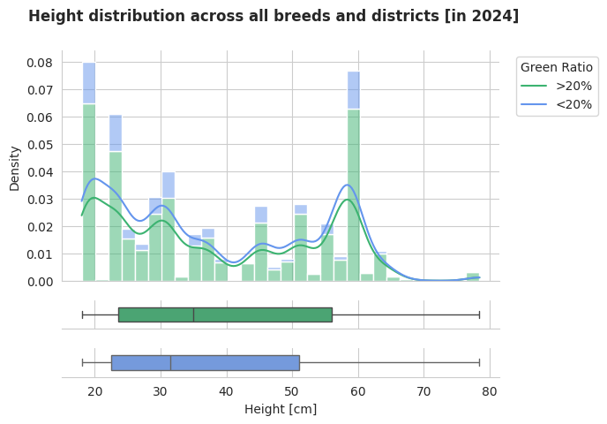
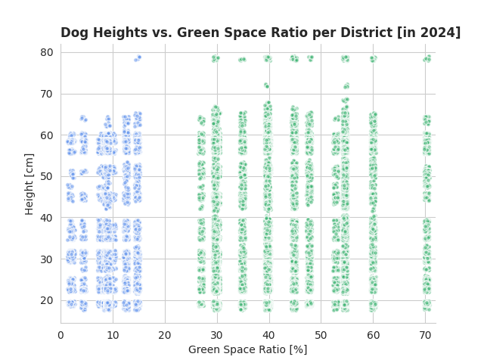
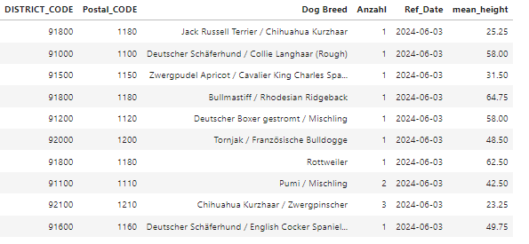
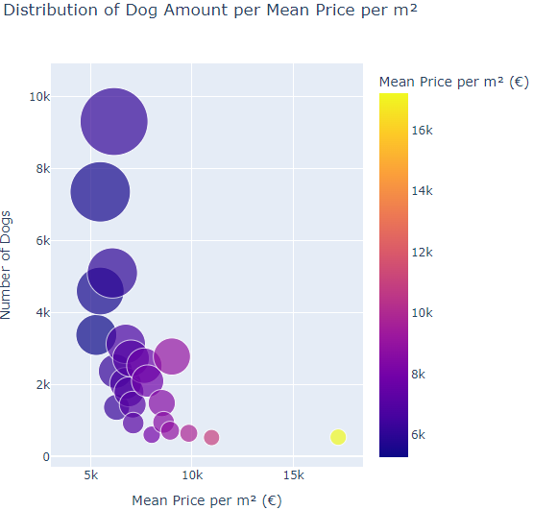
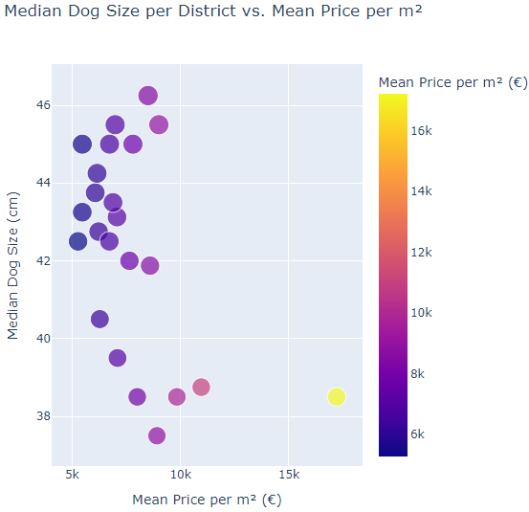
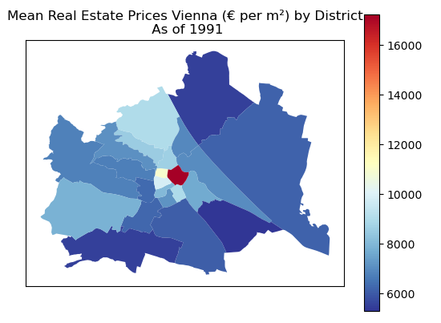
Dogs in Vienna – an Exploration
Group 4
Carlos Eduardo Tichy, Theresa Spiel, Martin Stasek, Anna Marie Punzengruber, Anna Till
University of Applied Sciences Technikum Wien
Introduction
Hypothesis 1 - Continuation
Hypothesis 4
Dog ownership in Vienna is very popular. In order to explore this Group’s several hypotheses, three Datasets¹ were explored: One containing the aggregated density of dogs per district as well as absolute number since 2002, the other two containing the count of individual dog breeds per district. The latter were combined to one dataset, since it contained the same info for different reference years.
Dog ownership is inversely correlated with population density in Vienna districts
To confirm the inverse correlation, the Pearson correlation coefficient was calculated, resulting in a value of -0.61.
Conclusion:
The graph shows a negative correlation between the population density and the number of dogs in the districts of Vienna.
Datasets Description
Dataset 1:
Structure description
Dog distribution (absolute)
Hypothesis 2
There is a positive correlation between the ownership of Listenhunde and district, with a higher prevalence of Listenhunde ownership in outer Viennese districts compared to inner districts.
Dataset 2 & 3
Hypothesis 5
2) The difference of relative percentage of Listenhunde in outer vs. inner districts is only ~ 0.2 %.
The number of dogs in a Viennese district correlates positively with the number of dog waste bag dispensers that district
Results:
Pearson correlation coefficient : 0.70
→ strong correlation
Difference between inner and outer districts
1) There is only a weak correlation between district and Listenhund for three Listenhund breeds (0.2 – 0.35) and less for the others.
Answer:
There is no positive correlation between the ownership of Listenhunde and the district.
Hypothesis 3
The height of registered dogs correlates positively with the ratio of green
space in a district.
Results:
Slight shift of 1st, 2nd and 3rd quartile to higher heights
Correlation-Coeff.:
- [Heights vs. Green Ratio]: only 0.07
- [Mean of all Heights per District vs. Green Ratio]: 0.68
Conclusion
Hypothesis 1
Results:
H1: real estate prices influence choice of dog breed
H2: no correlation between ownership of Listenhunde and district
H3: only upward trend when looking at mean of all heights per district vs green space ratio
H4: negative correlation between dog ownership and population density on district level
H5: strong correlation between dog ownership and number of waste bag dispensers on district level
The prevalence of specific dog breeds in Vienna is strongly influenced by real estate prices.
Conclusion:
No linear relationship between all Heights and Green Space Ratio
Upward trend when looking at mean of heights
References:
Cooperation OGD Österreich. Hundebestand seit 2002 – Bezirke Wien, Hunde pro Bezirk Wien, Hunderassen Wien. URL: https://www.data.gv.at/katalog/dataset/ (visited on 24.09.2024).

