Slide 1
Hypothesis
School Ranking/Number of Schools
Null Hypothesis - If the school ranking is not high then sales the price of property will be median
Alternative Hypothesis - If the school ranking is high then then sales the price of property will be high
Covid Effect
Null Hypothesis - If there was no covid then the sales number and price of property would be high
Alternative Hypothesis - If there is covid the sales number and price of property would be low

Slide 2
Observations
Looking at housing market during covid found changes in sales of %.
The impact 2021 would need further research as we only have data for the first two quarters
Does school ranking impact or number of schools the price of the property and number of properties sold in the area
Is purchase price and sell number and rent number impact by bank interest rate by how much
Has the number of list and sold change of the past two years
Have purchases increased/decreased between 2019 – 2021
What has caused the increase or decrease? (covid, loan interests, schools)
Does the median price of the rent have relationships with price of sold?
Does the list of rent have relationships with price of sold
What is the most popular suburb or type of dwelling? (government, catholic, private)
The outliners of 2019-2021 in Highest sell price, median sold price

Slide 3
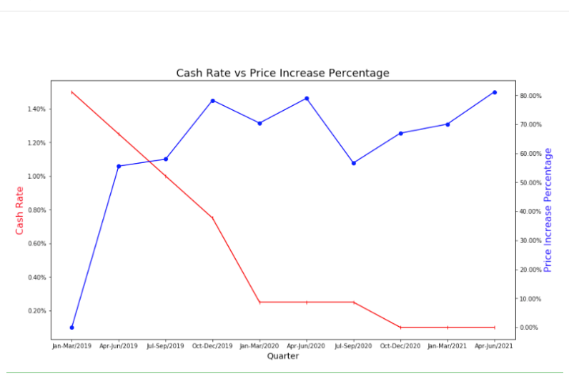
1.Do purchase price and sell number and rent number impact by bank interest rate (base on quartly data and bank interest rate, line chart) –Echo

Slide 4
2.In three different years, compare whole number of list and sold (use sum up value, bar chart) -therese

Slide 5
3.Have purchases increased/decreased between 2019 - 2021 (quartly, median sell price, listing, sold) - therese?

Slide 6
*4.What has caused the increase or decrease? (covid, loan interests, schools)

Slide 7
5.Does the quantity of the schools has anything do with the property price? Or just the quality of the schools? (heatmap of schools and heatmaps of price, heatmaps of median price with markers of top ranking schools) - Rachel

Slide 8
6.Does the median price of the rent has relationships with price of sold?(scatter plot, linear regression) - Anjali

Slide 9
7.Does the list of rent has relationships with price of sold?(scatter plot, linear regression) - Anjali

Slide 10
8.What is the most popular suburb or type of dwelling? (heatmap-googlemap geo module, marker about school (government, catholic, private) - Rachel

Slide 11
9.The outliners of 2019-2021 in Highest sell price, median sold price (boxplot, maybe highlight the outliner) - Echo

