Slide 1





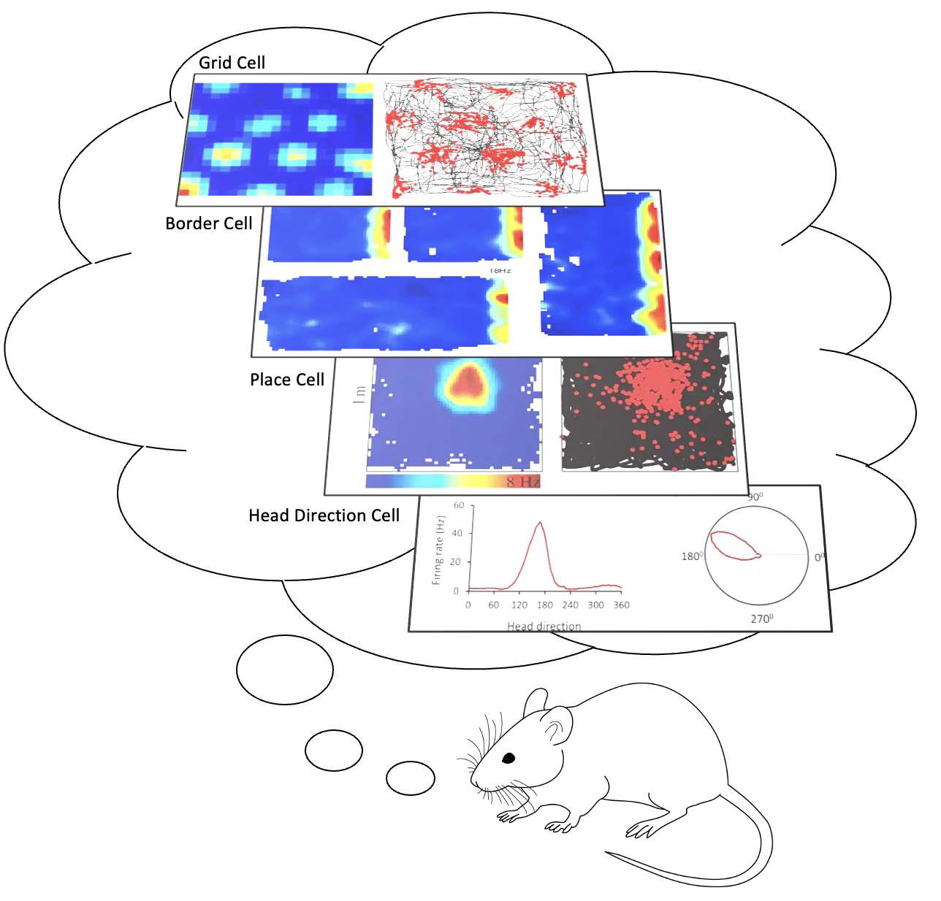
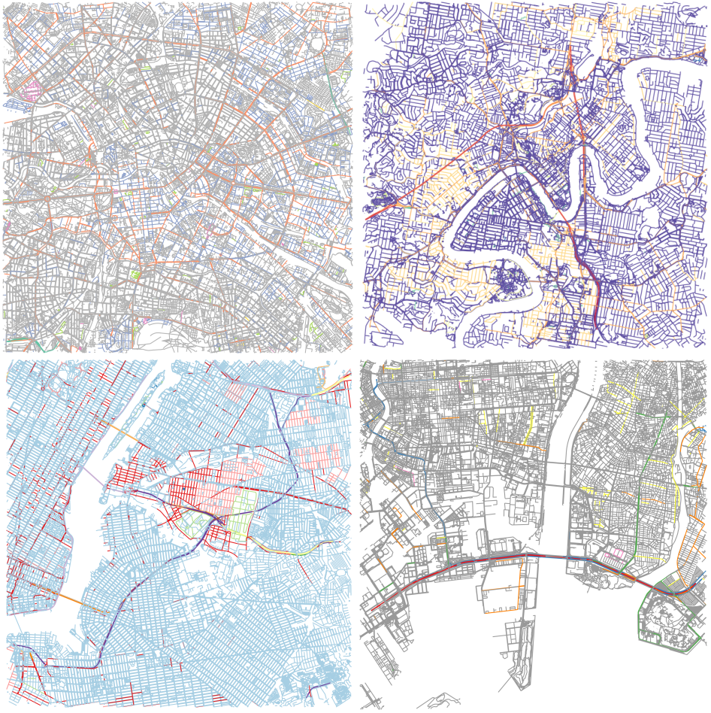
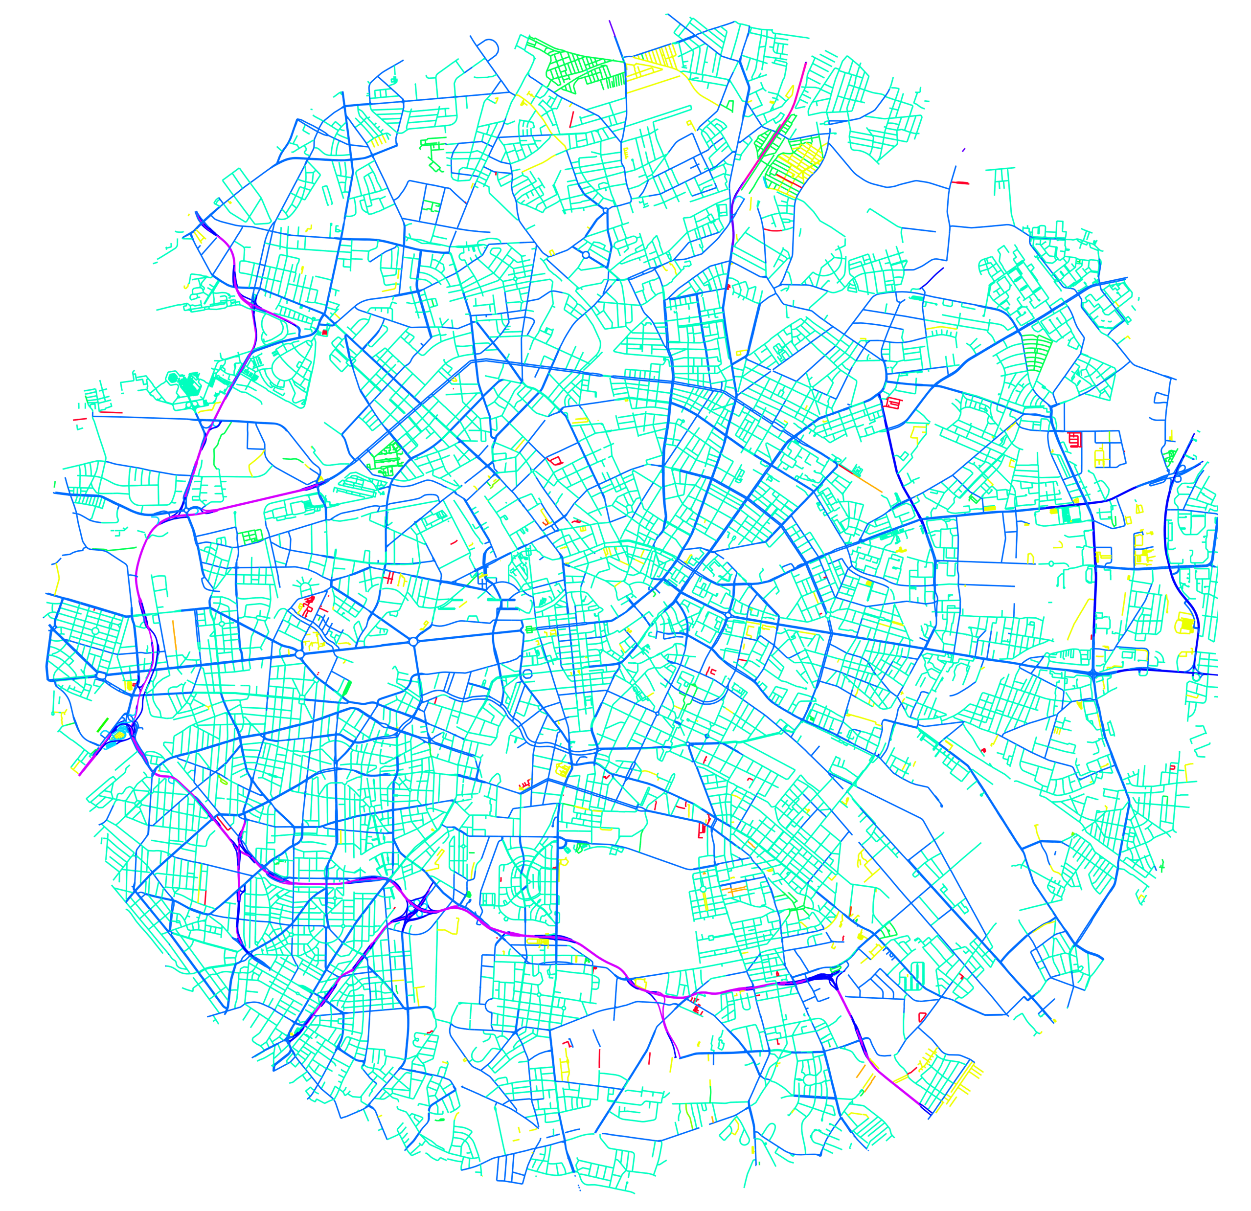
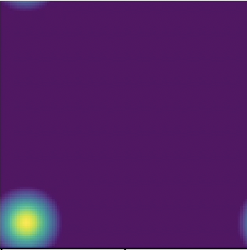
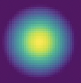
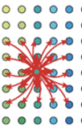
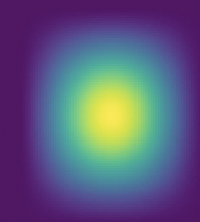
Email: t2.joseph@hdr.qut.edu.au
https://github.com/theresejoseph/Trajectory_Tracking_via_MCAN.git
Trajectory Tracking via Multiscale Continuous Attractor Networks
Therese Joseph, Tobias Fischer, Michael Milford
Queensland University of Technology
Motivation
Methodology
Results
We strive to improve robotics by leveraging neuroscience insights to develop advanced navigation systems. These systems aim to enhance existing bio-inspired models like RatSLAM [1] and NeuroSLAM [2], which use handcrafted, single-scale attractor networks.
Our proposed Multiscale Continuous Attractor Networks (MCAN) is a bio-inspired neural network architecture with parallel networks at various spatial scales. This allows the network to operate at a wide range of velocities, without incurring excessive memory usage. As shown below, MCAN integrates linear velocity and head direction inputs at various scales to generate trajectory estimates.
The absolute trajectory error for our multiscale system was orders of magnitude lower than the single-scale baseline.
Dataset | Single-scale | Multiscale (ours)
Tokyo (CSN simulation) | 1.093 ± 0.110 | 0.068 ± 0.010
Brisbane (CSN simulation) | 0.934 ± 0.102 | 0.070 ± 0.019
Berlin (CSN simulation) | 0.896 ± 0.166 | 0.046 ± 0.021
New York (CSN simulation) | 0.893 ± 0.137 | 0.070 ± 0.028
Kitti (odometry) | 0.136 ± 0.138 | 0.041 ± 0.02
Performance
Mechanisms in the brain for Spatial Navigation
The MCAN accurately tracks the path across Kitti and simulated trajectories, with improved performance at regions of high velocity in comparison to the single scale network.
Place Cells: encodes place by selectively responding to unique spatial regions
Head Direction Cells: encodes orientation by firing maximally in the preferred direction
Grid cells: integrates spatial information at different scales, by producing tessellating firing patterns, that can be combined to uniquely identify a place
Continuous Attractor Network Dynamics
An attractor network consists of recurrently connected neurons that can integrate input information through the excitation and inhibition of neighboring neurons [3]. The following steps illustrates one network update at a single scale.
City Scale Navigation Simulator
The multiscale and single scale networks were tested on 20 trajectories with increasing velocity ranges, revealing the robustness to velocity change within the multiscale network.
Berlin
Brisbane
Initialise the network as a 2D gaussian with an activation width of A x A
Initialisation
From MIT Media Lab
New York
Japan
Shift the active neurons based on input velocity and store it as a copy
Shifted Copy
Excite neurons weighted by the strength of its neighbours within an E x E region
Excitations
To provide challenging navigational scale ranges, we contribute a flexible city-scale navigation simulator that adapts to any street network.
Future Direction
Inhibit neurons by the sum of network activity weighted by an inhibition factor
Final Update
Develop a complete bio-inspired SLAM system with a dead reckoning back end and localization front end, using the CAN framework.
References
[1] M. Milford and G. Wyeth, “Persistent navigation and mapping using a biologically inspired slam system,” The International Journal of Robotics Research, vol. 29, no. 9, pp. 1131–1153, 2010. [2] F. Yu, J. Shang, Y. Hu, and M. Milford, “NeuroSLAM: A brain-inspired slam system for 3d environments,” Biological cybernetics, vol. 113, pp. 515–545, 2019.
[3] Y. Burak and I. R. Fiete, “Accurate path integration in continuous attractor network models of grid cells,” PLoS computational biology, vol. 5,no. 2, e1000291, 2009.
Network Update:
Acknowledgements
This work received funding from ARC Laureate Fellowship FL210100156 to MM, and from a grant from Intel Labs to TF and MM. The authors acknowledge continued support from the Queensland University of Technology (QUT) through the Centre for Robotics.

