Slide 1
A Smartphone Application for Detecting and Ranging the Ground Vibration
Presented By
Rezaul Islam
ID: 1204088
Supervised By
Dr. Asaduzzaman
Professor Department of CSE,CUET

Slide 2
Contents
Introduction
Motivation
Objectives
Literature Review
Methodology
Implementation
Performance Analysis
Future Work
Conclusion
References

Slide 3
Introduction
Ground vibrations can arise from many different sources in a modern society, for instance traffic, machines, hammering, explosions,
earthquakes and construction work.
It may affect buildings, streets, in‐ground pipes and more, as well as
disturb special equipment and people.
Today it is believed that vibrations from pile driving are the most
common sources in Bangladesh.

Slide 4
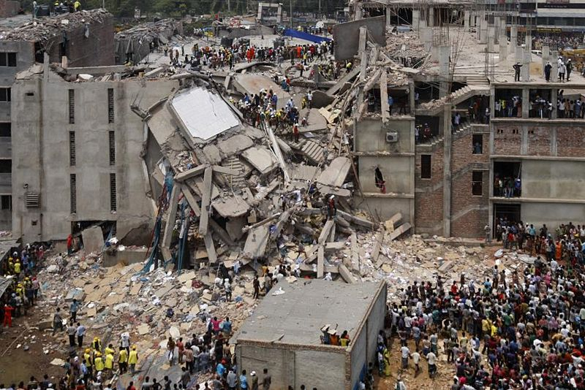
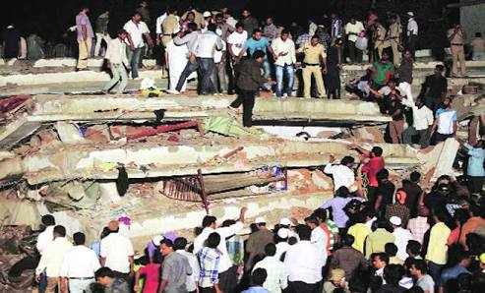
Motivation
Ground vibration directly influences its surrounding. Actually, we
have no control in environment. May be we can not control the
eartquake but, we have control in manmade vibration.
Sometime manmade ground vibration become a fact of building
collapses, road cracking etc.
Figure : Rana Plaza Collapse
Figure : Mumbra building collapse

Slide 5
Objectives
To detect ground vibration arising from manmade source.
To evaluate the range of vibration.
To evaluate the frequency of vibration.
To evaluate the intensity of vibration.

Slide 6
Literature Review
Community Sense and Response (CSR) System
(Faulkner ):
Described About Monitoring Earthquakes.
Described a Seismic Network for Calculate Intensity.
Limitations:
Need Significant Amount of Event data to a Centralized Server.

Slide 7
Literature Review(Contd.)
The iShake project designed by Jack :
Describes a Mobile Client back-end Server Architecture that
Uses Sensor-equipped Mobile Devices to Measure Vibrations
from Earthquakes.
Limitations:
Need Significant Amount of Event data to a Centralized
back-end Server.

Slide 8
Methodology
There are Three Modes of Operation:
Sensing Mode
Triggering Mode
Event Recording Mode

Slide 9
Methodology(Contd.)
Figure-1: Schematic representation of proposed system

Slide 10
Methodology(Contd.)
Implementation of the Application split into two Module of
Architecture.
Module-1: This module is to sense and retain only ground
vibration.
Module-2: This module is ranging and estimating intensity, frequency of detected ground vibration.

Slide 11

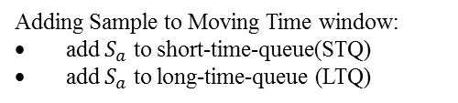


Methodology(Contd.)
Module-1
sample $S_{a}$ = ( $a_{x}$, $a_{y}$, $a_{z}$)
Adding Sample to Moving Time window:
add $S_{a}$ to short-time-queue(STQ)
add $S_{a}$ to long-time-queue (LTQ)
Averages Calculated in Moving Windows:
compute STA: average in short-time queue(STQ)
compute LTA: average in long-time-queue (LTQ)
NO
STA/LTA > TRth
(in all 3 direction)
YES (event triggered)
Event Recording: add sample ( $a_{x}$, $a_{y}$, $a_{z}$) to E
NO
STA/LTA < DTRth
(in all 3 direction)
YES
(detected event [E]=[ $a_{x}$, $a_{y}$, $a_{z}$] )
Figure 2: Module-1 Architecture

Slide 12

Methodology(Contd.)
Module-2
detected event [E]=[ $a_{x}$, $a_{y}$, $a_{z}$]
Feature Extraction:
Extract data
Estimation:
compute distance’, ‘intensity and ‘frequency’
Result Display:
Estimated world-states ‘distance’ and ‘intensity’
Figure 3: Module-2 Architecture

Slide 13
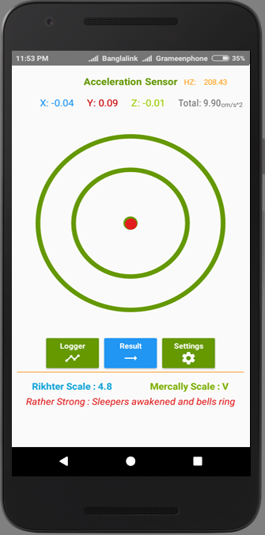
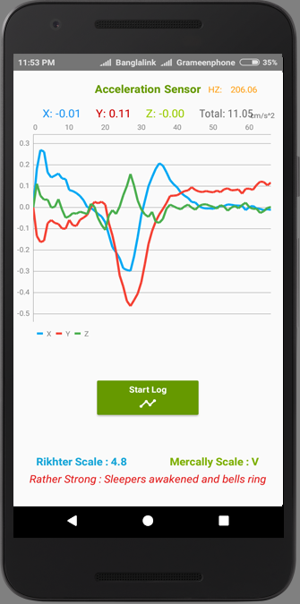
Implementation
Figure: Home Activity of Application
Figure: Logger Activity of Application

Slide 14
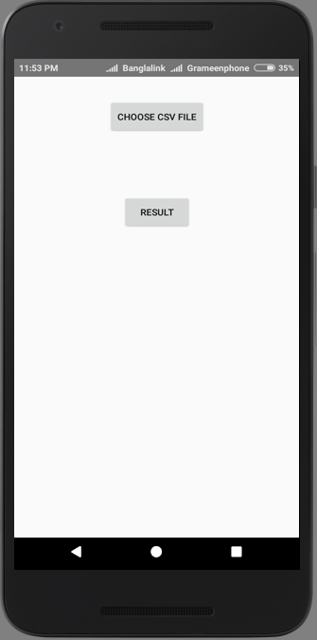
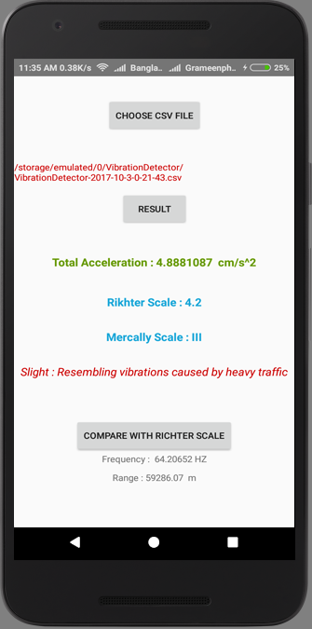
Implementation (Contd.)
Figure: Result Activity of Application

Slide 15
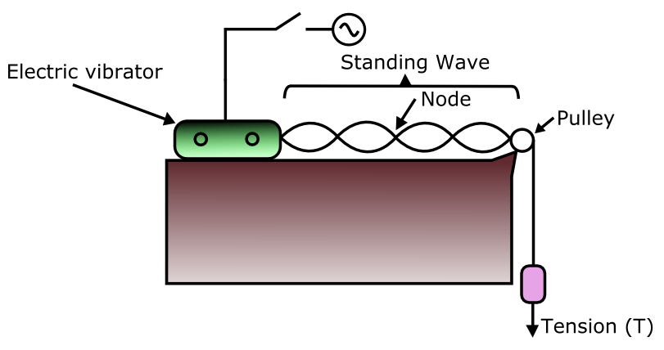
Performance Analysis
The performance of proposed application analyzed by
tuning fork experiment.
We first complete the tuning fork experiment and evaluate
its frequency. Then used this setup for test application.
Figure: Experimental setup for frequency measurement

Slide 16
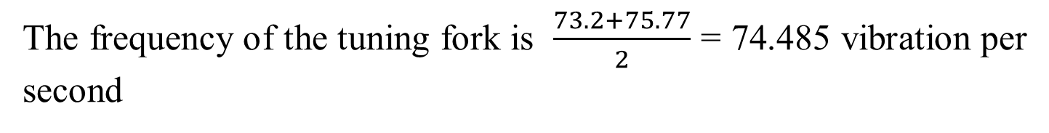
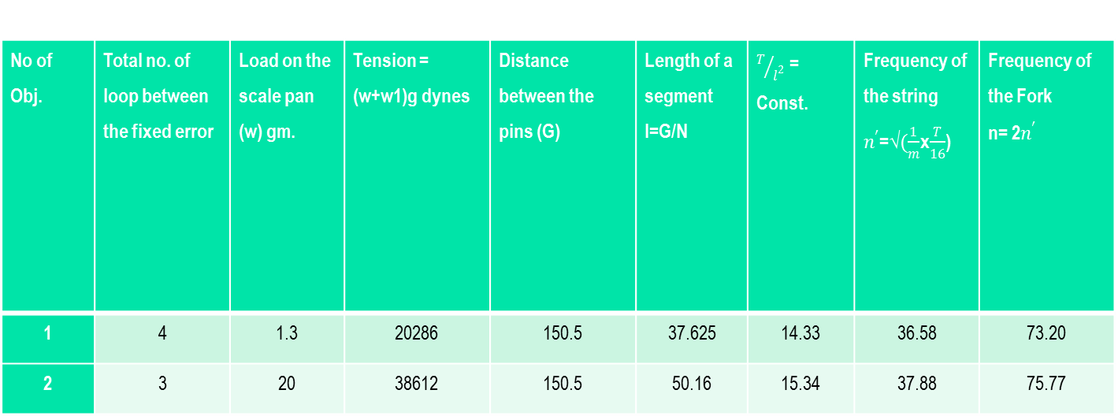
Performance Analysis (Contd.)
No of Obj. | Total no. of loop between the fixed error | Load on the scale pan (w) gm. | Tension = (w+w1)g dynes | Distance between the pins (G) | Length of a segment l=G/N | $T/{l^{2}}$ = Const. | Frequency of the string $n^{′}$=√$(\frac{1}{m}$x$\frac{T}{16}$) | Frequency of the Fork n= 2$n^{′}$
1 | 4 | 1.3 | 20286 | 150.5 | 37.625 | 14.33 | 36.58 | 73.20
2 | 3 | 20 | 38612 | 150.5 | 50.16 | 15.34 | 37.88 | 75.77
Figure: Experimental Result from Tuning Fork
The frequency of the tuning fork is $\frac{73.2+75.77}{2}$ = 74.485 vibration per second

Slide 17
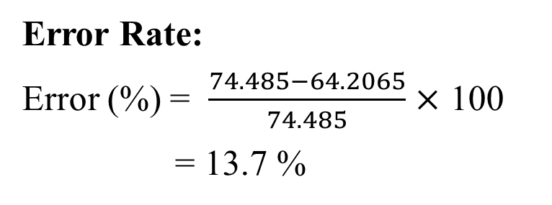
Performance Analysis (Contd.)
Total Acceleration | 4.8881087 cm/s^2
Richter scale | 4.2
Mercalli scale | III
Frequency | 64.2 HZ
Range | 59286.07 m
Witness Observation | Resembling vibrations caused by heavy traffic
Figure: Experimental Result from Application
Error Rate:
Error (%) = $\frac{74.485−64.2065}{74.485}$ $×$ 100
= 13.7 %

Slide 18
Future Work
Implementing centralized database for further prediction.
Implementing warning system for large scale vibration.
Implementing better filtering method for reduce noise and error.

Slide 19
Conclusion
A system that will ranging the ground vibration.
Though, we have no control in environment but we can
try to reduce the hamper for all types of ground vibration.
We should remember that “Safety First”.

Slide 20
References
[1] F. Deckner, “Ground vibrations due to pile and sheet pile
driving-influencing factors, predictions and measurements” at NCC Engineering and the Division of Soil and Rock Mechanics, Sept.2009
[2] A. Maslin, “Monitoring Ground Vibration arising from Piling and
Civil Engineering Projects”,May 2004 (Revised May 2015).
[3] S. C. Thandu, S. Chellappany, Z. Yin, “Ranging Explosion Events
Using Smartphones” at 2015 IEEE 11th International Conference on Wireless and Mobile Computing,Networking and Communication(WiMob).

Slide 21
References(Contd.)
[4] M. Faulkner, R. Clayton, T. Heaton, K. M. Chandy, M. Kohler,
J. Bunn, R. Guy, A. Liu, M. Olson, M. Cheng, and A. Krause
“Community sense and response systems: Your phone as quake
detector” Commun. ACM, 57(7):66-75, July 2014.
[5] J. Reilly, S. Dashti, M. Ervasti, J. D. Bray, Steven D. Glaser, and
A. M. Bayen“Mobile phones as seismologic sensors: Automating
data extraction for the ishake system” IEEE T. Automation Science and Engineering, 10(2):242:251, 2013.
[6] Q. Kong and R.M. Allen. Using smartphones to detect earthquakes. In AGU Fall Meeting Abstracts, volume 1, page 04, 2012.

Slide 22
References(Contd.)
[7] Tuning Fork. [Online] Retrieved: 2017-10-17 Available: https://en.wikipedia.org/wiki/Tuning_fork
[8] 2013 Savar building collapse. [Online] Retrieved: 2017-10-17 Available: https://en.wikipedia.org/wiki/2013_Savar_building_collapse
[9] “Power generators linked to Dhaka building collapse”. BBC News. 2013-05-03. Retrieved: 2017-10-17 Available: https://www.bbc.com/news/world-asia-22404461

Slide 23
References(Contd.)
[10] 2013 Thane Building Collapse. [Online] Retrieved: 2017-10-17 Available: https://en.wikipedia.org/wiki/2013_Thane_building_collapse
[11] “India building collapse near Mumbai kills 45”. BBC News. 5 April 2013 [Online] Retrieved: 2017-10-17 Available: https://www.bbc.com/news/world-asia-22036751

Slide 24
Thank You

