Slide 1
WiFi based Real Time Voice Communication during Disaster and Emergencies
Presented By
MD. Ashiqur Rahman
Supervised By
Dr. Asaduzzaman
Professor Department of CSE,CUET

Slide 2
Contents
Introduction
Motivation
Literature Review
Objectives
Methodology
Conclusion
References

Slide 3
Introduction
There have been a frequent number of earthquakes, tsunamis,
cyclones and floods from time to time across the entire globe
Cellular Mobile Networks are the dominant technology in the
today’s communication world
During Disaster, the communication infrastructure is often
damaged to large extents

Slide 4
Motivation
Many People died during disaster time .Most people
died because they are not rescued in proper time.
And many of the people trapped inside their house
during disaster time.
Our motivation is to help those affected people who are
trapped inside their house during disaster time.

Slide 5
Literature Review
Survey of Emergency Communication Network
Architctectures( D.Srinivasa rao et al., 2015 ):
Described about disaster warning.
Described Pre disaster and Post Disaster Communication
Limitations:
In Post disaster communication they used Satellite Communication which is very costly.

Slide 6
Literature Review(Contd.)
Wireless Adhoc Networks for Disaster Relief
Communication(Sandamini S.S.P et al., 2015 ):
Describes Long Range and Short Range Communication
during disaster time.
Limitations:
Their Process is too much complex during disaster
communication.
They Proposed satellite communication for long distance
during disaster time which is costly .

Slide 7
Literature Review(Contd.)
Bluetooth Talkie(Android App):
Developed an Android App which is able to communicate with other in Bluetooth Range.
Limitations:
The Coverage area of Bluetooth is very small.
Transmission rate of voice is too slow.

Slide 8
Objectives
To make a real time voice communication using WiFi
during disaster
To track down the location of affected people using
Alarming System.
To provide a text message transferring system using WiFi.

Slide 9
Methodology
The Entire Subsystem is divided into three major subsystems:
Real time Voice Communication System
Alarming System
Text Message Transferring System

Slide 10

Methodology(Contd.)
Real Time Voice Communication System:
The first sub-system will work when a man trapped into
building when no network coverage is available.
Now A general architecture of an audio transmission
application
Figure 1 : General Architecture of Audio Transmission

Slide 11
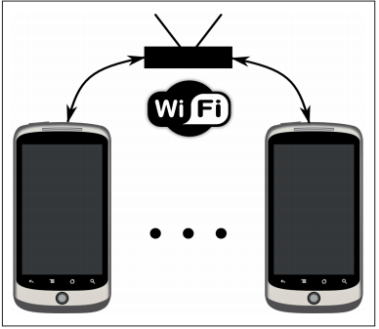
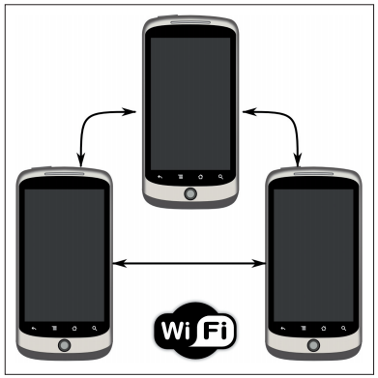
Methodology(Contd.)
There are two Wi-Fi scenarios depending of working mode
1.Infrastructure WiFi Scenario
2.Ad-hoc WiFi Scenario
Figure 2: Infrastructure WIFI Scenario
Figure 3: Ad-hoc WIFI Scenario

Slide 12
Methodology(Contd.)
Flow Chart For Real Time Voice Communication

Slide 13

Methodology(Contd.)
Alarming System:
The second sub-system will work when the rescue team
could not find the proper location of the affected people.
Figure 4:Alarming Button

Slide 14
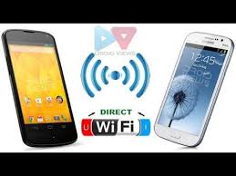
Methodology(Contd.)
Text Message Transfer:
The third sub-system will work when there is a need of text
message transfer that he is in danger but there is no network
coverage.
Figure 5:Text Message Transfer Using WIFI

Slide 15
Methodology(Contd.)
Flow Chart For Text Message Transfer

Slide 16
Conclusion
Disaster occurs every now and then almost in every country.
And many people died because they are not rescue in proper
time.
We cannot prevent disasters from happening but we can save
our lives by using this application.
We should remember that “Safety First”.

Slide 17
References
[1] Wikipedia.(2016,Dec.8).Geography Of Bangladesh. Available at: https://en.wikipedia.org/wiki/Geography_of_Bangladesh
[2] Wikipedia.(2016,Dec.27).Savar Building Collapse. Available at: https://en.wikipedia.org/wiki/ 2013_Savar_building_collapse.
[3] Román Belda, Pau Arce, Ismael de Fez, Francisco Fraile,Guerri “Android real-time audio communications over local wireless” Instituto de Telecomunicaciones y Aplicaciones Multimedia, Universitat Politècnica de València, 2012.
[4] P.Srivastava, K.Babu and T.OSV, “Performance Evaluation of Speex Audio Codec for Wireless Communication Networks,” in Proc. Wireless and Optical Communications Networks 2011, Ghaziabad, India, 2011.

Slide 18
References
[5] ITU-T Focus Group on Disaster Relief Systems (FG-DR&NRR),Network Resiliency and Recover, http://www.itu.int/en/ITU-T/focusgroups/drnrr
[6] D. Srinivasa rao, P.Devi Pradeep and B. Anil Kumar “A Survey of Emergency Communication Network Architectures”, in proc. International Journal of u- and e- Service, Science and Technology Vol.8, No.4 , pp.61-68, 2015.
[7] Gunaratna G.T.C, Jayarathna P.V.N.M, Sandamini S.S.P, De Silva D.S "Implementing Wireless Adhoc Networks for Disaster Relief Communication", in proc.8th International Conference on Ubi-media Computing(UMEDIA):066-071,Aug.2015

Slide 19
References
[8] Intercom for Android. Available at: http://github.com/intercom/intercom-android.
[9] Bluetooth Talkie. Available at: http://play.google.com/store/apps

Slide 20
Thank You

