Slide 1

BAKPOTUTA
An Intelligent System for Conversion of Bangla Sign Language to Speech
Supervised by:
Dr. Mohammed Moshiul Hoque
Professor & Head of the Department
Department of CSE, CUET
Presented by:
Shuvashish Sarker
(ID: 1204108)
Department of CSE, CUET

Slide 2
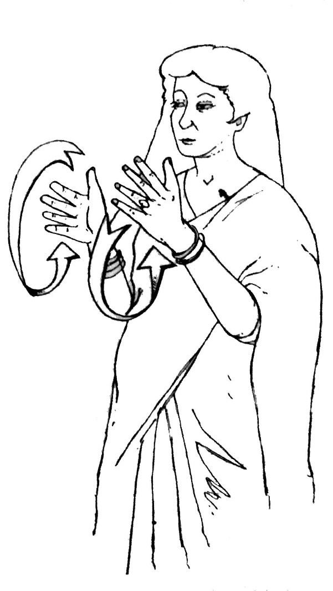
Introduction
A sign language is a language which chiefly uses manual communication to convey meaning.
Different countries or regions have their own sign language. Bangladeshi sign language is called Bangla sign language.
When a vocally impaired person wants to communicate with a normal person then s/he also have to know the sign language.
ইশারা ভাষা
Sign language
Department of CSE, CUET

Slide 3
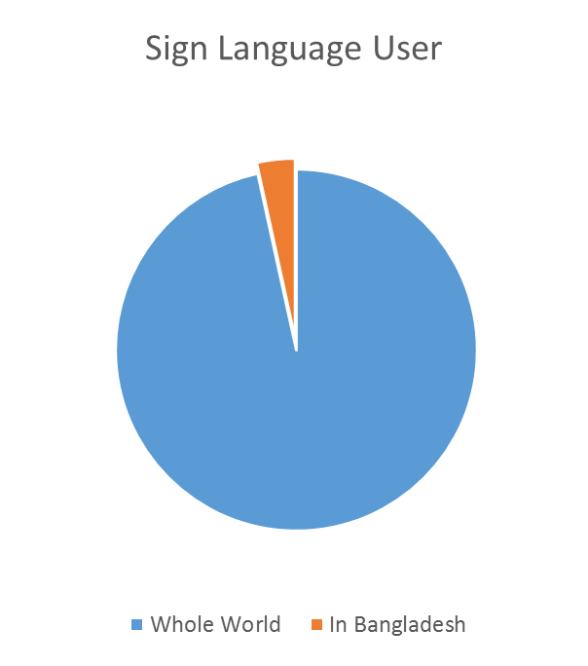
Introduction
The numbers of vocally or speech impaired in the world are roughly calculated to be from 70 to 90 million.
In Bangladesh the number of using sign language is 2.4 million.
Department of CSE, CUET

Slide 4





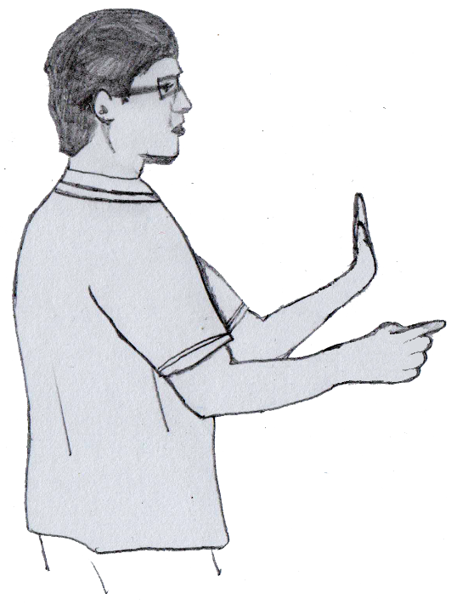
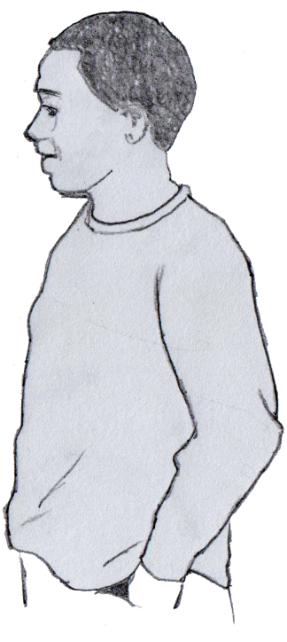


Motivation
Vocally impaired
Normal people
Department of CSE, CUET

Slide 5
Objectives
The key objectives of our proposed system are:
To design a system that can convert Bangla sign language to speech in real-time.
To develop a theoretical approach of recognizing Bangla sign language.
To evaluate the performance of the proposed system in real environment.
Department of CSE, CUET

Slide 6
Proposed Methodology
Flex sensors
Get data and send them to PC via Bluetooth
Find out specific word’s voice track by comparing input data with database
Play sound track via speaker
Accelerometers and Gyroscope sensor
‎Initialization data
Department of CSE, CUET

Slide 7
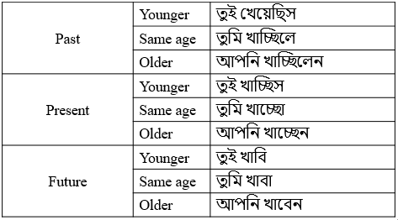




Proposed Methodology (Cont.)
Initialization data:
Same age
Present
Older
Younger
Past
Future
Left glove
Right glove
Department of CSE, CUET

Slide 8
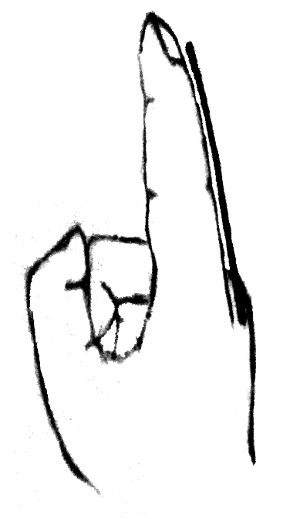
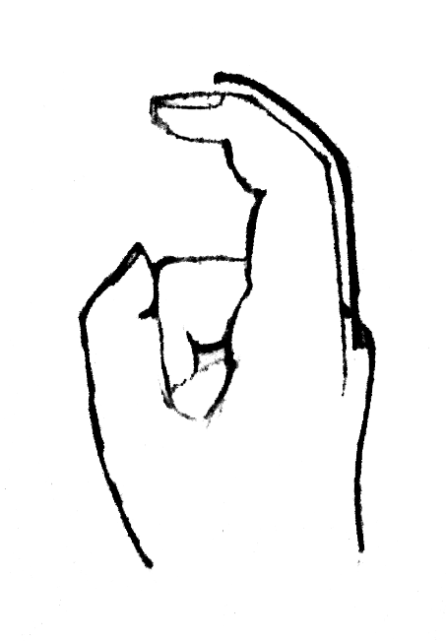
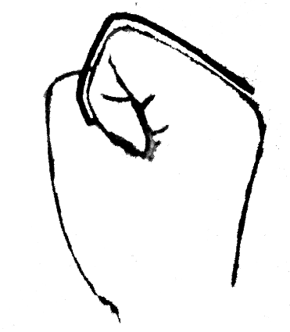
Proposed Methodology (Cont.)
Flex sensor
Flex Sensor
≈23Ω
≈98Ω
≈67Ω
Resistive value of flex sensor
Department of CSE, CUET

Slide 9
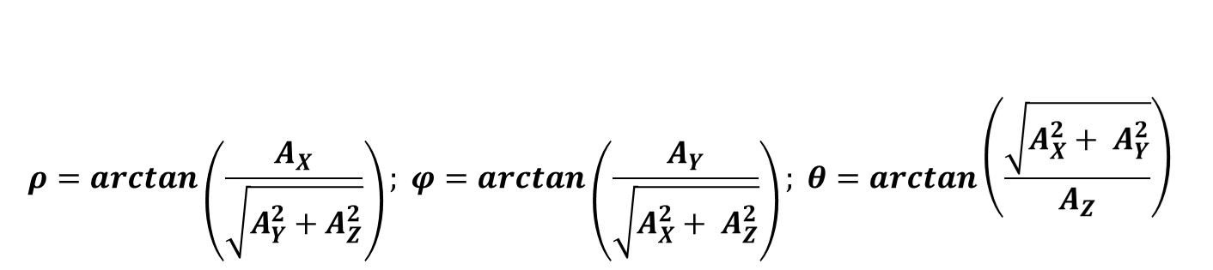
Proposed Methodology (Cont.)
Accelerometers and Gyroscope sensor
θ φ φ
ρ ρ
Department of CSE, CUET

Slide 10
Proposed Methodology (Cont.)
Initialization data
Flex sensors
Accelerometers and Gyroscope sensor
P
A2B42C15D13E35
F313G4H1I3J1K4
b
Right Glove
Left Glove
O
A2B414C15D134E36
F2G1H3I5J1K1
e
Department of CSE, CUET

Slide 11

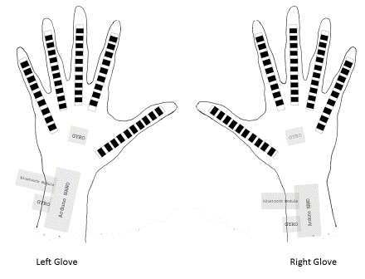

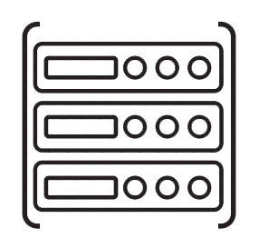

Proposed Methodology (Cont.)
Department of CSE, CUET

Slide 12

Conclusion
A system that will reduce the communication difficulty of vocally impaired people.
A system that will never remind a vocally impaired helpless.
It will create opportunities for vocally impaired people to live a like normal people.
Department of CSE, CUET

Slide 13
References
L. Simon “Sign Language Recognition with Kinect”. Institut for Informatik, Freie Universitat Berlin, Berlin: Freie Universitat Berlin, September 2011.
N. Azodi and T. Pryor. (2016), SignAloud: Gloves that Transliterate Sign Language into Text and Speech [Online]. Available: http://www.washington.edu/news/2016/04/12/uw-undergraduate-team-wins-10000-lemelson-mit-student-prize-for-gloves-that-translate-sign-language
B. S. Parton, "Sign Language Recognition and Translation: A Multidisciplined Approach from the Field of Artificial Intelligence." Journal of Deaf Studies and Deaf Education (Oxford Journals) 11, no. 1 (2005).
Department of CSE, CUET

Slide 14
References (Cont.)
M. I. Khan, K. Deb, H. Parvin M. and S. Chowdhury, ''Two-Handed Sign Language Recognition for Bangla Character Using Normalized Cross Correlation''. Global Journal of Computer Science and Technology, ISSN: 0975-4172, Vol. 12, Issue 3, pp. 01-06, Global Journals Inc., USA, 2012.
D. S. H. Pavel, T. Mustafiz, A. I. Sarkar, M. Rokonuzzaman. " Modeling of Bengali Sign Language Expression as Dynamic 3D Polygons for Developing a Vision Based Intelligent System for Dumb People." National Conference on Computer Processing of Bangla. 2004.
P. Dreuw, J. Forster et al “Scientific Understanding and Vision Based Technological Development for Continuous Sign Language Recognition and Translation.” SignSpeak Project, Annual Public Report. 2010. Available: http://www.signspeak.eu
Department of CSE, CUET

Slide 15
References (Cont.)
K. Sarella, "Formulation of an image processing technique for improving Sign2 performance" (2006). Available: http://scholarworks.rit.edu/other/793
“Bangla Sign Language Anthology: CDD’s JOURNEY”, Centre for Disability in Development (CDD), Bangladesh, 2009.
T. Jimbo (2016, May 5), Flex Sensor Hookup Guide [Online], Available: https://learn.sparkfun.com/tutorials/flex-sensor-hookup-guide
H. Debra (2013, March 31), Gyroscopes and Accelerometers on a Chip [Online], Available: http://www.geekmomprojects.com/gyroscopes-and-accelerometers-on-a-chip
Department of CSE, CUET

Slide 16

Department of CSE, CUET

Slide 17
Department of CSE, CUET

